Slide 1
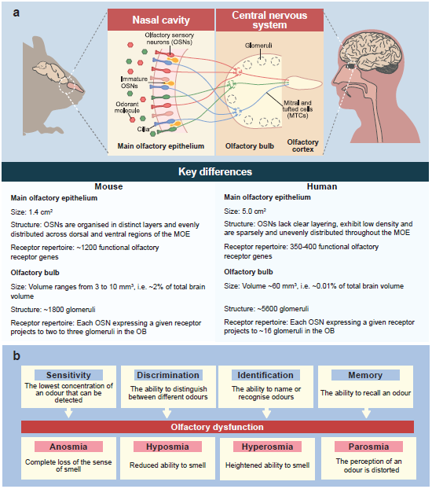
Visualisation of the similarities and differences between the olfactory systems in mice and humans
Bulk et al (2026) Diabetologia DOI 10.1007/s00125-026-06755-w
©The Authors 2026. Distributed under the terms of the CC BY 4.0 Attribution License (http://creativecommons.org/licenses/by/4.0/). Central image in (a) adapted from Sakano et al (https://doi.org/10.1016/j.neuron.2010.07.003) with permission from Elsevier

Slide 2
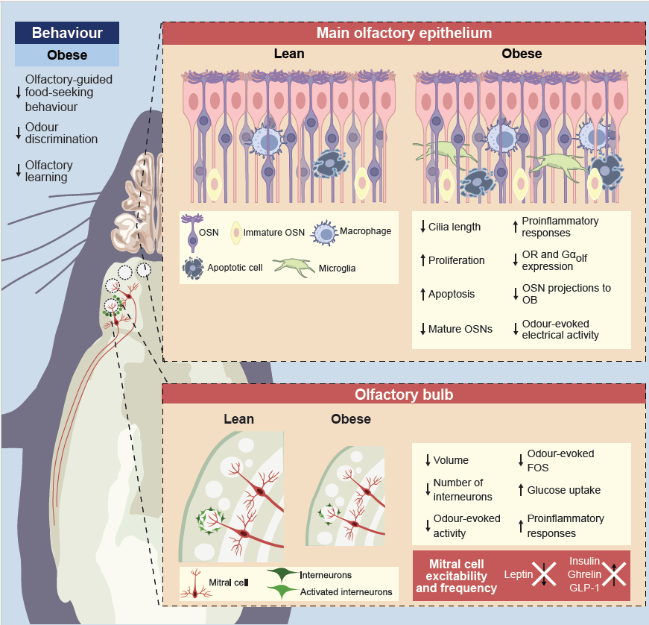
Influence of obesity and type 2 diabetes on the olfactory system
Bulk et al (2026) Diabetologia DOI 10.1007/s00125-026-06755-w
©The Authors 2026. Distributed under the terms of the CC BY 4.0 Attribution License (http://creativecommons.org/licenses/by/4.0/)

Slide 3
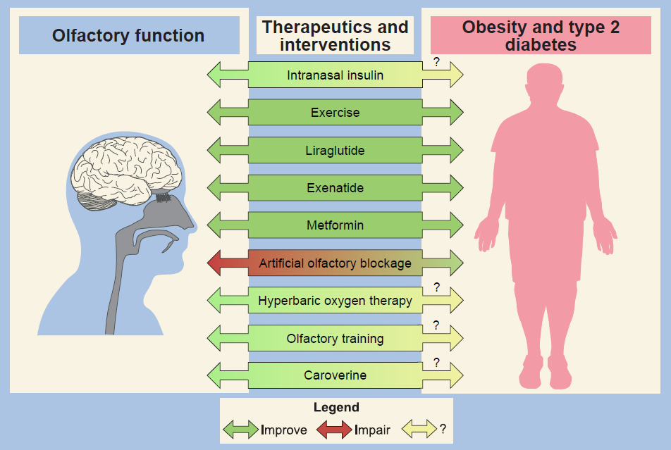
The olfactory system as a therapeutic target in metabolic disease
Bulk et al (2026) Diabetologia DOI 10.1007/s00125-026-06755-w
©The Authors 2026. Distributed under the terms of the CC BY 4.0 Attribution License (http://creativecommons.org/licenses/by/4.0/)

