Slide 1
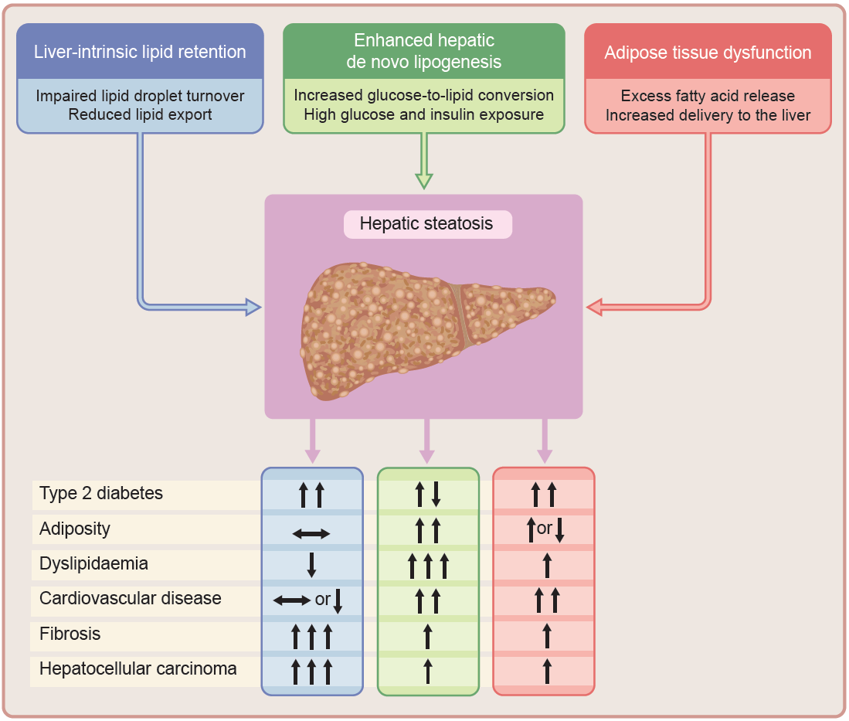
Distinct biological pathways leading to hepatic steatosis and their differential associations with metabolic and clinical outcomes
Bilson and Yaghootkar (2026) Diabetologia DOI 10.1007/s00125-026-06759-6
©The Authors 2026. Distributed under the terms of the CC BY 4.0 Attribution License (http://creativecommons.org/licenses/by/4.0/)

Slide 2
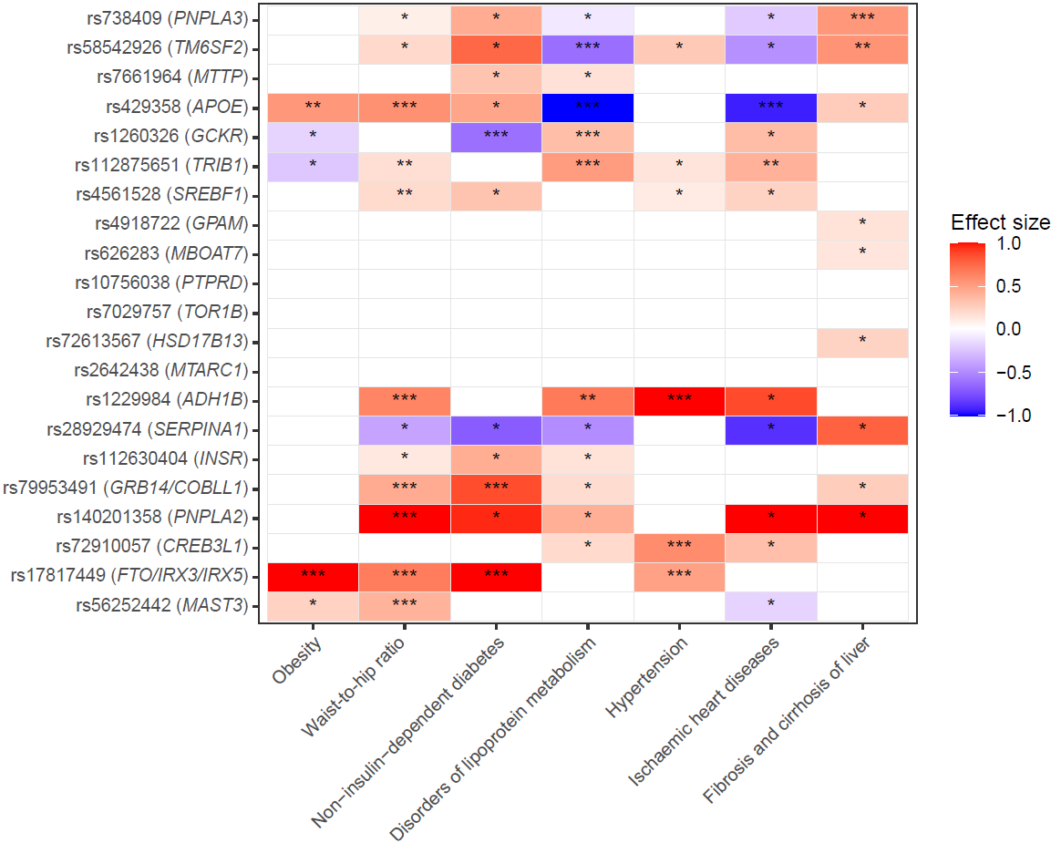
Effects of MASLD risk (or liver fat-increasing) alleles on cardiometabolic and liver-related traits derived from the Gene ATLAS web tool
Bilson and Yaghootkar (2026) Diabetologia DOI 10.1007/s00125-026-06759-6
©The Authors 2026. Distributed under the terms of the CC BY 4.0 Attribution License (http://creativecommons.org/licenses/by/4.0/)

Slide 3
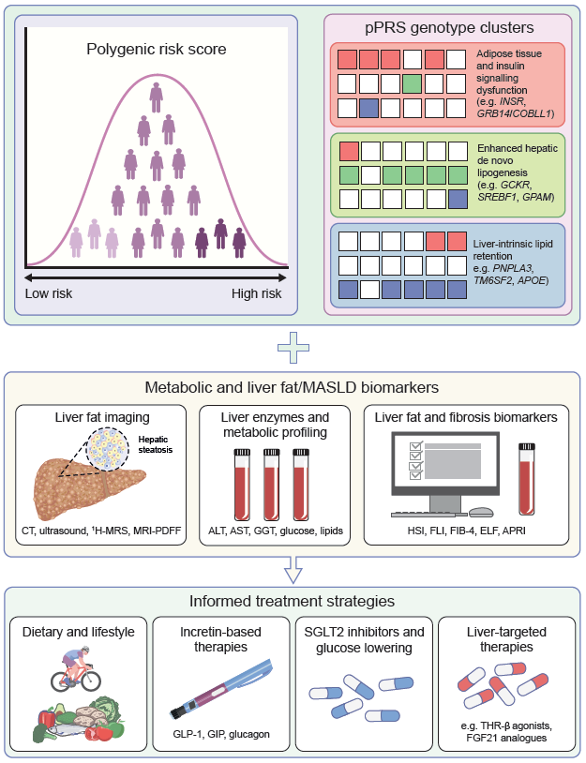
Mechanism-informed precision framework for MASLD risk stratification in people with diabetes
Bilson and Yaghootkar (2026) Diabetologia DOI 10.1007/s00125-026-06759-6
©The Authors 2026. Distributed under the terms of the CC BY 4.0 Attribution License (http://creativecommons.org/licenses/by/4.0/)

