Slide 1
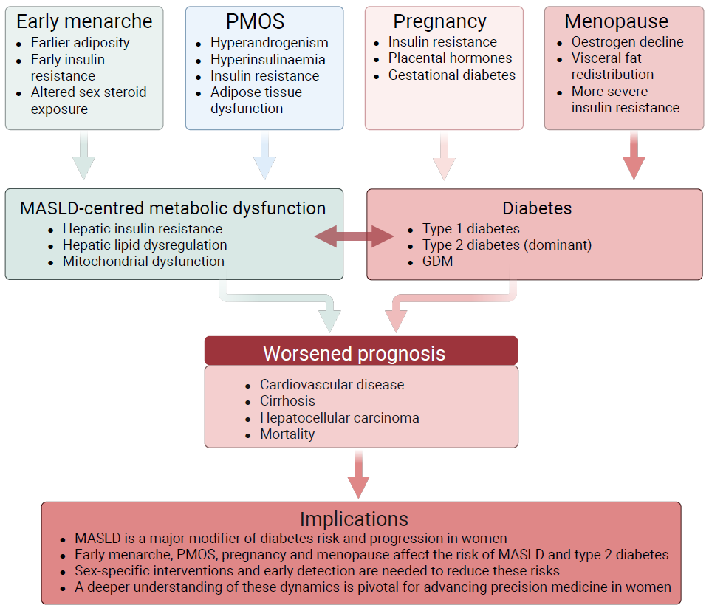
Conceptual framework linking female reproductive stages with insulin resistance, MASLD, diabetes and cardiometabolic risk
Stener-Victorin et al (2026) Diabetologia DOI 10.1007/s00125-026-06761-y
©The Authors 2026. Distributed under the terms of the CC BY 4.0 Attribution License (http://creativecommons.org/licenses/by/4.0/)

Slide 2
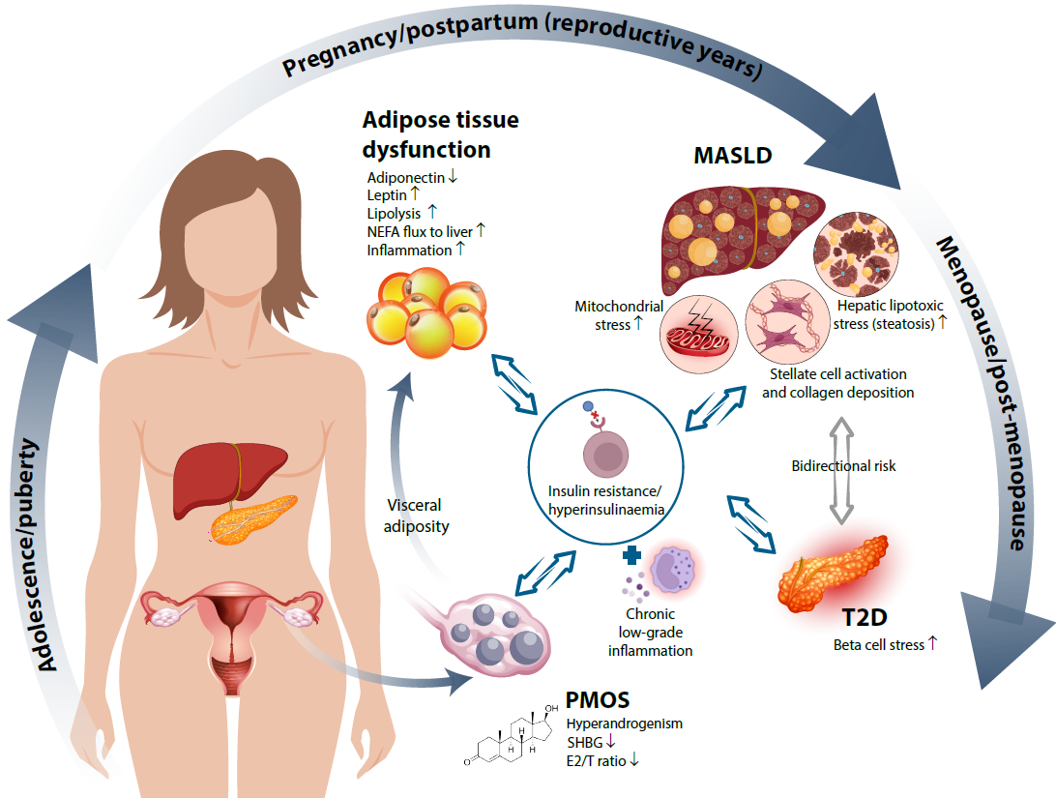
Conceptual schematic illustrating how insulin resistance with compensatory hyperinsulinaemia acts as a central hub linking hyperandrogenism, adipose tissue dysfunction and hepatic steatosis
Stener-Victorin et al (2026) Diabetologia DOI 10.1007/s00125-026-06761-y
©The Authors 2026. Distributed under the terms of the CC BY 4.0 Attribution License (http://creativecommons.org/licenses/by/4.0/)

Slide 3
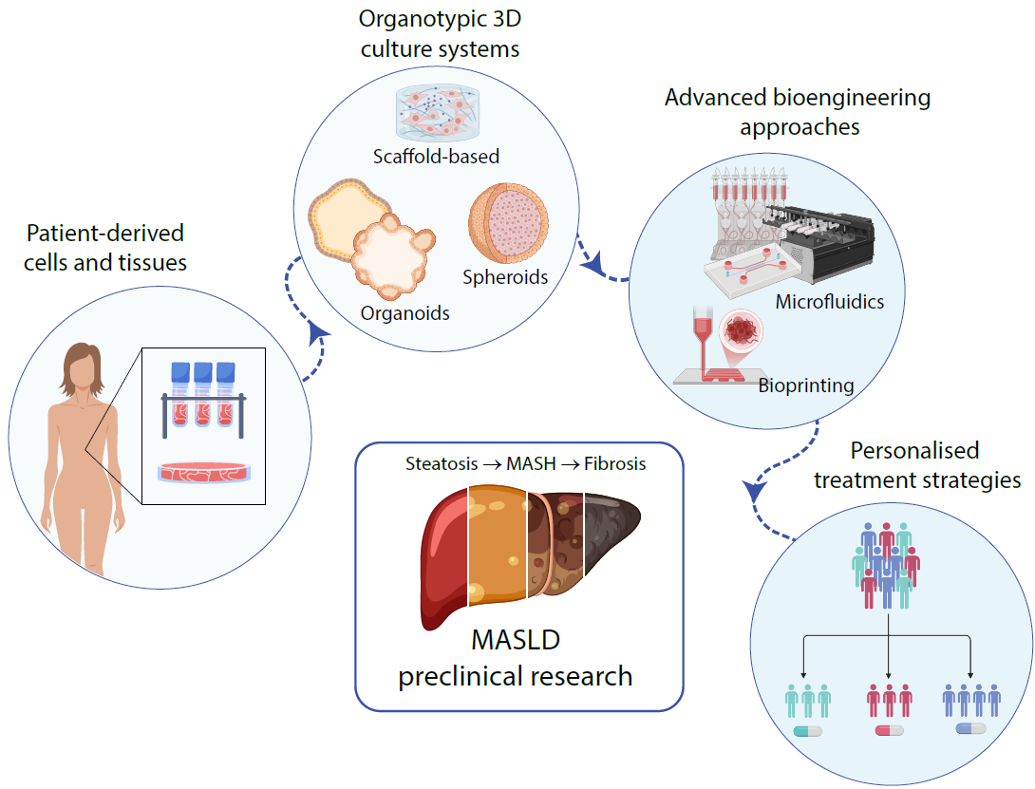
Schematic overview of how patient-derived cells and clinical samples can be integrated with organotypic 3D culture systems to generate human-relevant models spanning the different stages of MASLD progression
Stener-Victorin et al (2026) Diabetologia DOI 10.1007/s00125-026-06761-y
©The Authors 2026. Distributed under the terms of the CC BY 4.0 Attribution License (http://creativecommons.org/licenses/by/4.0/)

