Slide 1
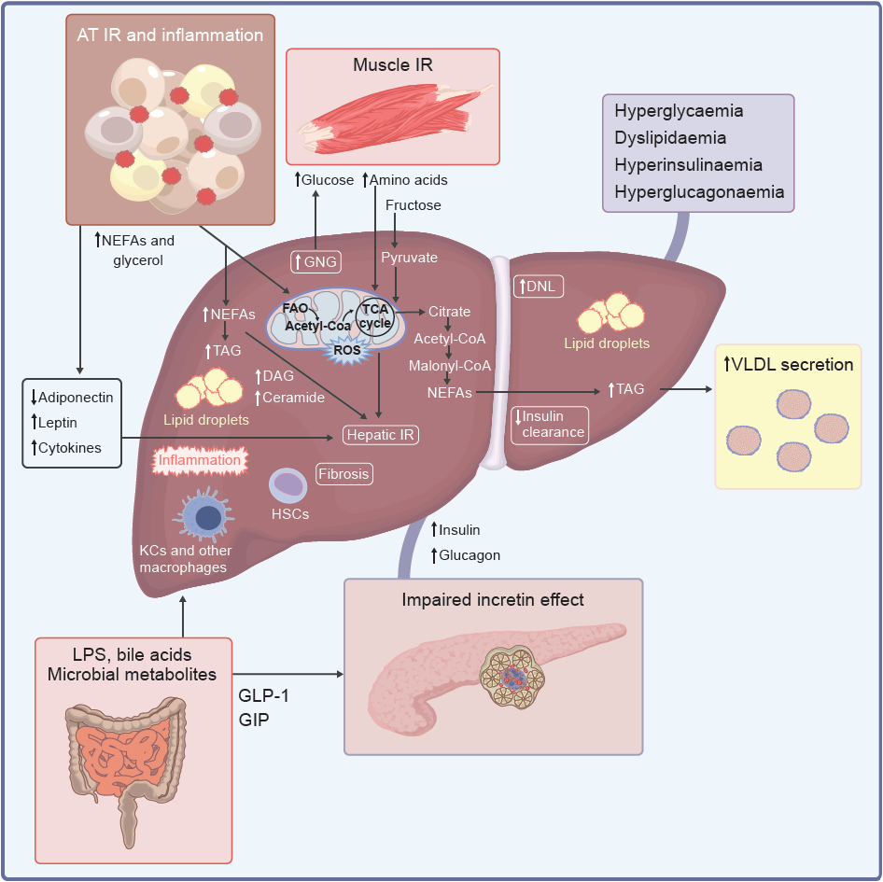
Metabolic network linking substrate excess, peripheral and liver insulin resistance, inflammation and fibrosis in MASLD/MASH
Gastaldelli et al (2026) Diabetologia DOI 10.1007/s00125-026-06744-7
©The Authors 2026. Distributed under the terms of the CC BY 4.0 Attribution License (http://creativecommons.org/licenses/by/4.0/)

Slide 2
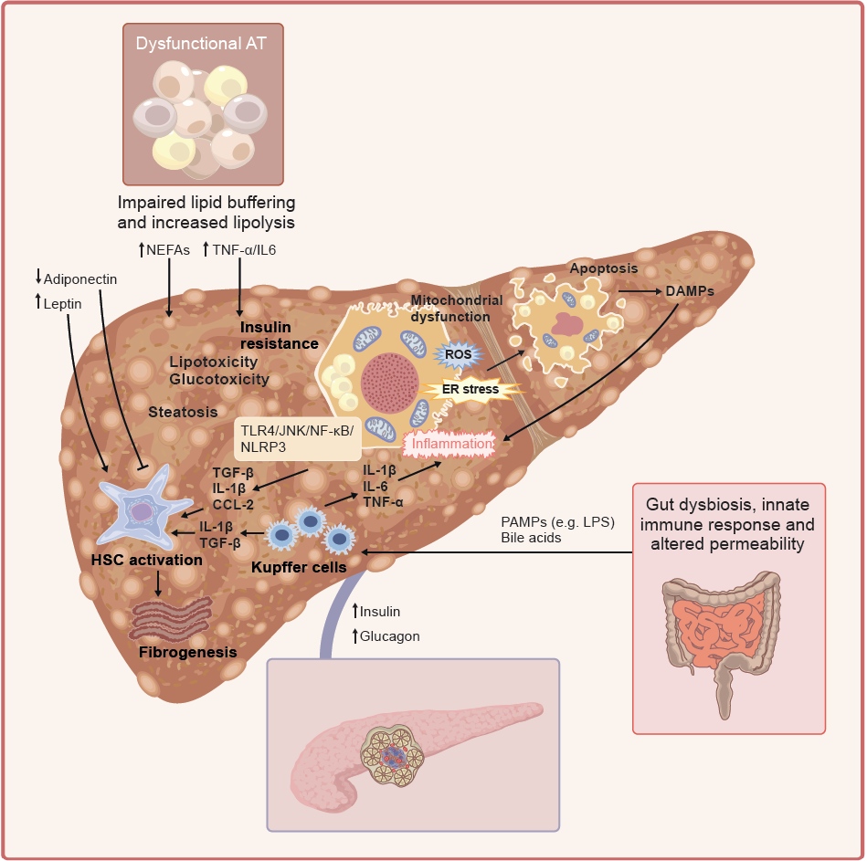
Mechanisms of hepatic fibrogenesis
Gastaldelli et al (2026) Diabetologia DOI 10.1007/s00125-026-06744-7
©The Authors 2026. Distributed under the terms of the CC BY 4.0 Attribution License (http://creativecommons.org/licenses/by/4.0/)

Slide 3
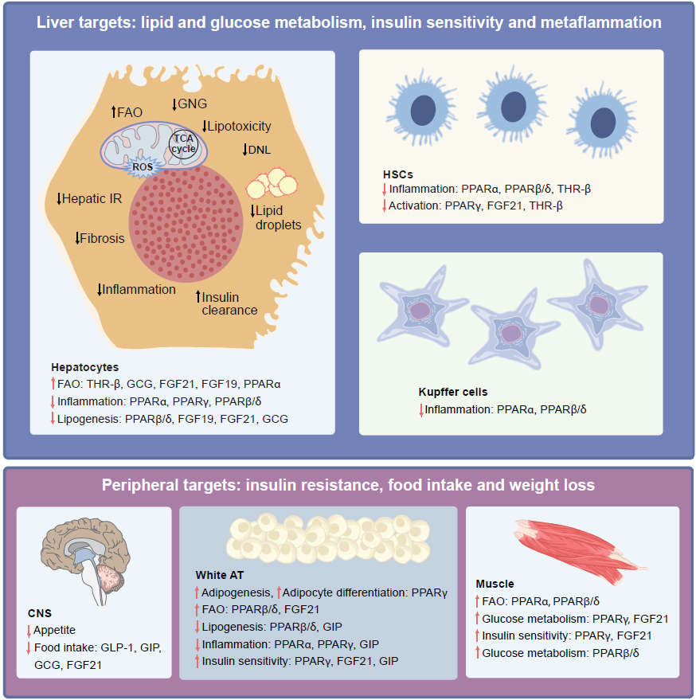
Main direct and indirect targets for therapeutic modulation of liver dysfunction in MASLD/MASH
Gastaldelli et al (2026) Diabetologia DOI 10.1007/s00125-026-06744-7
©The Authors 2026. Distributed under the terms of the CC BY 4.0 Attribution License (http://creativecommons.org/licenses/by/4.0/)

