Slide 1
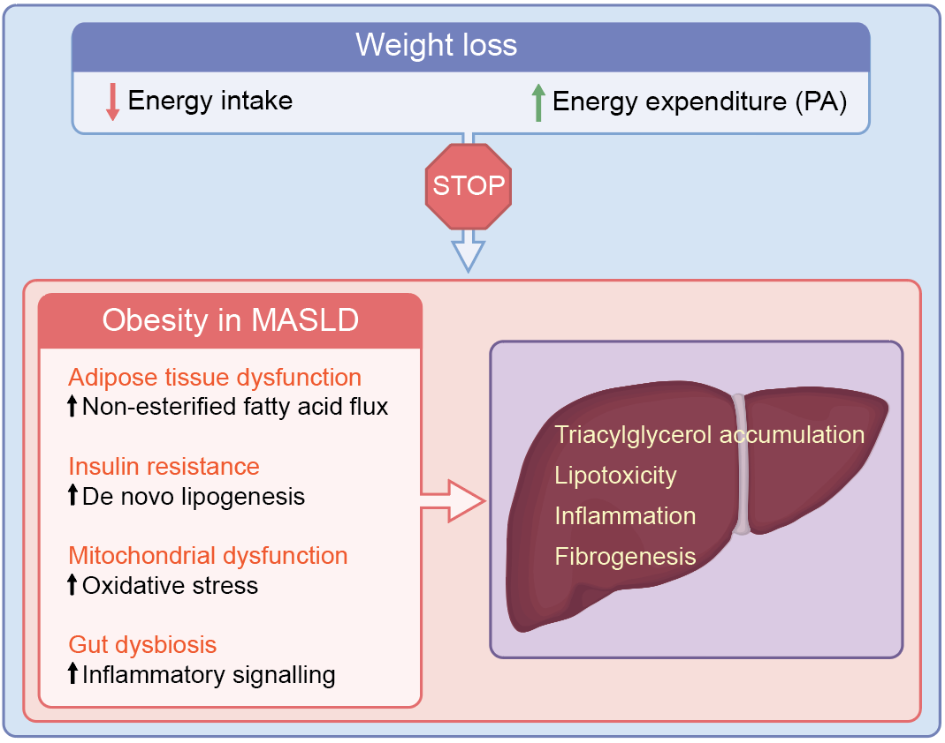
Impact of weight loss on the main pathophysiological mechanisms driving MASLD
Dufour and Berzigotti (2026) Diabetologia DOI 10.1007/s00125-026-06811-5
©The Authors 2026. Distributed under the terms of the CC BY 4.0 Attribution License (http://creativecommons.org/licenses/by/4.0/)

Slide 2
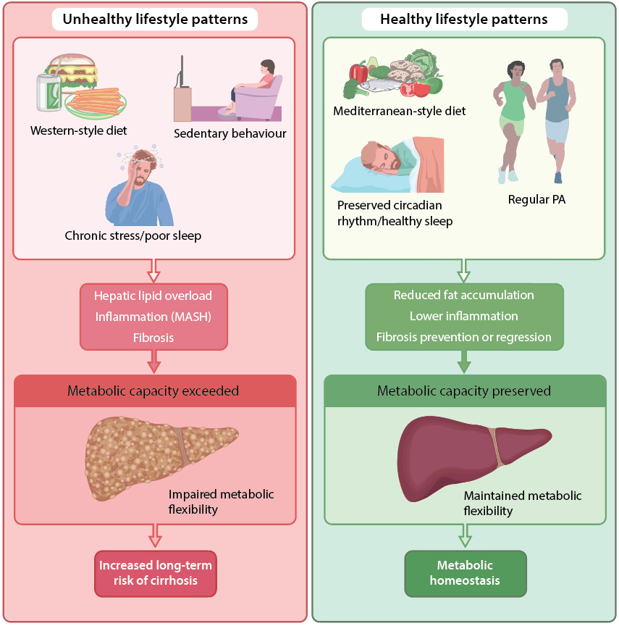
Impact of lifestyle patterns on metabolic capacity and MASLD
Dufour and Berzigotti (2026) Diabetologia DOI 10.1007/s00125-026-06811-5
©The Authors 2026. Distributed under the terms of the CC BY 4.0 Attribution License (http://creativecommons.org/licenses/by/4.0/)

