Slide 1
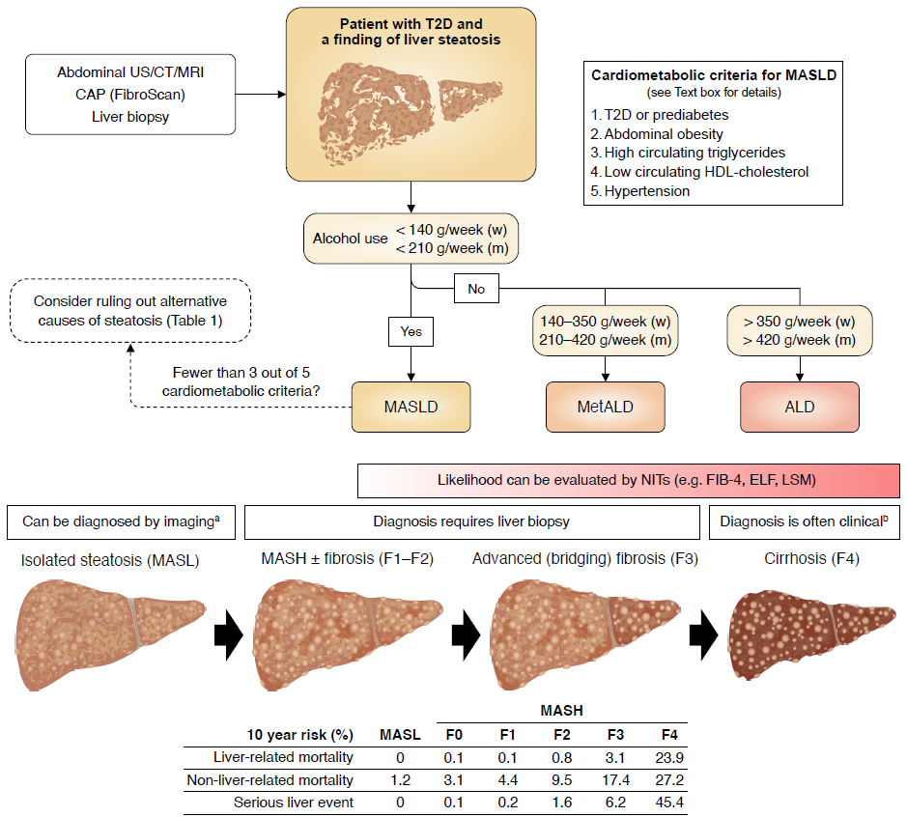
Diagnosing and staging MASLD in individuals with type 2 diabetes
Qadri (2026) Diabetologia DOI 10.1007/s00125-026-06816-0
©The Authors 2026. Distributed under the terms of the CC BY 4.0 Attribution License (http://creativecommons.org/licenses/by/4.0/)

Slide 2
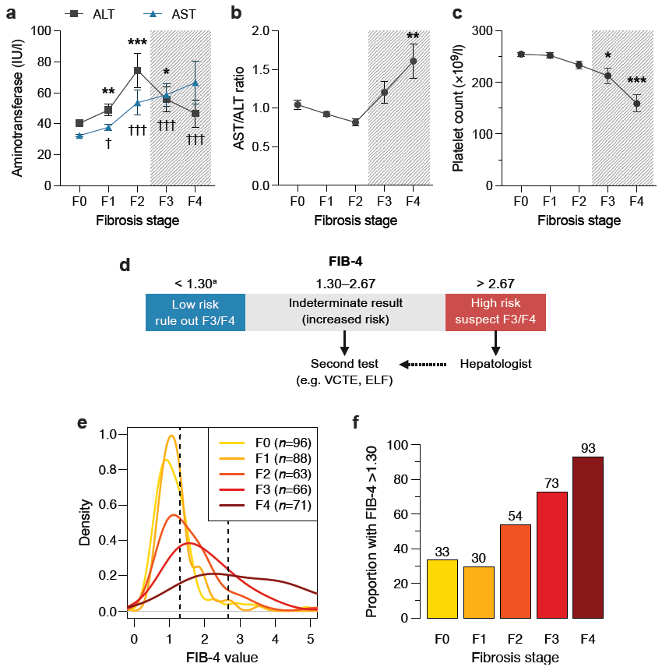
Overview of FIB-4 and its utility in the evaluation of MASLD-related advanced fibrosis
Qadri (2026) Diabetologia DOI 10.1007/s00125-026-06816-0
©The Authors 2026. Distributed under the terms of the CC BY 4.0 Attribution License (http://creativecommons.org/licenses/by/4.0/)

Slide 3
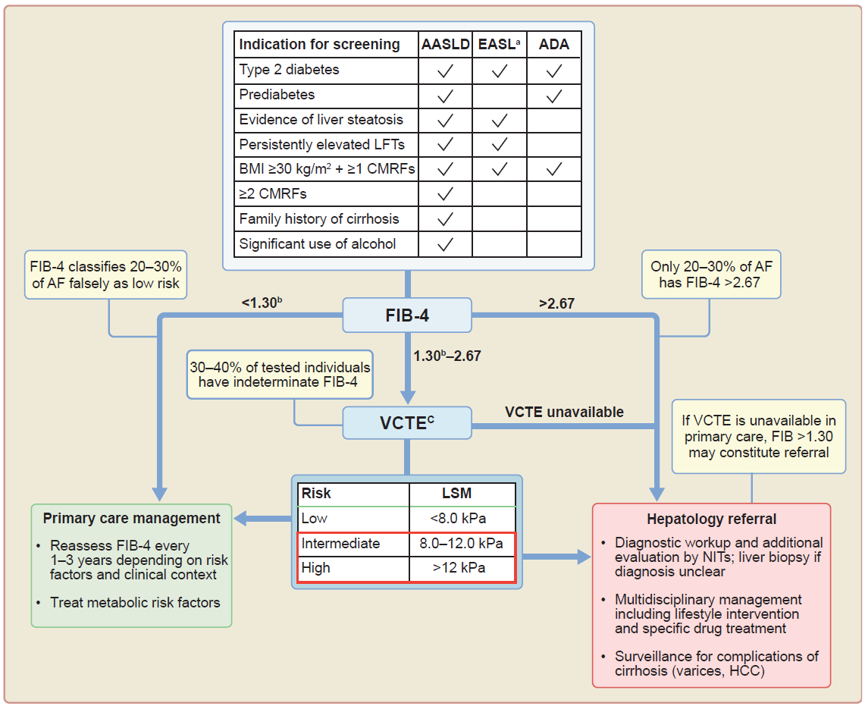
Algorithm for screening for MASLD-related advanced fibrosis (AF) in primary care and diabetology clinics
Qadri (2026) Diabetologia DOI 10.1007/s00125-026-06816-0
©The Authors 2026. Distributed under the terms of the CC BY 4.0 Attribution License (http://creativecommons.org/licenses/by/4.0/)

Slide 4
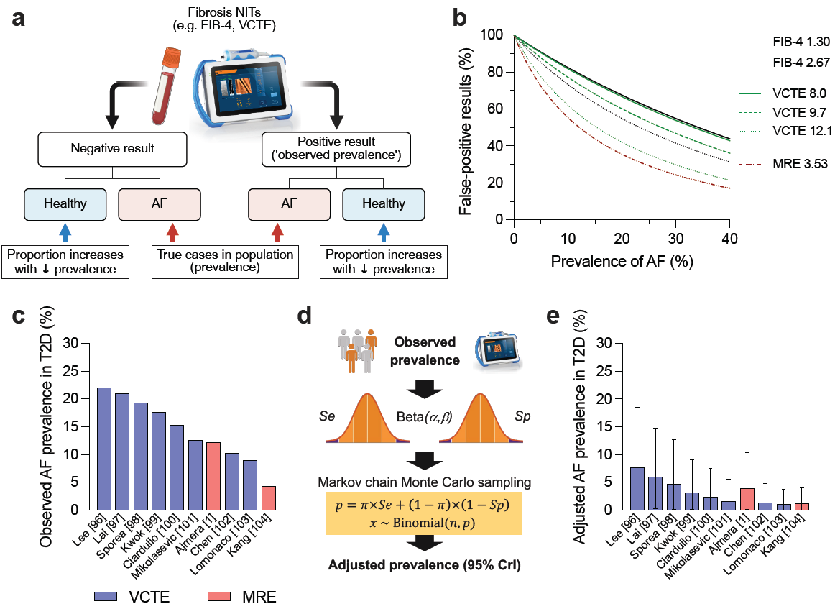
Influence of advanced fibrosis prevalence on the false discovery rate of non-invasive tests and implications for LSM-based prevalence estimates
Qadri (2026) Diabetologia DOI 10.1007/s00125-026-06816-0
©The Authors 2026. Distributed under the terms of the CC BY 4.0 Attribution License (http://creativecommons.org/licenses/by/4.0/)
AF, advanced fibrosis; LSM, liver stiffness measurement; NIT, non-invasive test

Slide 5
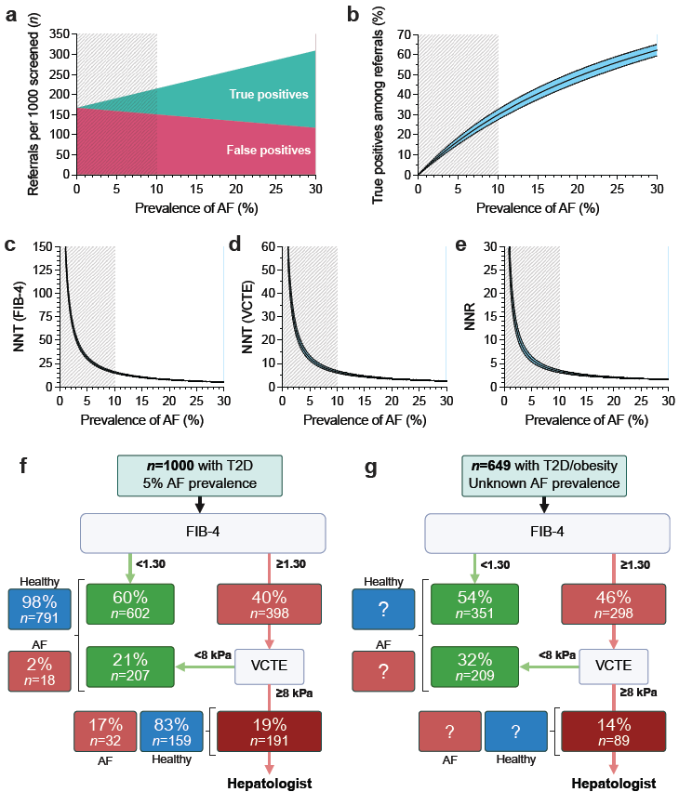
Predicted and real-world outcomes of screening for advanced fibrosis in type 2 diabetes according to current guidelines
Qadri (2026) Diabetologia DOI 10.1007/s00125-026-06816-0
©The Authors 2026. Distributed under the terms of the CC BY 4.0 Attribution License (http://creativecommons.org/licenses/by/4.0/)

Slide 6
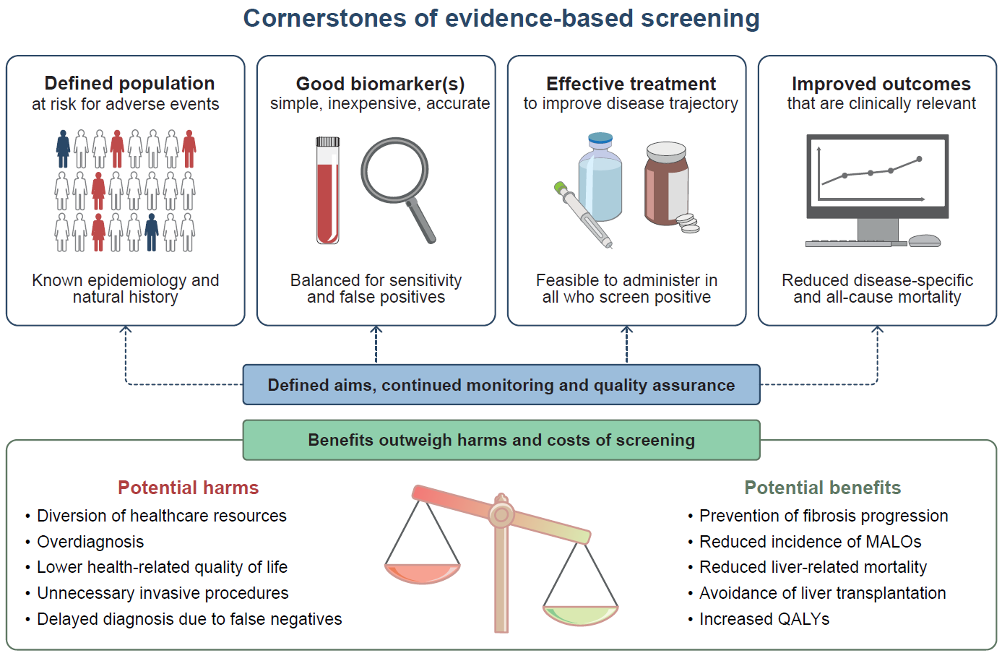
Cornerstones of a successful screening programme and potential harms and benefits
Qadri (2026) Diabetologia DOI 10.1007/s00125-026-06816-0
©The Authors 2026. Distributed under the terms of the CC BY 4.0 Attribution License (http://creativecommons.org/licenses/by/4.0/)

