Slide 1
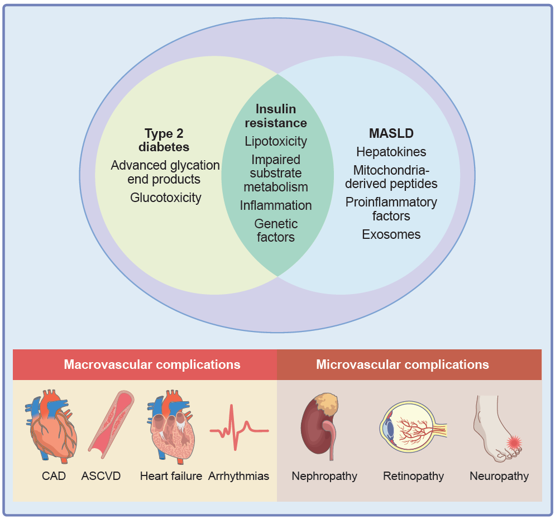
Current understanding of the interaction between MASLD and the development of diabetes-related micro- and macrovascular complications
Kahl et al (2026) Diabetologia DOI 10.1007/s00125-026-06817-z
© The Author(s), under exclusive licence to Springer-Verlag GmbH Germany, part of Springer Nature 2026

Slide 2
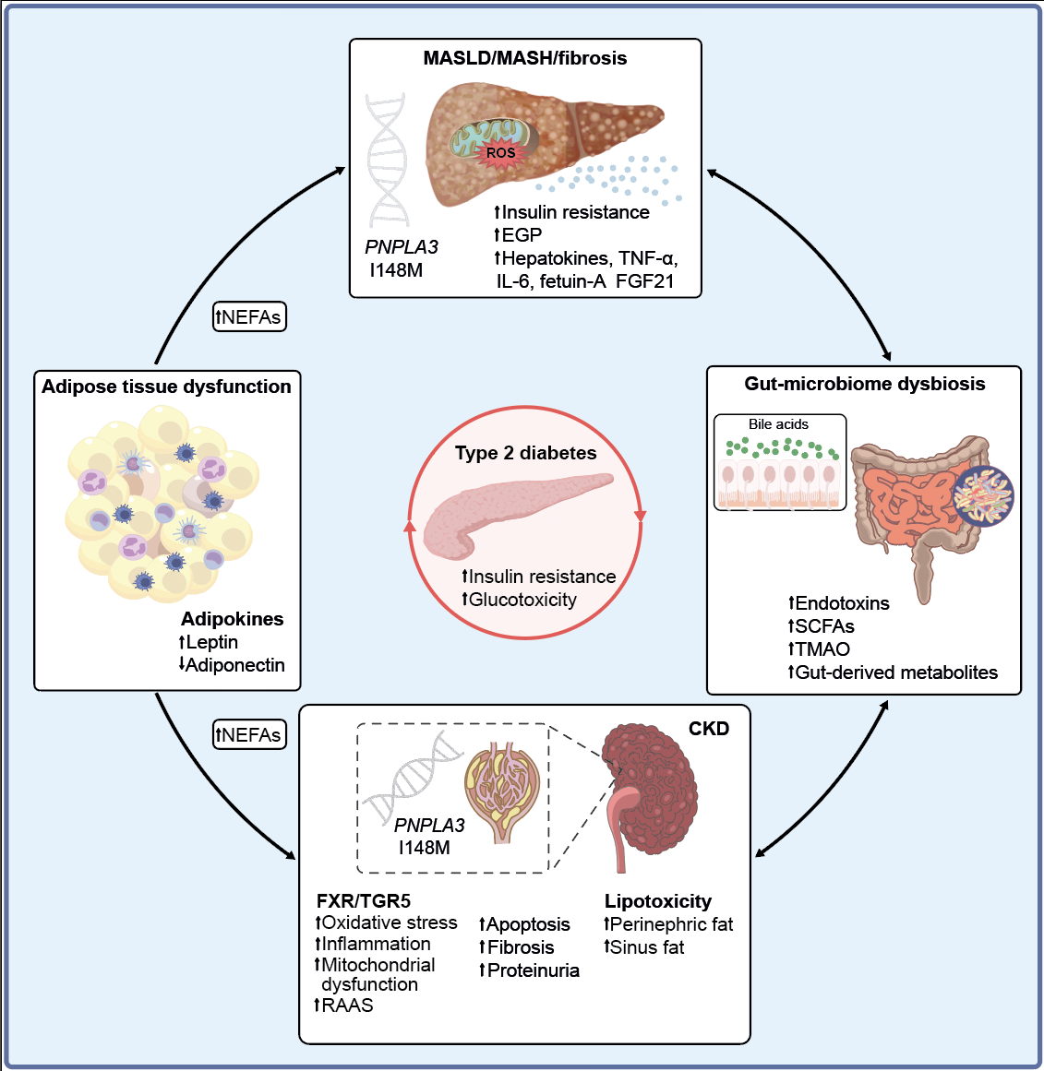
Mechanisms linking MASLD with nephropathy in people with diabetes
Kahl et al (2026) Diabetologia DOI 10.1007/s00125-026-06817-z
© The Author(s), under exclusive licence to Springer-Verlag GmbH Germany, part of Springer Nature 2026

Slide 3
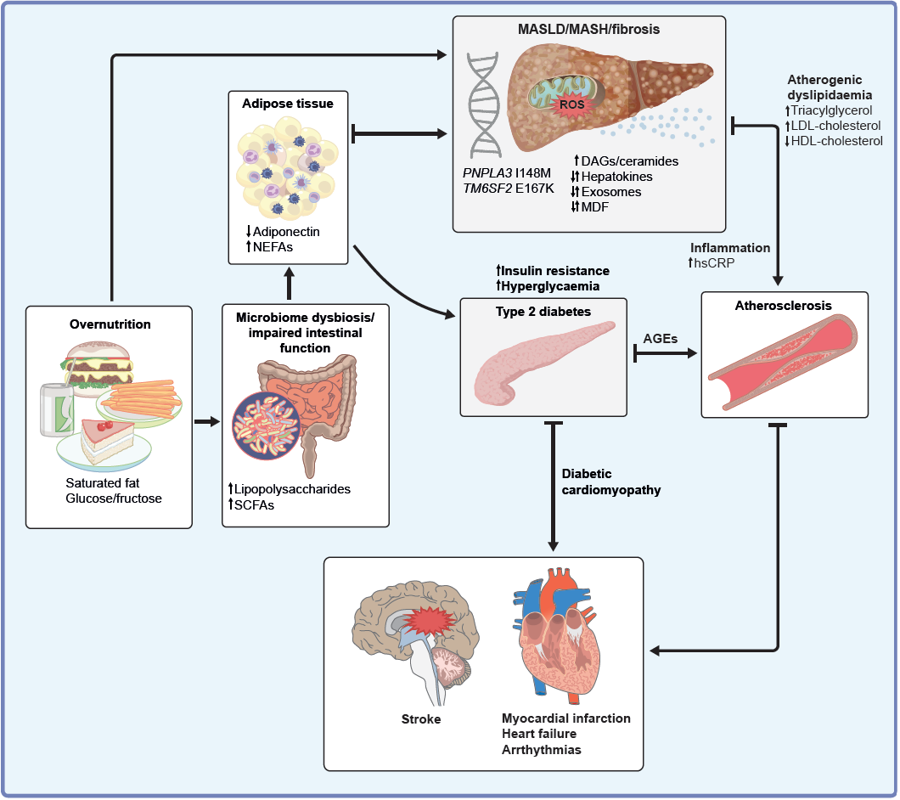
Mechanisms linking MASLD with cardiovascular disease in people with diabetes
Kahl et al (2026) Diabetologia DOI 10.1007/s00125-026-06817-z
© The Author(s), under exclusive licence to Springer-Verlag GmbH Germany, part of Springer Nature 2026

