Slide 1
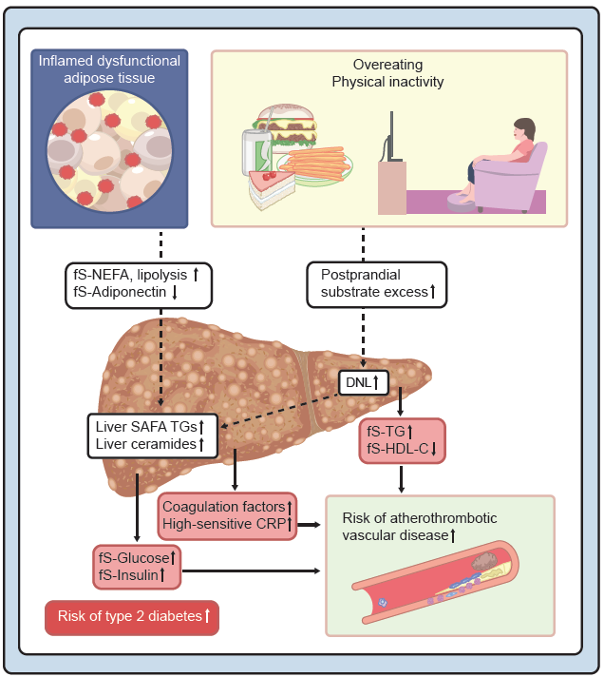
MASLD and the metabolic syndrome: pathogenesis of steatosis
Yki-Järvinen and Roden (2026) Diabetologia DOI 10.1007/s00125-026-06827-x
©The Authors 2026. Distributed under the terms of the CC BY 4.0 Attribution License (http://creativecommons.org/licenses/by/4.0/)

Slide 2
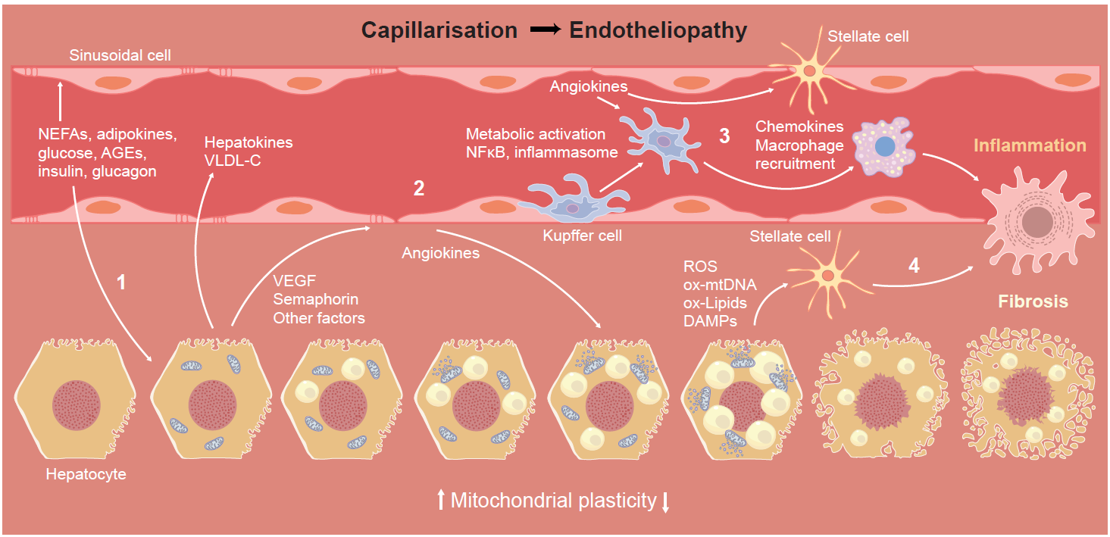
Diabetes mellitus and the liver microenvironment
Yki-Järvinen and Roden (2026) Diabetologia DOI 10.1007/s00125-026-06827-x
©The Authors 2026. Distributed under the terms of the CC BY 4.0 Attribution License (http://creativecommons.org/licenses/by/4.0/)

