Slide 1
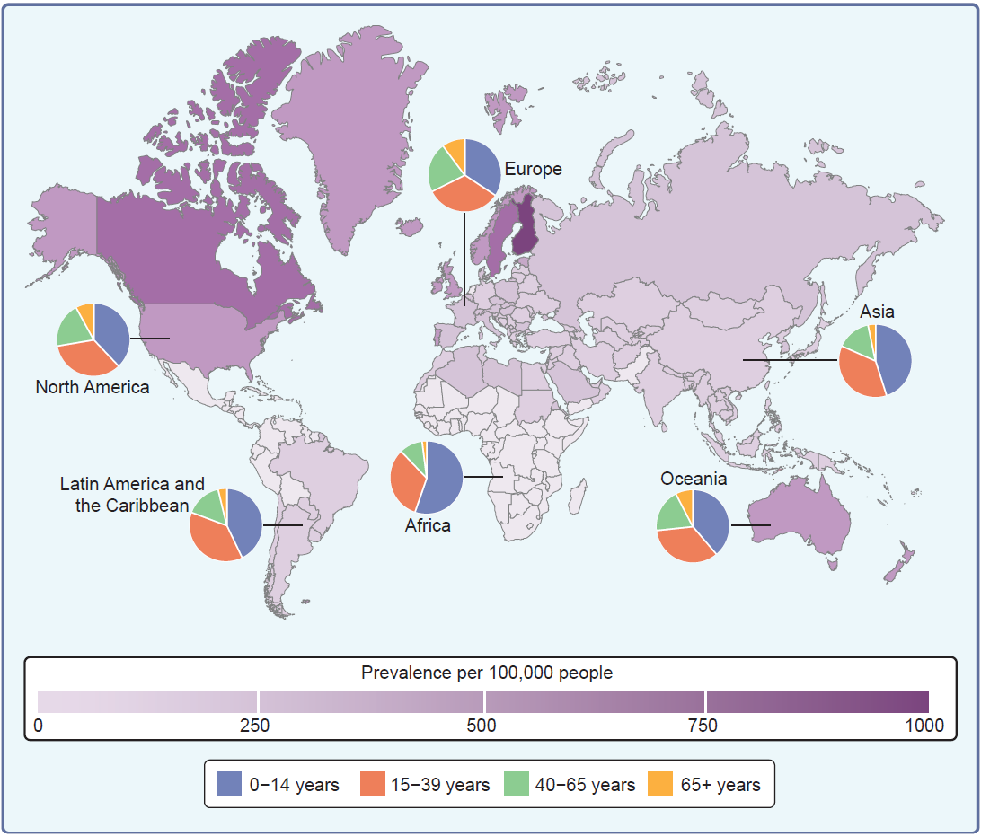
Prevalence and incidence of type 1 diabetes per age group across the globe
Manousaki et al (2026) Diabetologia DOI 10.1007/s00125-026-06831-1
© The Author(s), under exclusive licence to Springer-Verlag GmbH Germany, part of Springer Nature 2026

Slide 2
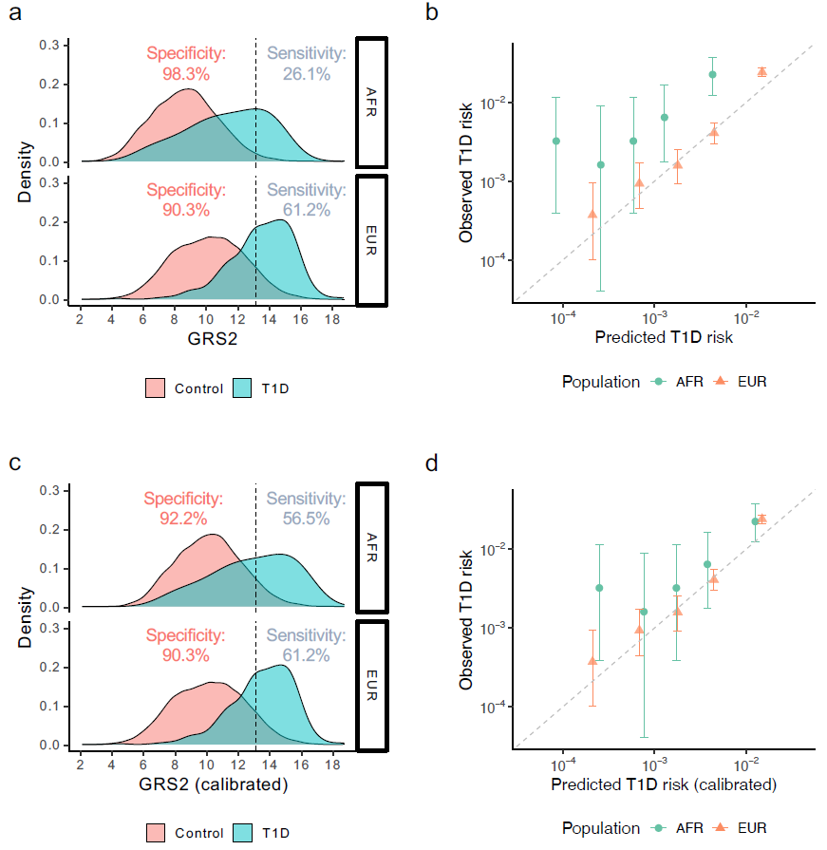
Discrimination and calibration of GRS2
Manousaki et al (2026) Diabetologia DOI 10.1007/s00125-026-06831-1
© The Author(s), under exclusive licence to Springer-Verlag GmbH Germany, part of Springer Nature 2026

Slide 3
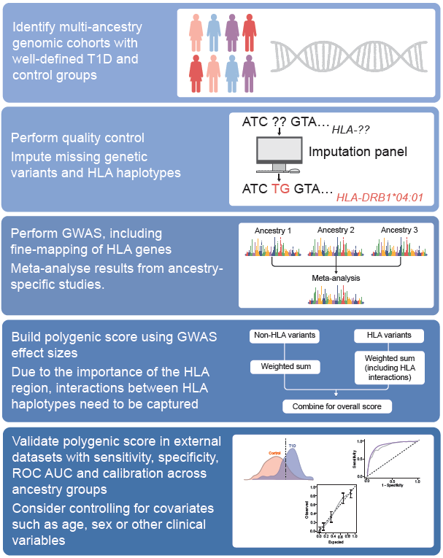
Overview of the development and testing of multi-ancestry type 1 diabetes polygenic scores
Manousaki et al (2026) Diabetologia DOI 10.1007/s00125-026-06831-1
© The Author(s), under exclusive licence to Springer-Verlag GmbH Germany, part of Springer Nature 2026

