Slide 1
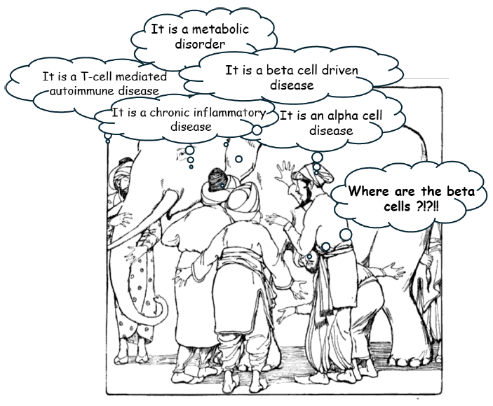
The parable ‘blind men and an elephant’, illustrating how selective views can influence our understanding of disease development, islet organisation and beta cell biology
Scharfmann and Zaldumbide (2026) Diabetologia DOI 10.1007/s00125-026-06839-7
Adapted from ‘Blind men and an elephant’, Martha Adelaide Holton & Charles Madison Curry, Holton-Curry Readers, Rand McNally & Co. (Chicago), 1914

