Slide 1
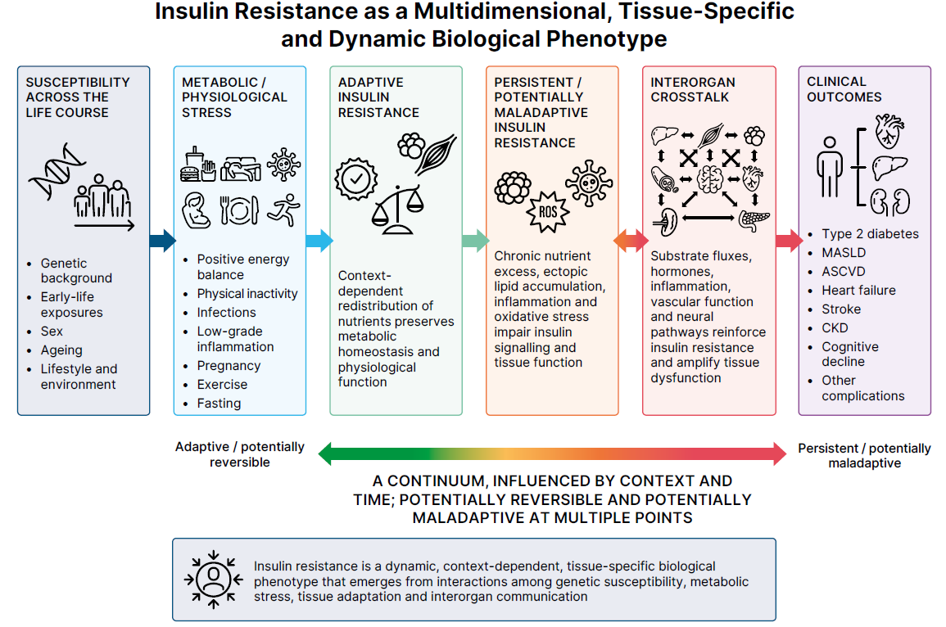
A working model of insulin resistance as a dynamic multidimensional biological phenotype
Gastaldelli et al (2026) Diabetologia DOI 10.1007/s00125-026-06853-9
© American Diabetes Association and the European Association for the Study of Diabetes 2026.
Distributed under the terms of the CC BY 4.0 Attribution License (http://creativecommons.org/licenses/by/4.0/)

Slide 2
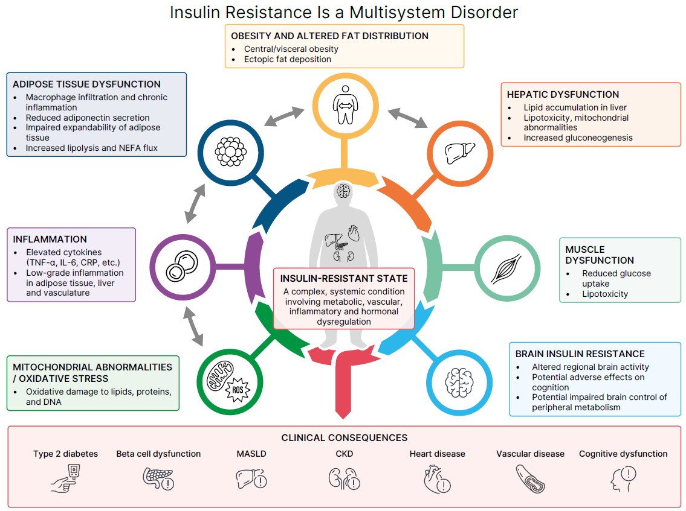
The insulin-resistant state is a systemic disorder
Gastaldelli et al (2026) Diabetologia DOI 10.1007/s00125-026-06853-9
© American Diabetes Association and the European Association for the Study of Diabetes 2026.
Distributed under the terms of the CC BY 4.0 Attribution License (http://creativecommons.org/licenses/by/4.0/)

Slide 3
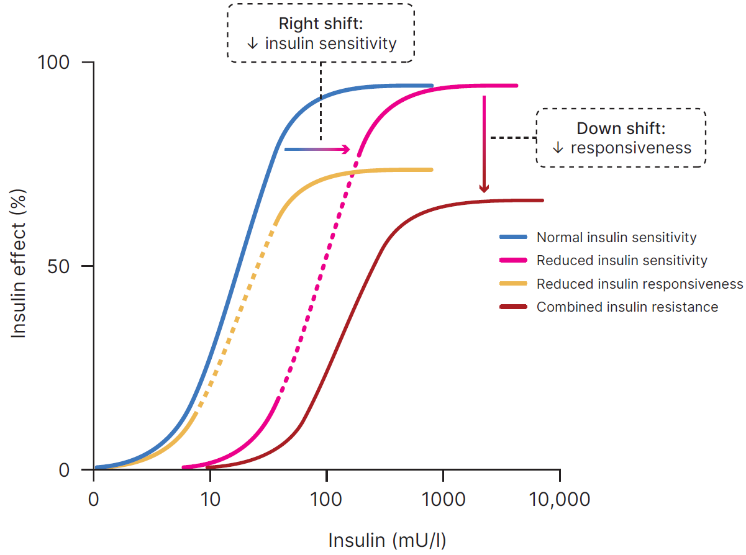
Model of concentration-dependent effects of insulin
Gastaldelli et al (2026) Diabetologia DOI 10.1007/s00125-026-06853-9
© Based on Brehm and Roden (2007) (https://doi.org/10.1002/9780470513095.ch4), adapted from a figure originally published in Kahn (1978) (https://doi.org/10.1016/S0026-0495(78)80007-9), with permission from Elsevier

Slide 4
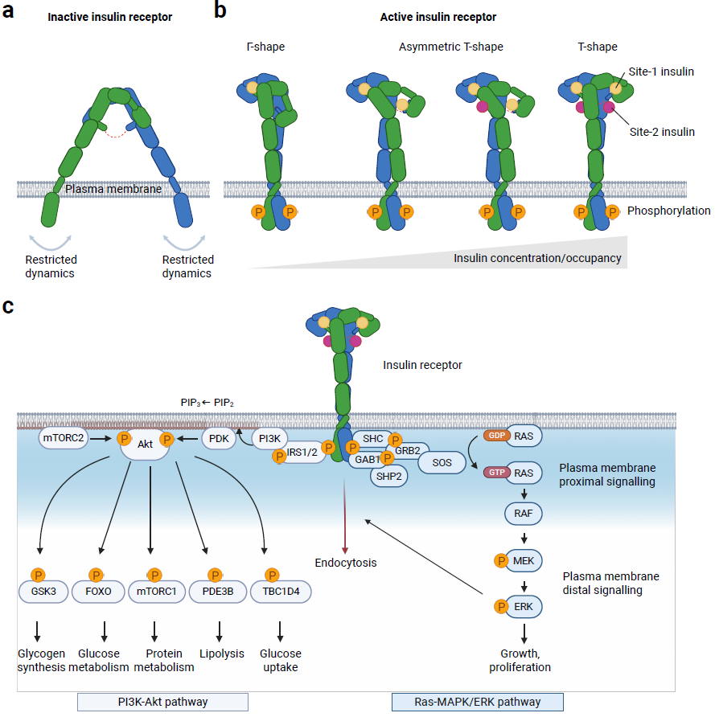
Insulin-dependent activation and signalling of the insulin receptor
Gastaldelli et al (2026) Diabetologia DOI 10.1007/s00125-026-06853-9
© American Diabetes Association and the European Association for the Study of Diabetes 2026.
Distributed under the terms of the CC BY 4.0 Attribution License (http://creativecommons.org/licenses/by/4.0/)

