Slide 1
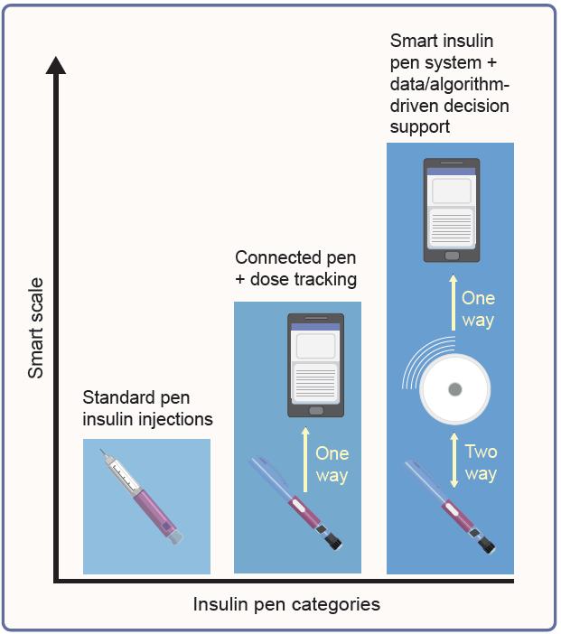
Differentiation of standard insulin pens, connected insulin pens and smart insulin pen systems
Jendle et al (2026) Diabetologia DOI 10.1007/s00125-026-06858-4
©The Authors 2026. Distributed under the terms of the CC BY 4.0 Attribution License (http://creativecommons.org/licenses/by/4.0/)

Slide 2
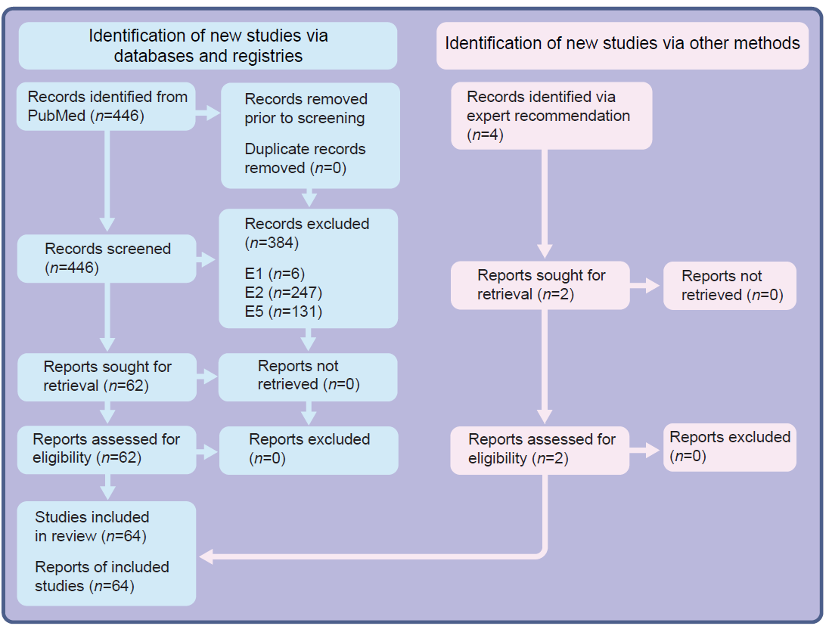
PRISMA flow diagram for narrative review
Jendle et al (2026) Diabetologia DOI 10.1007/s00125-026-06858-4
©The Authors 2026. Distributed under the terms of the CC BY 4.0 Attribution License (http://creativecommons.org/licenses/by/4.0/)

