Slide 1
PiCO 1:
IV-MFT Indications

Slide 2
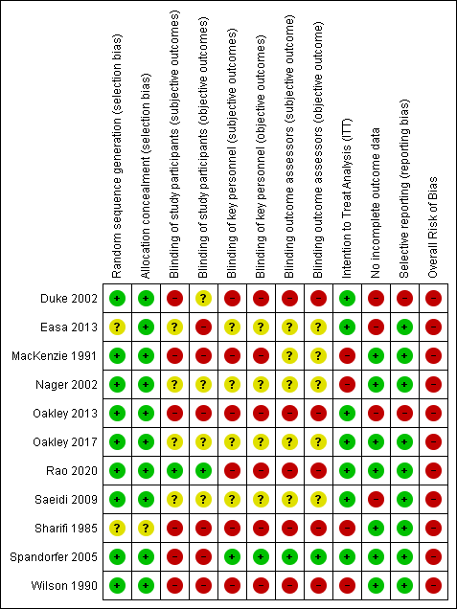
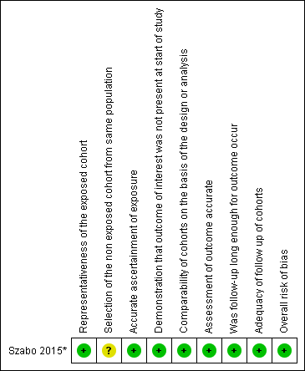
Quality assessment
RCT (randomised controlled trial) studies
Cohort studies

Slide 3
Meta-analyses
Experimental group: IV-MFT
Control group: Enteral hydration

Slide 4
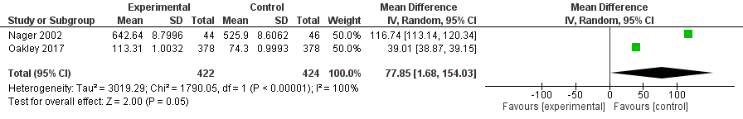
Outcome: Costs
Forest plot - Cost
Costs are significantly higher in the experimental group (mean difference = 77.85 95%CI [1.68; 154.03], p=0.05).
High heterogeneity between the two studies (I²=100%, p<0.001).

Slide 5
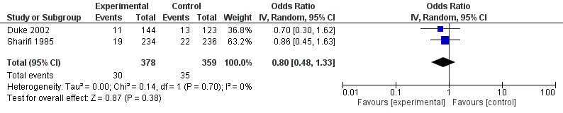
Outcome: Sodium plasma rate -Hyponatremia
Forest plot - Hyponatremia
NO significant difference between experimental and control groups (OR=0.80 95%CI[0.48 ; 1.33], p=0.38).
Both studies are homogeneous (I²=0%, p=0.70).

Slide 6
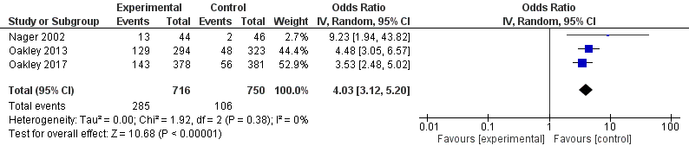
Outcome: Failure of insertion of IV-line or Naso gastric tube
Forest plot – Failure insertion IV or NGT
Significant difference: more failure rate in the experimental group (OR=4.03 95%CI[3.12 ; 5.20], p<0.001).
No heterogeneity between studies (I²=0%, p=0.62).

Slide 7
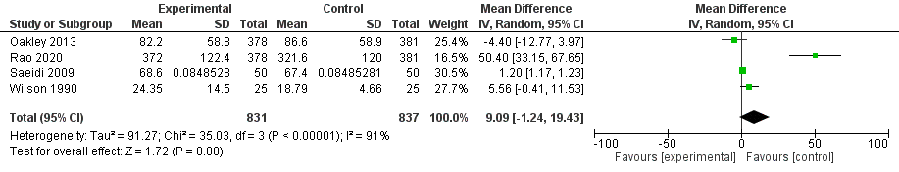
Outcome: Length of stay in hospital (in hours)
Forest plot – LOS (in hours)
For Saeidi et al. 2009 study, an approximation of the standard deviation was calculated, based on global mean and number of patients per group.
NO significant difference between groups (MD=9.09 95%CI[-1.24 ; 19.43], p=0.08).
Trend towards a better outcome in the control group.
High heterogeneity between studies (I²=91%, p<0.001).

Slide 8
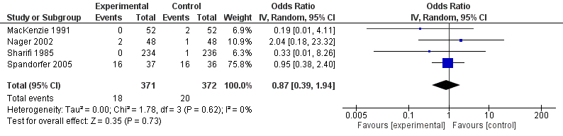
Outcome: Failure of rehydratation
Forest plot – Failure of rehydratation
No significant difference between experimental and control groups (OR = 0.87 95%CI [0.39 – 1.94], p=0.73).
NO heterogeneity between studies (I²=0%, p=0.62).

Slide 9
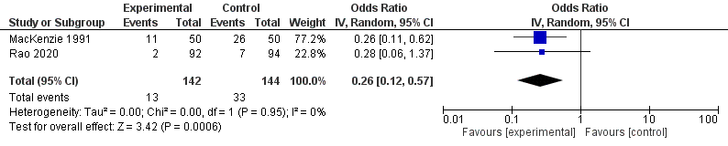
Outcome: Vomiting
Forest plot - Vomiting
Significant difference: less vomiting in the experimental group (OR= 0.26 95%CI [0.12; 0.57], p<0.001).
No heterogeneity between studies (I²=0%, p=0.95).

Slide 10
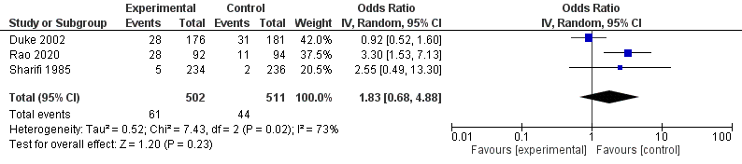
Outcome: Mortality
Forest plot – Mortality
NO significant difference between groups (OR=1.83 95%CI[0.68 ; 4.88], p=0.23)
Some heterogeneity w=between studies (I²=73%, p=0.02).

Slide 11
Funnel plots
(for meta-analysis with 4 or more included studies)

Slide 12
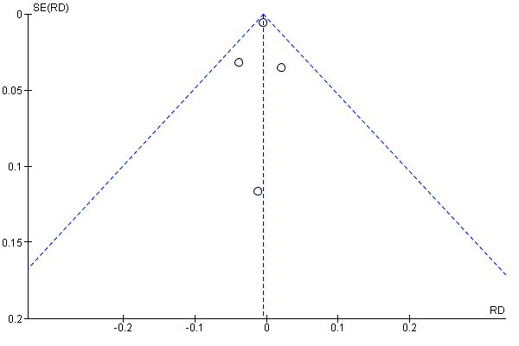
Funnel plot – Outcome: Failure of rehydratation
No publication bias observed in this analysis.

