Slide 1
PiCO 2:
IV-MFT Isotonic solutions

Slide 2
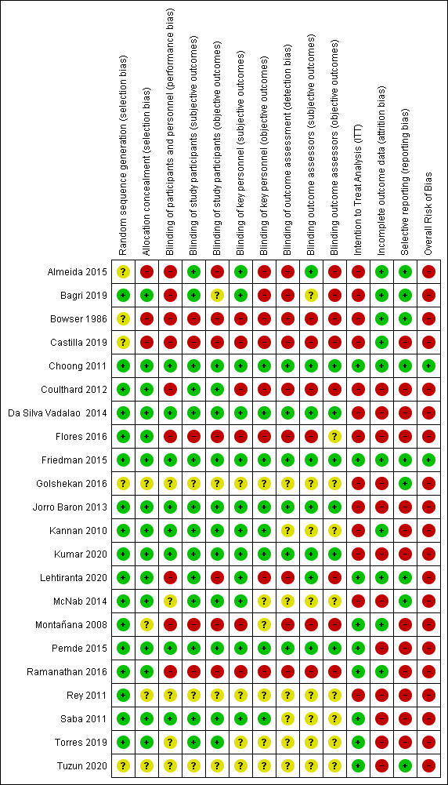
Quality assessment
RCT
(Randomised controlled trials)

Slide 3
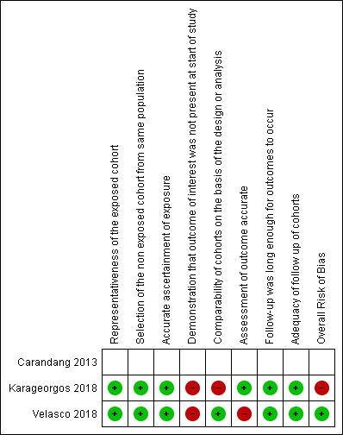
Quality assessment
Cohort studies

Slide 4
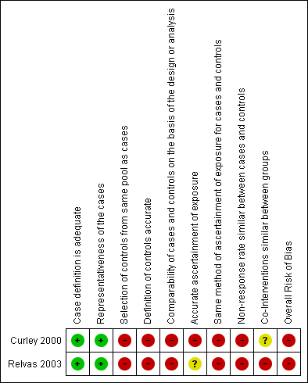
Quality assessment
Case serie studies

Slide 5
Meta-analysis
Experimental group: Isotonic solutions
Control group: Hypotonic solutions

Slide 6
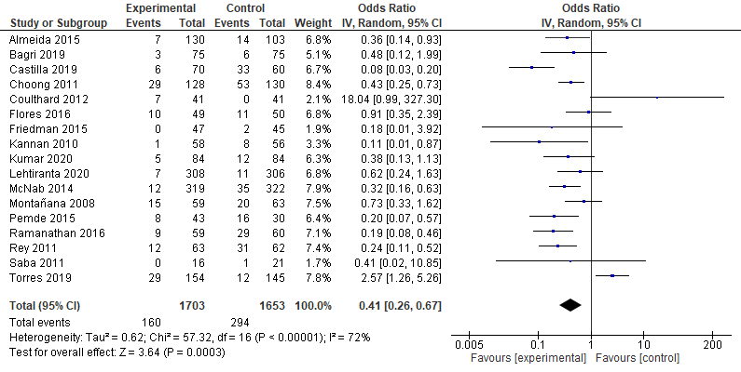
Outcome: HypoNatremia
Forest plot - Hyponatremia
Significant difference in favor of the experimental group (OR=0.41 95%Confidence Interval (CI) [0.26, 0.67], p=0.0003)
High heterogeneity between studies (I²=72%, p<0.0001)

Slide 7
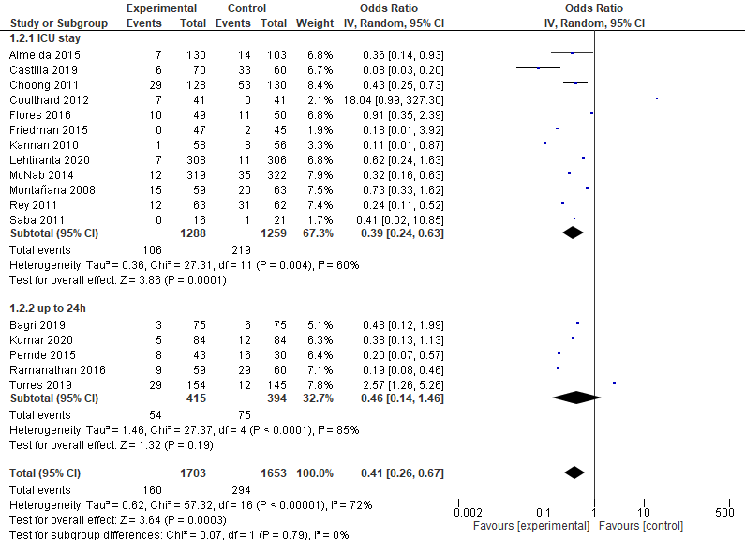
Outcome: HypoNatremia
Forest plot – Hyponatremia (subgroup)
Subgroup analysis :
Studies with outcome measure during ICU stay :
  Significant difference in favor of the experimental group (less hyponatremia in the experimental group than in the control group) (OR = 0.39 95%CI[0.24, 0.63], p<0.001)
  Moderate heterogeneity between studies (I²=60%, p=0.004)
Studies with outcome measure up to 24h :
  No significant difference between groups (OR=0.41 95%CI[0.14, 1.46], p=0.19)
  High heterogeneity between studies (I²=85%, p<0.001)
Overall effect :
Significant difference in favor of the experimental group (OR=0.41 95%CI [0.26, 0.67], p=0.0003)
High heterogeneity between studies (I²=72%, p<0.0001)
No significant difference between subgroups (p=0.79)

Slide 8
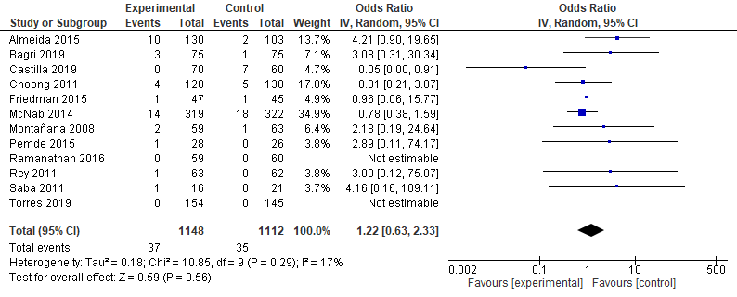
Outcome: HyperNatremia
Forest plot – Hypernatremia
No significant difference between groups (OR=1.22 95%CI [0.63, 2.33], p=0.56)
No heterogeneity between studies (I²=17%, p=0.29)

Slide 9
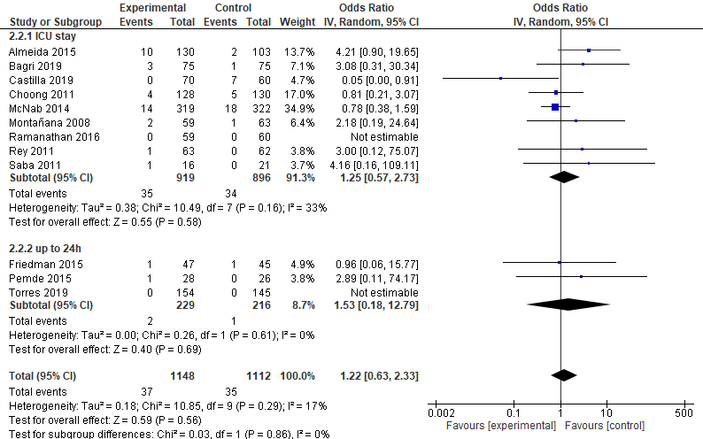
Outcome: HyperNatremia
Forest plot – Hypernatremia (subgroup)
Subgroup analysis :
Studies with outcome measure during ICU stay :
  No significant difference between groups (OR=1.25 95%CI [0.57, 2.73], p=0.58)
  No heterogeneity between studies (I²=33%, p=0.16)
Studies with outcome measure up to 24h :
  Only two studies can be analyzed (questionable analysis)
  No significant difference between groups (OR=1.53 95%CI[0.18, 12.79], p=0.69)
  No heterogeneity between studies (I²=0%, p=0.61)
Overall effect :
No significant difference between groups (OR=1.22 95%CI [0.63, 2.33], p=0.56)
No heterogeneity between studies (I²=17%, p=0.29)
No significant difference between subgroups (p=0.86)

Slide 10
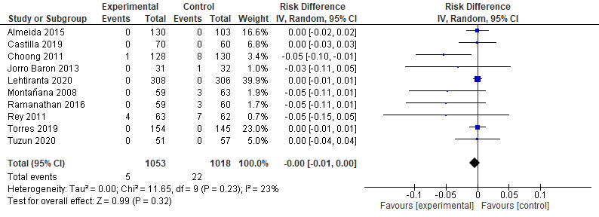
Outcome: Severe hyponatremia
Forest plot – Severe Hyponatremia
No significant difference between groups (RD=0.00 95%CI[-0.01, 0.00], p=0.32)
No heterogeneity between studies (I²=23%, p=0.23)

Slide 11
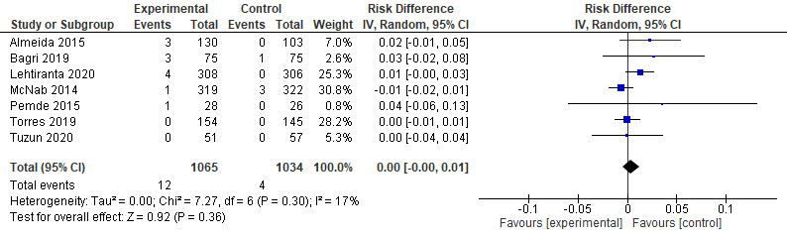
Outcome: Severe hypernatremia
No significant difference between groups (RD=0.00 95%CI[-0.00, 0.01], p=0.36)
No heterogeneity between studies (I²=17%, p=0.30)
Forest plot – Severe Hypernatremia

Slide 12
Funnel plots
(for meta-analysis with 4 or more included studies)

Slide 13
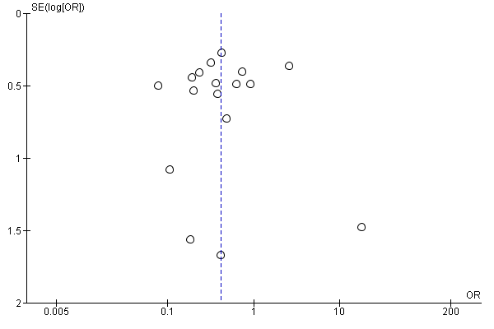
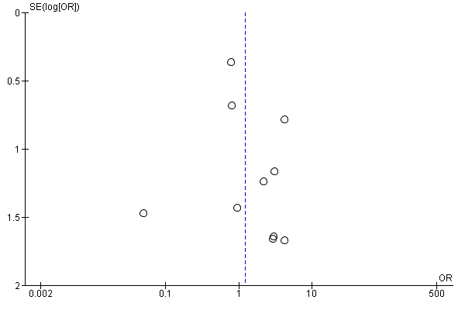
Funnel plot - Outcome Hyponatremia
Funnel plot – Outcome Hypernatremia

