Slide 1
PiCO 3:
IV-MFT Balanced solutions

Slide 2
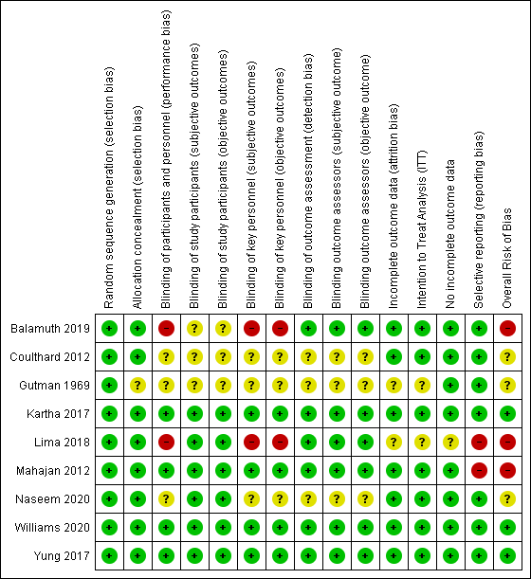
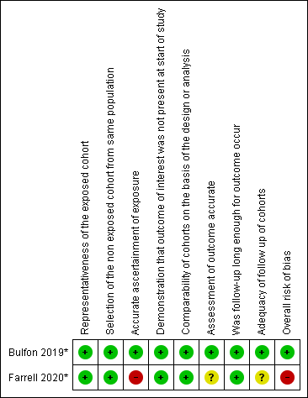
Quality assessment
Randomised controlled trials
Cohort studies

Slide 3
Meta-analyses
Experimental group: Balanced solutions
Control group: Non-balanced solutions

Slide 4
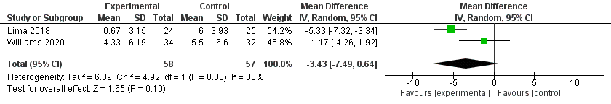
Outcome: Chloremia & delta chloremia & hyperchloremia
Forest plot - Delta chloremia
No significant difference (mean difference = -3.43 95%CI [-7.49; 0.64], p=0.10).
Trend towards a larger delta-Chloremia in the control group.
Strong heterogeneity between studies (I²=80%, p=0.03).

Slide 5
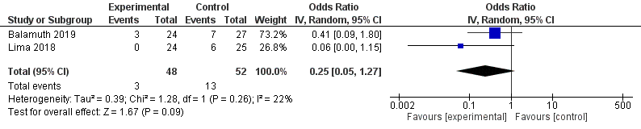
Outcome: Chloremia & delta chloremia & hyperchloremia
Forest plot - Hyperchloremia
No significant difference between groups (OR=0.25 95%CI[0.05 ; 1.27], p=0.09).
Trend towards fewer hyper-Cl in the experimental group
No heterogeneity between the two studies (I²=22%, p=0.26).

Slide 6
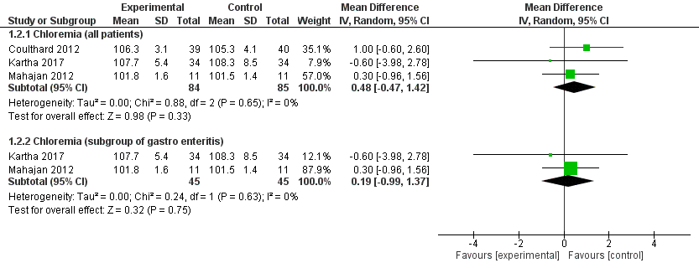
Outcome: Chloremia & delta chloremia & hyperchloremia
No significant difference between groups.
No heterogeneity between studies (I²=0%, p=0.65 et p=0.63)
Forest plot - Chloremia

Slide 7
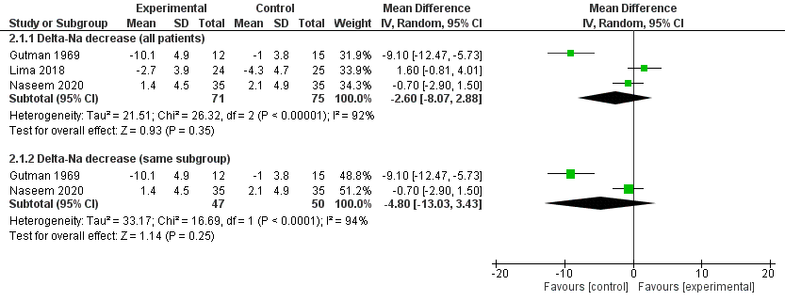
Outcome: Natremia & Delta Natremia & Hyponatremia
No significant difference between groups.
Strong heterogeneity between studies (I²=92% et I²=94%).
Forest plot – Delta-Na

Slide 8
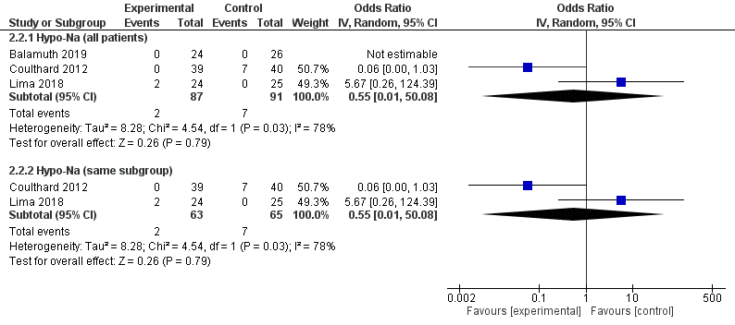
Outcome: Natremia & Delta Natremia & Hyponatremia
No significant difference between groups. (p=0.79)
Strong heterogeneity between studies (I²=78%, p=0.03).
Forest plot – Hypo-Na

Slide 9
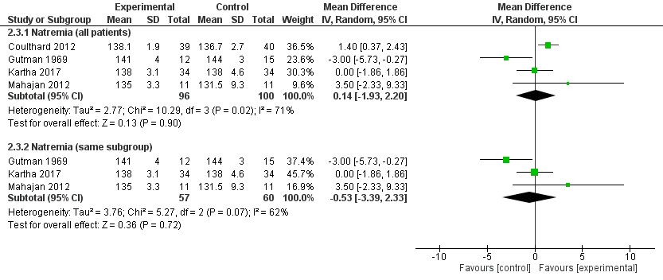
Outcome: Natremia & Delta Natremia & Hyponatremia
No significant difference (p=0.90 et p=0.72).
Some heterogeneity between studies (I²=71% et I²=62%).
Forest plot - Natremia

Slide 10
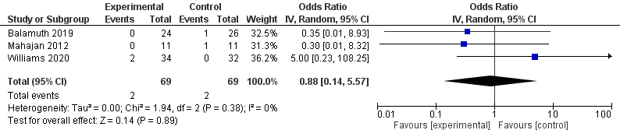
Outcome: Mortality
No significant difference between groups (OR=0.88 95%CI[0.14 ; 5.57], p=0.89)
No heterogeneity between studies (I²=0%, p=0.38)
Forest plot – Mortality

Slide 11
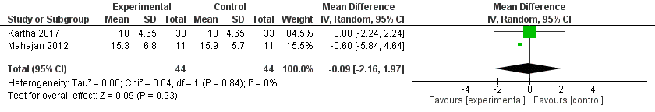
Outcome: Base excess
No significant difference between groups (mean difference=-0.09 95%CI [-2.16 ; 1.97], p=0.93)
No heterogeneity between studies (I²=0%, p=0.84)
Forest plot – BE value

Slide 12
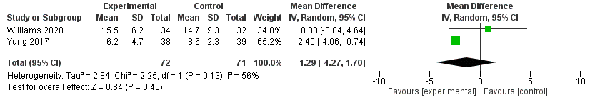
Outcome: Time to resolve Diabetic ketoacidosis (DKA)
No significant difference between groups (mean difference=-1.29 95%CI [-4.27 ; 1.70], p=0.40)
Slight heterogeneity between studies (I²=56%, p=0.13)
Forest plot – Time to resolve DKA

Slide 13
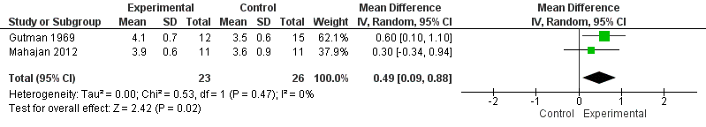
Outcome: Kalemia
Kalemia is significantly higher in the experimental group (mean difference=0.49 95%CI[0.09 ; 0.88], p=0.02).
No heterogeneity between studies (I²=0%, p=0.47).
Forest plot – Kalemia level

Slide 14
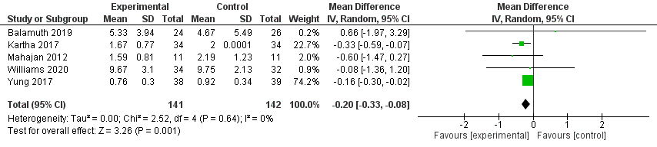
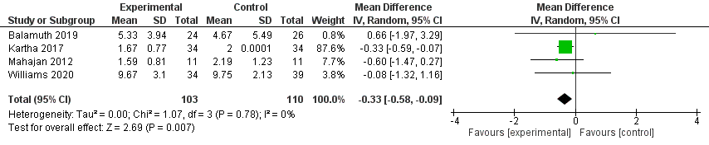
Outcome: length of stay (LoS)
LoS is significantly shorter in the experimental group (mean difference (MD)=-0.20 95%CI[-0.33 ; -0.08], p=0.001 for acute and critical care; MD=-0.33 95%CI[-0.58 ; -0.09], p=0.007 for hospital stay)
No heterogeneity between studies (I²=0%, p=0.64 et p=0.78).
Forest plot – length of stay (acute care or intensive care stay)
Forest plot – length of stay (hospital stay)

Slide 15
Funnel plots
(for meta-analysis with 4 or more included studies)

Slide 16
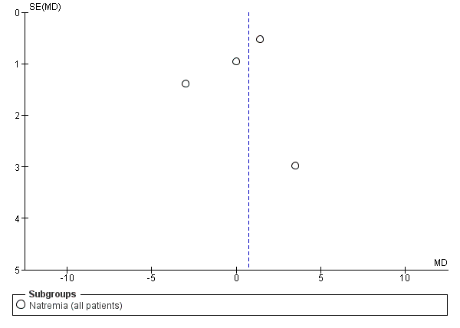
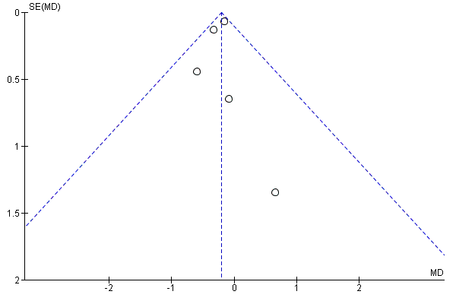
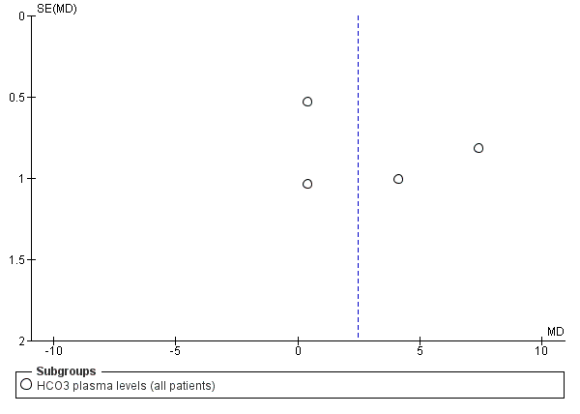
Funnel plot - Outcome 3 Natremia
Funnel plot - Outcome 13 LoS
Funnel plot - Outcome 5 HCO3 plasma levels
No publication bias observed.

