Slide 1
PiCO 5:
IV-MFT fluid amount strategy

Slide 2
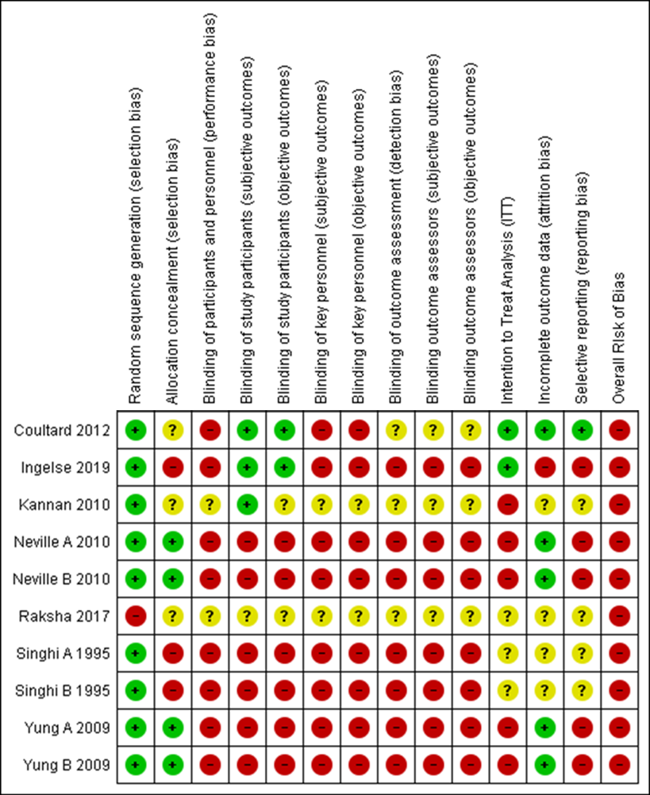
Quality assessement
Randomised controlled trials

Slide 3
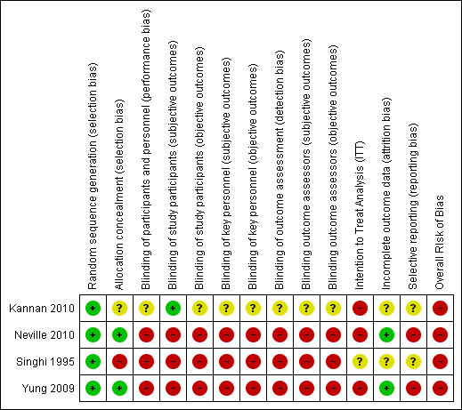
Quality assessement
Randomised controlled trials in the meta-analysis

Slide 4
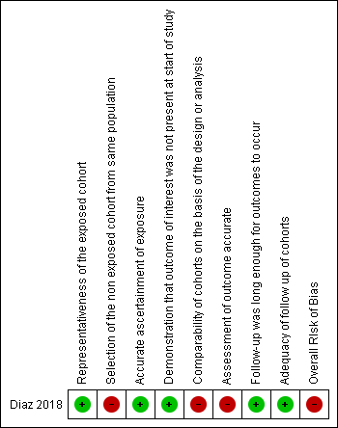
Quality assessement
Cohort studies

Slide 5
Meta-analyses
Experimental group: restrictive strategy (< Holliday and Segar goals)
Control : standard strategy (= Holliday and Segar goals)

Slide 6
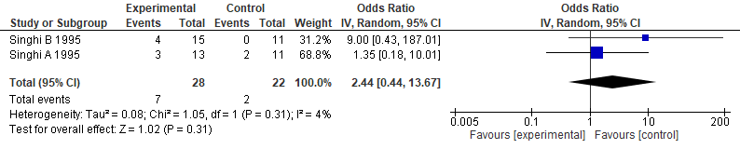
Outcome: Mortality
Forest plot – Mortality
No significant difference between experimental and control groups (OR=2.44 95%CI[0.44 ; 13.67], p=0.31).
No heterogeneity between studies (I²=4%, p=0.31).

Slide 7
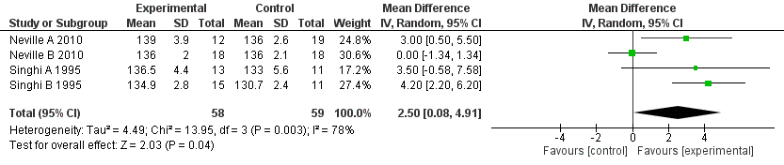
Outcome: Natremia, delta-natremia, hyponatremia & hypernatremia
Forest plot – Natremia (>H12)
Significant difference between groups: higher Natremia in the experimental group (MD=2.50 95%CI[0.08, 4.91], p=0.04).
High heterogeneity between studies (I²=78%, p=0.003).

Slide 8
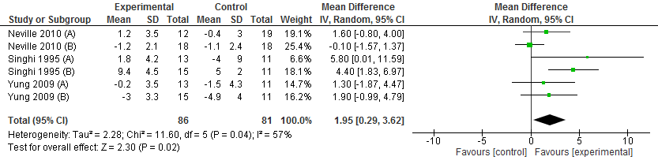
Outcome: Natremia, delta-natremia, hyponatremia & hypernatremia
Forest plot – Delta-Na (>H12)
Significant difference between groups wich favors the experimental group (mean difference=1.95 95%CI[0.29 ; 3.62], p=0.02).
Slight heterogeneity between studies (I²=57%, p=0.04).

Slide 9
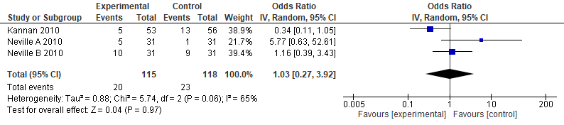
Outcome: Natremia, delta-natremia, hyponatremia & hypernatremia
Forest plot – Hyponatremia (<135 mmol/L)
No significant difference (OR=1.03 95%CI[0.27 ; 3.92], p=0.97).
Slight heterogeneity between studies (I²=65%, p=0.06).

Slide 10
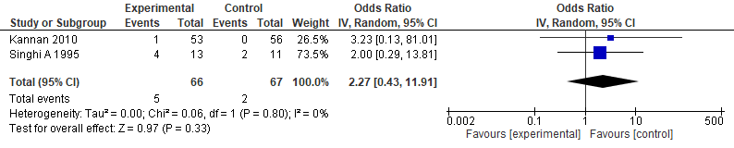
Outcome: Neurological adverse outcome
Forest plot –Neurological adverse outcome
No significant difference between groups (p=0.33).
No heterogeneity between stidues (I²=0%, p=0.80).

Slide 11
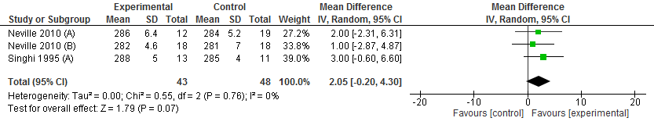
Outcome: Osmolality and change in plasma osmolality
Forest plot – Plasma Osmolality
No significant difference (OR=2.05 95%CI[-0.20 ; 4.30], p=0.07).
Trend towards a higher osmolality in the experimental group
No heterogeneity between studies (I²=0%, p=0.76).

Slide 12
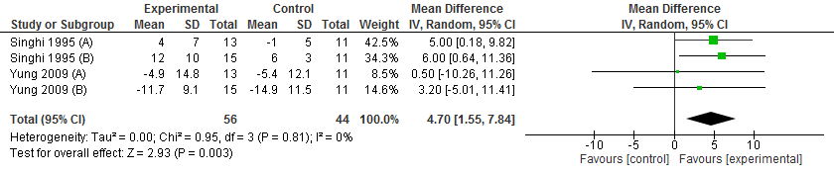
Outcome: Osmolality and change in plasma osmolality
Forest plot – Delta-osmolality
Significant difference between experimental and control groups (mean difference= 4.70 95%CI[1.55 ; 7.84], p=0.003).
No heterogeneity between studies(I²=0%, p=0.81).

Slide 13
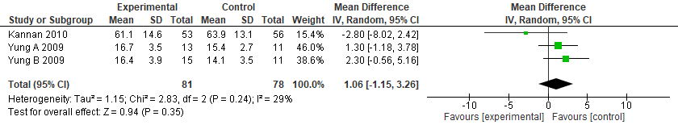
Outcome 6 : Length of therapy, in hours
Forest plot – Length of therapy
No significant difference (p=0.35).
No heterogeneity between studies(I²=29%, p=0.24).

Slide 14
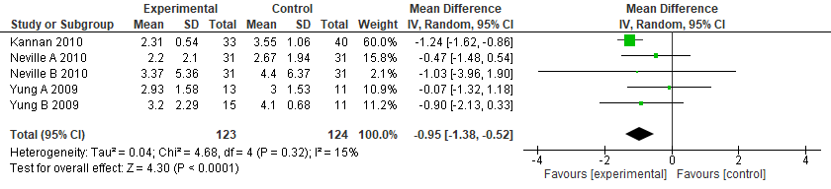
Outcome: Fluid intake
Forest plot – Fluid intake (ml/kg/h)
Fluid intake is significantly decreased in the experimental group (mean difference= -0. 95 95%CI[-1.38 ; -0.52], p<0.001).
No heterogeneity between studies(I²=15%, p=0.32).

Slide 15
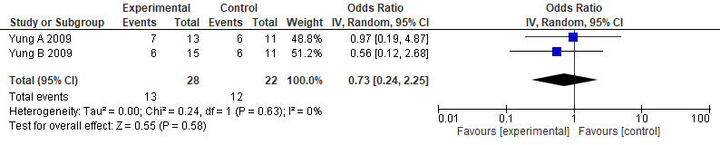
Outcome: Fluid bolus
Forest plot – Number of patients receiving fluid boluses
No significant difference between groups (p=0.58).
No heterogeneity between studies(I²= 0%, p=0.63).

Slide 16
Funnel plots
(for meta-analysis with 4 or more included studies)

Slide 17
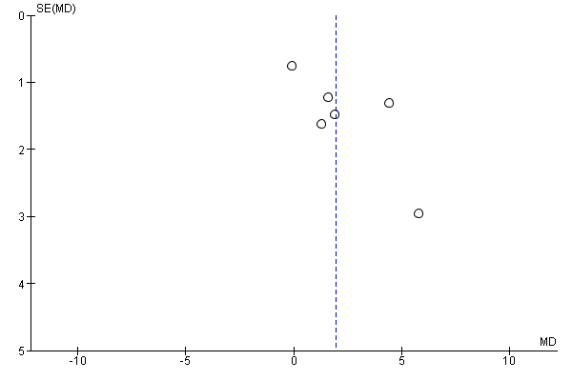
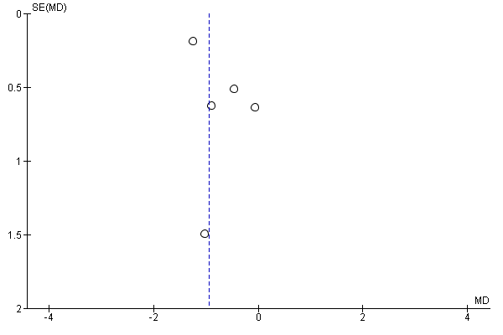
Funnel plot – Outcome Delta-natremia
Funnel plot – Outcome Fluid intake

