Slide 1
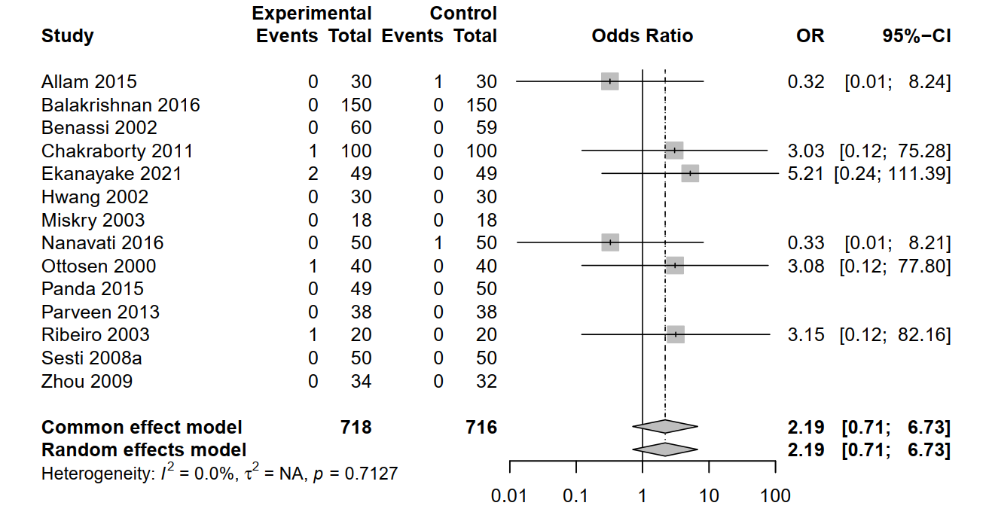
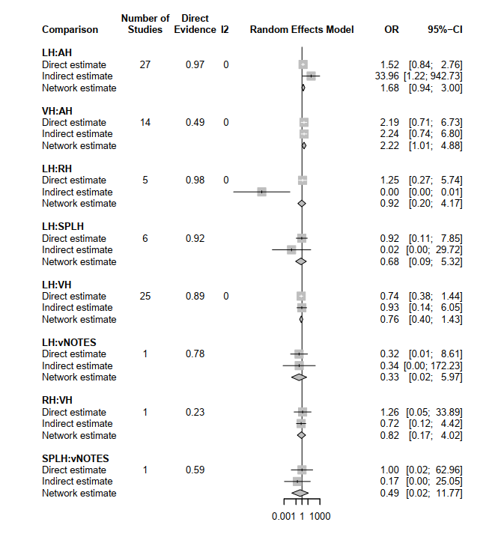
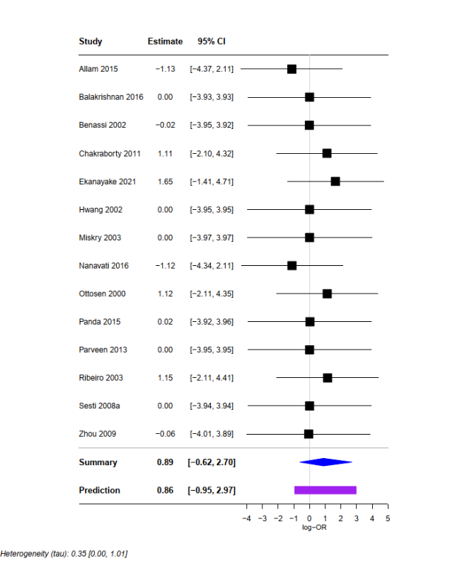
ESM 2
A
C
Pairwise meta-analysis of bladder injuries
(LH vs AH)
B
Comparison of direct and indirect evidence

