Slide 1
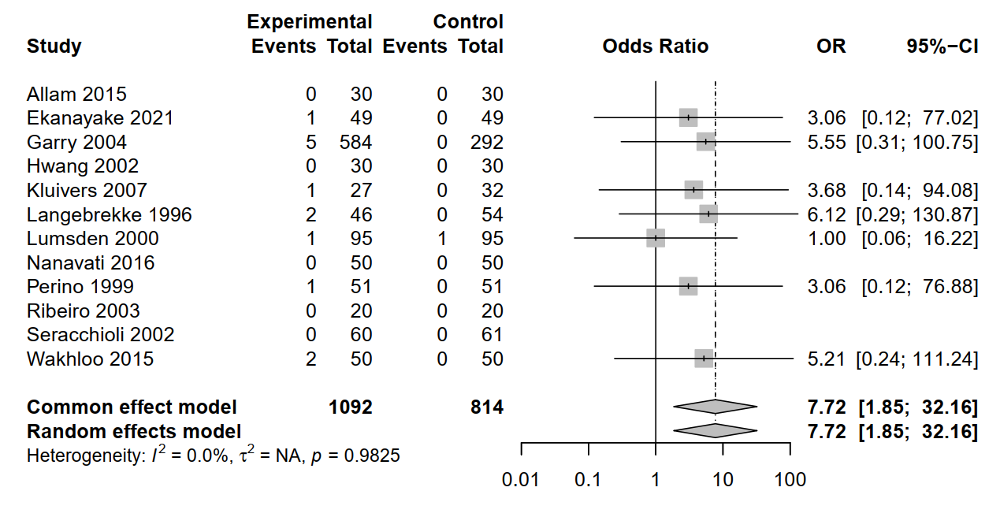
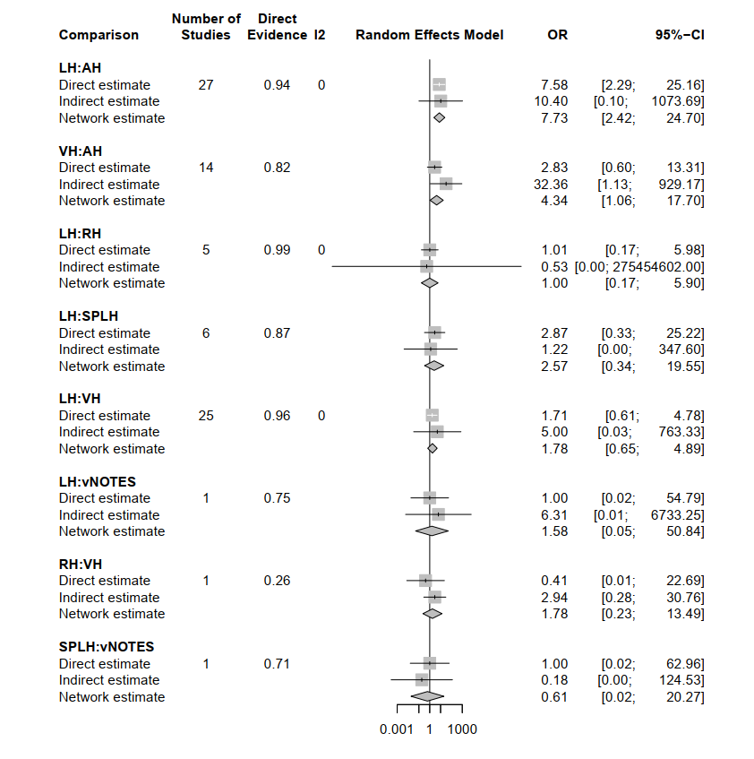
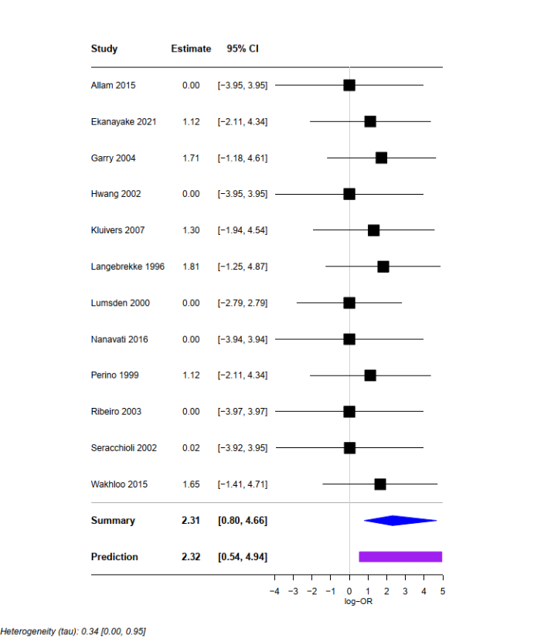
ESM 3
A
C
Pairwise meta-analysis of ureter unjuries
(LH vs AH)
B
Comparison of direct and indirect evidence

