Slide 1
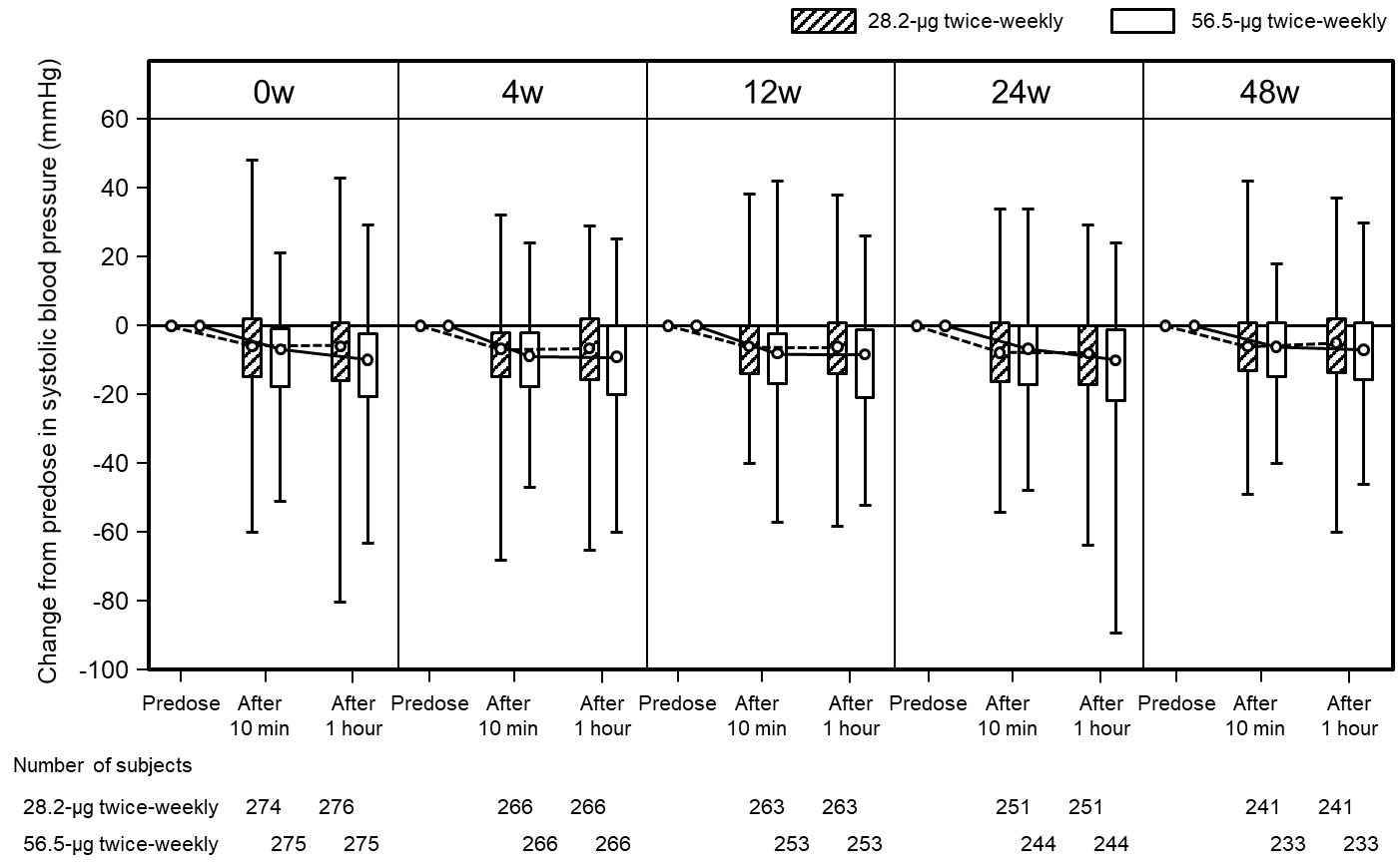
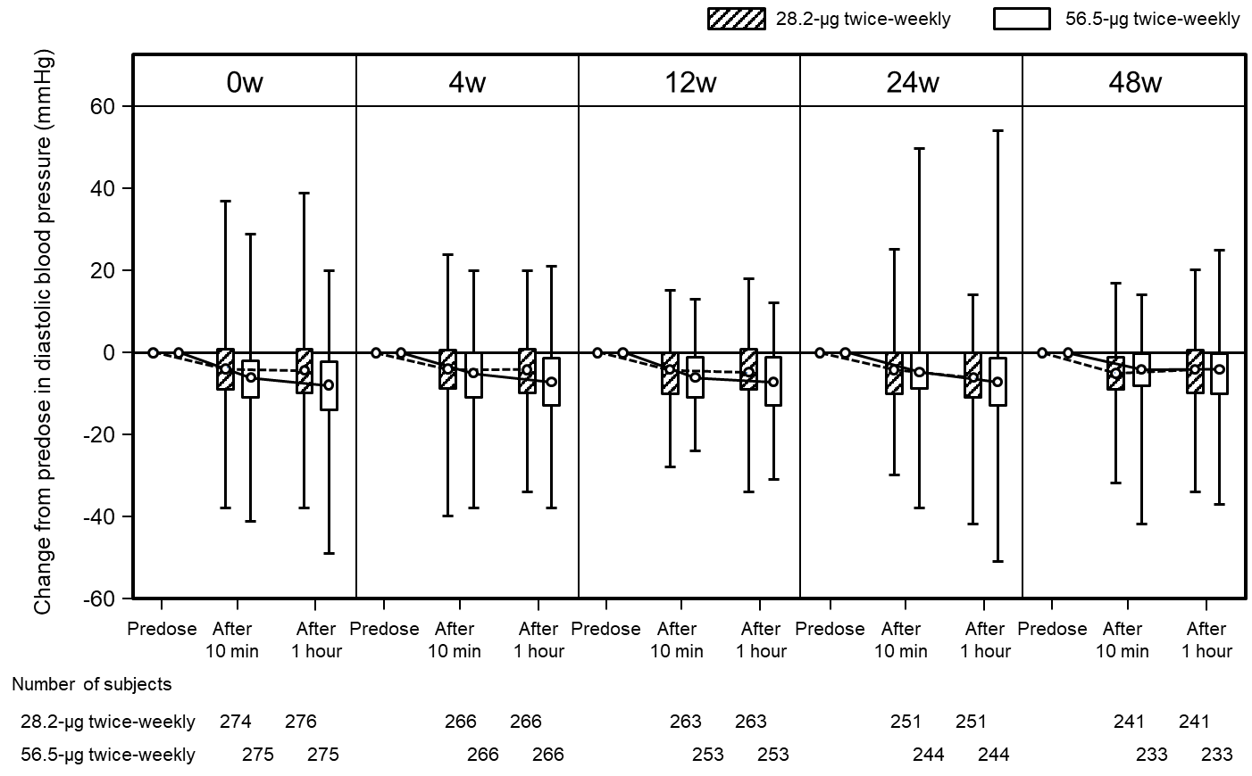
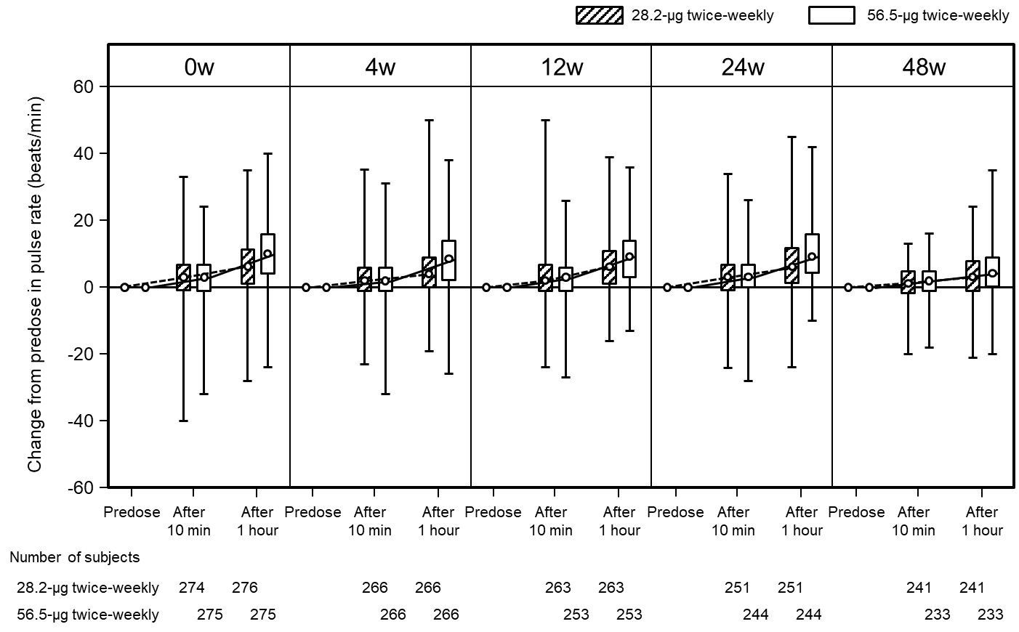
(a)
(b)
(c)
Supplementary Fig. 2 Change from pre-dose in vital signs
systolic blood pressure, (b) diastolic blood pressure, and (c) pulse rate
Upper horizontal line of box, third quartile; lower horizontal line of box, first quartile; circle within box, median; upper horizontal bar outside box, maximum; lower horizontal bar outside box, minimum.

