Slide 1
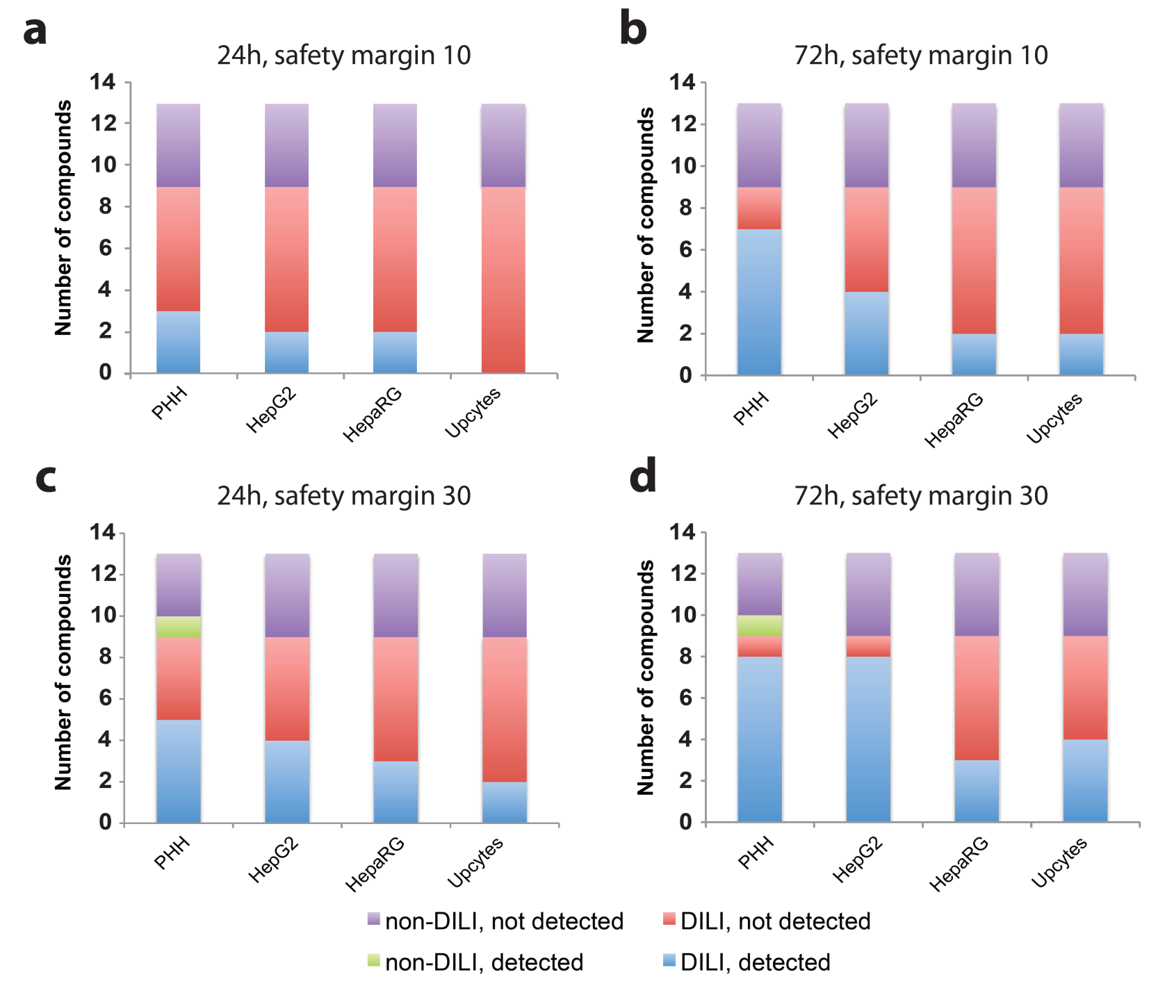
Supplementary Figure 1
24 h, EC₅₀/C_{max} = 10
72 h, EC₅₀/C_{max} = 10
24 h, EC₅₀/C_{max} = 30
72 h, EC₅₀/C_{max} = 30

Slide 2
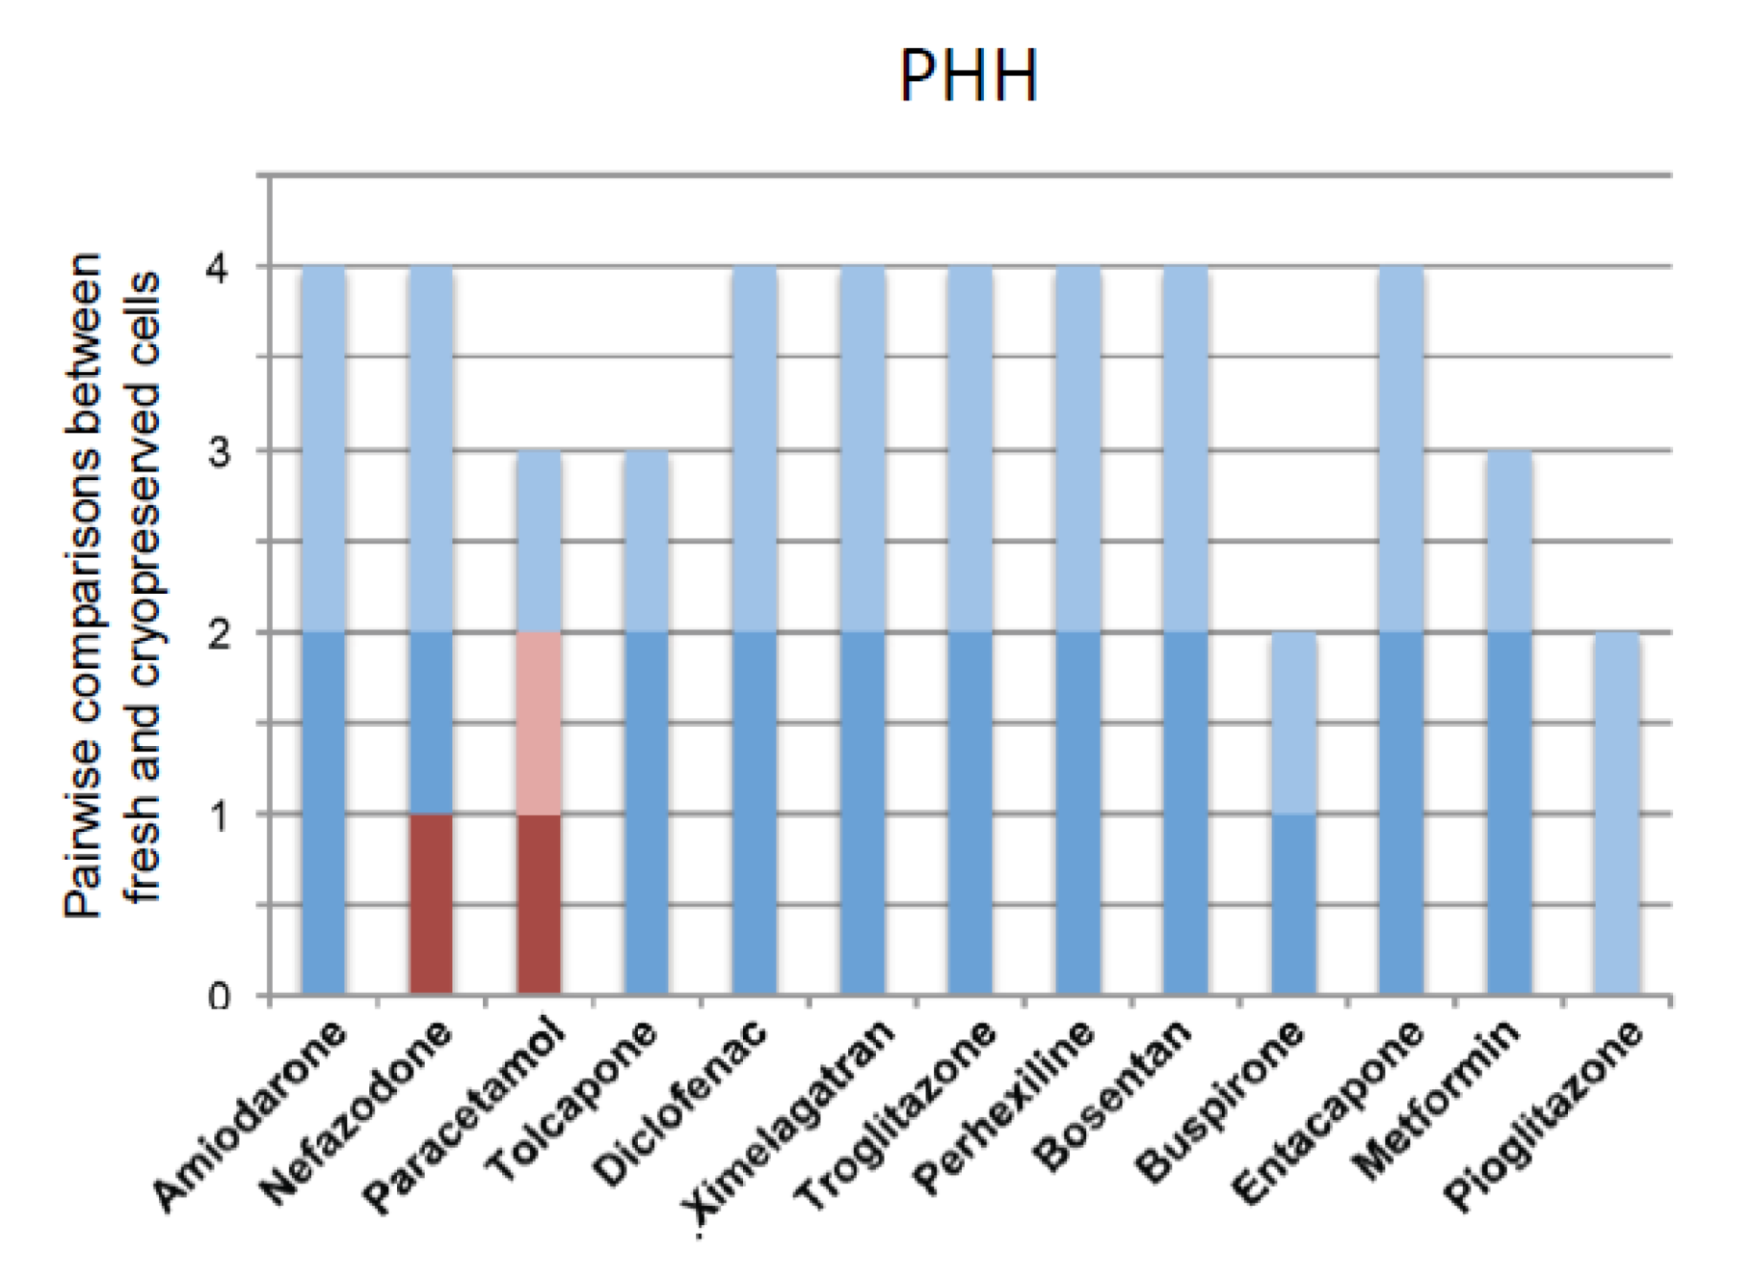
Supplementary Figure 2

