Slide 1
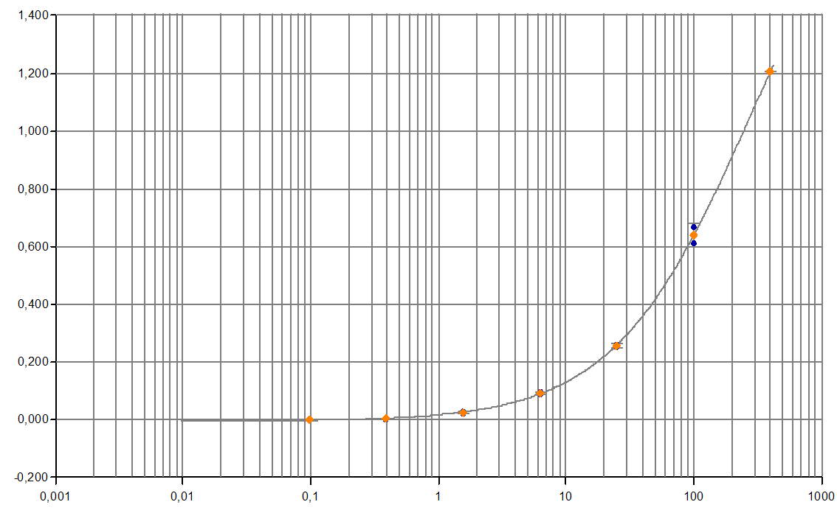
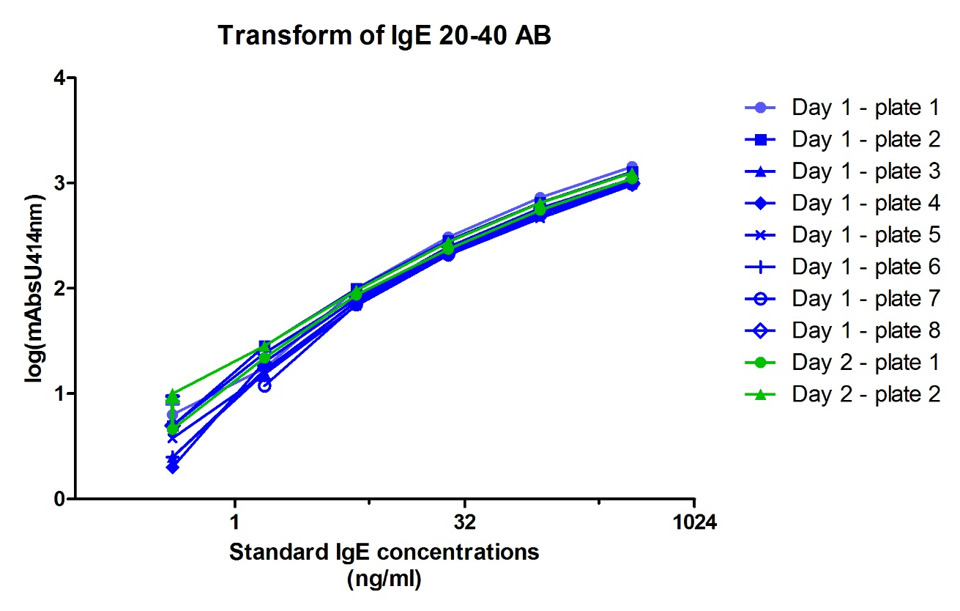
Supplementary Material - Fig. 1
A
B
CV<13%
CV<13%
mAbsU_{414nm}
CV<8%
Standard IgE concentration
(ng/ml)

