Slide 1
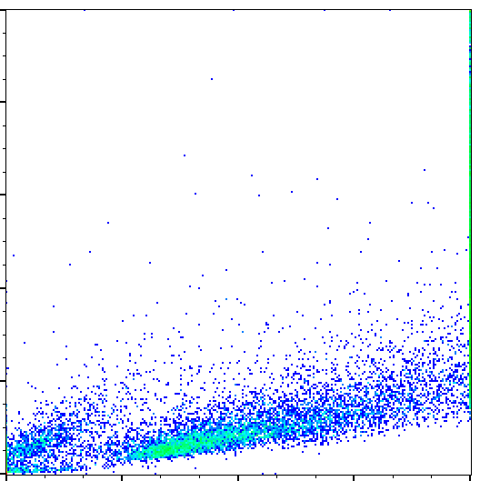
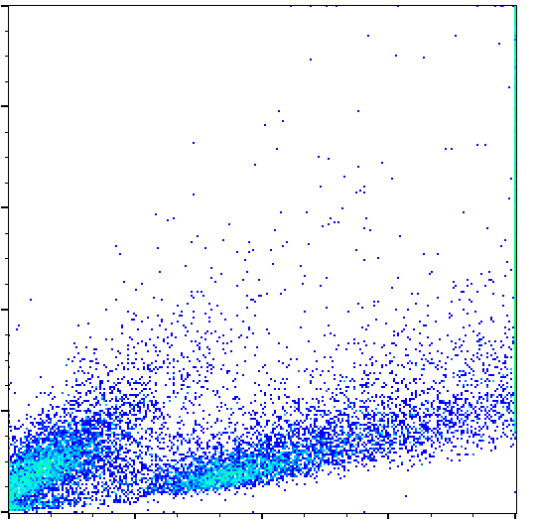
SI
Fig S1: Flow cytometry analysis of HepG2 without treatment (A) and cells treated with 5 mM APAP (B). FSC-A: Forward Scatter Area, a measure of cell size, SSC-A: Side scatter area, measure of cell complexity.
A
B
live cells
dead cells
live cells
dead cells
SSC-A
FSC-A

Slide 2
Fig. S2:Relative abundance of isotopologues of fumarate in control and APAP-treated cultures labelled with u-¹³C Glucose.(A) and u-¹³C Glutamine (B). Errors bars represent S.E., all experiment n=3.
A
Control
B
Control
APAP
APAP
fraction labelled
fraction labelled
isotopologue
isotopologue

Slide 3
Fig. S3:Relative abundance of isotopologues of serine in control and APAP-treated cultures labelled with u-¹³C Glucose.(A) and u-¹³C Glutamine (B). Errors bars represent S.E., all experiment n=3.
A
Control
B
Control
APAP
APAP
fraction labelled
fraction labelled
isotopologue
isotopologue

Slide 4
Fig. S4:Relative abundance of isotopologues of glycine in control and APAP-treated cultures labelled with u-¹³C Glucose.(A) and u-¹³C Glutamine (B). Errors bars represent S.E., all experiment n=3.
A
Control
B
Control
APAP
APAP
fraction labelled
fraction labelled
isotopologue
isotopologue

Slide 5
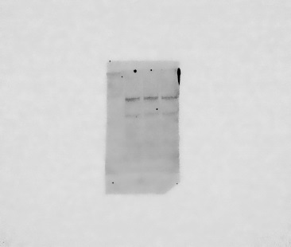
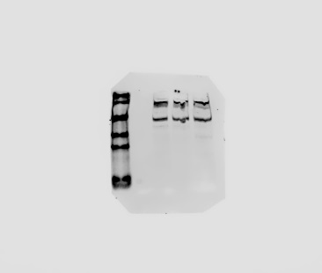
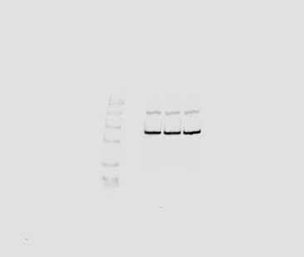
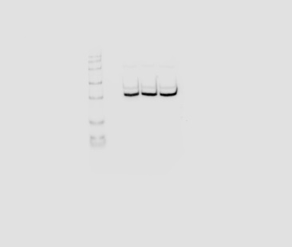
Fig. S5: Western-blot analysis of AMPK and AMPK phosphorylation levels in response to 24h treatment with indicated APAP levels. HepG2 cells were treated as indicated for 24h. Protein lysates were analysed by Western-blot against AMPKα and phosphor-AMPKα antibodies, β-actin and GAPDH were used as loading controls. Data are expressed as means ± standard errors of three different experiments
0.5mM APAP
5mM APAP
untreated
AMPK
p-AMPK
β-actin
GAPDH

