Slide 1
Figure S1
INACCURACY FOLLOWING PLACEBO ADMINISTRATION BY GENOTYPE
Inaccuracy (seconds)
p = .109; z = -1.60, n = 63
There is a trend toward a difference between COMT genotypes for inaccuracy at each of the 4 time points following placebo administration (p = .109, z = -1.60, n = 63; Val/Val = 24, Val/Met = 27, Met/Met = 12).

Slide 2
Figure S2
INACCURACY FOLLOWING TOLCAPONE ADMINISTRATION BY GENOTYPE
Inaccuracy (seconds)
Inaccuracy at each of the 4 time points following tolcapone administration and segregated by COMT genotype.

Slide 3
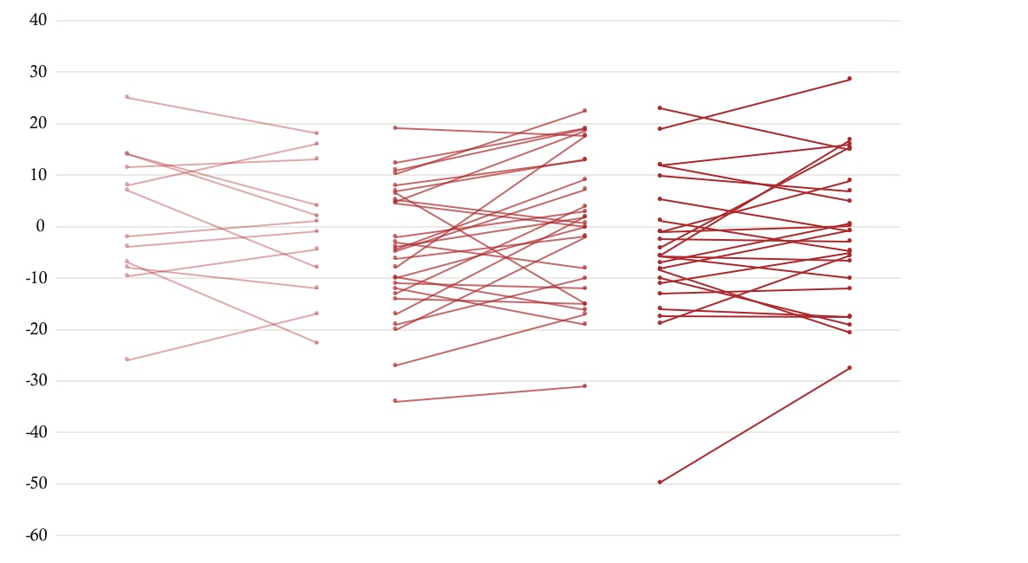
Figure S3
INACCURACY FOLLOWING PLACEBO AND TOLCAPONE ADMINISTRATION BY GENOTYPE
Met/Met
Met/Val
Val/Val
Inaccuracy (seconds)
PLACEBO TOLCAPONE
PLACEBO TOLCAPONE
PLACEBO TOLCAPONE

Slide 4
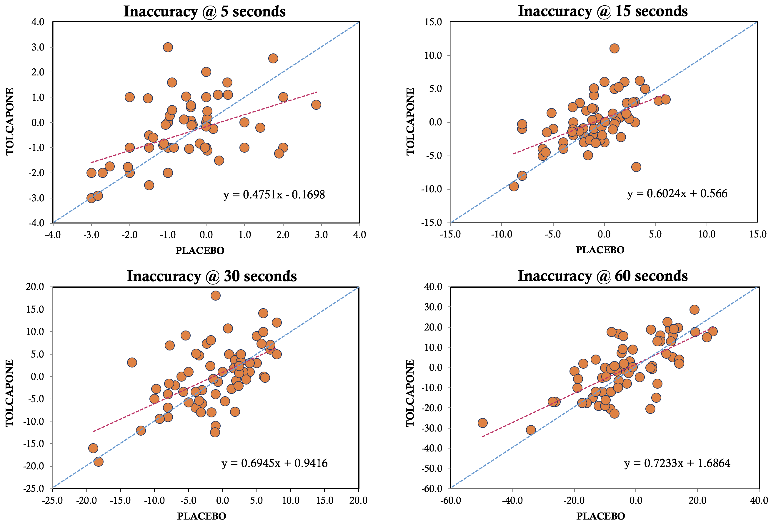
Figure S4
Plotting inaccuracy for both tolcapone and placebo at each of the time points demonstrates that both the y-intercept and slope of the linear regression line increase as time increases, indicating that subjects are less inaccurate over time on tolcapone compared to placebo.

Slide 5
Figure S5
p = .041, R = .25, t = 2.08, N = 66

Slide 6
Figure S6
R value | BIS | DAS | BDI | OCDS | AUDIT
BIS | 1 | 0.527 | 0.608 | 0.452 | 0.608
DAS | 0.527 | 1 | 0.899 | 0.52 | 0.564
BDI | 0.608 | 0.899 | 1 | 0.567 | 0.608
OCDS | 0.452 | 0.52 | 0.567 | 1 | 0.813
AUDIT | 0.608 | 0.564 | 0.608 | 0.813 | 1
R values demonstrate the inter-correlation of behavioral measures.

