Slide 1
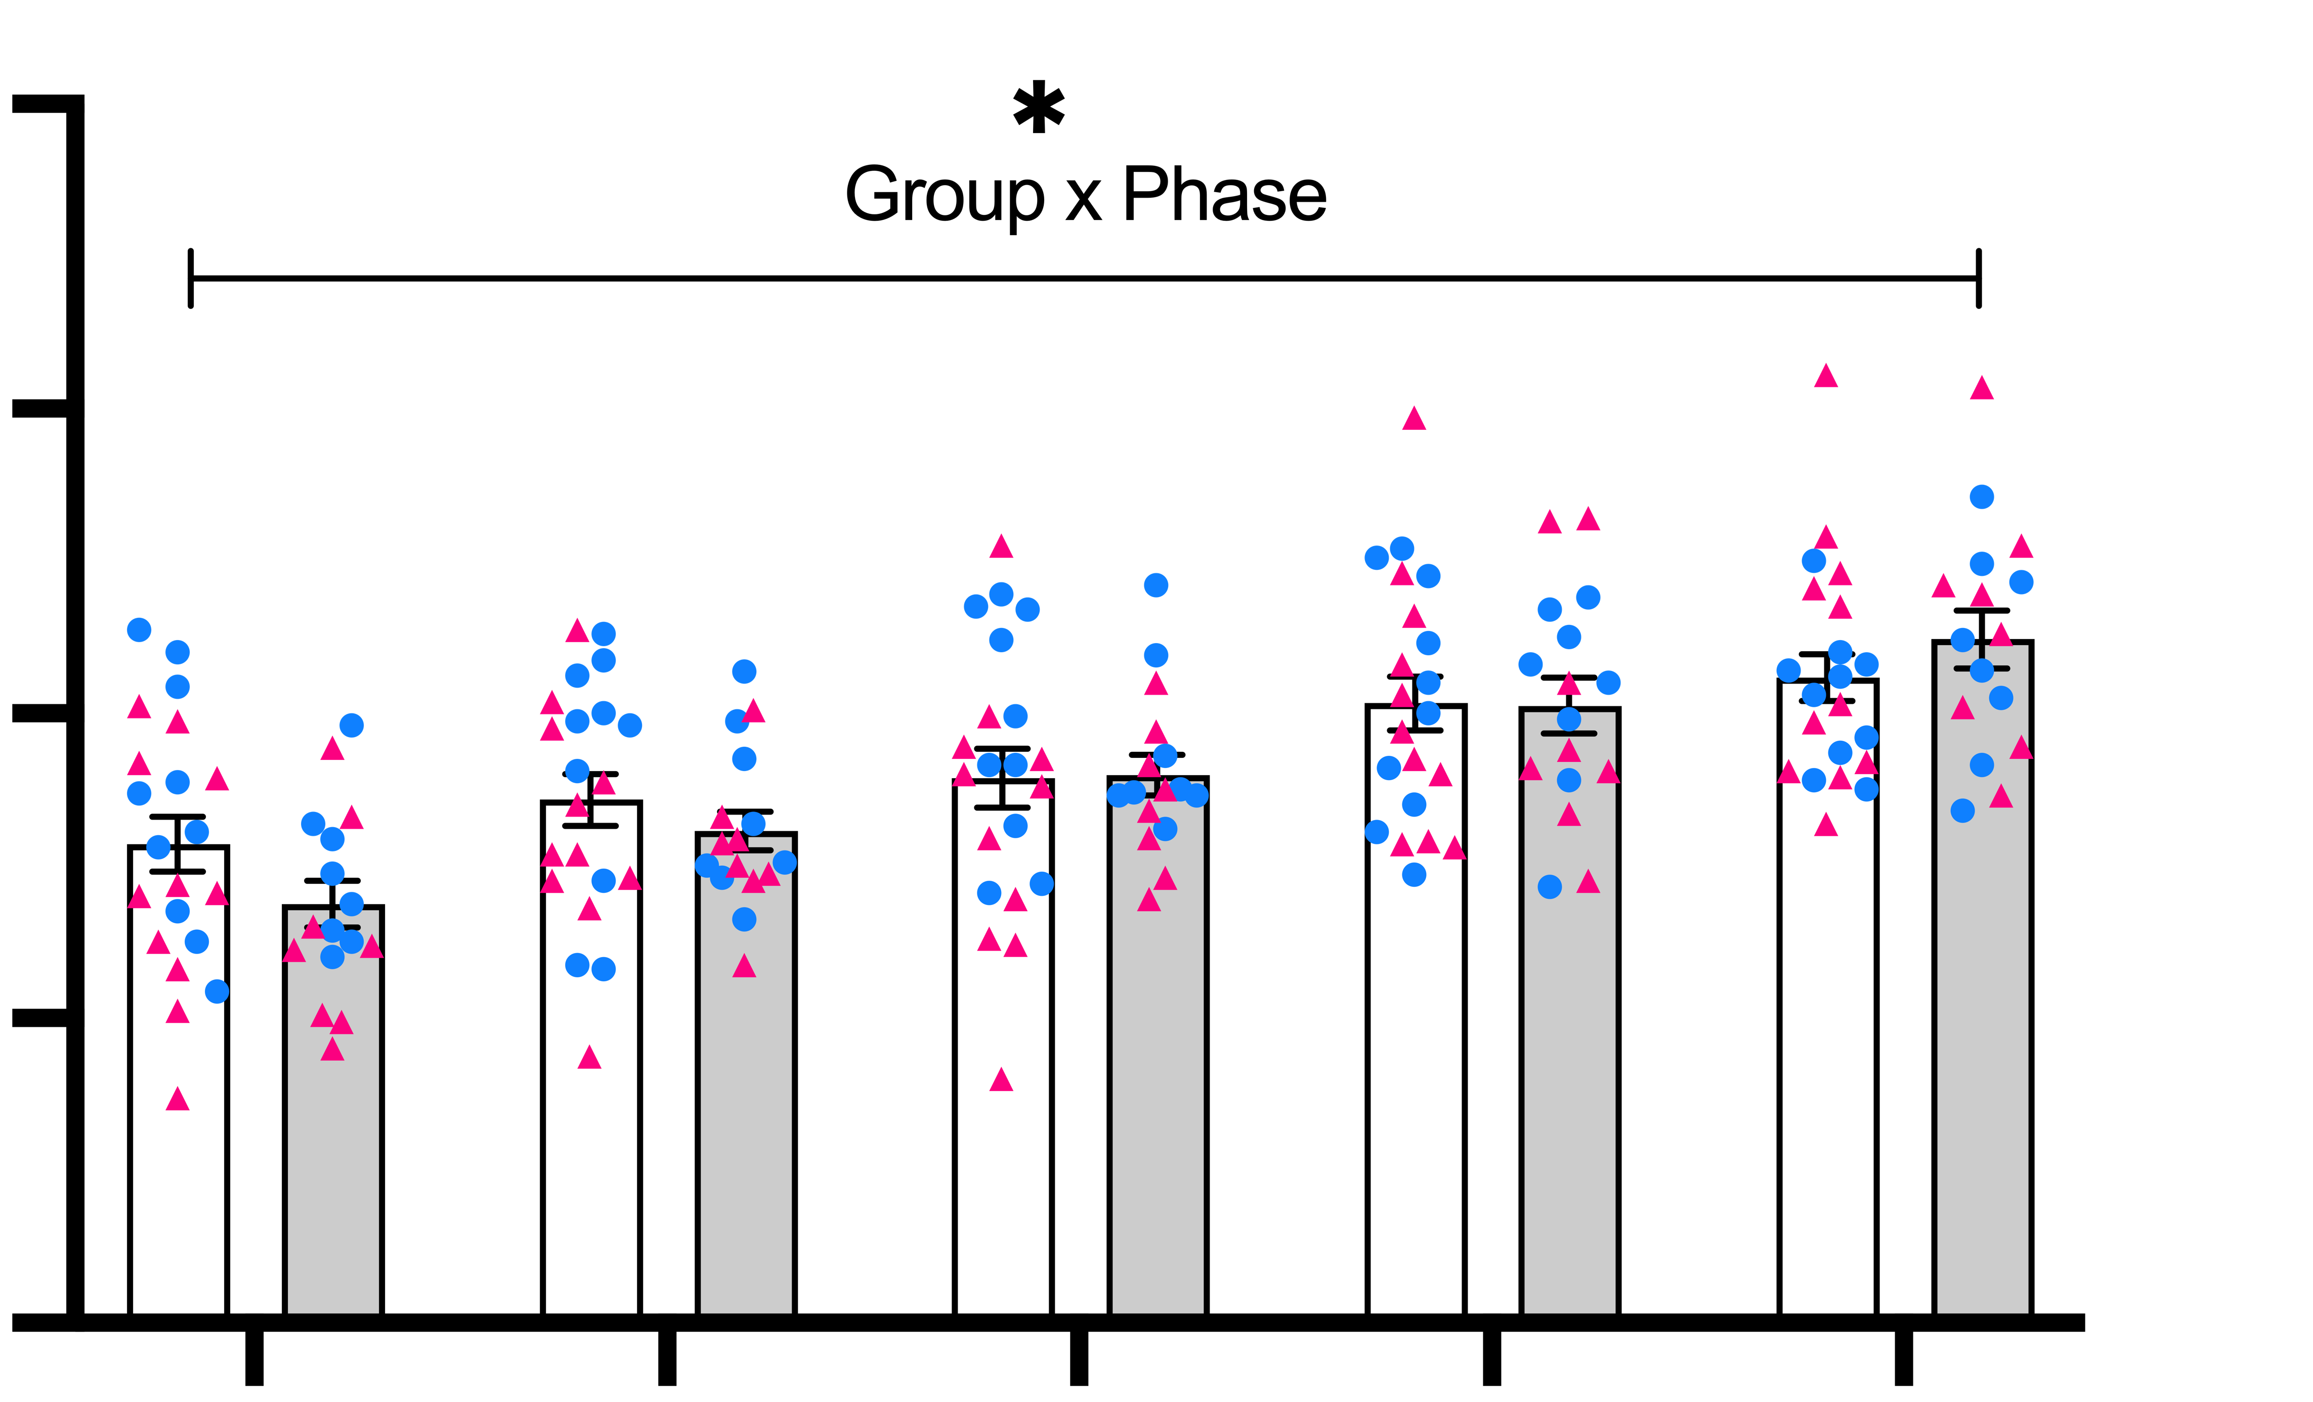
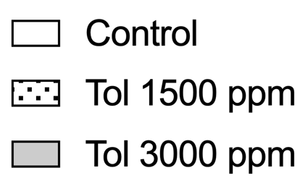
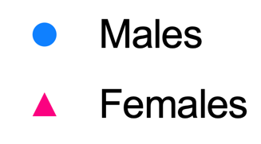
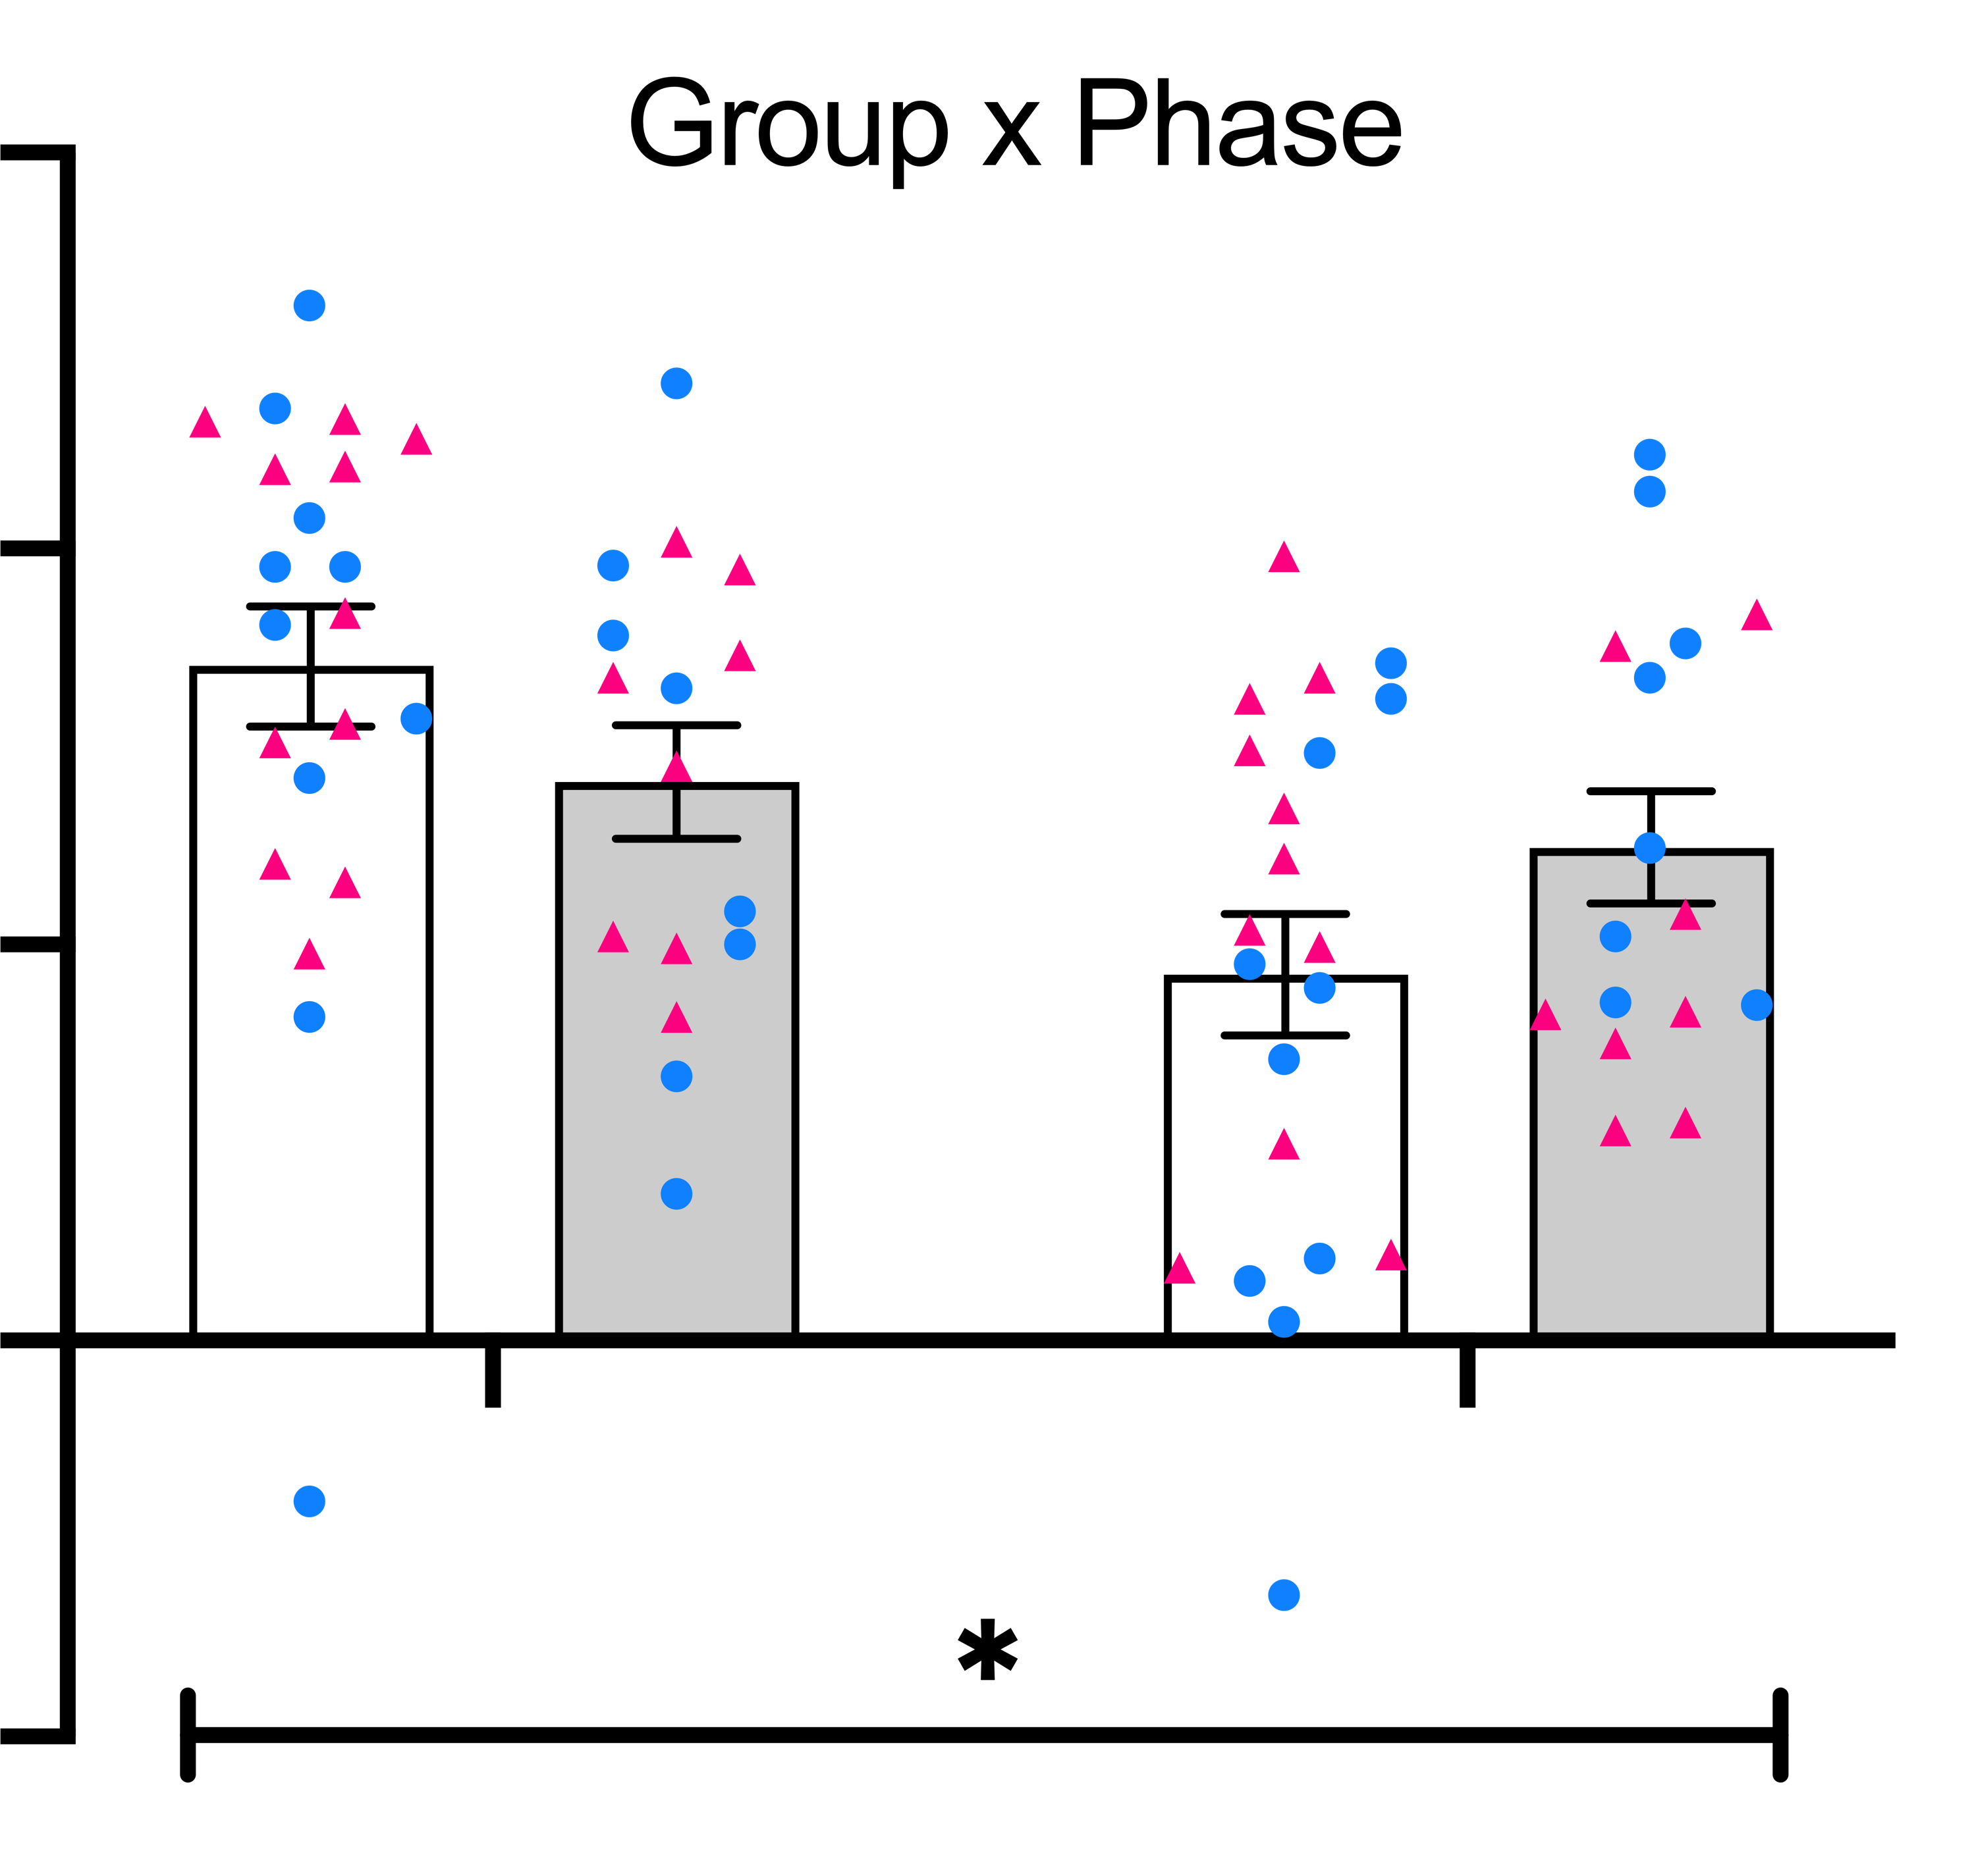
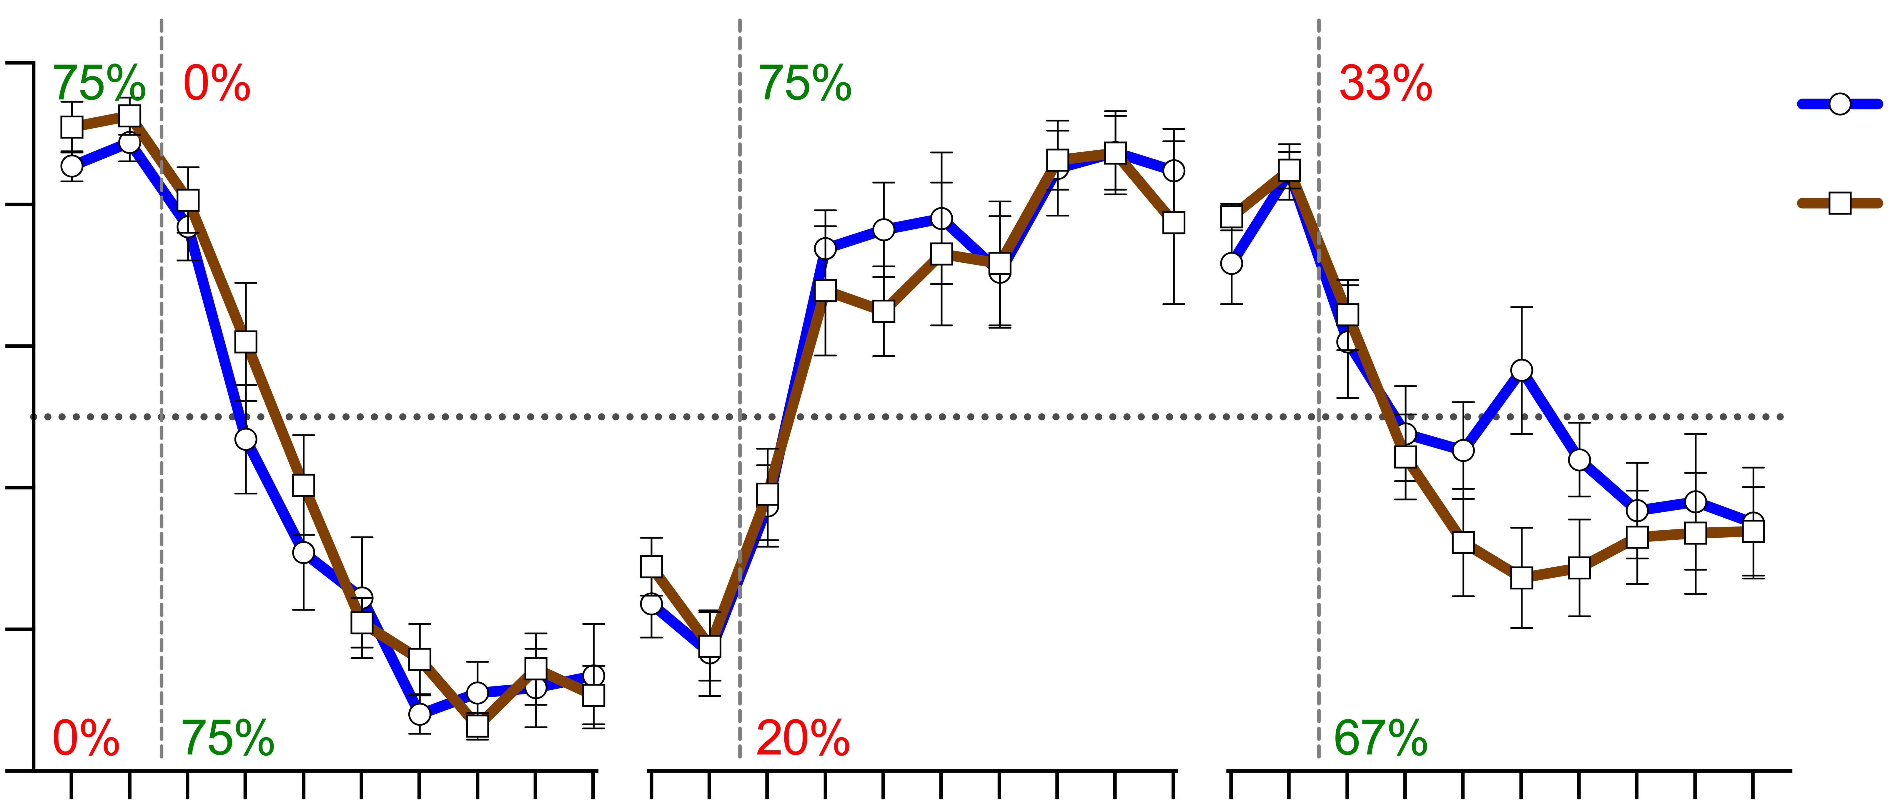
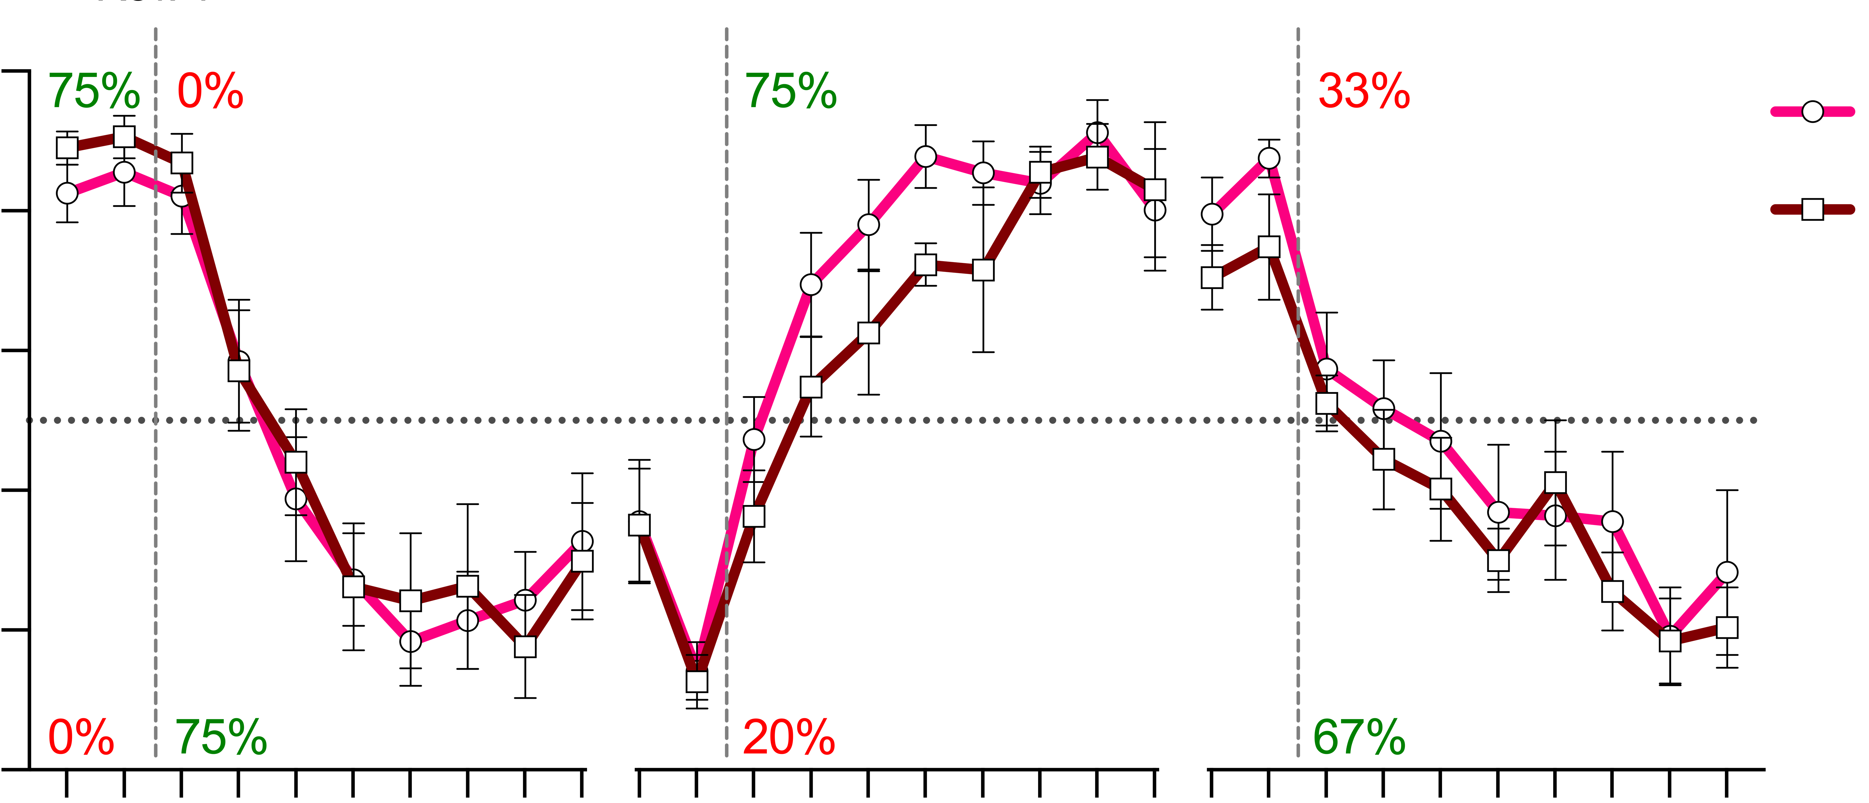
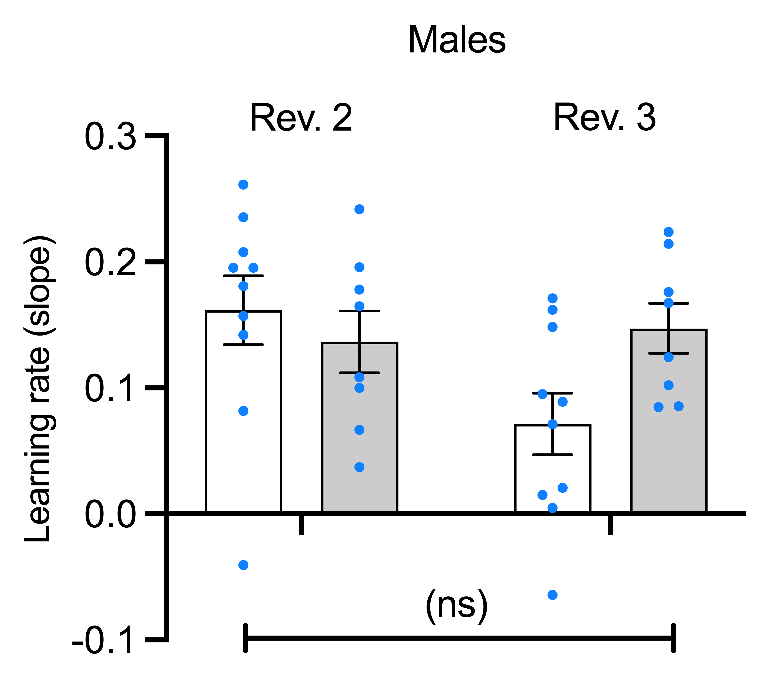
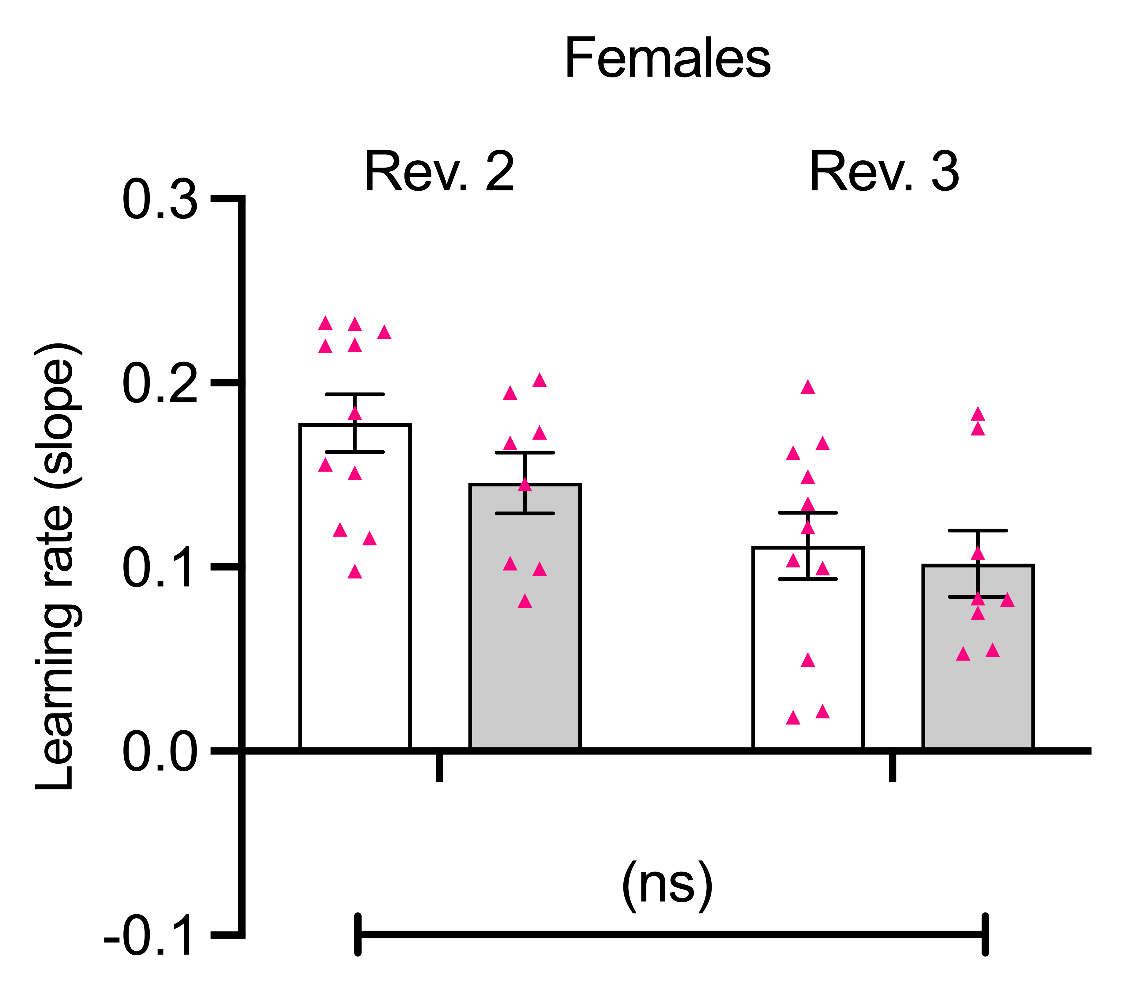
A
40
30
Control
Toluene
Total presses per min
20
10
2
3
4
5
6
Test day
B
0.3
Rev. 2
Rev. 3
0.2
0.1
Learning rate (slope)
0.0
-0.1
C
Males
D
Females
1.0
Rev. 1
Rev. 2
Rev. 3
Control
1.0
Rev. 1
Rev. 2
Rev. 3
Control
0.8
Toluene
0.8
Toluene
0.6
0.6
Bar preference score
(ns)
Bar preference score
0.4
0.4
(ns)
0.2
0.2
min
1
2
3
4
5
6
7
8
9
10
1
2
3
4
5
6
7
8
9
10
1
2
3
4
5
6
7
8
9
10
mins
1
2
3
4
5
6
7
8
9
10
1
2
3
4
5
6
7
8
9
10
1
2
3
4
5
6
7
8
9
10
E
Day 4
Day 5
Day 6
F
Day 4
Day 5
Day 6

