Slide 1
Supplemental Figures
Article Title: Polyclonal antibodies targeting defined epitopes on cancer biomarker MUC16
Journal: Analytical and Bioanalytical Chemistry
Authors: Spencer E. Moffitt, Anubhuti Srivastava, Naviya Schuster-Little, Caitlin R. McEntee, Jane C. March, Chien-Wei Wang, Danielle R. Dotson, Holly V. Goodson, and Rebecca J. Whelan*
*Corresponding author: rwhelan1@ku.edu, University of Kansas Department of Chemistry

Slide 2
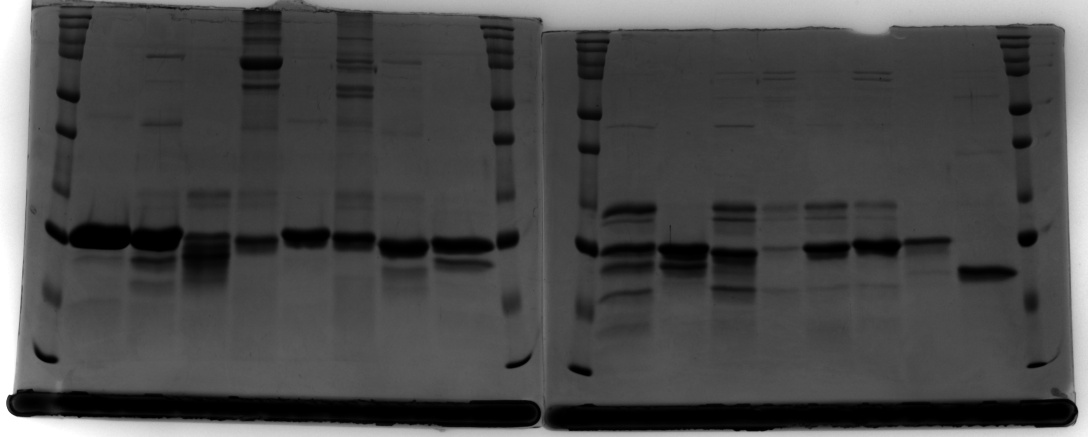
Figure S1
Ladder
Ladder
Ladder
Ladder
R10
R12
R13
R15
R16
kDa
250
150
100
75
50
37
25
20
15
10
R1
R2
R3
R4
R5
R6
R7
R8
R9
R11
R17
kDa
250
150
100
75
50
37
25
20
15
10
kDa
250
150
100
75
50
37
25
20
15
10
50
37
25
20
50
37
25
20
Notes:
Figure S1. Coomassie blue stained gel image confirmation of expressed and purified recombinant repeat proteins. 5 µg of purified protein was inputted into a 12% polyacrylamide gel and run at 150 V for 75 minutes. Following separation, the gel was stained with Coomassie Brilliant blue R-250 (Bio-Rad) and visualized on an Azure 400 imaging system (Azure, Dublin, CA).

Slide 3
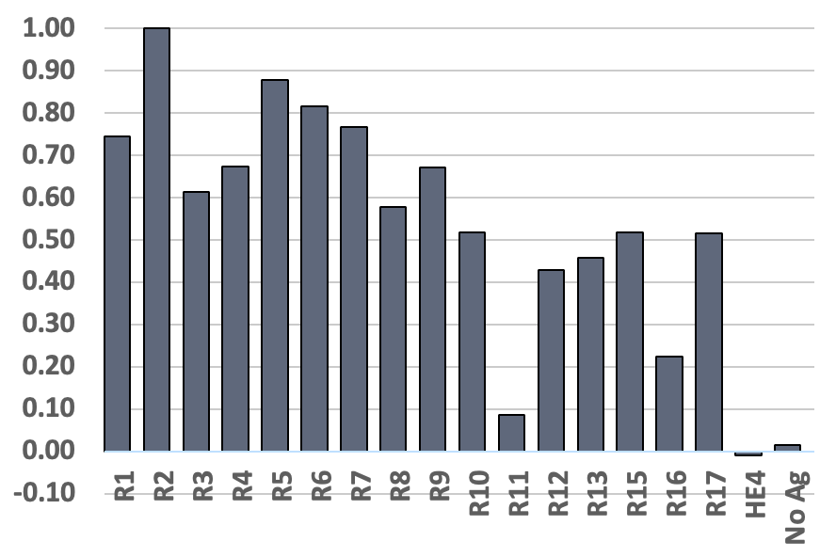
Figure S2
Notes:
Figure S2. Comparison of the binding of pre- and post-immunization sera. The increase in the signal from the mean 2B post-immunization ELISA signal compared to the mean 2B pre-immunization ELISA signal generally matches the 2B purified antibody ELISA binding pattern (n=2).

Slide 4
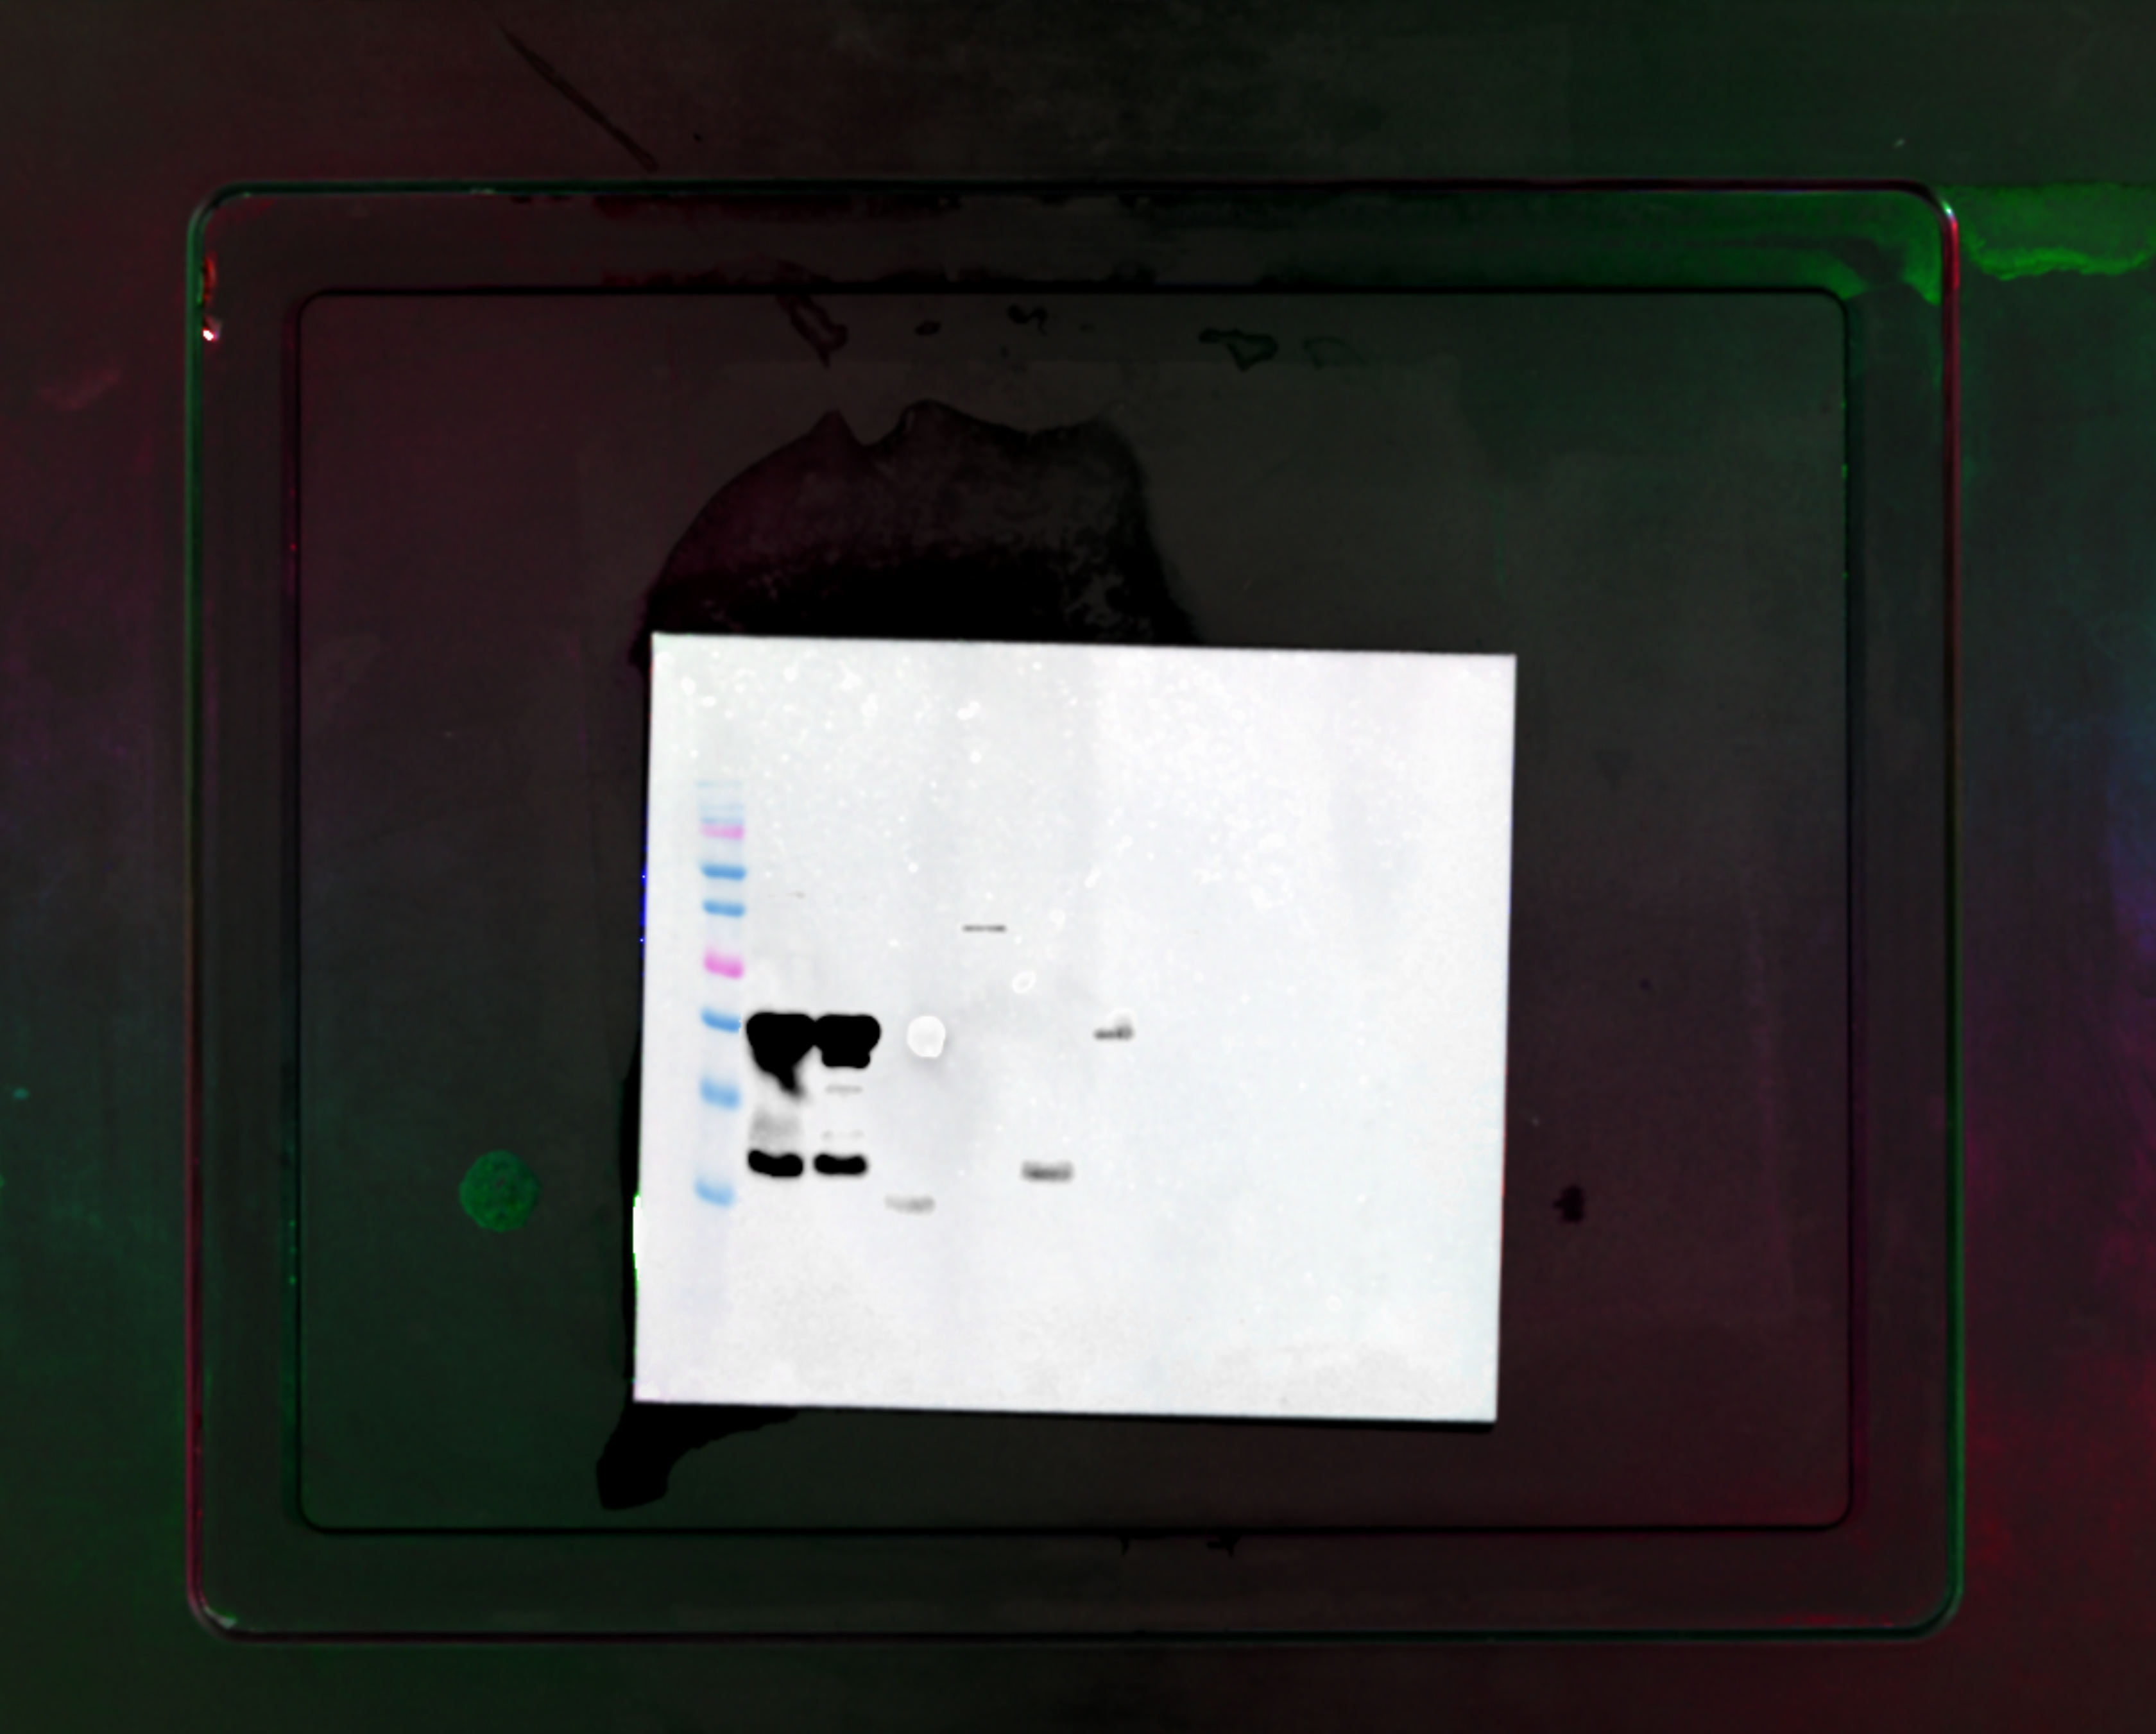
Figure S3
Notes:
Figure S3. Uncropped Western blot corresponding to Figure 6A, left panel, showing the interaction between polyclonal antibody 1A and repeats R1 through R8

Slide 5
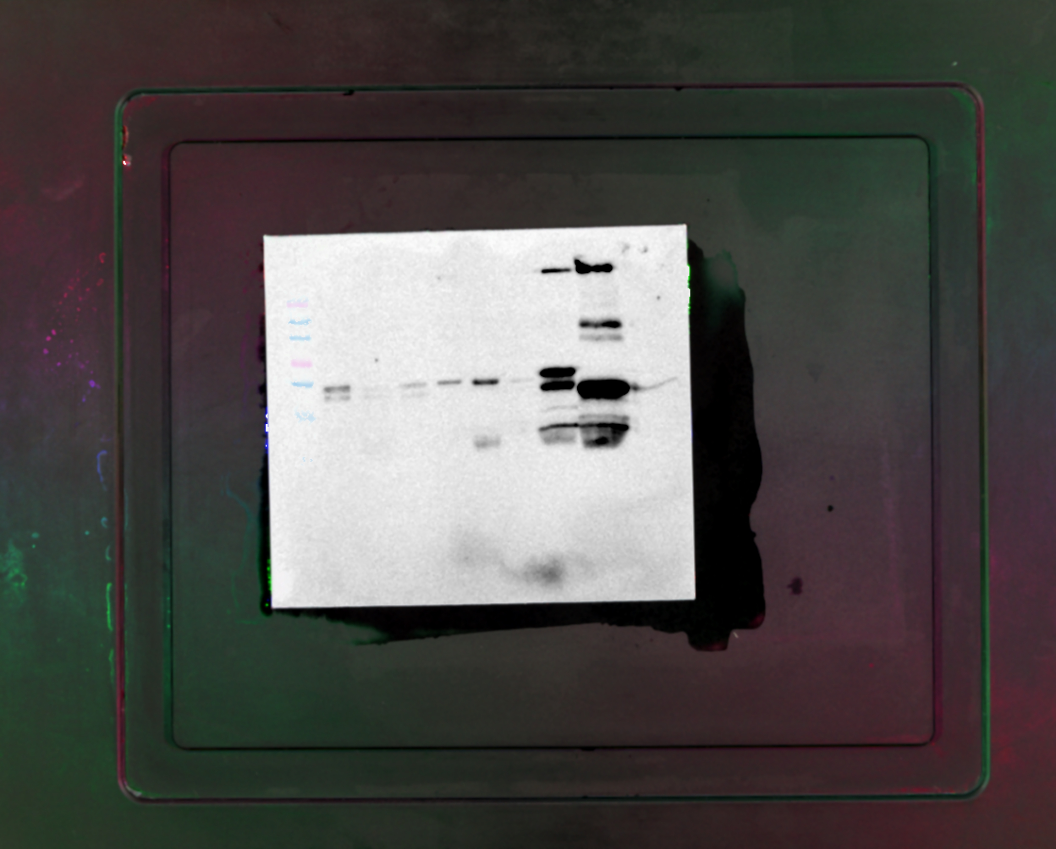
Figure S4
Notes:
Figure S4. Uncropped Western blot corresponding to Figure 6A, right panel, showing the interaction between polyclonal antibody 1A and repeats R9 through R17

Slide 6
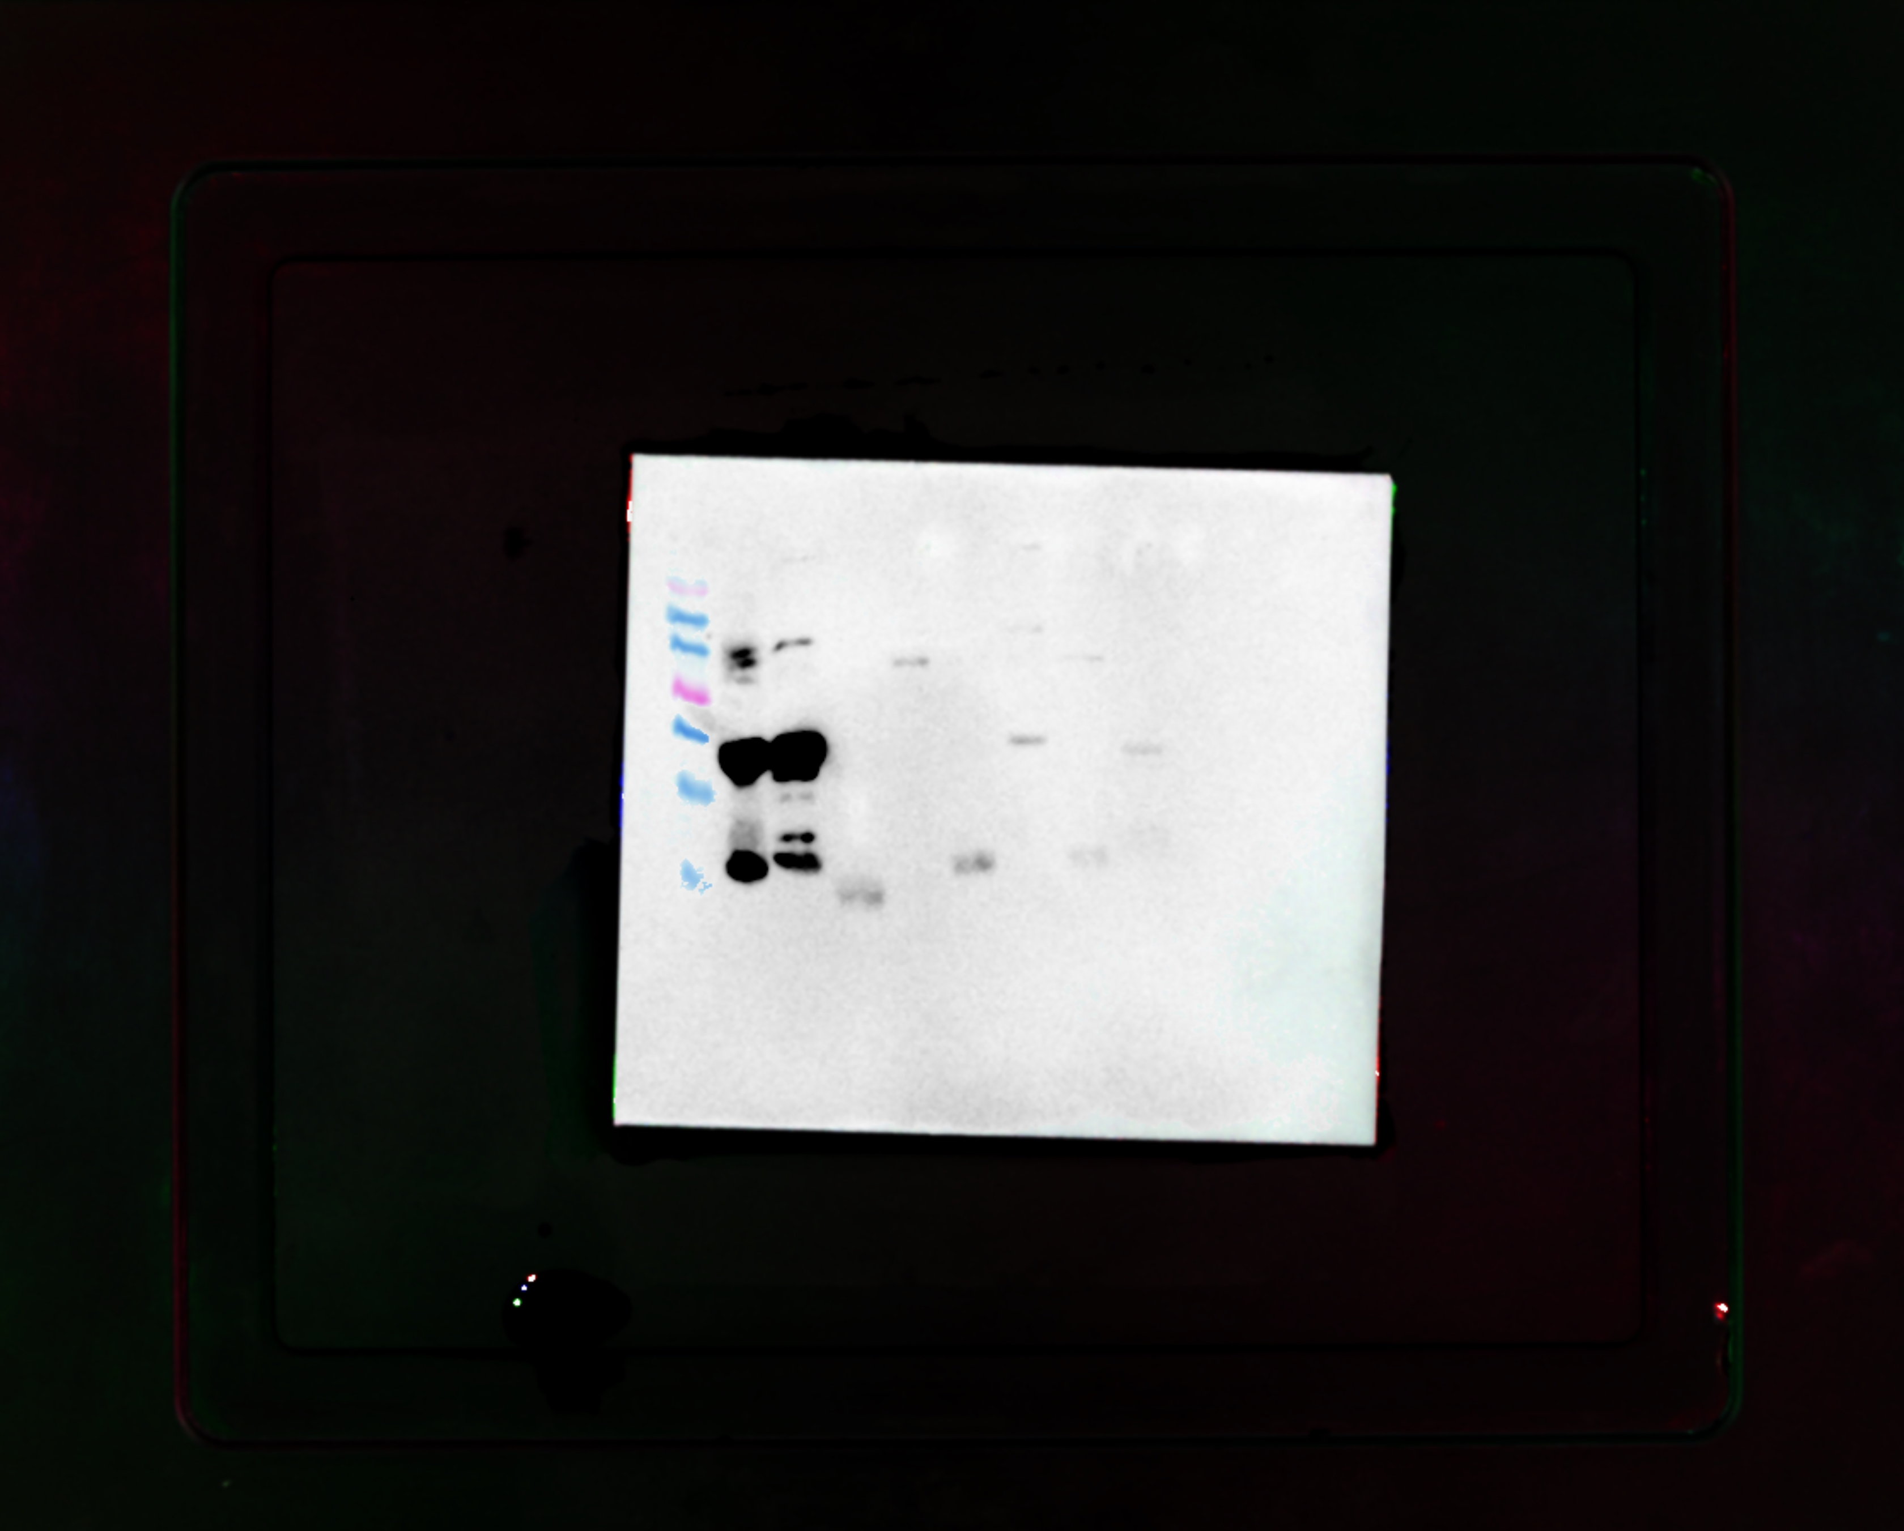
Figure S5
Notes:
Figure S5. Uncropped Western blot corresponding to Figure 6B, left panel, showing the interaction between polyclonal antibody 1B and repeats R1 through R8

Slide 7
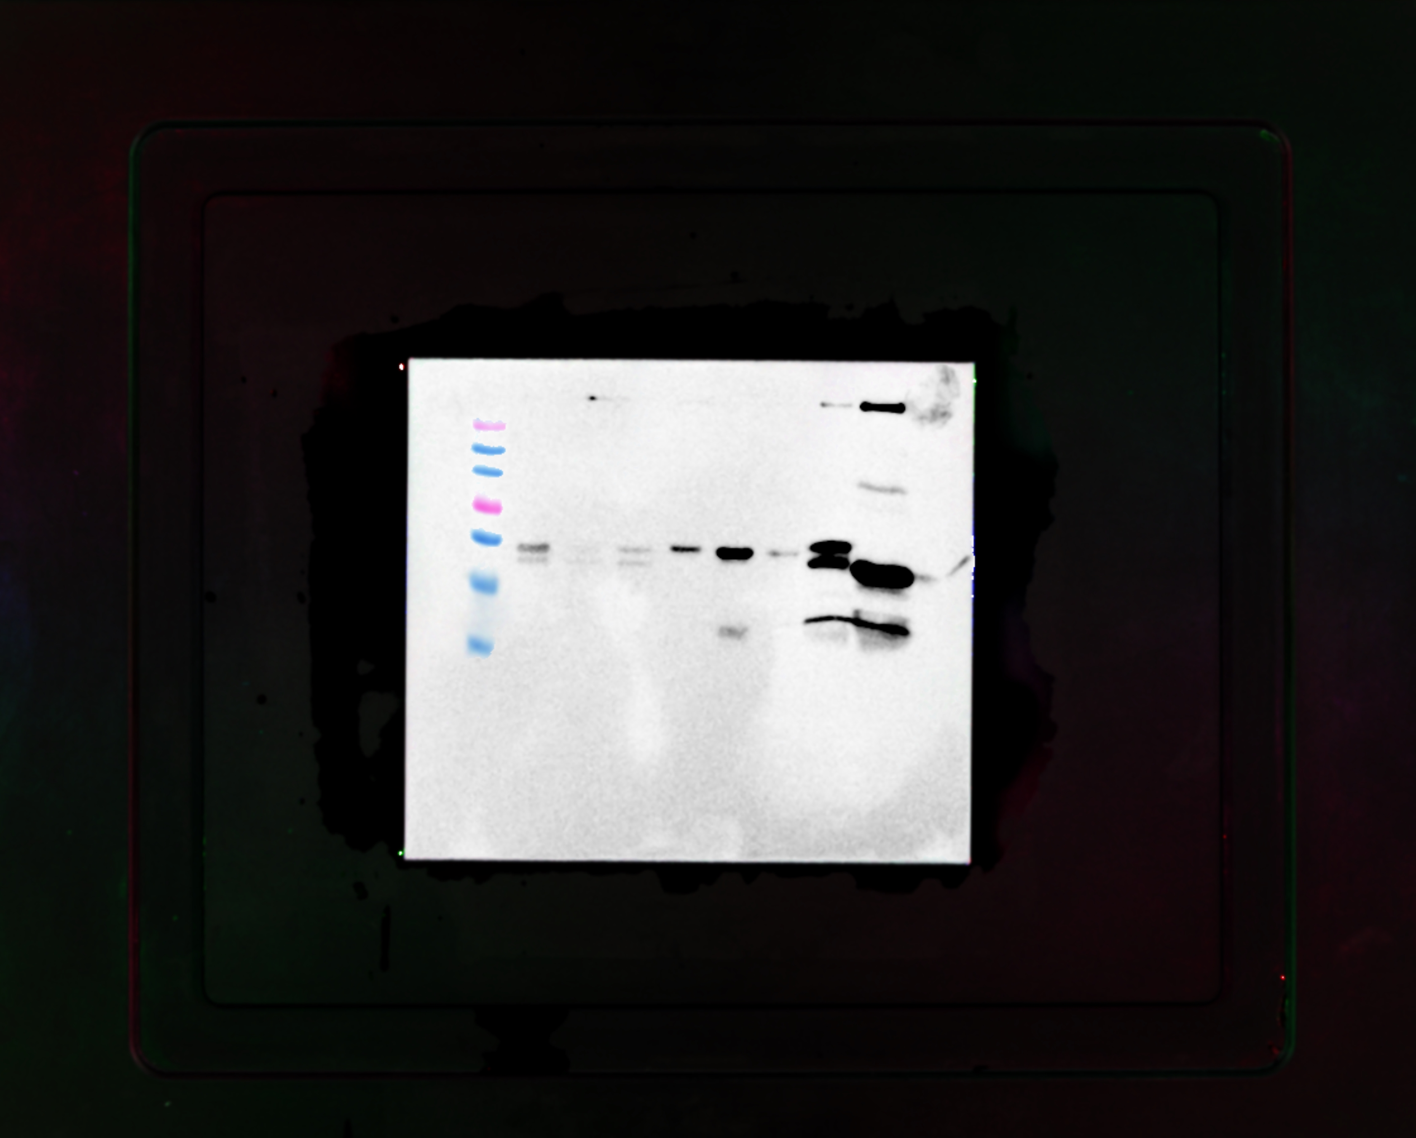
Figure S6
Notes:
Figure S6. Uncropped Western blot corresponding to Figure 6B, right panel, showing the interaction between polyclonal antibody 1B and repeats R9 through R17

Slide 8
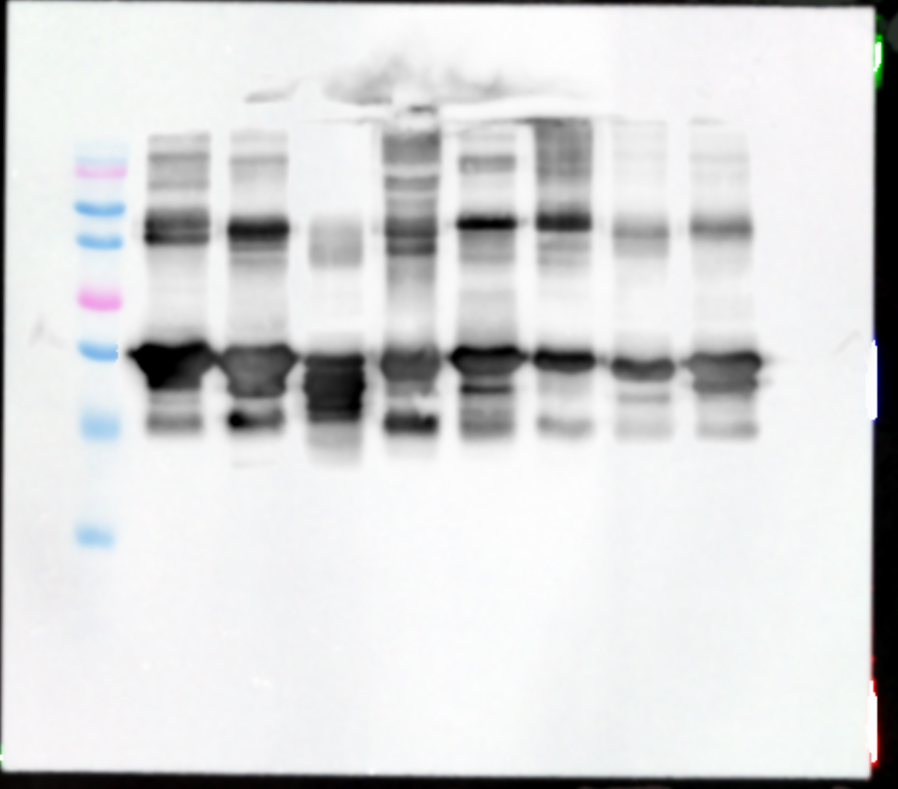
Figure S7
Notes:
Figure S7. Uncropped Western blot corresponding to Figure 6C, left panel, showing the interaction between polyclonal antibody 2A and repeats R1 through R8

Slide 9
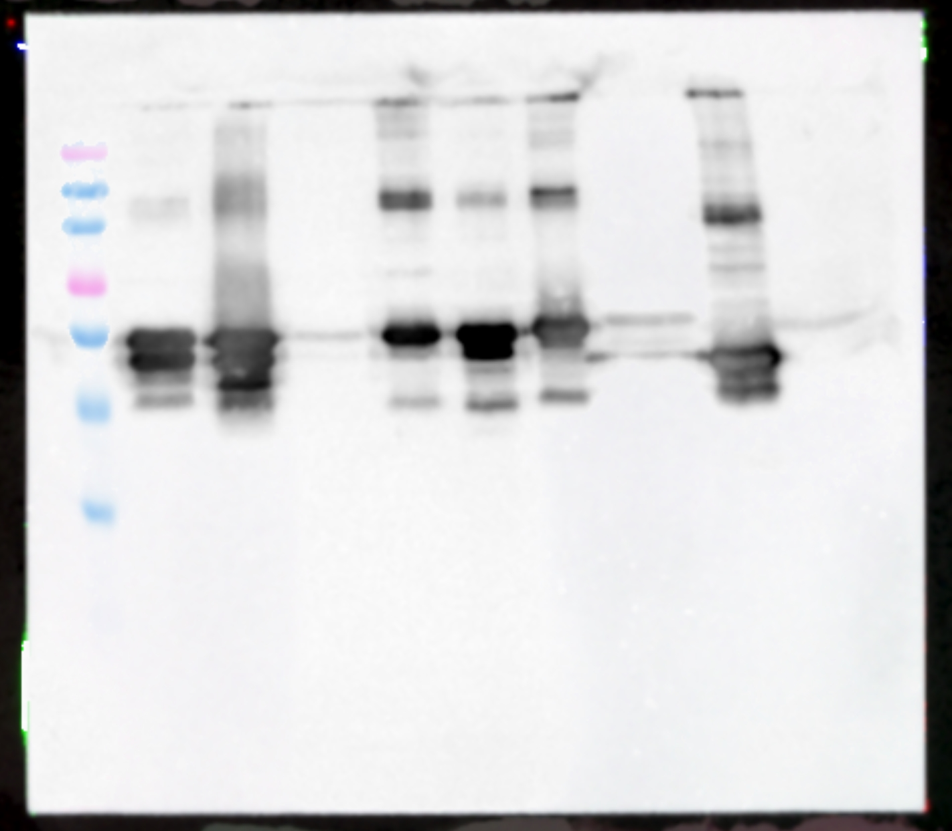
Figure S8
Notes:
Figure S8. Uncropped Western blot corresponding to Figure 6C, right panel, showing the interaction between polyclonal antibody 2A and repeats R9 through R17

Slide 10
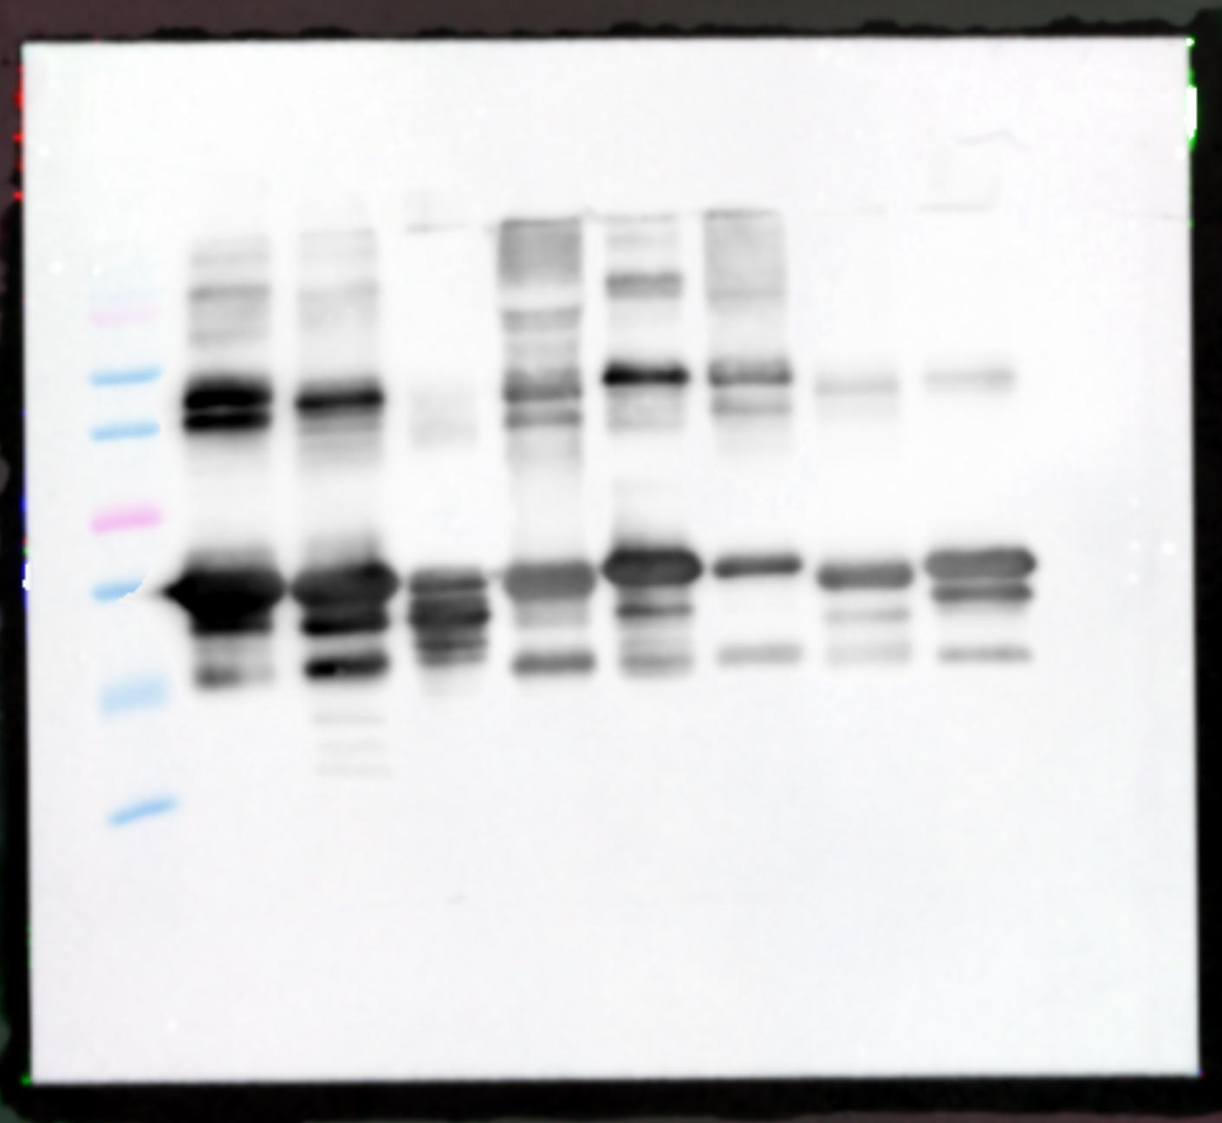
Figure S9
Notes:
Figure S9. Uncropped Western blot corresponding to Figure 6D, left panel, showing the interaction between polyclonal antibody 2B and repeats R1 through R8

Slide 11
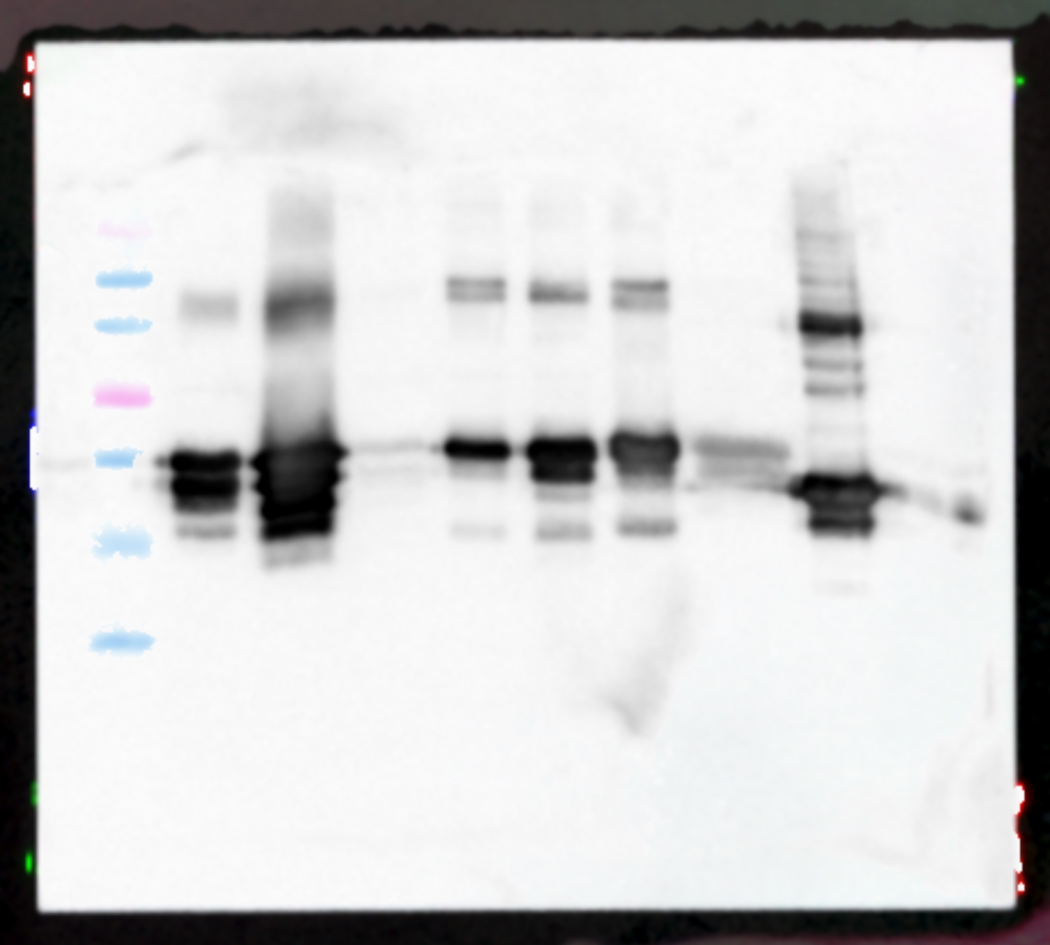
Figure S10
Notes:
Figure S10. Uncropped Western blot corresponding to Figure 6D, right panel, showing the interaction between polyclonal antibody 2B and repeats R9 through R17

Slide 12
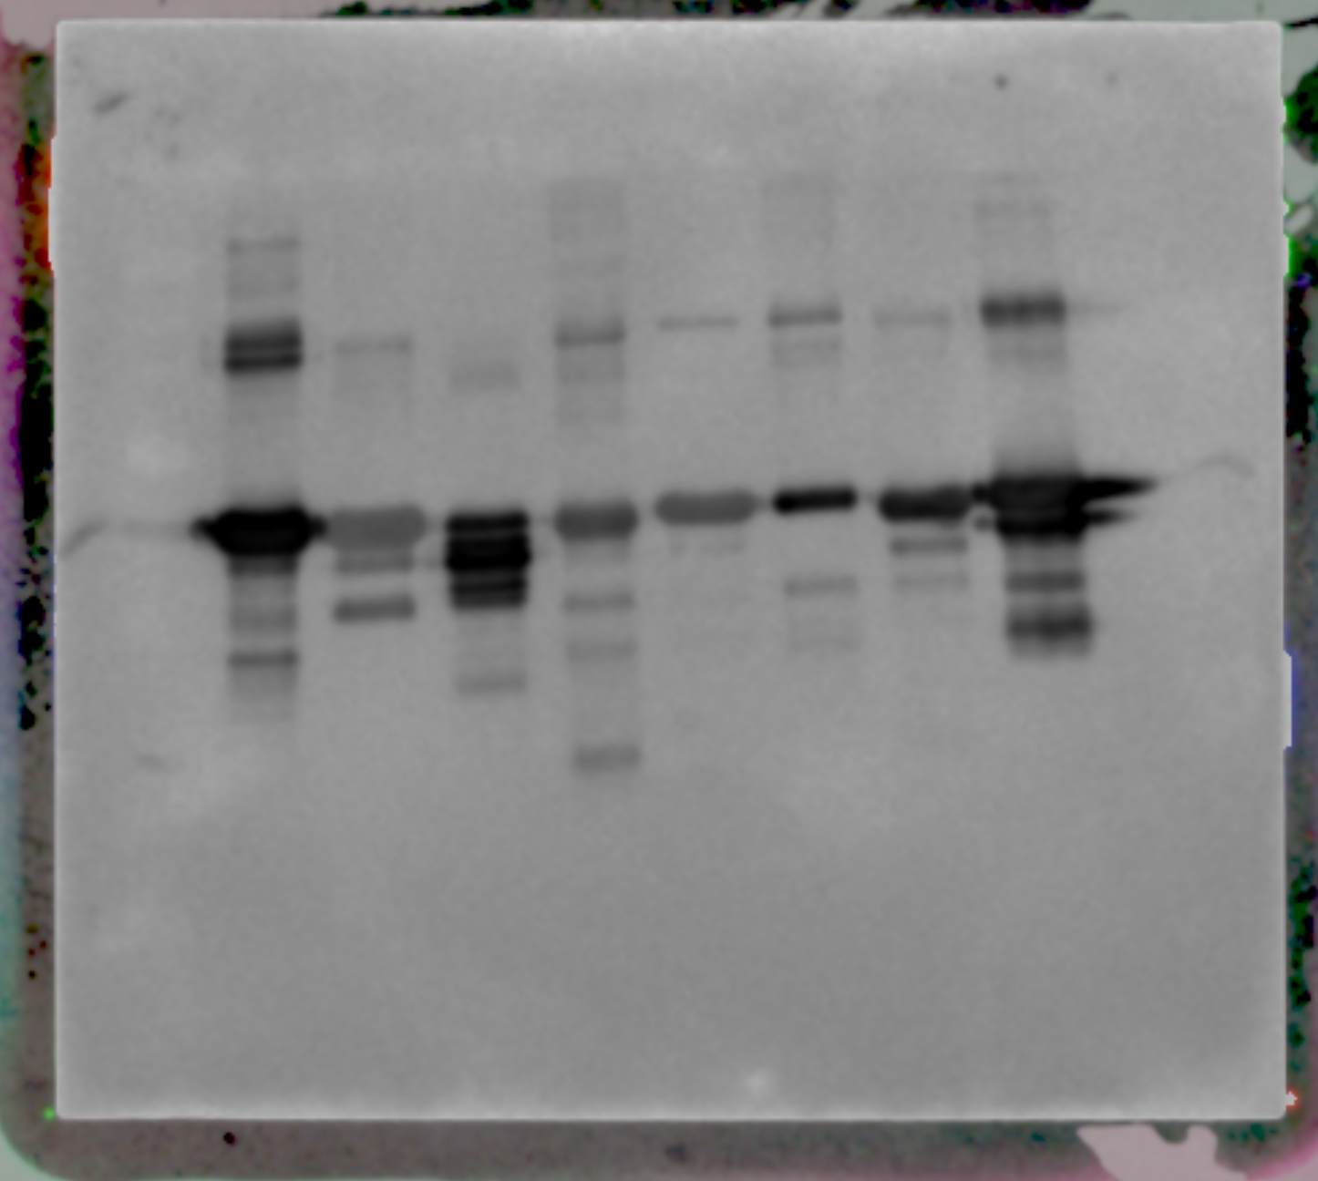
Figure S11
Notes:
Figure S11. Uncropped Western blot corresponding to Figure 6E, left panel, showing the interaction between polyclonal antibody 3A and repeats R1 through R8

Slide 13
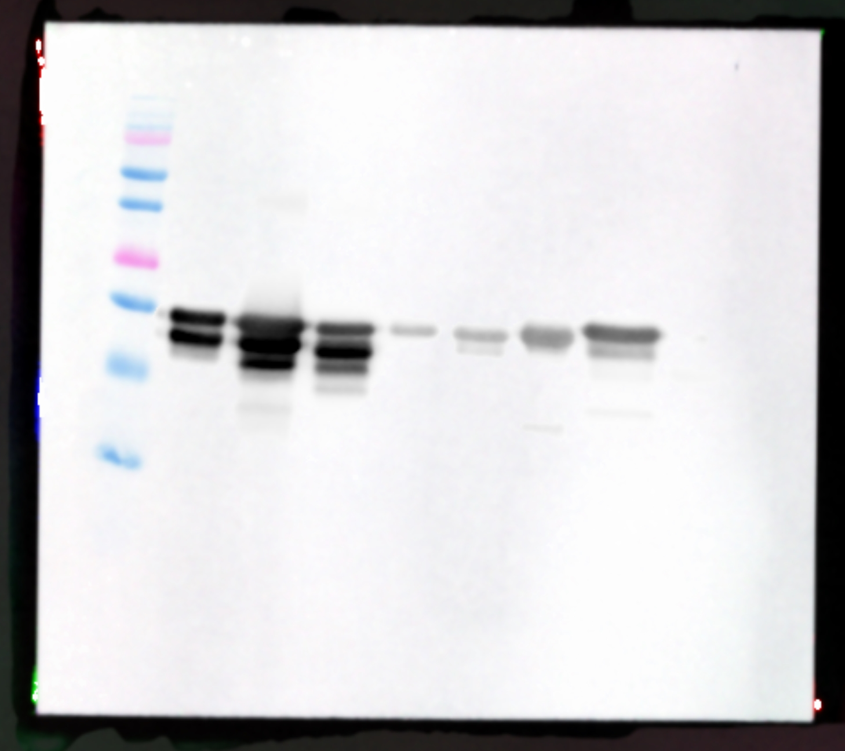
Figure S12
Notes:
Figure S12. Uncropped Western blot corresponding to Figure 6E, right panel, showing the interaction between polyclonal antibody 3A and repeats R9 through R17

Slide 14
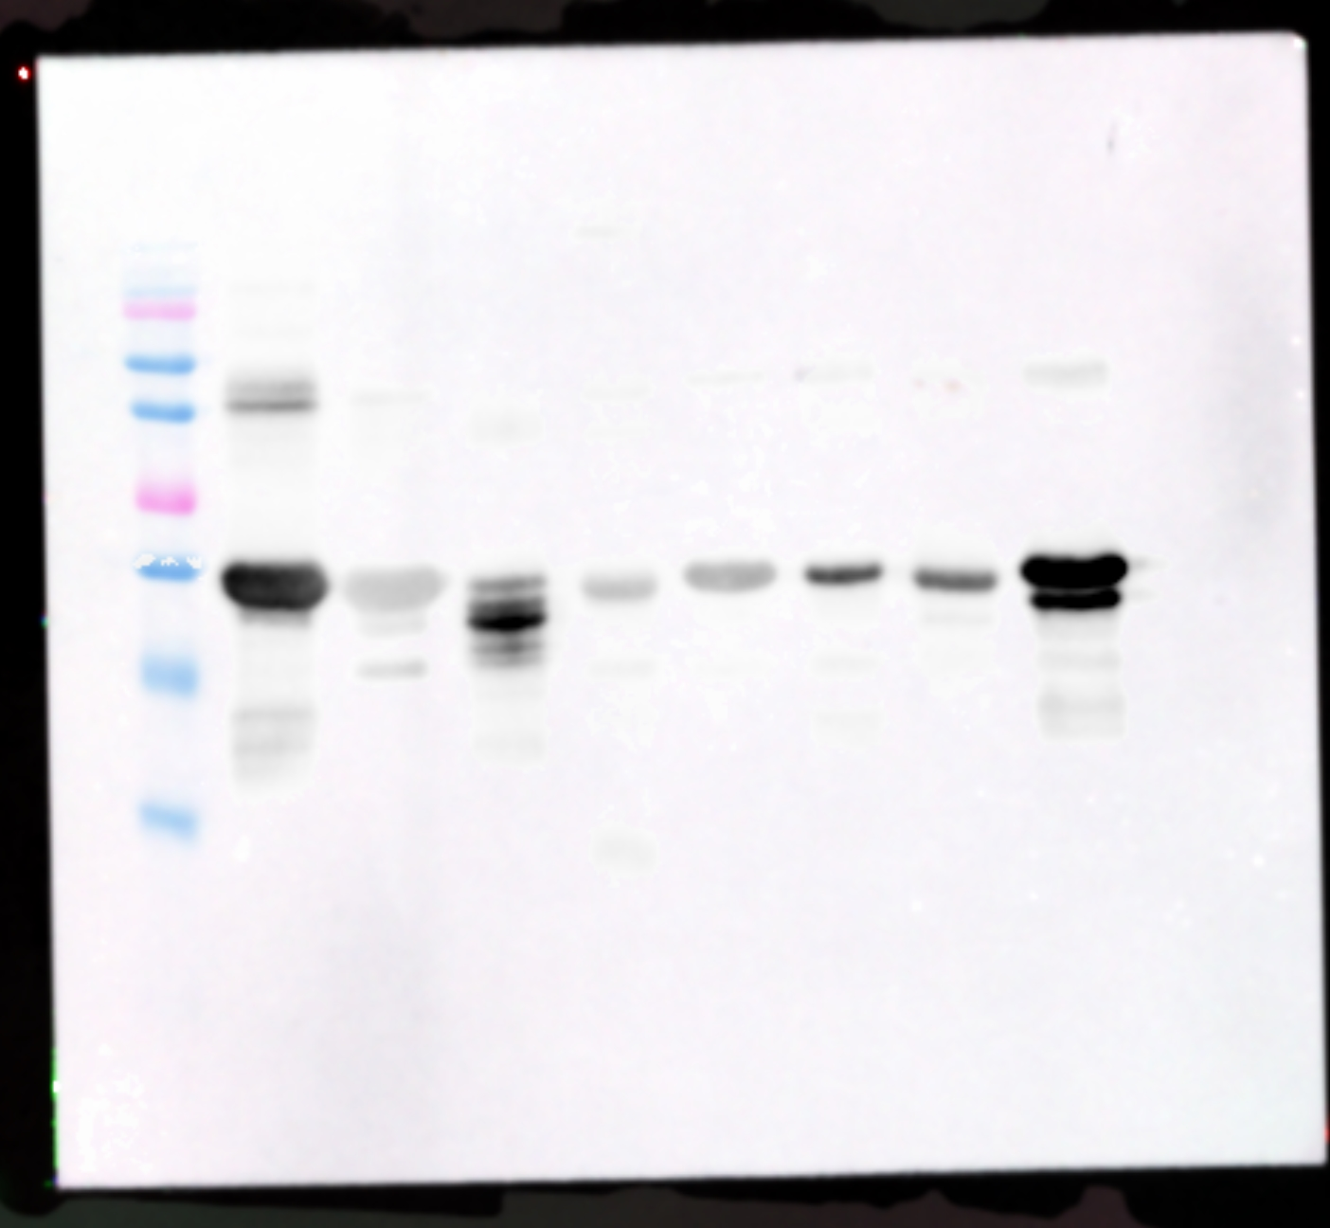
Figure S13
Notes:
Figure S13. Uncropped Western blot corresponding to Figure 6F, left panel, showing the interaction between polyclonal antibody 3B and repeats R1 through R8

Slide 15
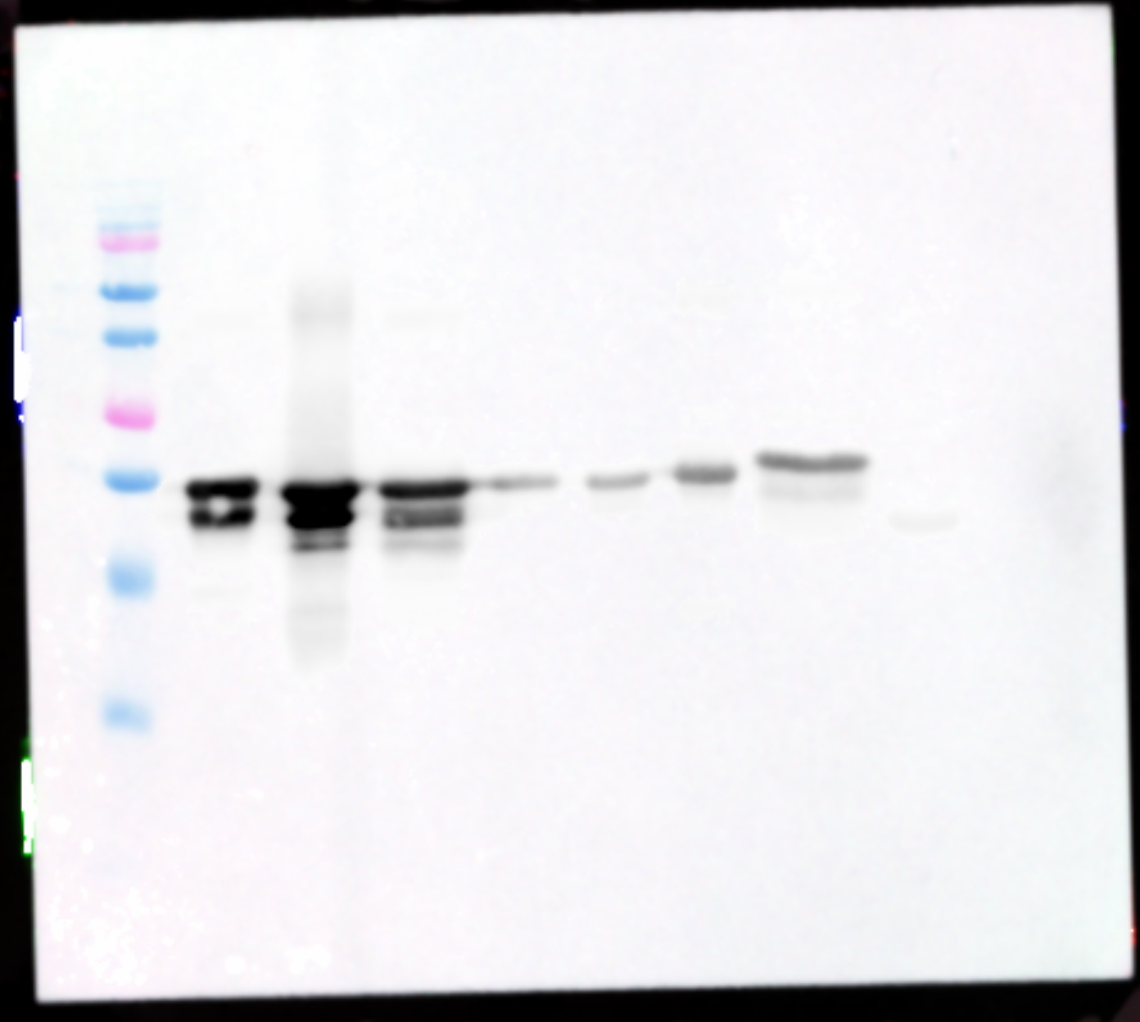
Figure S14
Notes:
Figure S14. Uncropped Western blot corresponding to Figure 6F, right panel, showing the interaction between polyclonal antibody 3B and repeats R9 through R17

Slide 16
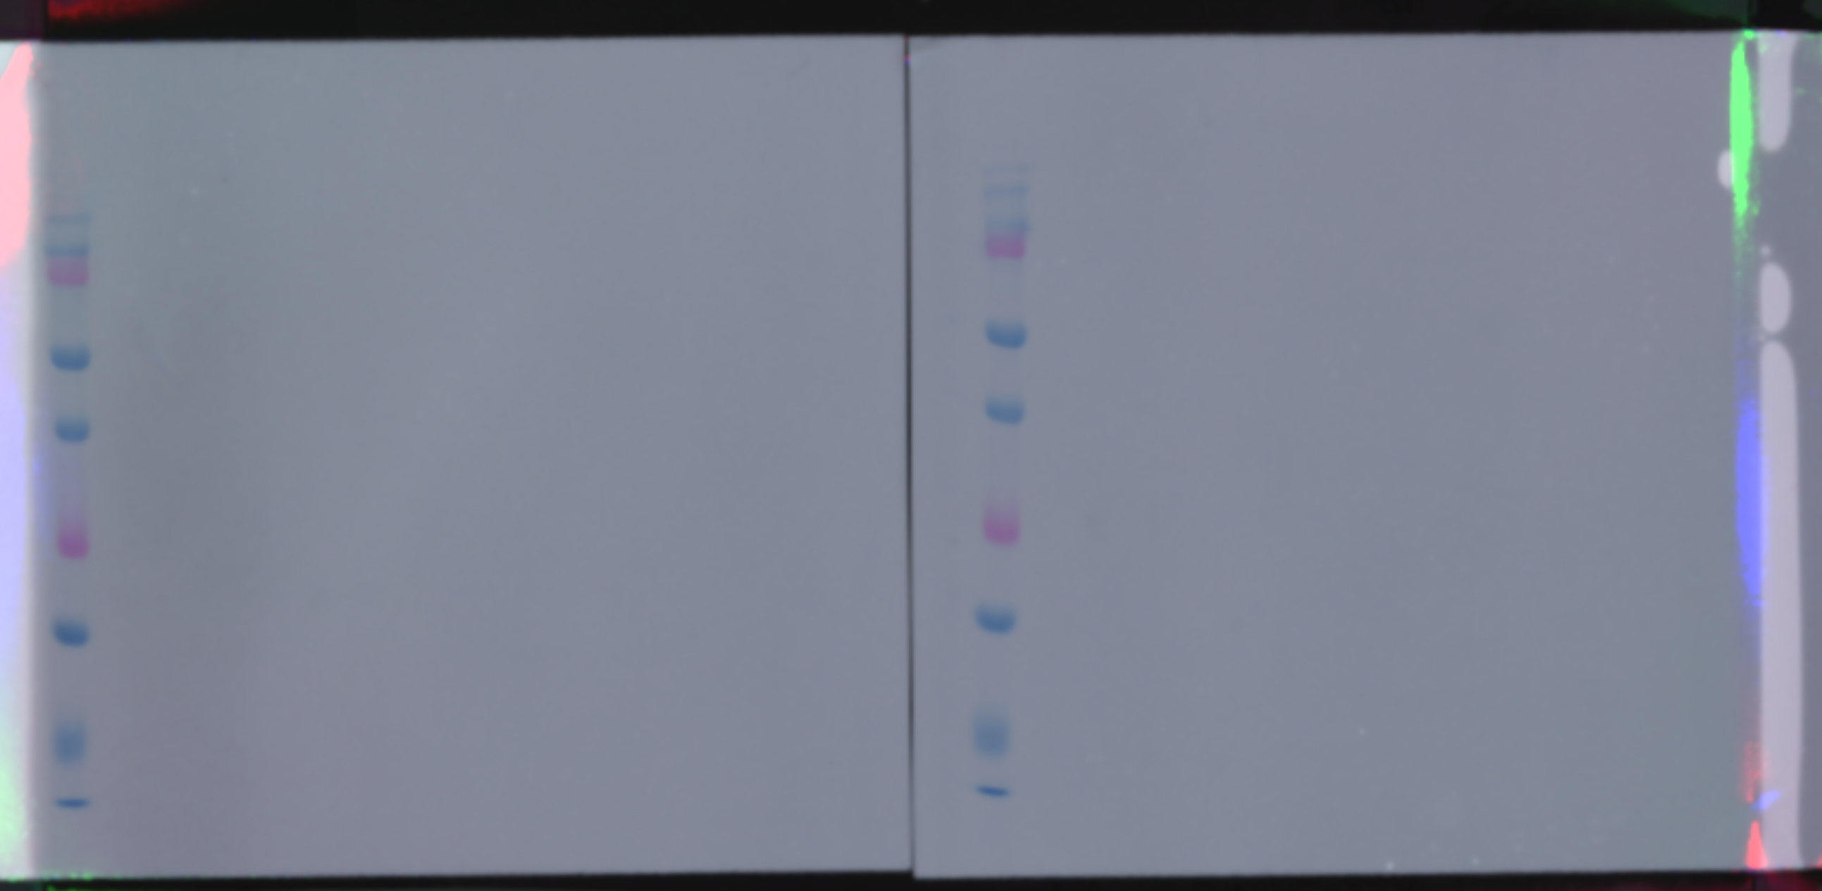
Figure S15
Ladder
Ladder
R10
R12
R13
R15
R16
R1
R2
R3
R4
R5
R6
R7
R8
R9
R11
R17
kDa
250
150
100
75
50
37
25
20
15
10
kDa
250
150
100
75
50
37
25
20
15
10
Notes:
Figure S15. Western blot confirmation of no nonspecific interactions of the secondary anti-mouse HRP antibody. Proteins were separated by 12% SDS-PAGE at 150V for 75 minutes and transferred to a polyvinylidene difluoride membrane. The membrane was blocked with 5% non-fat milk in TBST buffer (Tris-buffered saline with 0.05% Tween-20) at room temperature for 1 hour and then incubated with anti-mouse HRP-conjugated secondary antibody (Thermo, 62-6520, 1:5000) at room temperature for 1 hour. Pierce ECL Western Blotting Substrate (Thermo, Waltham, MA) was used to detect specific bands on an Azure 400 imager.

Slide 17
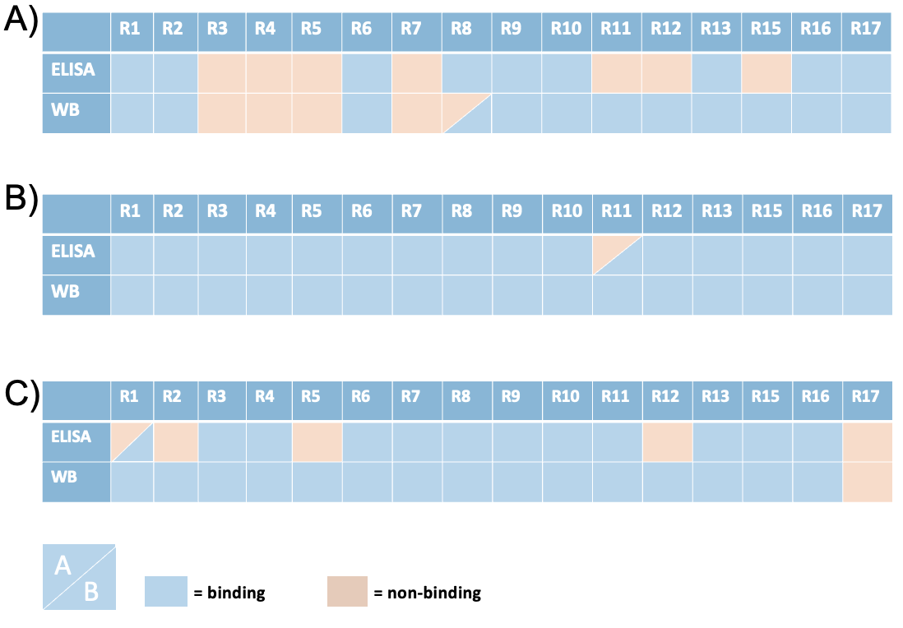
Figure S16
Notes:
Figure S16. Comparison of analytical methods. Binding patterns generated from ELISA and Western blot for the A and B antibodies are nearly identical, with only three instances of binding patterns differing between the two analytical methods. Shown are the ELISA and western blot binding patterns for A) antibody 1, B) antibody 2, and C) antibody 3. Blue designates binding; pink shows non-binding.

