Slide 1
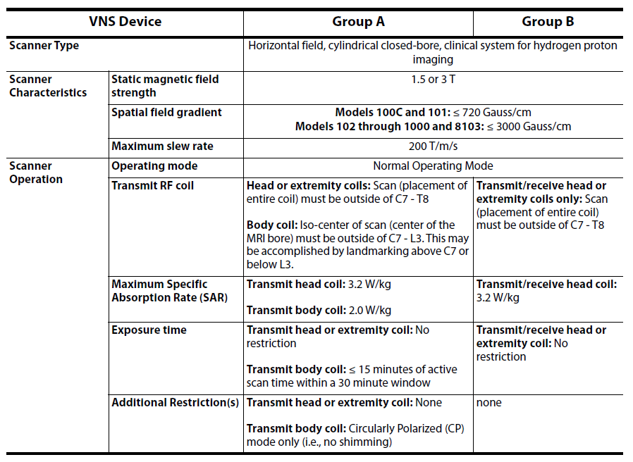
Supplementary materials: Figure 1: Summary of Conditional MR Use. Excerpt from the LivaNova PLC MRI Labelling (MRI with the VNS Therapy® System; page 8; October 2019).

