Slide 1
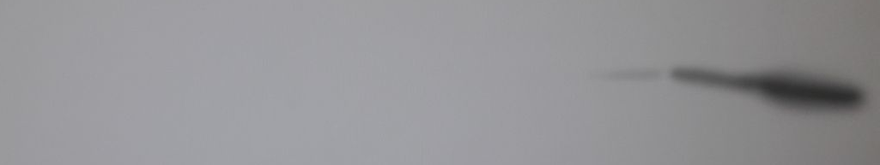
S. arenaria SAG 2562
S. costaricana
C. reinhardtii
Supplementary Fig. S1 Western blot showing no detection of the protein LHCSR3 in species
Streptosarcina arenaria SAG 2562 and Streptosarcina costaricana. Chlamydomonas reinhardtii
was used as a control.

