Slide 1
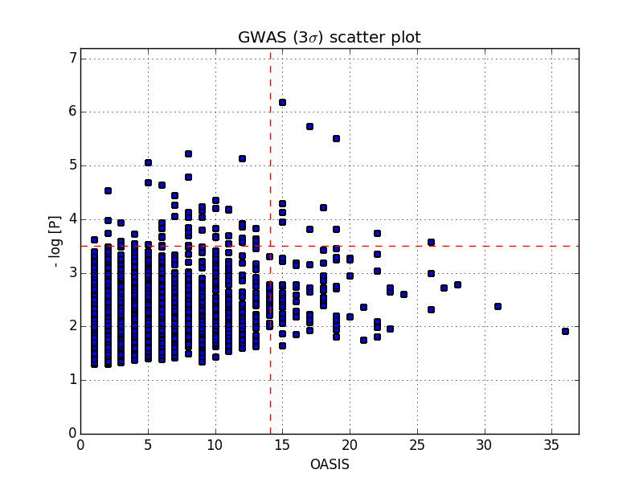
OASIS
Quadrants
A – Positive in both PLINK 3-sigma rule and OASIS
B
A
B – Positive in standard PLINK analysis using 3-sigma rule (also novel)
C – Positive in OASIS only (totally novel)
D – is the discarded
group of SNPs
D
C
Quadrants
B: High –log[P] only
A: High oasis and –log[P]
C: High Oasis only

