Slide 1
Component | Company | Catalog No. | Stock Concentration
RSPO1 supernatant | Prepared in house | n/a | n/a
Noggin supernatant | Prepared in house | n/a | n/a
Wnt3a supernatant | Prepared in house | n/a | n/a
IGF-1 | Biolegend | 590908 | 100 μg/mL
Matrigel | Corning | 356238 | n/a
B27 | Invitrogen | 17504001 | 50x
AdDMEM/F12 | Invitrogen | 12634010 | n/a
HEPES | Invitrogen | 15630080 | 1M
Glutamax-1 | Invitrogen | 35050061 | 100x
Penicillin-Streptomycin | Invitrogen | 15140122 | 10000 units/mL
EGF | Invitrogen | PHG0311 | 50 μg/mL
Primocin | Invivogen | Ant-Pm-1 | 50 mg/mL
FGF2 | PeproTech | 100-18B | 100 μg/mL
Neuregulin1 | PeproTech | 100-03 | 5 μM
FGF7 | PeproTech | 100-19 | 100 μg/mL
FGF10 | PeproTech | 100-26 | 100 μg/mL
FGF4 | PeproTech | 100-31 | 100 μg/mL
Y-27632 | Selleckchem | S1049 | 10 mM
NAC | Sigma Aldrich | A9165 | 500 mM
Gastrin I | Sigma Aldrich | G9145 | 10 μM
SB202190 | Sigma Aldrich | S7067 | 10 mM
Nicotinamide | Sigma Aldrich | S0636 | 1M
A83-01 | Tocris | 2939 | 10 mM
CHIR 99021 | Tocris | 4423 | 5 mM
Tumor Dissociation Kit | Miltenyi Biotec | 130-095-929 | n/a
Dispase II, powder | Gibco | 17105041 | 10 mg/mL
Anti-Anti | Gibco | 15240096 | 10000 U/mL
PGE2 | R&D | 2296 | 20 mM
ACK Lysing Buffer | Lonza | BP10-548E | 1x
TrypLE Express | Gibco | 12605-010 | 1x
SAG | Enzo | ALX-270-426-M001 | 1 mM
Supplementary Table S1. Reagents with manufacturing information

Slide 2
Medium component | Final concentration
Advanced DMEM/F12 | 75%
R-Spondin conditioned medium | 10%
Noggin conditioned medium | 10%
Neuregulin 1 | 5 nM
FGF 7 | 5 ng/mL
FGF 10 | 20 ng/mL
EGF | 5 ng/mL
A83-01 | 500 nM
Y-27632 | 5 μM
SB202190 | 500 nM
B27 supplement | 1x
NAC | 1.25 mM
Nicotinamide | 5 mM
Glutamax | 1x
HEPES | 10 mM
Penicillin-Streptomycin | 100 U/mL
Primocin | 100 μg/mL
Supplementary Table S2. Breast Cancer Media

Slide 3
Medium component | Final concentration
Wnt3a conditioned medium | 50%
Advanced DMEM/F12 | 25%
RSPO1 conditioned medium | 10%
Noggin conditioned medium | 10%
HEPES | 10 mM
Glutamax | 1x
Primocin | 100 μg/mL
Penicillin-Streptomycin | 100 U/mL
NAC | 1 mM
EGF | 50 ng/mL
Gastrin I | 10 nM
IGF-1 | 100 ng/mL
FGF2 | 50 ng/mL
A83-01 | 0.5 μM
B27 | 1x
Y-27632 | 10 μM
Supplementary Table S3. Colorectal Cancer Media

Slide 4
Medium component | Final concentration
Wnt3a conditioned medium | 50%
Advanced DMEM/F12 | 25%
RSPO1 conditioned medium | 10%
Noggin conditioned medium | 10%
HEPES | 10 mM
Glutamax | 1x
Primocin | 100 μg/mL
NAC | 1 mM
EGF | 50 ng/mL
Gastrin I | 10 nM
FGF10 | 100 ng/mL
Nicotinamide | 10 mM
A83-01 | 0.5 μM
PGE2 | 1 μM
B27 | 1x
Y-27632 | 10 μM
Supplementary Table S4. Pancreatic Cancer Media

Slide 5
Medium component | Final concentration
Advanced DMEM/F12 | 84%
Noggin | 10%
Glutamax | 1x
HEPES | 10 mM
B27 | 1x
Anti-Anti | 100 U/mL
FGF 4 | 100 ng/mL
CHIR 99021 | 250 nM
SAG | 100 nM
FGF 10 | 100 ng/mL
EGF | 50 ng/mL
A83-01 | 500 nM
Y-27632 | 10 mM
NAC | 1.25 mM
Penicillin-Streptomycin | 100 U/mL
Supplementary Table S5. NSCLC Media

Slide 6
Medium component | Final concentration
Advanced DMEM/F12 | 35%
Wnt3a conditioned medium | 50%
RSPO1 conditioned medium | 10%
B27 | 1.5%
Penicillin-Streptomycin | 100 U/mL
HEPES | 1%
Glutamax | 1%
NAC | 1 mM
Primocin | 100 ug/mL
FGF10 | 100 ng/mL
Y-27632 | 10 uM
A83-01 | 5 uM
EGF | 50 ng/mL
Supplementary Table S6. RCC Media

Slide 7
A)
Organoid ID | Diagnosis | Tumor site | Primary or Met? | Days to >3e6 cells
4402_008 | BC | Breast | Primary | Not available
4427_001 | BC | Liver | Met | Not available
4433_001 | BC | Lung | Met | Not available
4435_001 | BC | Skin | Met | Not available
4406_001 | CRC | Liver | Met | Not available
4406_002 | CRC | Liver | Met | Not available
4421_001 | CRC | Lung | Met | Not available
4421_002 | CRC | Lung | Met | Not available
4423_001 | CRC | Lung | Met | Not available
4424_001 | CRC | Lung | Met | Not available
4425_001 | CRC | Cervical LN | Met | Not available
4429_001 | CRC | Lung | Met | Not available
4430_001 | CRC | Lung | Met | Not available
4432_001 | CRC | Lung | Met | Not available
4439_001 | CRC | Liver | Met | Not available
4442_001 | CRC | Liver | Met | Not available
4442_002 | CRC | Liver | Met | Not available
4448_001 | CRC | Liver | Met | Not available
4415_001 | PaCa | Lung | Met | Not available
4415_002 | PaCa | Pleura | Met | Not available
4419_001 | PaCa | Lung | Met | Not available
4437_001 | PaCa | Abd wall | Met | Not available
4243_001 | NSCLC | LN | Met | 58
4444_001 | CRC | Liver | Met | 147
4445_001 | CRC | Liver | Met | 90
4447_001 | CRC | Liver | Met | 34
4451_002 | CRC | Liver | Met | 126
4454_001 | CRC | Liver | Met | 21
4455_002 | CRC | Liver | Met | 91
4459_002 | CRC | Liver | Met | 14
4461_002 | CRC | Lung | Met | 25
4464_A | CRC | Lung | Met | 19
4464_B | CRC | Lung | Met | 19
4449_001 | CCA | Liver/bile duct | Met | 36
4457_001 | CCA | Lung | Met | 25
4450_001 | SCC | Liver | Met | 17
4466_001 | EAC | Lung | Met | 32
RCC-1 | RCC | Kidney | Primary | 56
B)
Organoid ID | Diagnosis | Tumor site | Primary or Met?
4428_001 | BC | Lung | Met
4443_001 | BC | Subcutaneous | Met
4420_001 | CRC | Abd LN | Met
4440_001 | CRC | Chest wall | Met
4441_001 | CRC | Liver | Met
4441_002 | CRC | Liver | Met
4451_001 | CRC | Liver | Met
4414_001 | PaCa | Peritoneum | Met
4458_002 | PaCa | Peritoneum | Met
C)
Range of days to >3e6 cells | Median days to >3e6 cells | Overall establishment rate
14-147 | 32 | 38/47
NSCLC: Non-small cell lung carcinoma
BC: Breast carcinoma
CRC: Colorectal carcinoma
PaCa: Pancreatic carcinoma
CCA: Cholangiocarcinoma
SCC: Squamous cell carcinoma (anal)
EAC: Esophageal adenocarcinoma
RCC: Renal cell carcinoma
Supplementary Table S7.
Successful attempts at establishing PDTO
Unsuccessful attempts at establishing PDTO
Summary of successful PDTO timeline

Slide 8
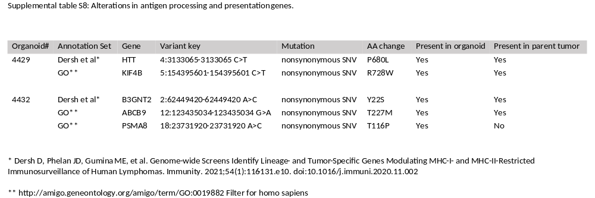

Slide 9
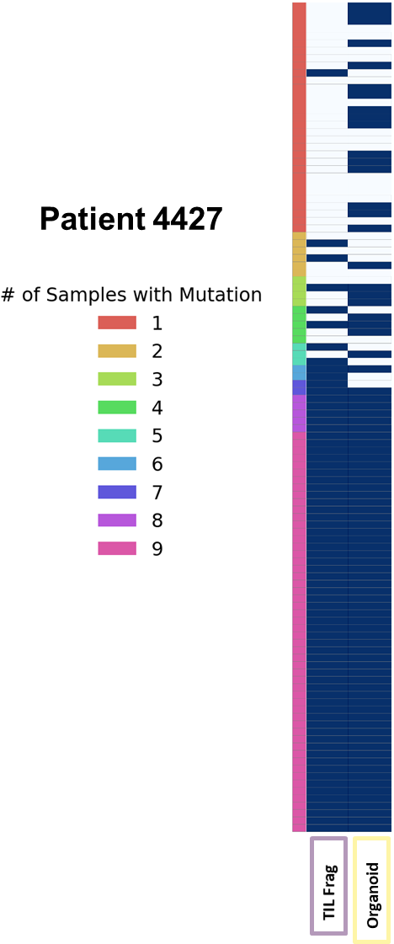
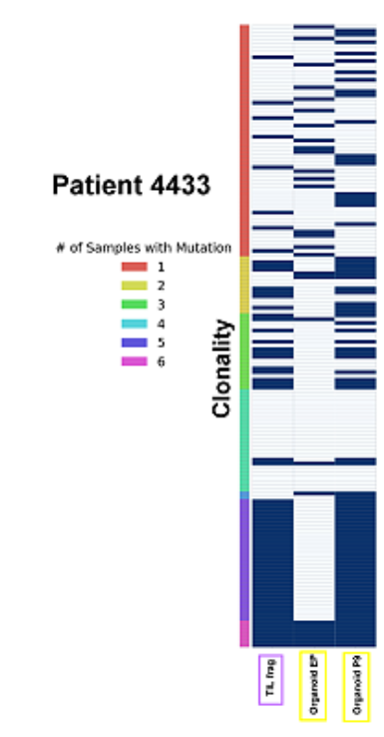
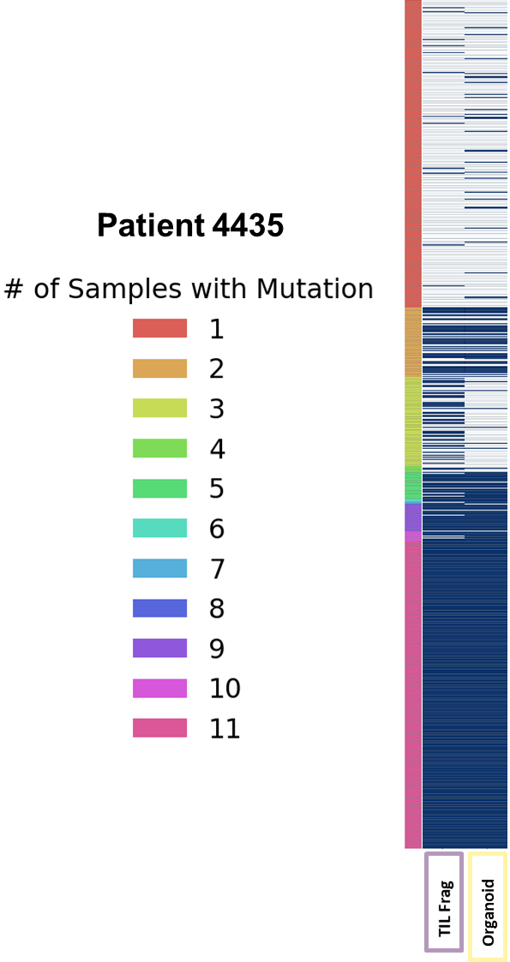
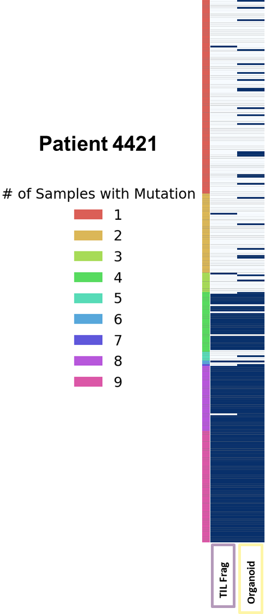

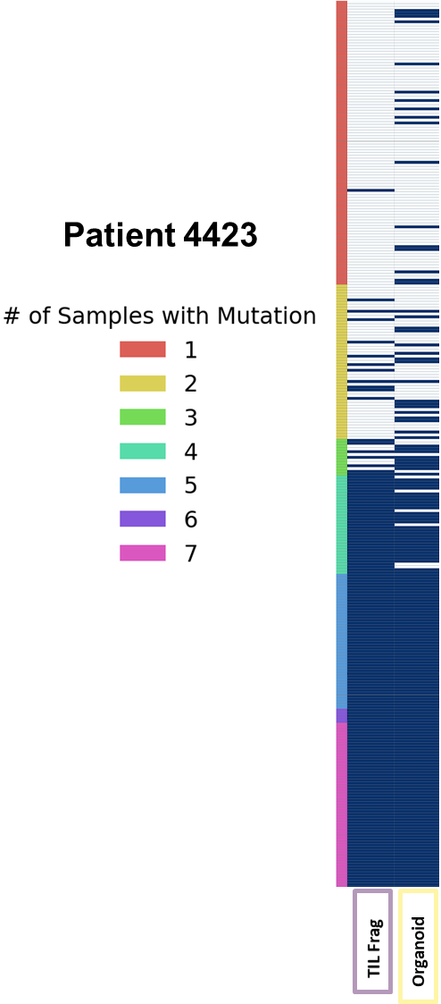
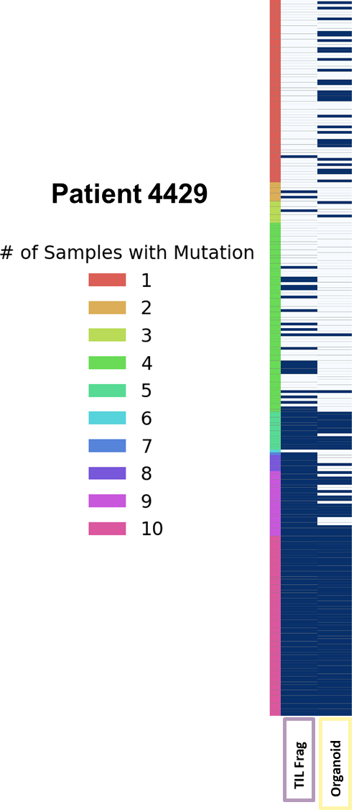
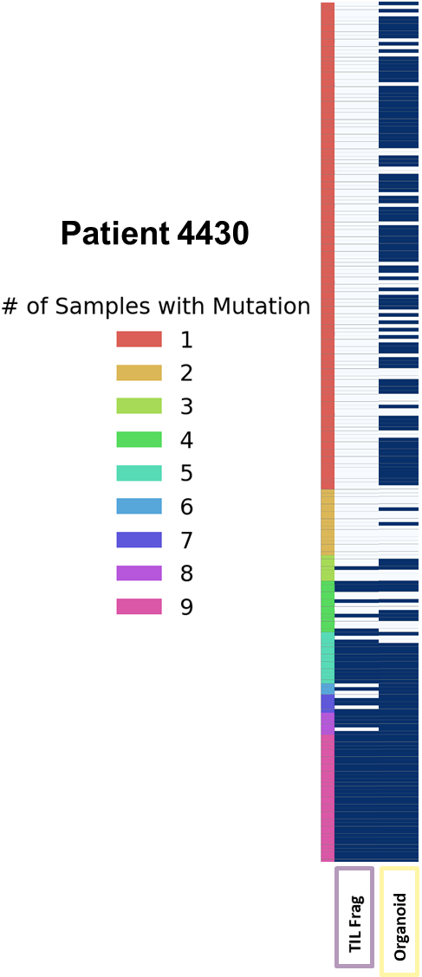
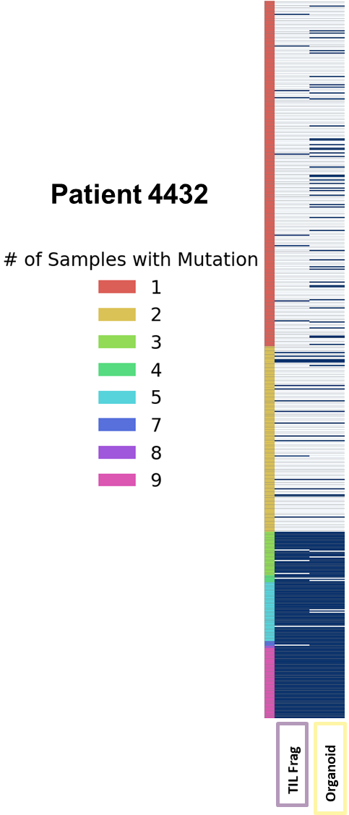
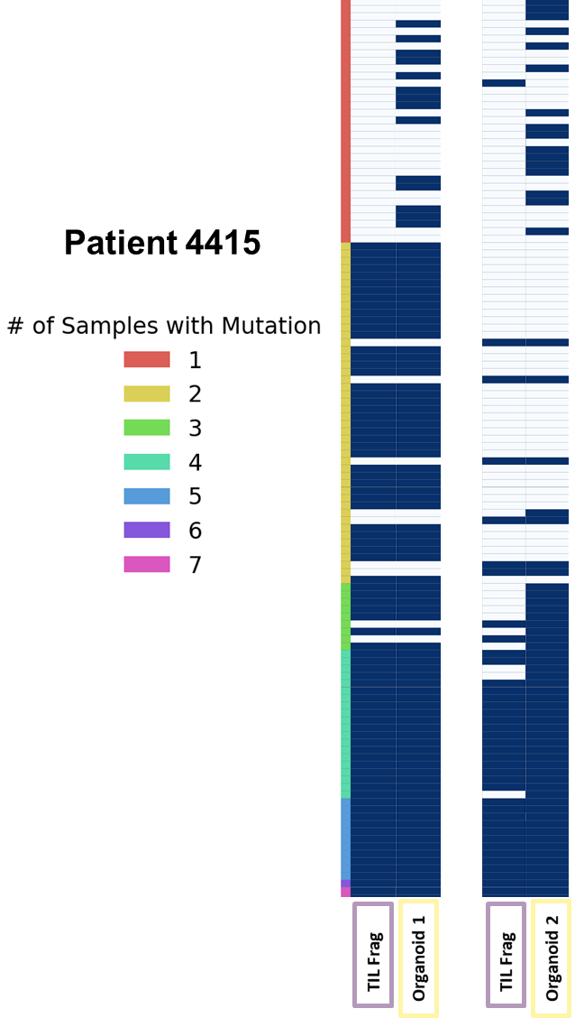
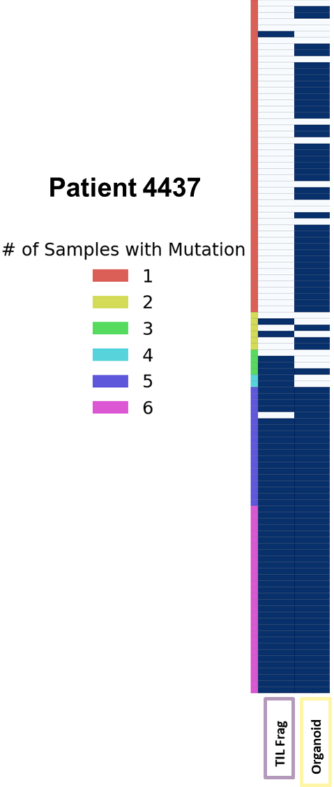
Supplementary Figure S1. Genetic fidelity of PDTO to parental tumors. See legend for Fig 1. For Patient 4433, WES for an early (EP) and late passage (P9) PDTO are shown, illustrating the effect of increasing tumor cell fraction.

