Slide 1
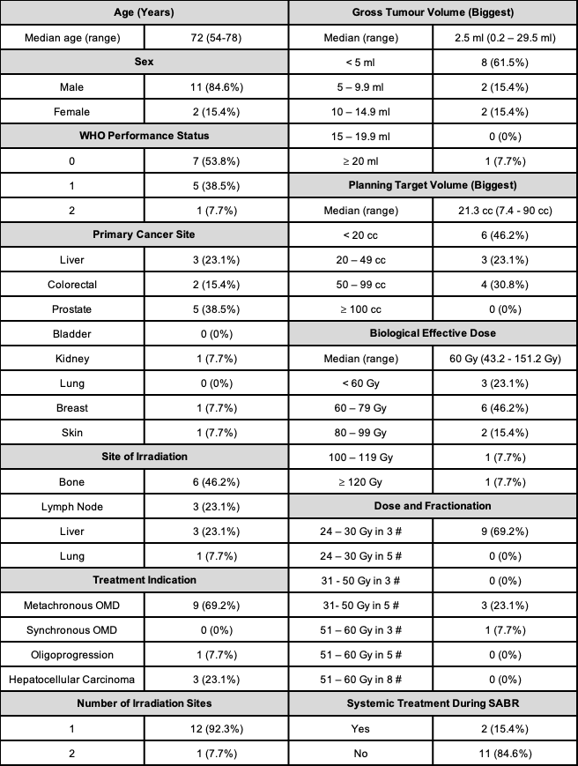
Supplementary Table 1- Patient Characteristics of Patients Whose Cancer Did Not Progress During the Study Follow Up Period

Slide 2
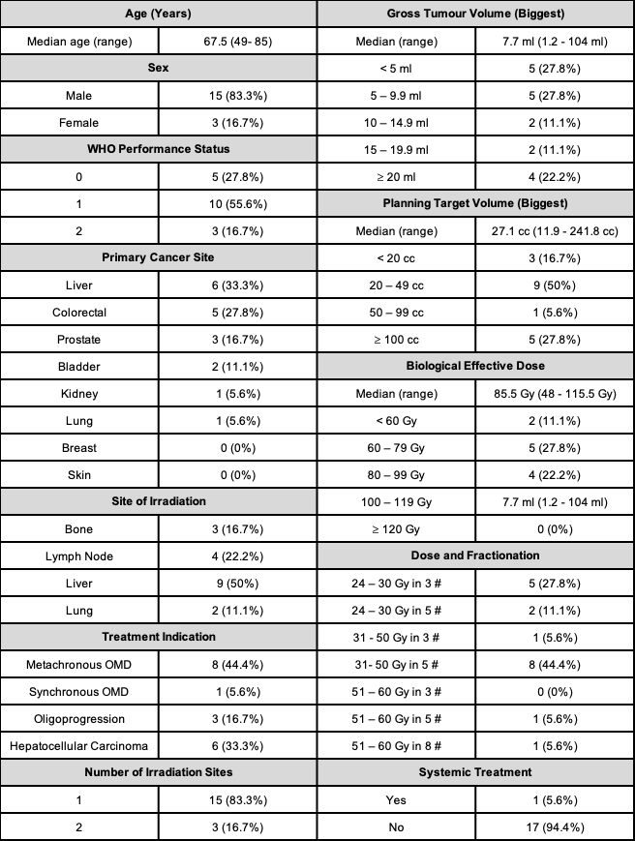
Supplementary Table 2- Patient Characteristics of Patients Whose Cancer Progressed During the Study Follow Up Period

Slide 3
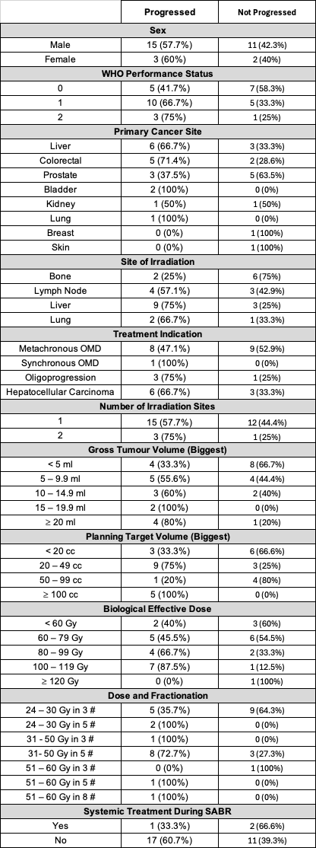
Supplementary Table 3- Patient Characteristics Stratified by Progression Status

Slide 4
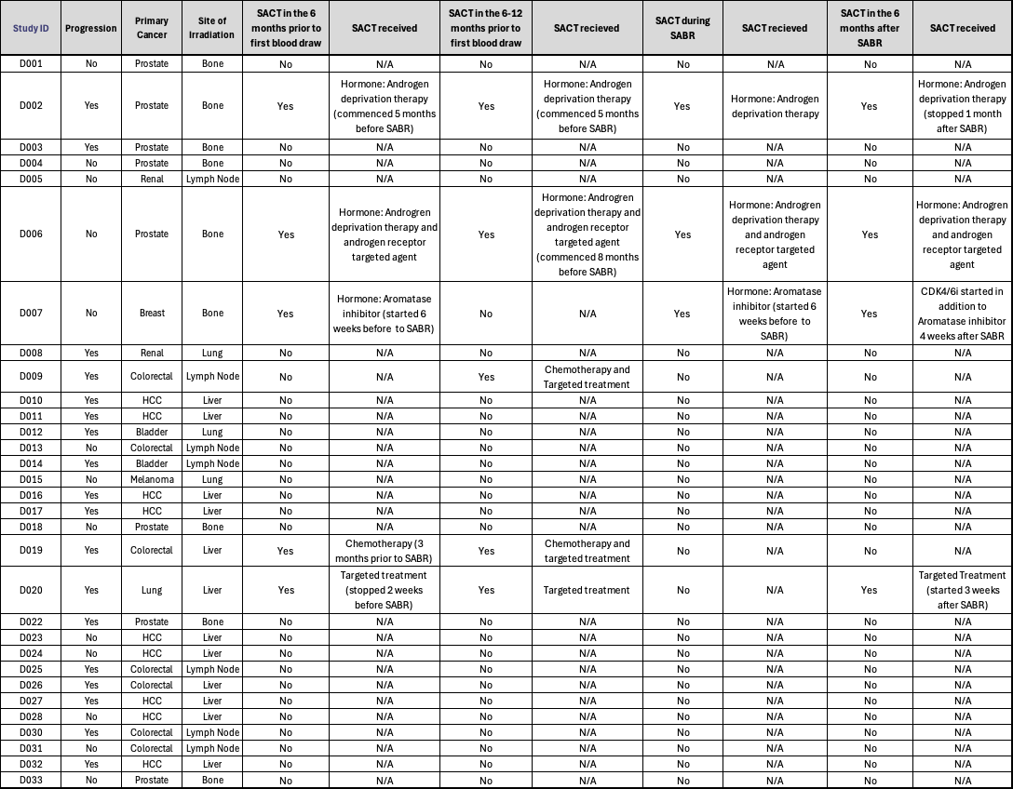
Supplementary Table 4- Details of Patients Who Received Systemic Anti-Cancer Therapy (SACT) Before, During, and After SABR

Slide 5
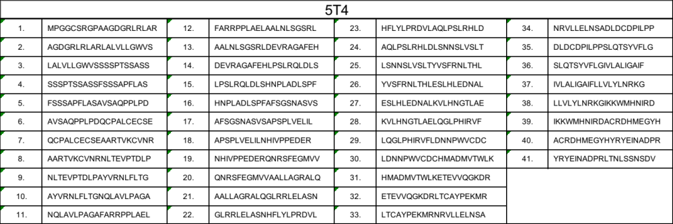
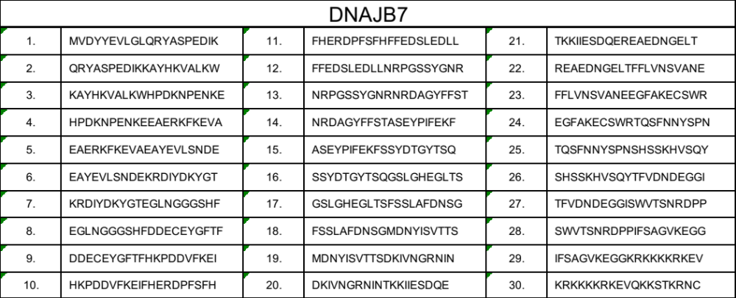
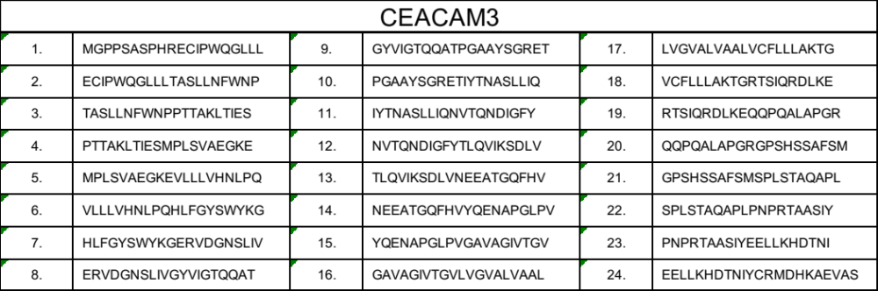
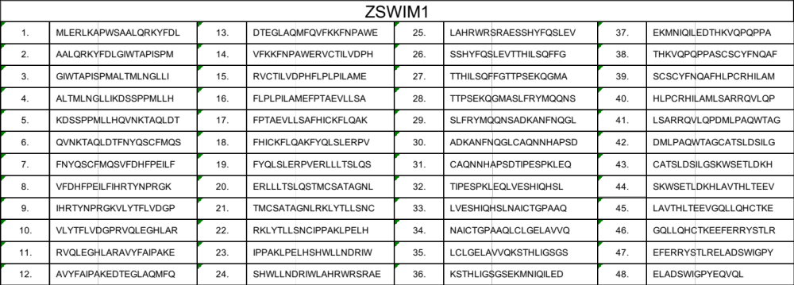
Supplementary Table 5- Tables of Peptide Pools Used in ELISpot Assays

Slide 6
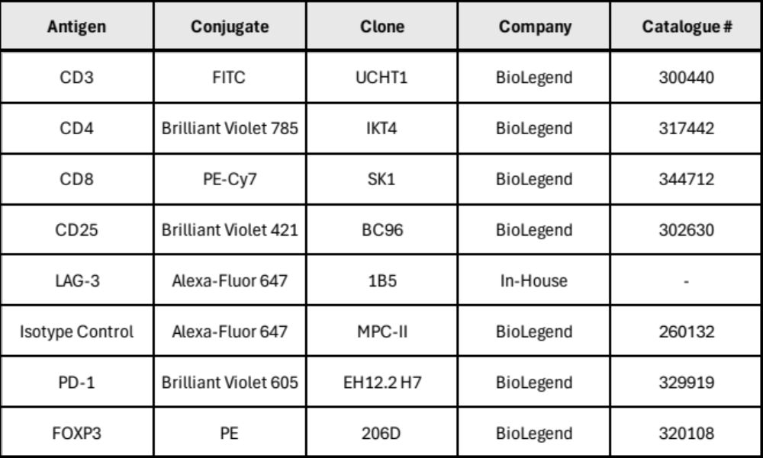
Supplementary Table 6- Antibodies Used for Extracellular and Intracellular Staining of Human Peripheral Blood Mononuclear Cells

Slide 7
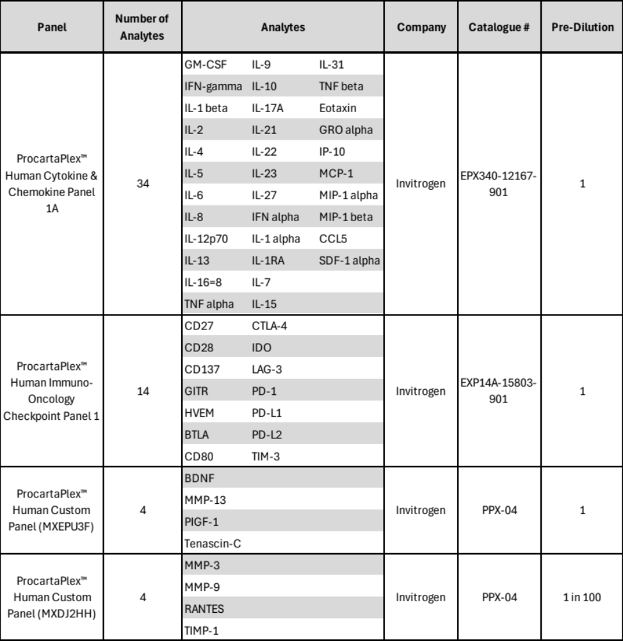
Supplementary Table 7- Kits and Corresponding Analytes used in Luminex Analysis of Human Plasma Samples

