Slide 1
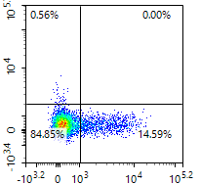
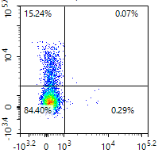
Supplementary Figure 1
Before culture
After culture
CD8
IgG4
PD-1

Slide 2
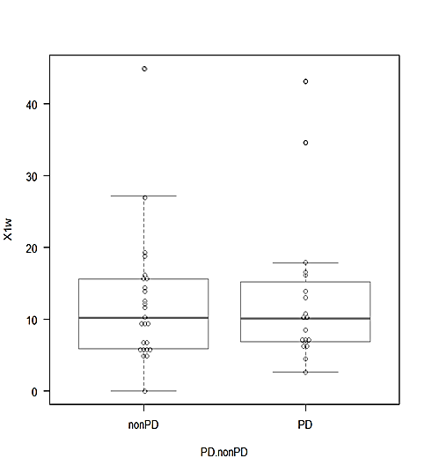
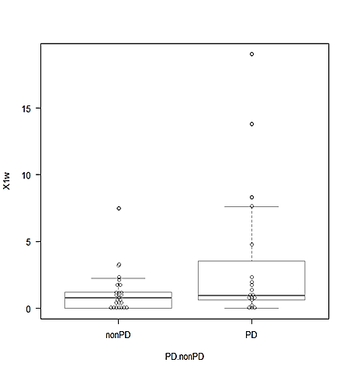
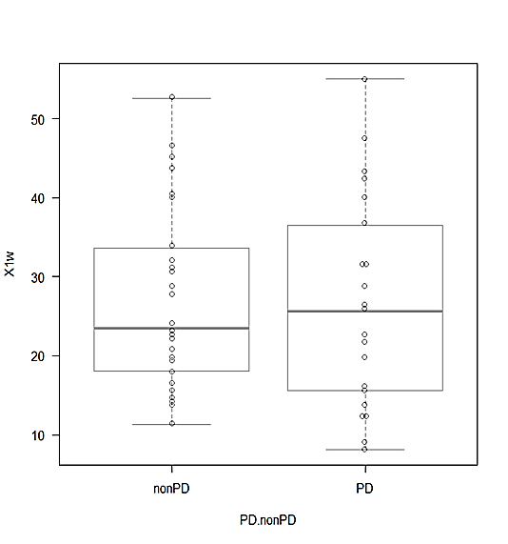
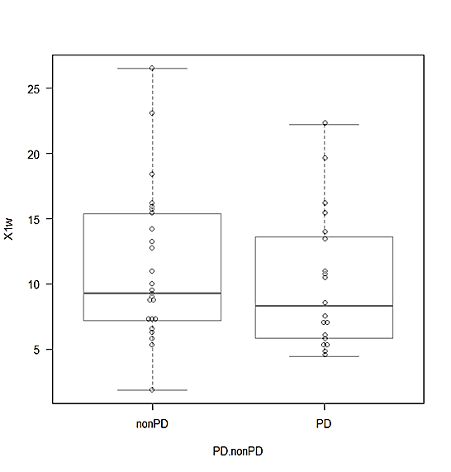
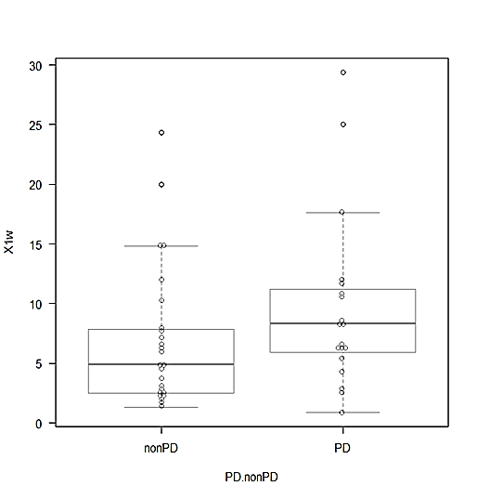
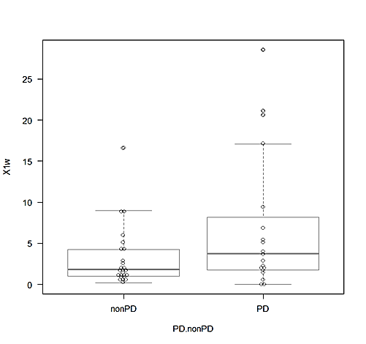
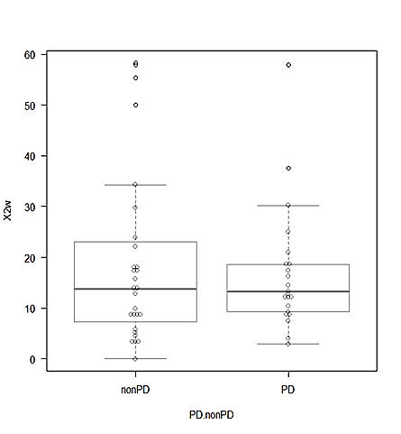
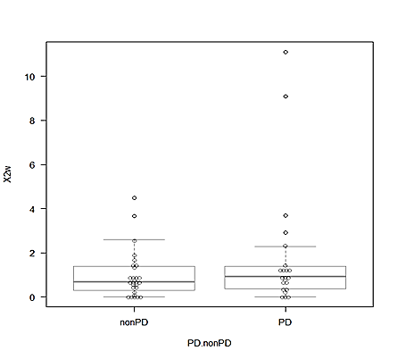
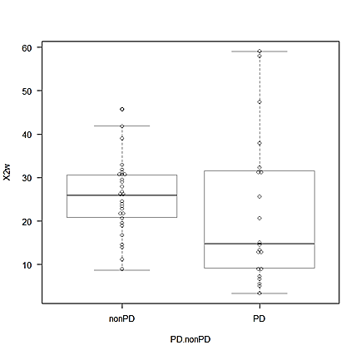
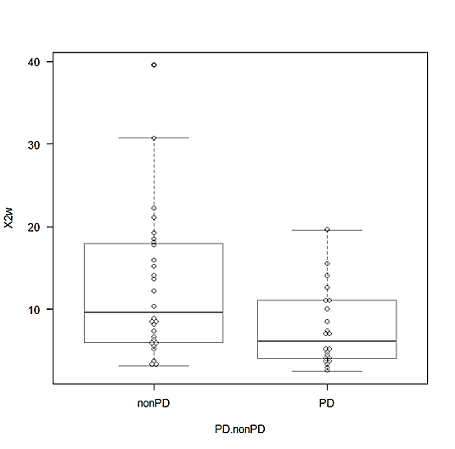
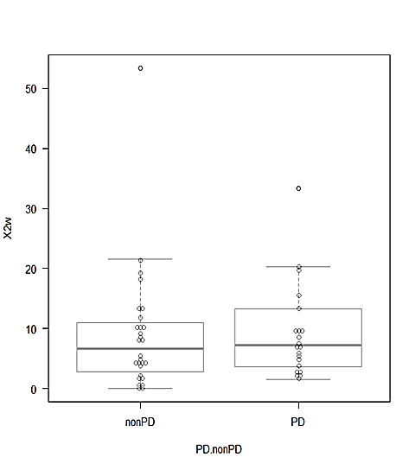
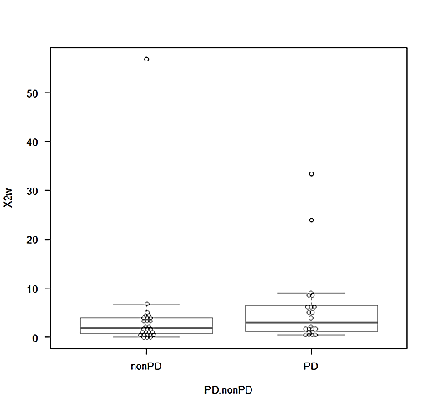
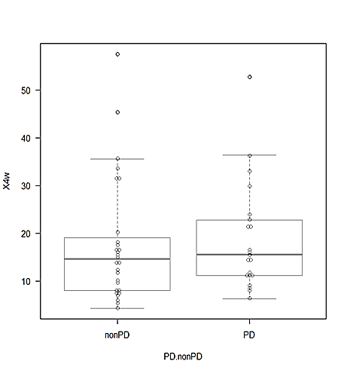
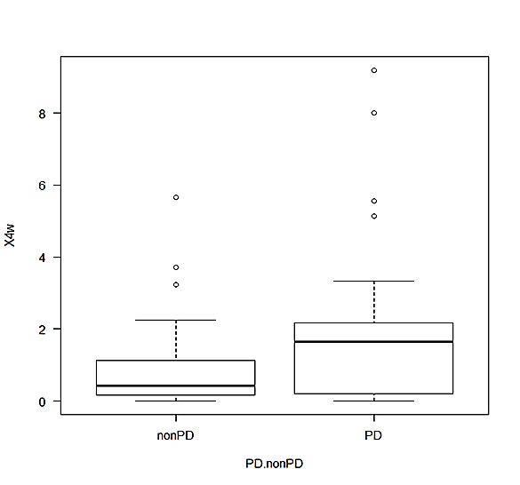
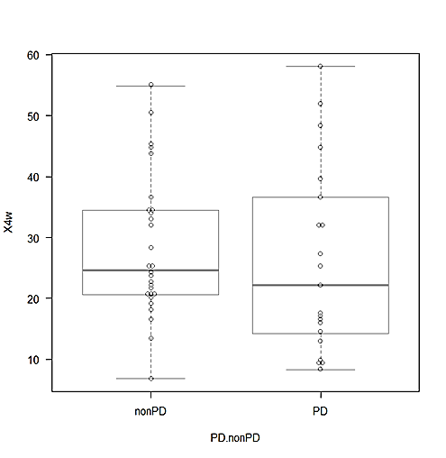
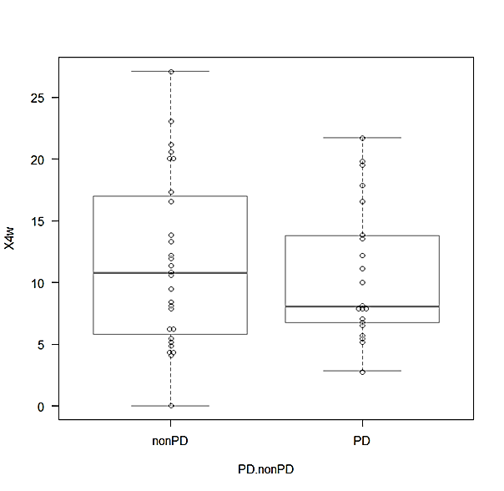
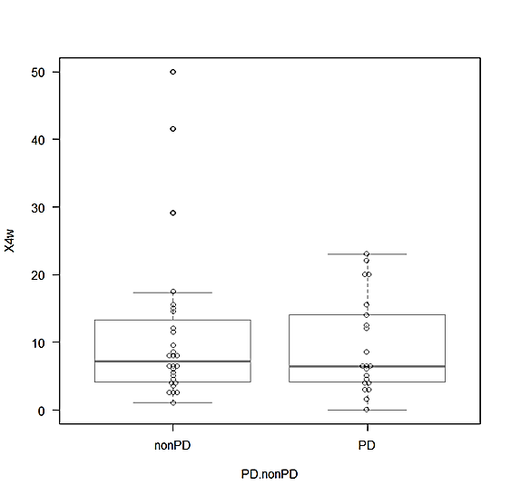
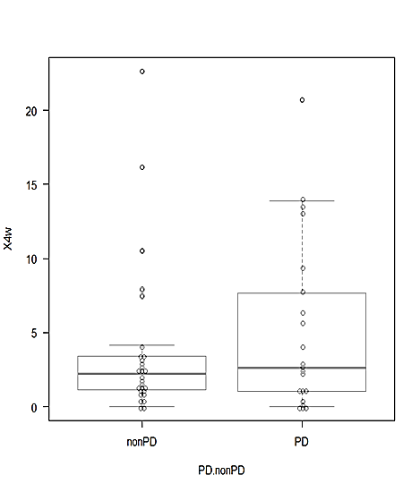
Supplementary Figure 2
%Ki-67
1w
%LAG-3
1w
%CD45RA
1w
%CD103
1w
%TIGIT
1w
%Tim-3
1w
P=0.907
P=0.143
P=0.775
P=0.384
P=0.108
P=0.0756
40
50
25
30
15
20
25
25
30
40
20
20
20
10
30
15
15
15
10
5
20
10
10
10
0
10
5
5
5
0
0
0
Non-PD
Non-PD
PD
Non-PD
PD
Non-PD
PD
Non-PD
PD
PD
Non-PD
PD
%Ki-67
2w
%LAG-3
2w
%CD45RA
2w
%CD103
2w
%TIGIT
2w
P=0.815
%Tim-3
2w
60
P=0.313
P=0.107
P=0.0171
P=0.482
P=0.0854
10
60
40
50
50
50
50
40
8
40
30
40
40
30
6
30
20
30
30
20
4
20
20
20
10
2
10
10
10
10
0
0
0
0
Non-PD
Non-PD
Non-PD
PD
PD
PD
Non-PD
Non-PD
PD
PD
Non-PD
PD
%Ki-67
4w
%LAG-3
4w
%CD45RA
4w
%CD103
4w
%TIGIT
4w
%Tim-3
4w
P=0.477
P=0.0909
P=0.369
P=0.802
P=0.976
P=0.649
50
25
50
8
50
40
20
40
6
40
20
15
30
15
30
20
4
30
10
20
10
10
2
20
5
10
5
0
10
0
0
0
Non-PD
PD
Non-PD
PD
Non-PD
PD
Non-PD
Non-PD
Non-PD
PD
PD
PD

