Slide 1
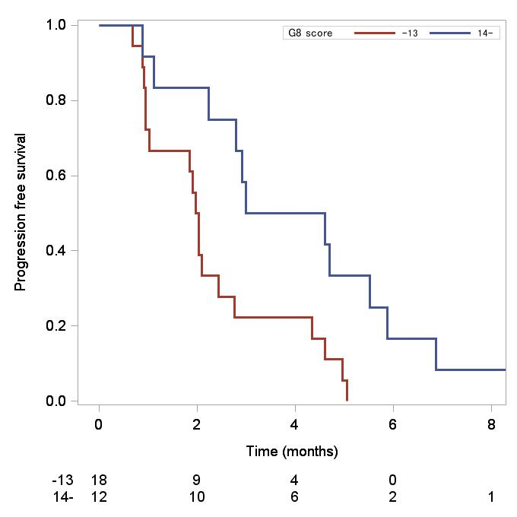
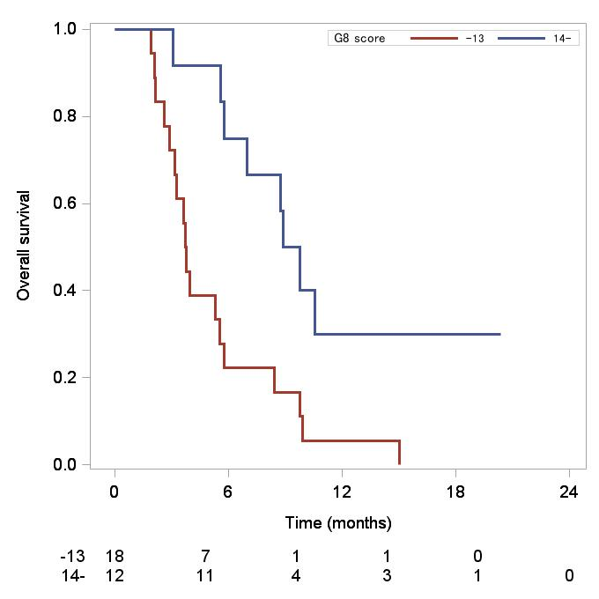
Supplementary Figure 1
A
B
G8 score ≥14 vs. <14
Median PFS
3.8 vs. 2.0 M
P = 0.008
Median OS
9.3 vs. 3.7 M
P = 0.0028

Slide 2
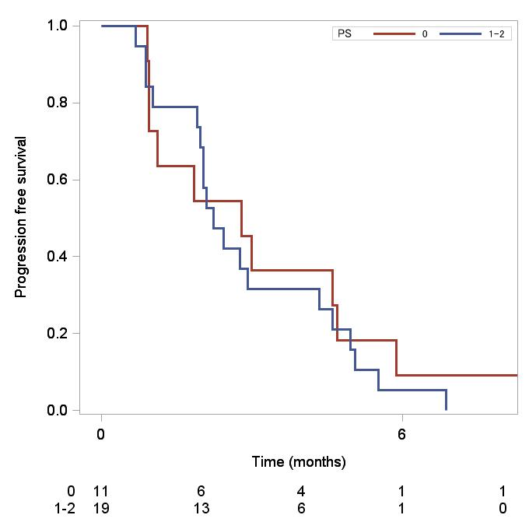
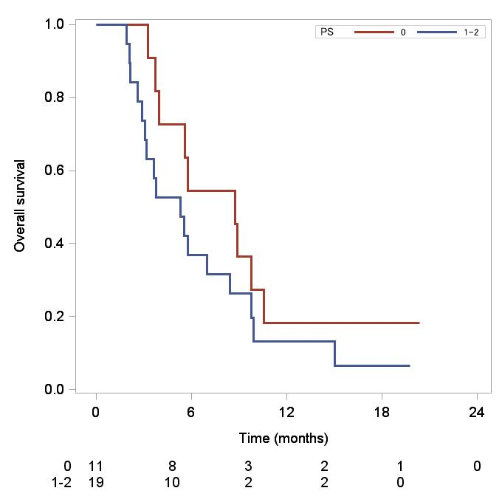
Supplementary Figure 2
A
B
PS 0 vs 1-2
Median PFS
3.0 vs. 2.2 M
P = 0.55
Median OS
8.8 vs. 5.3 M
P = 0.21

