Slide 1
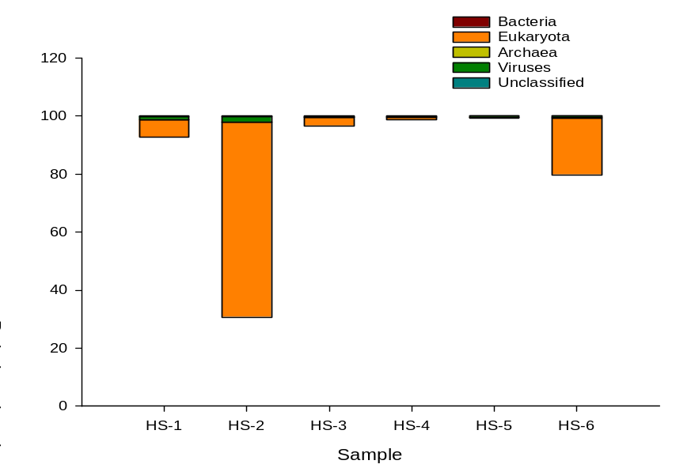
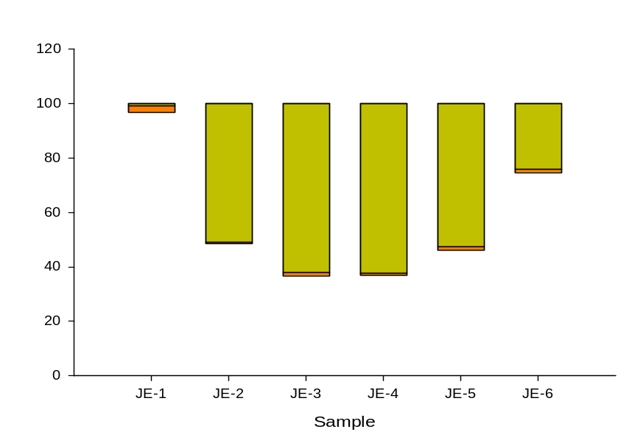
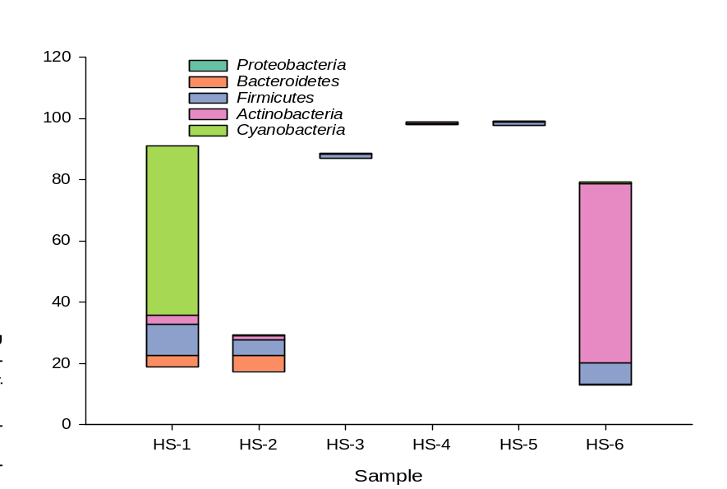
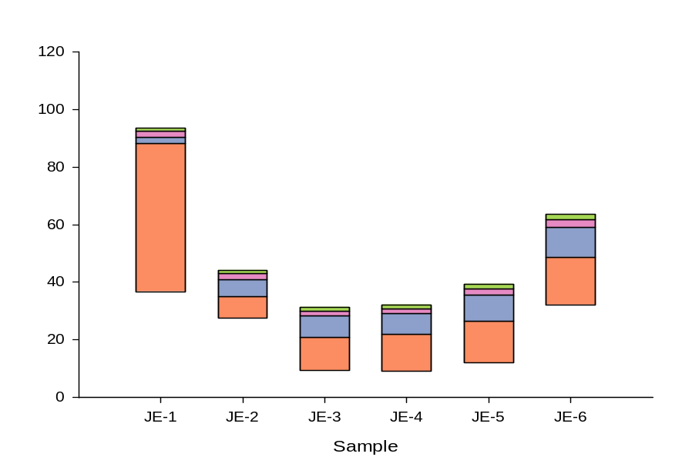
(A)
(B)
(C)
(D)
Supplementary Fig. 1 Number of relative abundance analysis of annotated species of two different groundwater sources (Hot Springs, AR.: A and C, Jefferson, AR.: B and D) from February to August, 2022. Histogram of the domain-level relative abundance in different groundwater (A and B). Histogram of the phylum-level relative abundance in different groundwater sources (C and D).

Slide 2
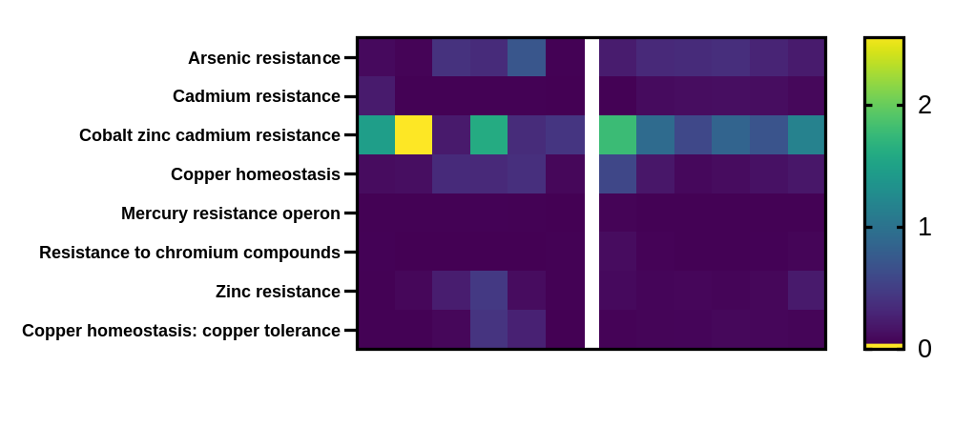
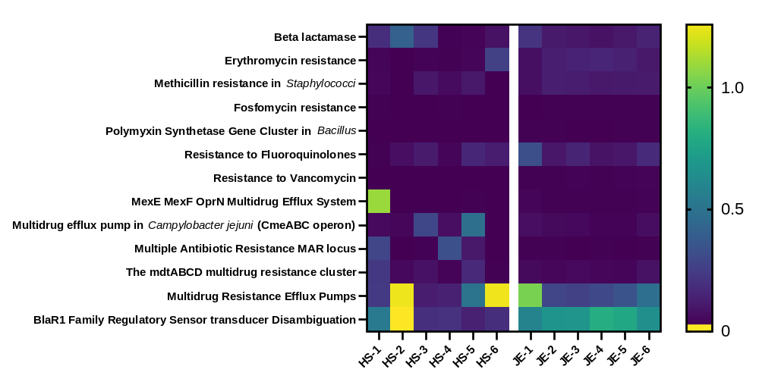
Toxic compounds
Antibiotics
Hot Springs
Jefferson
Supplementary Fig. 2 Heatmap of relative abundance of the resistance to toxic compounds (7) and antibiotics (11) in the Virulence, Disease and Defense of Subsystem function

