Slide 1
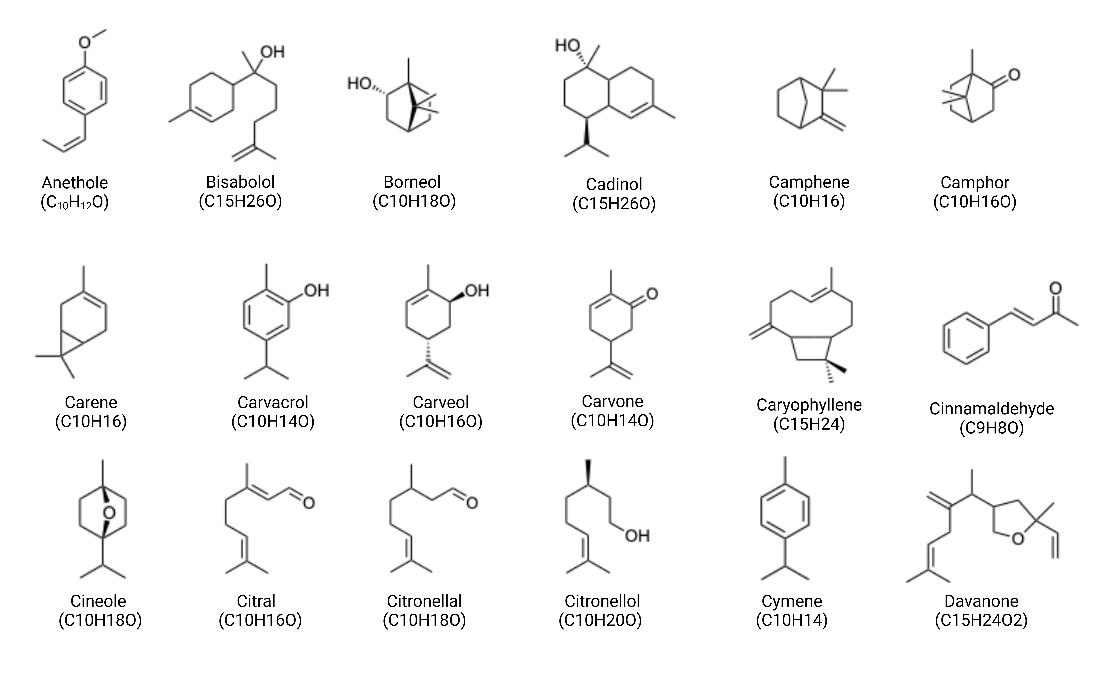
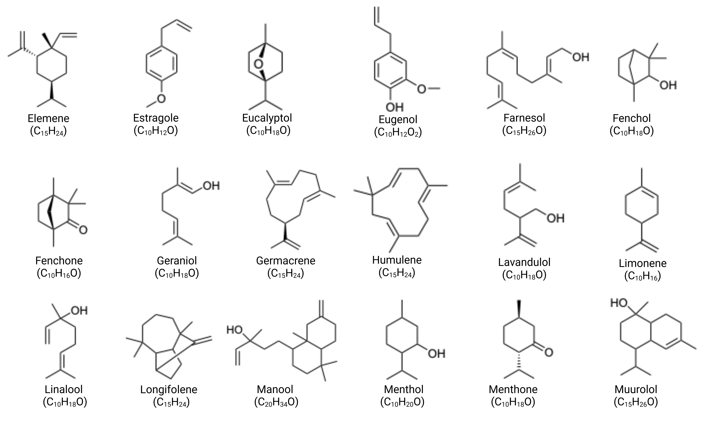
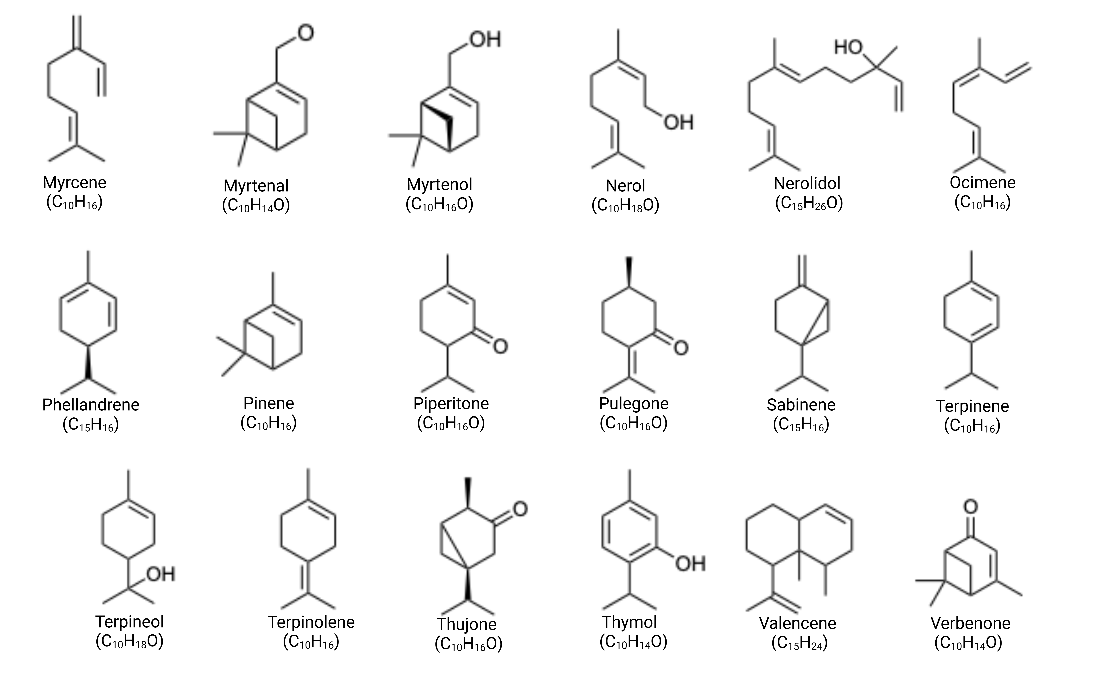
Notes:
Supplementary Figure 1. Chemical structures of common terpenes which have tested for antimicrobial properties

