Slide 1
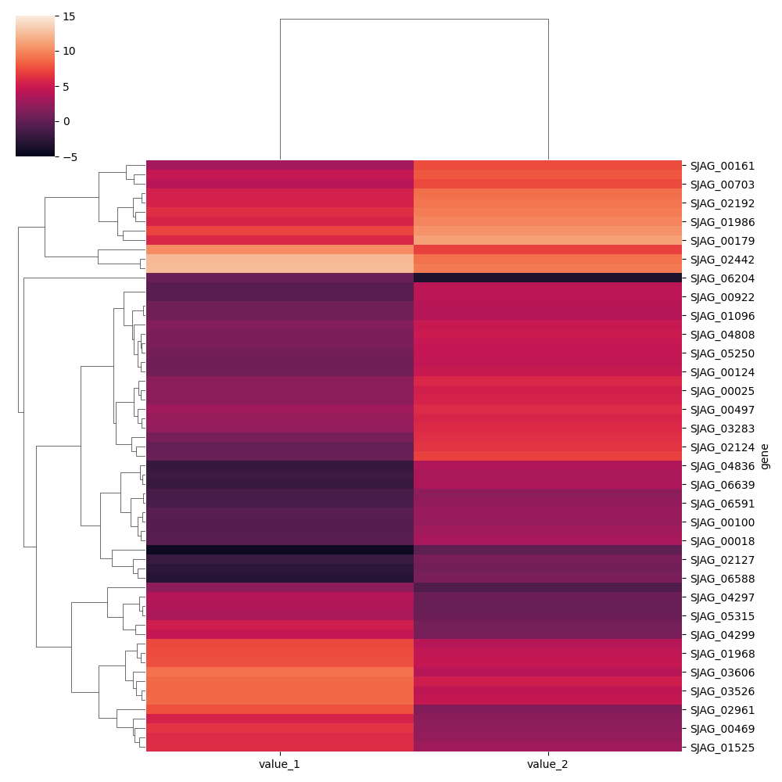
Colour code:
Up-regulation
Down-regulation

