Slide 1
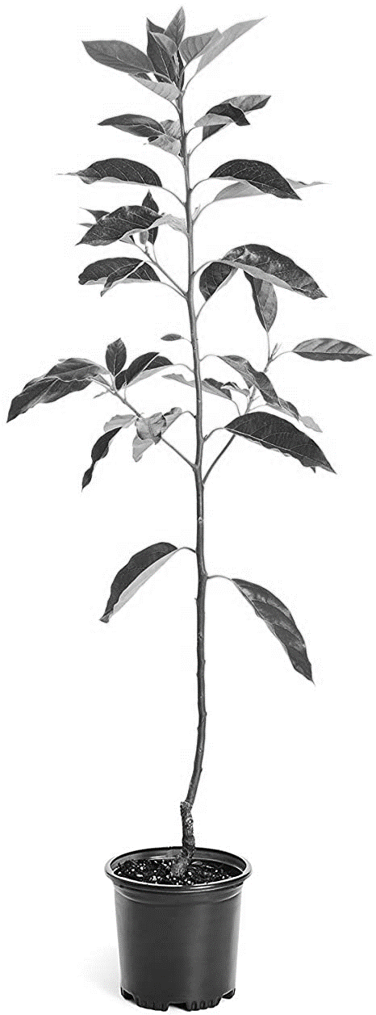
Upwards zone 2
8 cm
Upwards zone 1
8 cm
3 cm
Downwards zone
8 cm
≈15 cm
Fig. S1 Inoculation points for Xylella fastidiosa (white circles) and application points of the peptide (black rectangle) in almond plants. Sampled zones are also indicated as upwards zones 1 and 2 and downwards zone.

