Slide 1
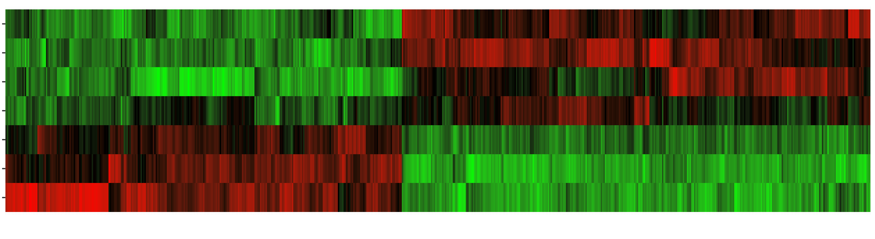
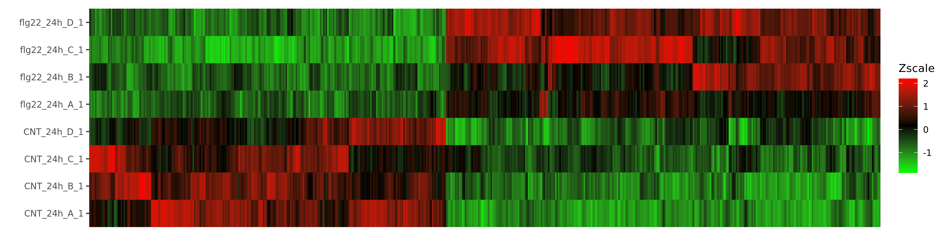
D
C
flg22-NH₂
B
6h
A
D
NTC
C
A
D
C
flg22-NH₂
B
24h
A
D
NTC
C
B
A
DOWNREGULATED
UPREGULATED
DIFFERENTIALLY EXPRESSED GENES (DEG)
Figure S3. Heat map of the expression patterns (Z-scaled fragments per kilobase million values) of the differentially expressed genes (DEGs) in almond plants (replicates A, B, C and D) treated with the peptide flg22-NH₂ compared with the not treated controls (NTC) after 6 and 24h. Columns correspond to the identified DEGs. Changes in expression levels are displayed from green (underexpressed) to red (overexpressed). The order of genes was established after hierarchical clustering using the Euclidean distance.

