Slide 1
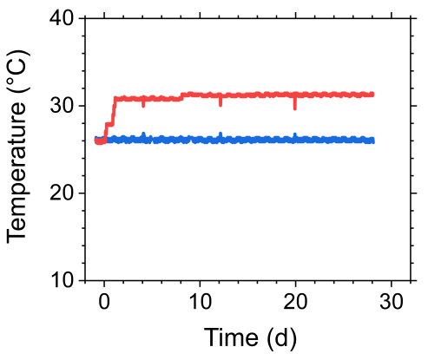
Supplemental Figure S1. Time course of the water temperature in 26ºC- (blue) and 31ºC- (red) tanks.
Figure S1

Slide 2
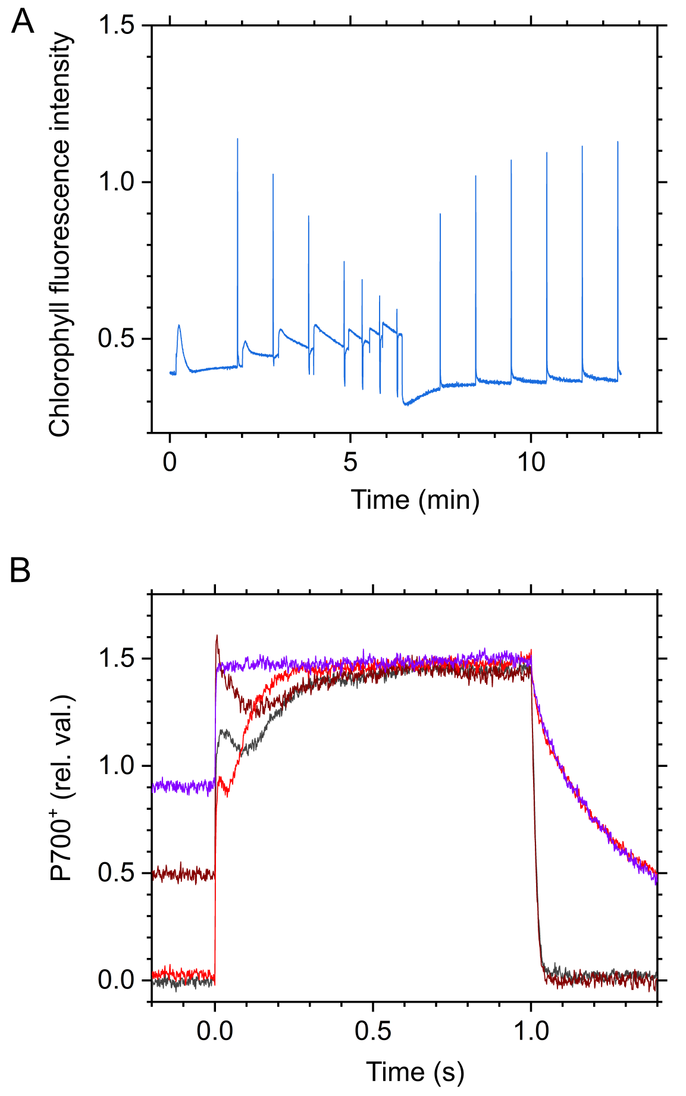
Supplemental Figure S2. Raw traces of chlorophyll fluorescence and near-infrared absorbance in the photosynthetic measurements. (A) The representative data of chlorophyll fluorescence for measuring a light-response curve at 26ºC in the #1 strain of A. tenuis. (B) The representative data of near-infrared absorbance for the determination of the total photo-oxidizable P700 amount at 26ºC in the #1 strain. For the measurements, 1-s saturation flashes were applied without (black) and with 10-s pre-illumination with far-red light (wine red), which was again performed in the presence of DCMU (red and purple, respectively).
Figure S2

Slide 3
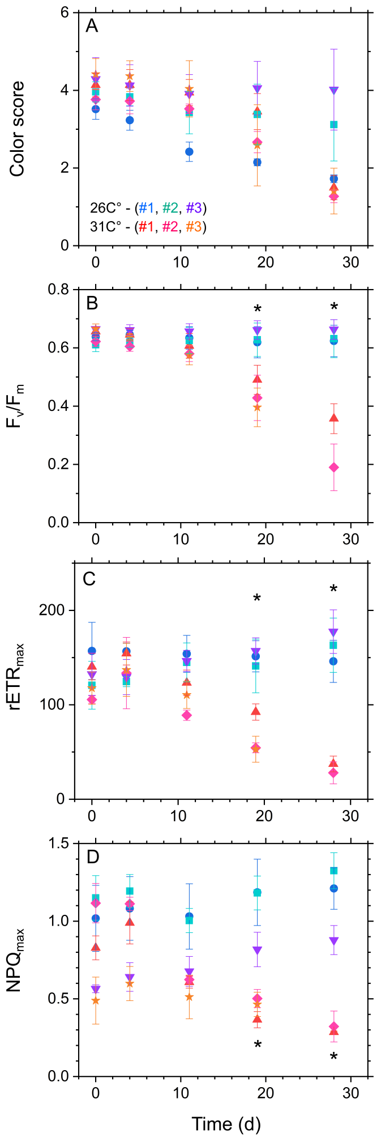
Supplemental Figure S3. Time courses of color score, maximum quantum yield of photosystem II photochemistry (F_{v}/F_{m}), relative electron transport rate, and non-photochemical quenching at 1500 µmol photons m⁻² s⁻¹ (rETR_{max} and NPQ_{max}, respectively) in three strains of A. tenuis during one-month cultivation at 26ºC and 31ºC. Data are shown as means with standard deviations of four independent replicates. Blue circles and red triangles, #1 at 26ºC and 31ºC; sky blue squares and pink diamonds, #2 at 26ºC and 31ºC; purple inverted triangles and orange stars, #3 at 26ºC and 31ºC. Asterisks indicate statistically significant differences (*p<0.05) between 26ºC and 31ºC as per Welch’s t-test.
Figure S3

Slide 4
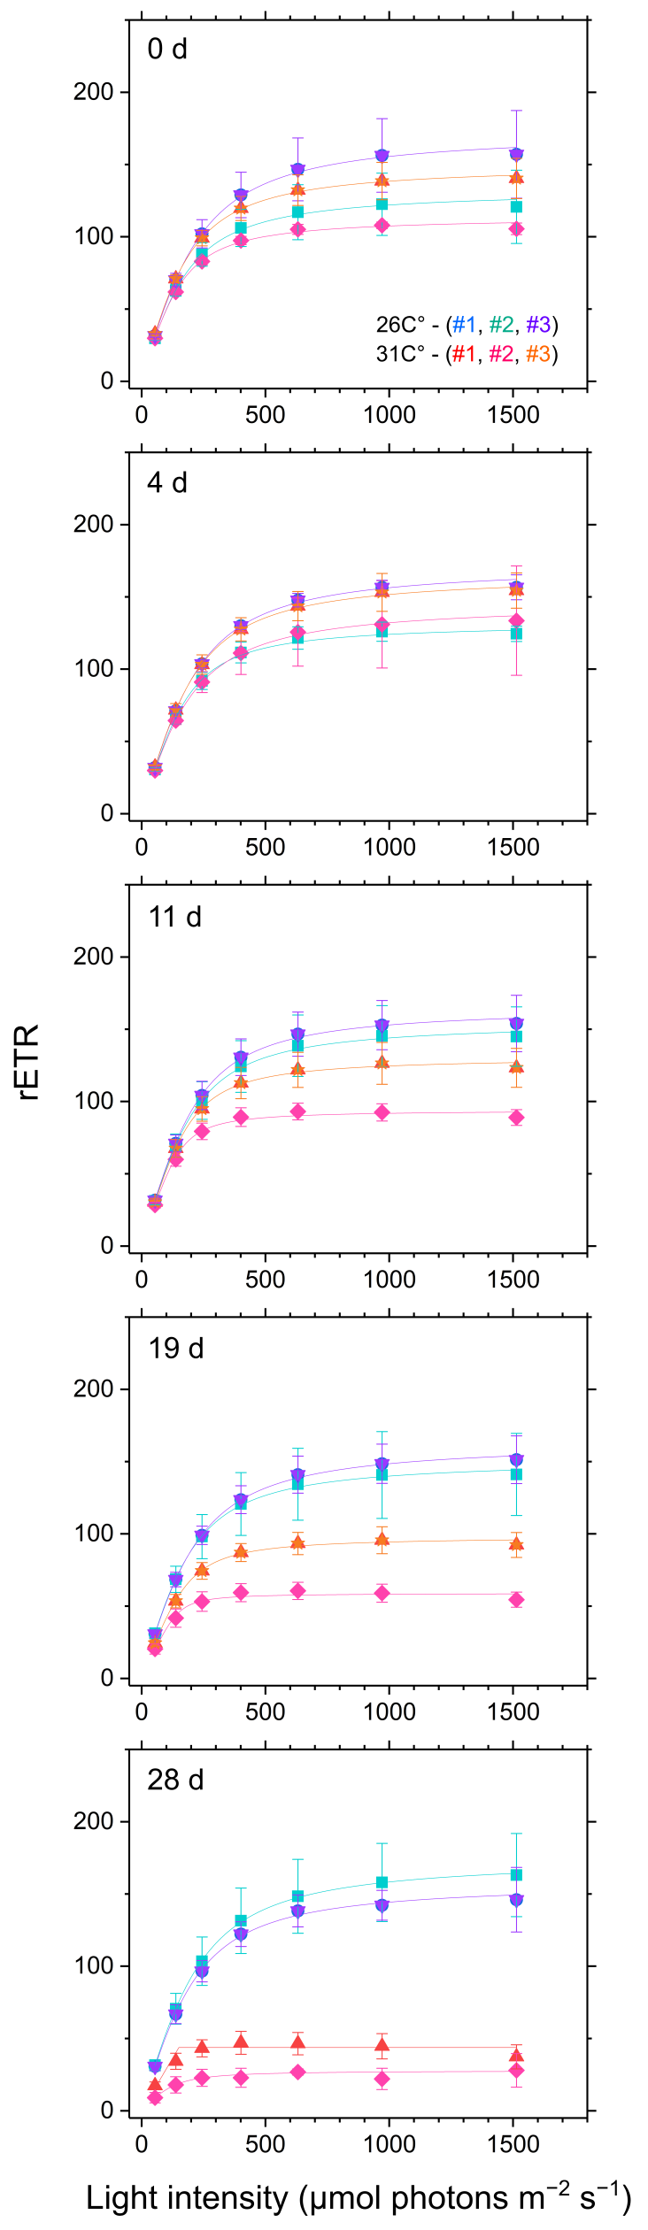
Supplemental Figure S4. Light-response curve of relative electron transport rate (rETR) in the three different strains of A. tenuis during the cultivation at 26ºC and 31ºC. Data are shown as means with standard deviations of four independent replicates. Blue circles and red triangles, #1 at 26ºC and 31ºC; sky blue squares and pink diamonds, #2 at 26ºC and 31ºC; purple inverted triangles and orange stars, #3 at 26ºC and 31ºC.
Figure S4

Slide 5
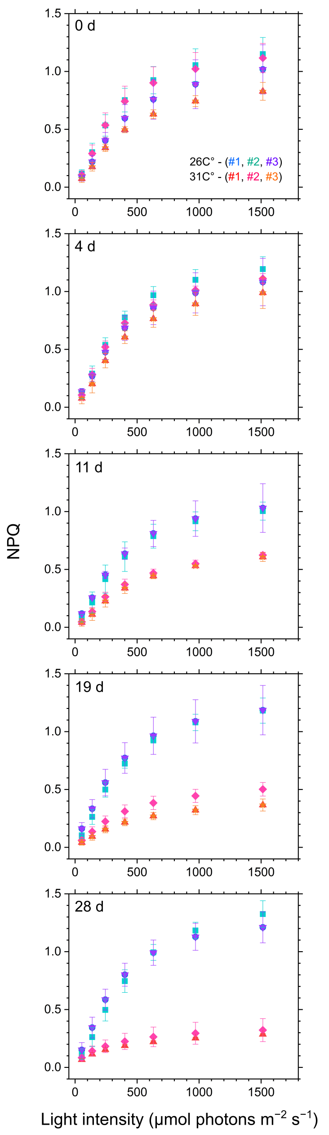
Supplemental Figure S5. Light-response curve of non-photochemical quenching (NPQ) in the three different strains of A. tenuis during the cultivation at 26ºC and 31ºC. Data are shown as means with standard deviations of four independent replicates. Blue circles and red triangles, #1 at 26ºC and 31ºC; sky blue squares and pink diamonds, #2 at 26ºC and 31ºC; purple inverted triangles and orange stars, #3 at 26ºC and 31ºC.
Figure S5

Slide 6
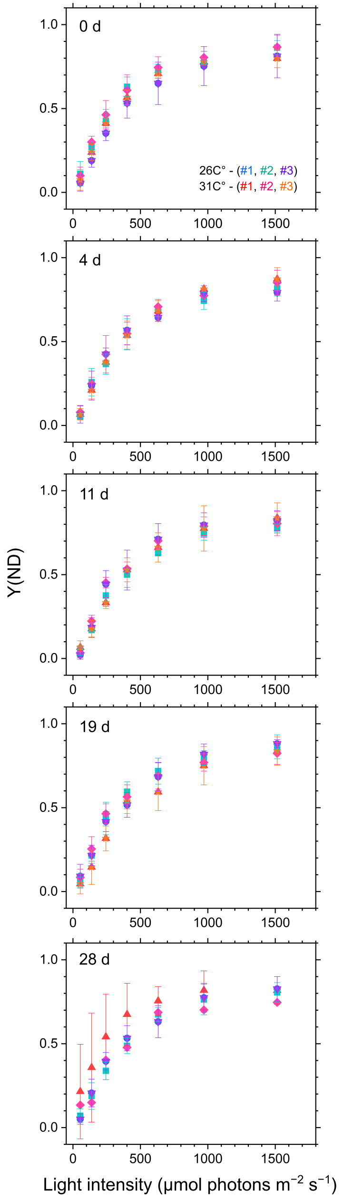
Supplemental Figure S6. Light-response curve of donor-side limitation of photosystem I ,Y(ND), in the three different strains of A. tenuis during the cultivation at 26ºC and 31ºC. Data are shown as means with standard deviations of four independent replicates. Blue circles and red triangles, #1 at 26ºC and 31ºC; sky blue squares and pink diamonds, #2 at 26ºC and 31ºC; purple inverted triangles and orange stars, #3 at 26ºC and 31ºC.
Figure S6

Slide 7
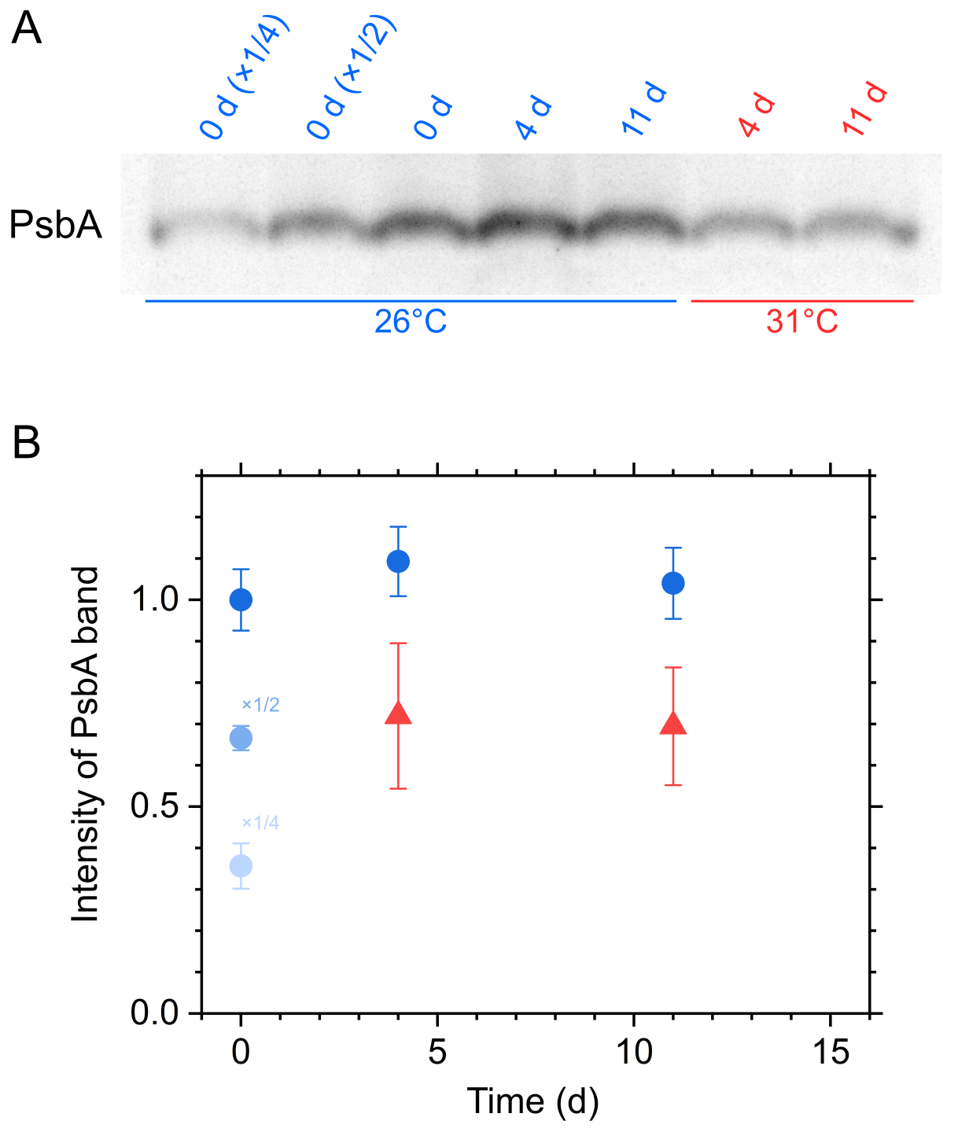
Supplemental Figure S7. Immunoblotting of whole crude extract with a specific antibody to PsbA in the #1 strains of A. tenuis during the 2-weeks cultivation at 26ºC (blue circles) and 31ºC (red triangles). (A) Representative data are shown. (B) Band intensity was semi-quantified by densitometry. Data are shown as the mean with the standard deviation (three technical replicates).
Figure S7

Slide 8
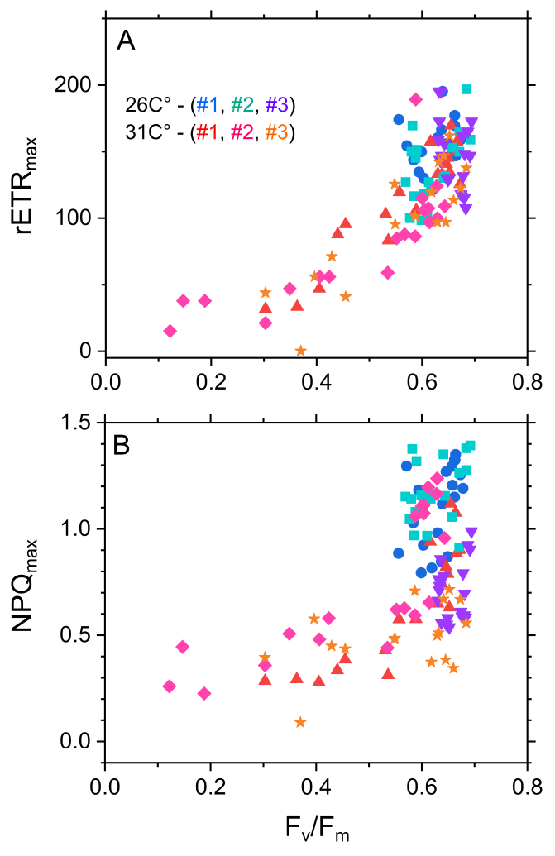
Supplemental Figure S8. Relationship of relative electron transport rate and non-photochemical quenching at 1500 µmol photons m⁻² s⁻¹ (rETR_{max} and NPQ_{max}, respectively) with maximum quantum yield of photosystem II photochemistry (F_{v}/F_{m}) in the three independent strains of A. tenuis (#1−3) during the one-month cultivation. Data of four each independent replicate are shown: blue circles and red triangles, #1 at 26ºC and 31ºC; sky blue squares and pink diamonds, #2 at 26ºC and 31ºC; purple inverted triangles and orange stars, #3 at 26ºC and 31ºC.
Figure S8

Slide 9
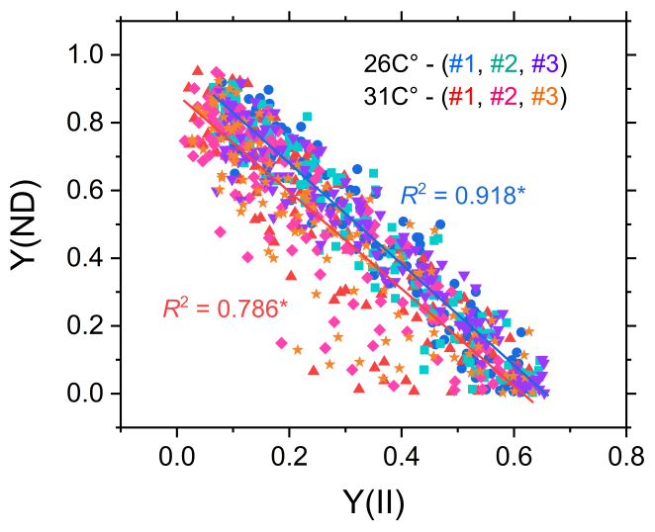
Supplemental Figure S9. Relationship of donor-side limitation of photosystem I [Y(ND)], with the effective quantum yield of photosystem II [Y(II)] in the three independent strains of A. tenuis (#1−3) during the one-month cultivation. Data of four each independent replicate are shown: blue circles and red triangles, #1 at 26ºC and 31ºC; sky blue squares and pink diamonds, #2 at 26ºC and 31ºC; purple inverted triangles and orange stars, #3 at 26ºC and 31ºC. A linear regression analysis was performed, resulting in the adjusted coefficient of determination as shown in the panel. Asterisks indicate statistically non-zero slope (*p<0.05) as per ANOVA.
Figure S9

