Slide 1
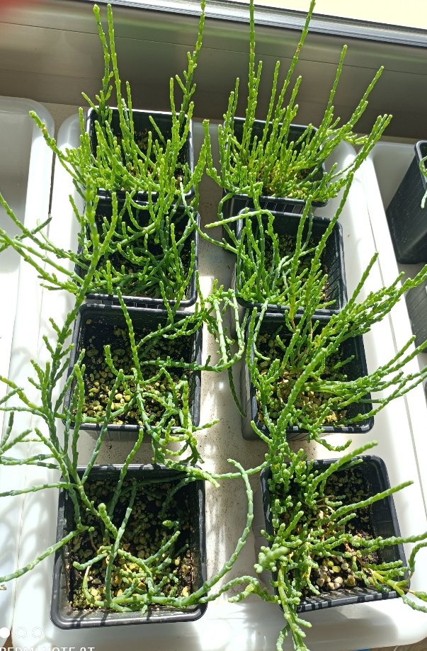
Irrigation
Water NaCl
Supplemental Figure 1. Image of Arthrocaulon macrostachyum plants irrigated with wáter or NaCl, sixteen weeks after the transition from in vitro to ex vitro conditions.

