Slide 1
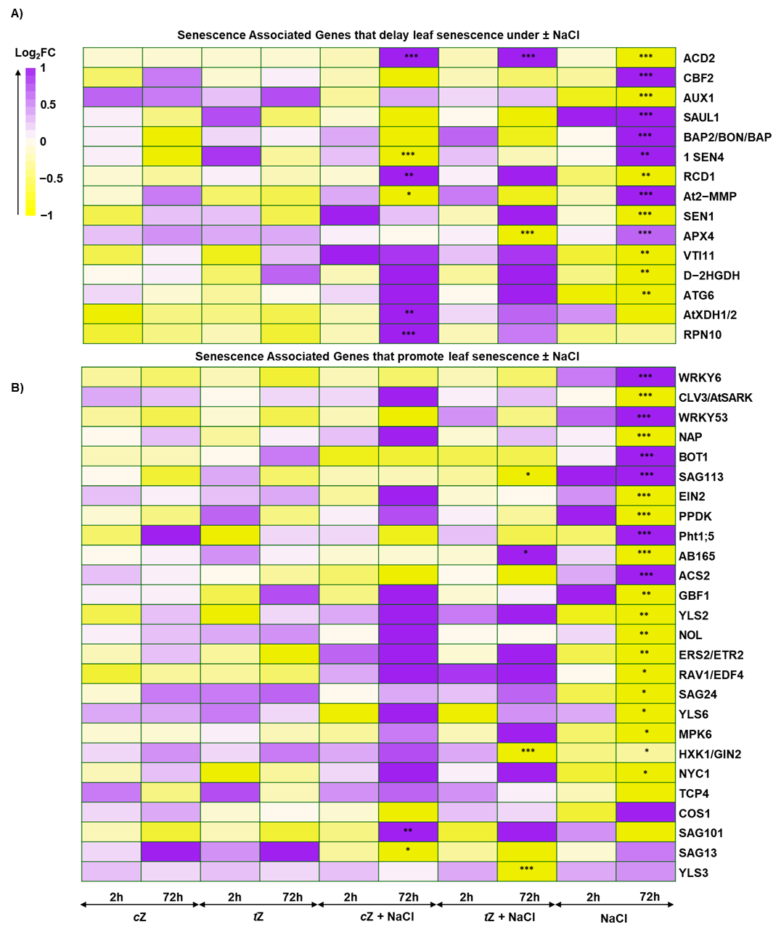
Supplementary Figure S1 – Senescence Associated Genes (SAGs) that A) delay and B) promote leaf senescence - Asterisks (*) indicates the statistical significance (*P < 0.05, **P<0.01, ***P<0.001). Color intensity represents the Log₂ Fold Change (Log₂FC) indicating the level of gene expression changes.

Slide 2
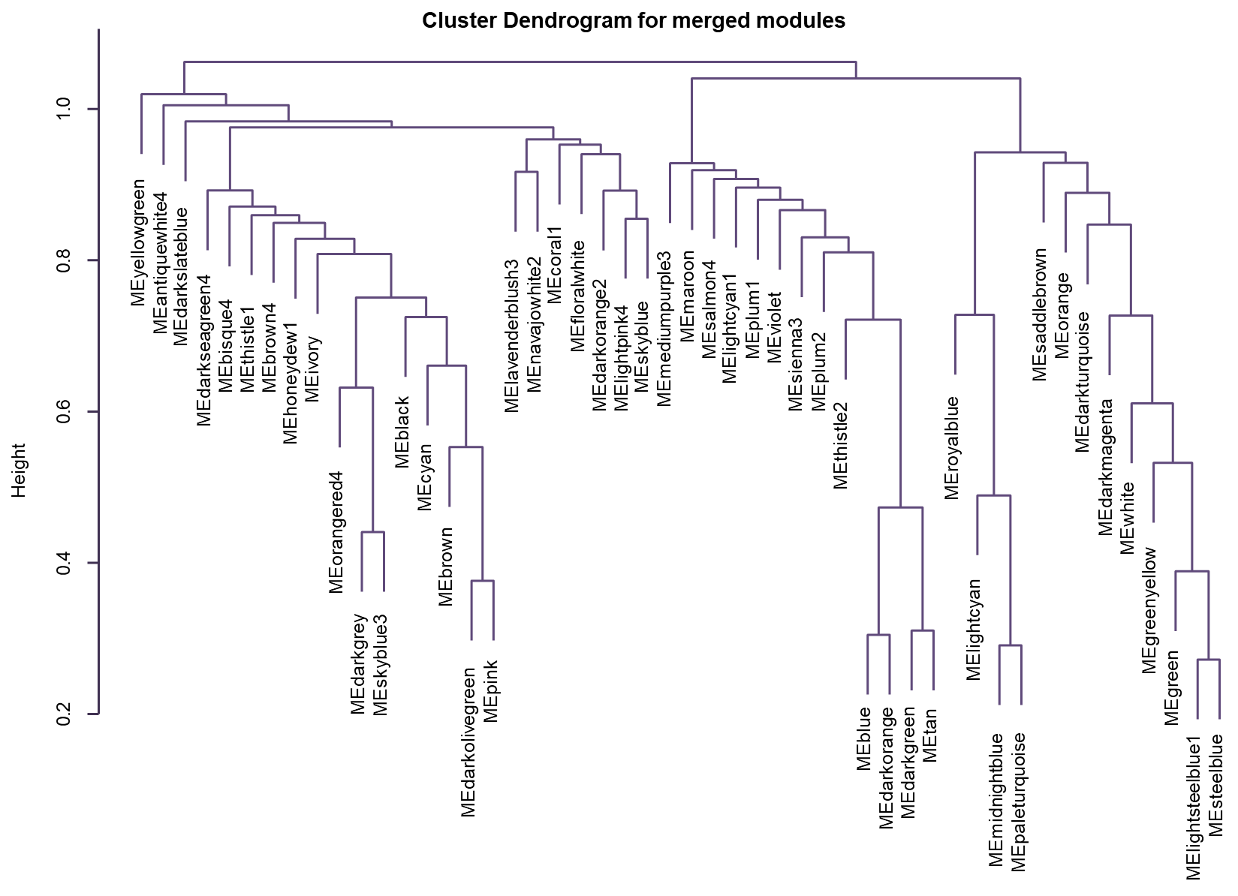
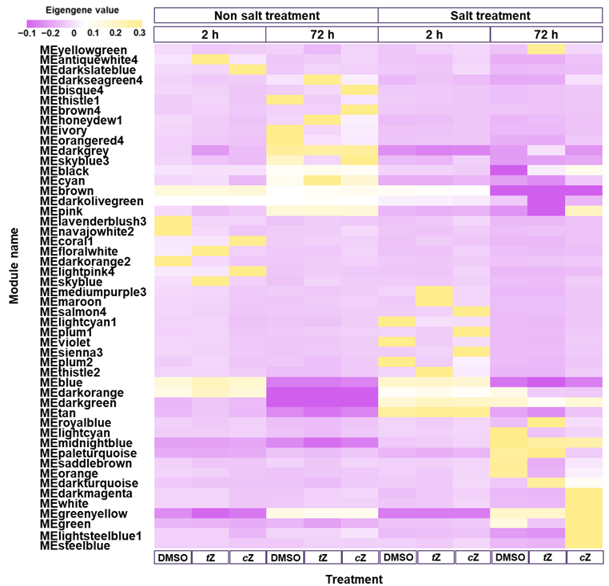
A)
B)
Supplementary Figure S2) Eigengene value for each 50 merged module with cZ and tZ ± 150 mM NaCl treatment. Pearson correlation between modules Color intensity represents the Log₂ Fold Change (Log₂FC) indicating the level of gene expression changes.

Slide 3
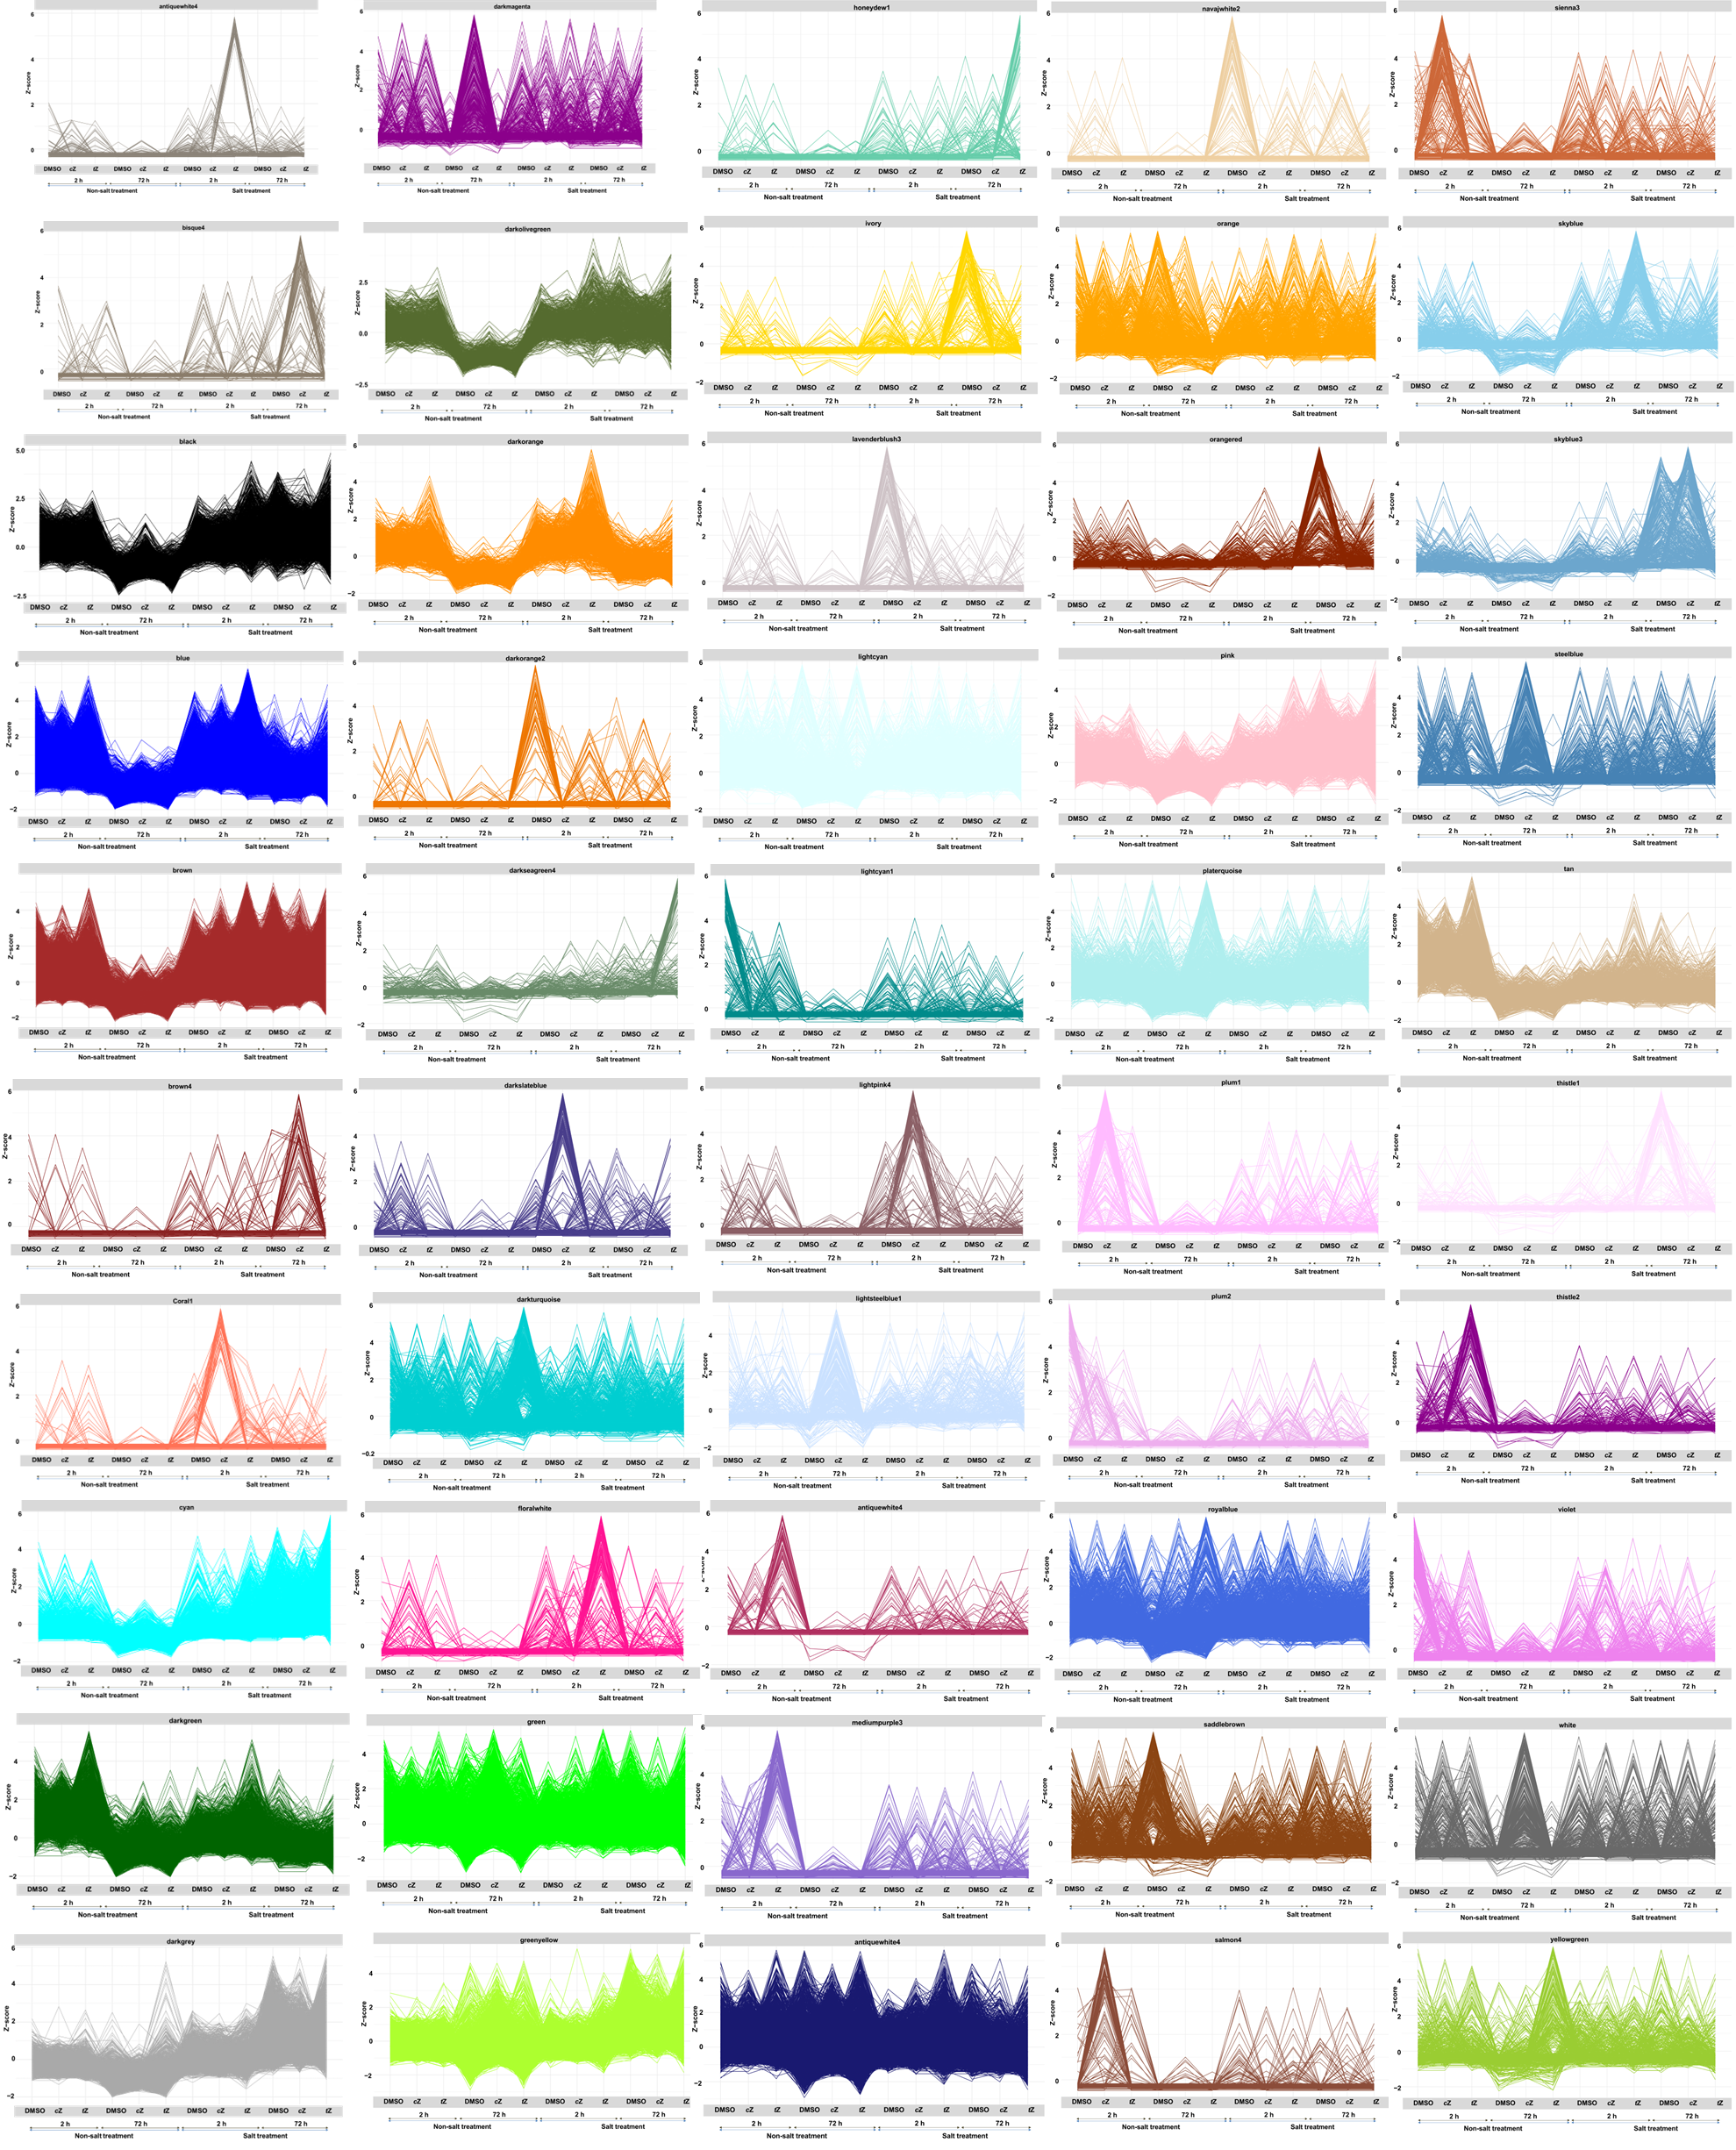
Supplementary Figure S3 – Line graph depicting expression pattern of all 50 modules for cZ and tZ with ± 150 mM NaCl at 2 h and 72 h timepoints - Each line represents the expression (plotted as z-score) of a gene for one of the three biological replicates (such that each gene is represented by three lines)

Slide 4
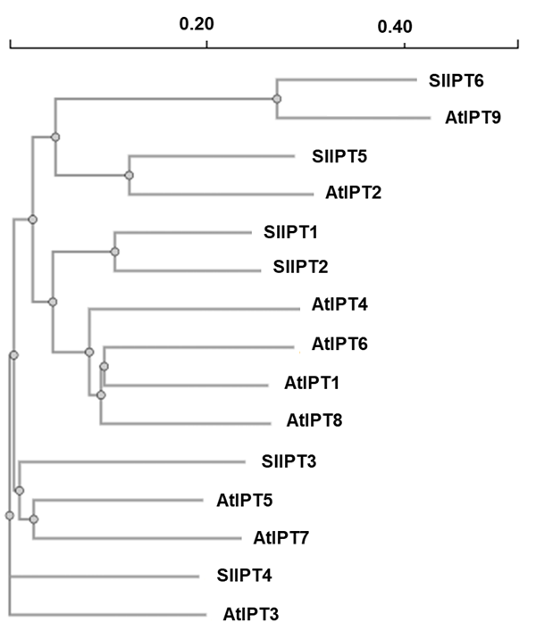
Supplementary Figure S4. Phylogenetic analysis of IPT proteins from tomato and Arabidopsis. – The phylogenetic tree indicates the six isopentenyltransferase (IPT) proteins from Solanum lycopersicum (SlIPT1–6) and nine IPT proteins from Arabidopsis thaliana (AtIPT1–9). Arabidopsis AtIPT2 and AtIPT9, which are associated with cis-zeatin (cZ) biosynthesis via the mevalonate (MVA) pathway, cluster with SlIPT5 and SlIPT6 respectively. This phylogenetic relationship suggests potential functional conservation of cZ biosynthesis related IPTs in tomato.

Slide 5
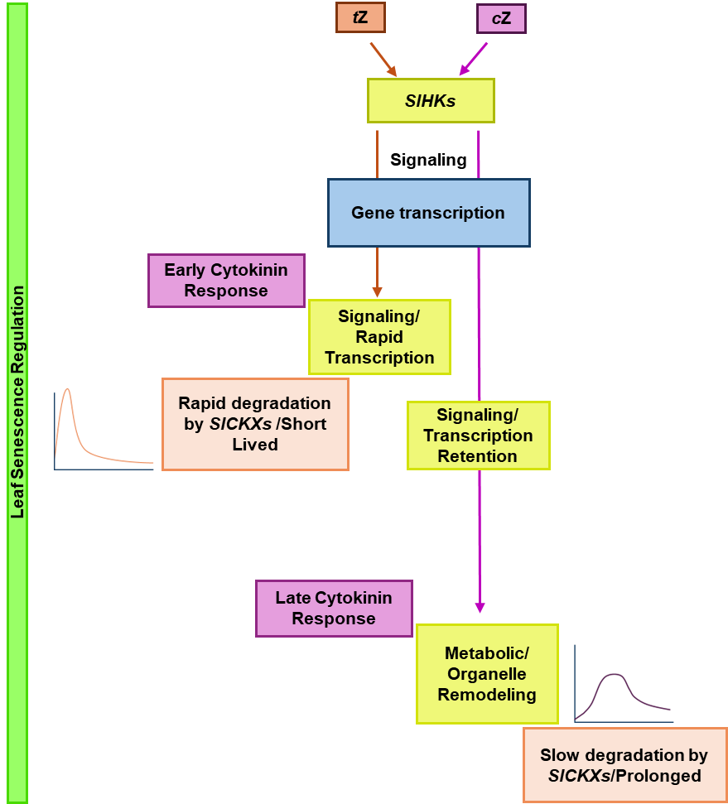
Supplementary Figure S5. Conceptual model of cis-zeatin (cZ) and trans-zeatin (tZ) mediated transcriptomic responses. – Time course transcriptomic analysis indicates that early cytokinin (CK) responses are predominantly associated with signaling and transcriptional initiation, whereas later responses are enriched for metabolic processes and organelle remodeling. Both tZ and cZ are perceived by shared histidine kinase CK receptors. However, transcriptomic data reveal differential SlCKX gene expression between tZ and cZ treatments during salt stress, as indicated by log₂ fold change values. Under stress conditions, this differential turnover is proposed to favor the accumulation of cZ base forms, contributing to sustained transcriptional responses and divergence in downstream physiological outcomes, including leaf senescence. This model is hypothetical and is intended to summarize and integrate the transcriptomic observations presented in this study.

