Slide 1
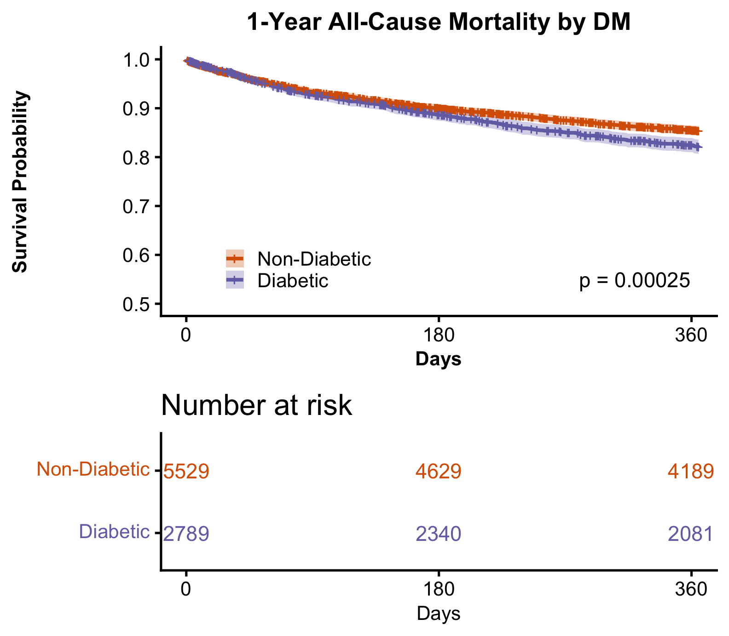
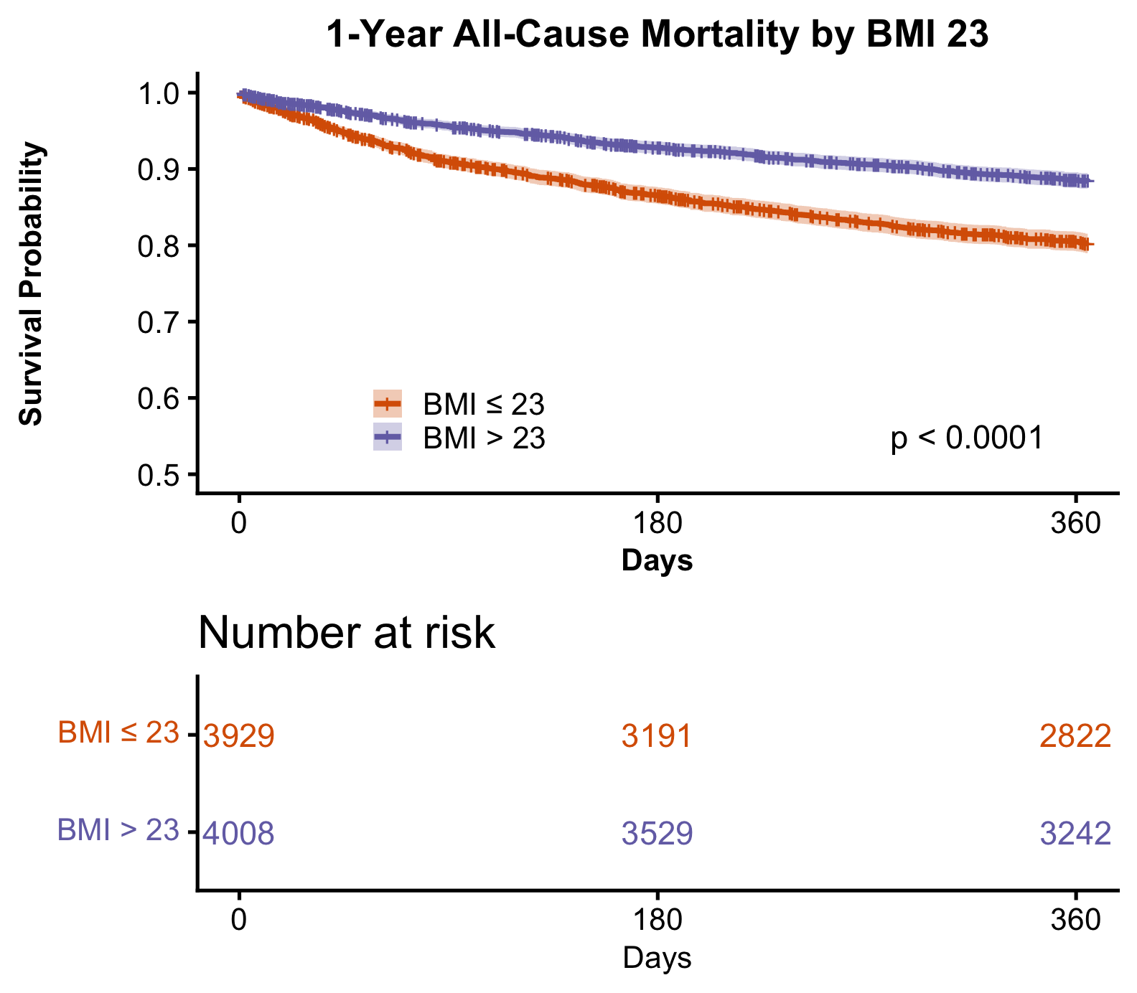
Figure S1. Kaplan-Meier survival curves for 1-year all-cause mortality stratified by (A) diabetes status and (B) overweight status (body mass index ≥ 23 kg/m²)
(A)
(B)

Slide 2
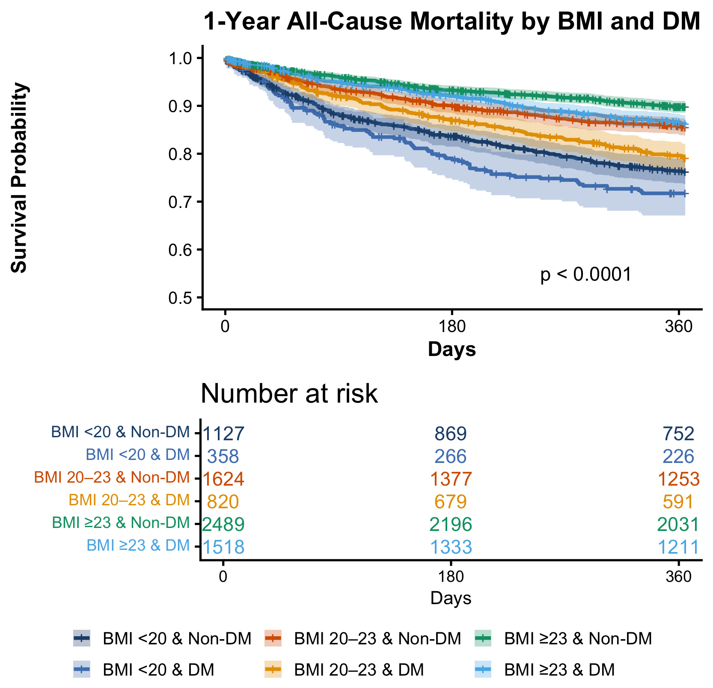
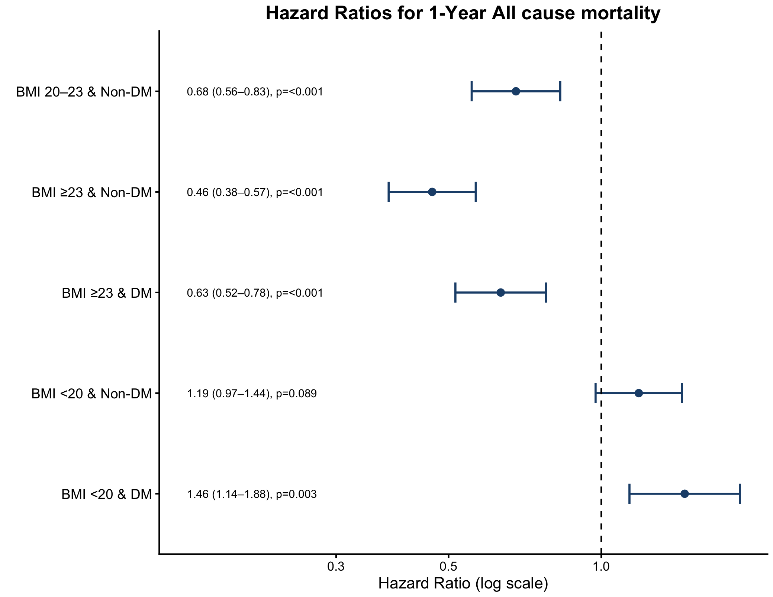
Figure S2. Kaplan-Meier survival curves and Cox proportional hazard ratios for 1-year all-cause mortality stratified by BMI and diabetes status. (A) Kaplan-Meier survival curves across six groups defined by BMI category (< 20, 20–23, and ≥ 23 kg/m²) and diabetes status. (B) Forest plot of unadjusted Cox proportional hazard ratios for 1-year all-cause mortality, with BMI 20–23 kg/m² and diabetes as the reference group.
(A)
(B)
Reference : BMI 20-23 & DM

Slide 3
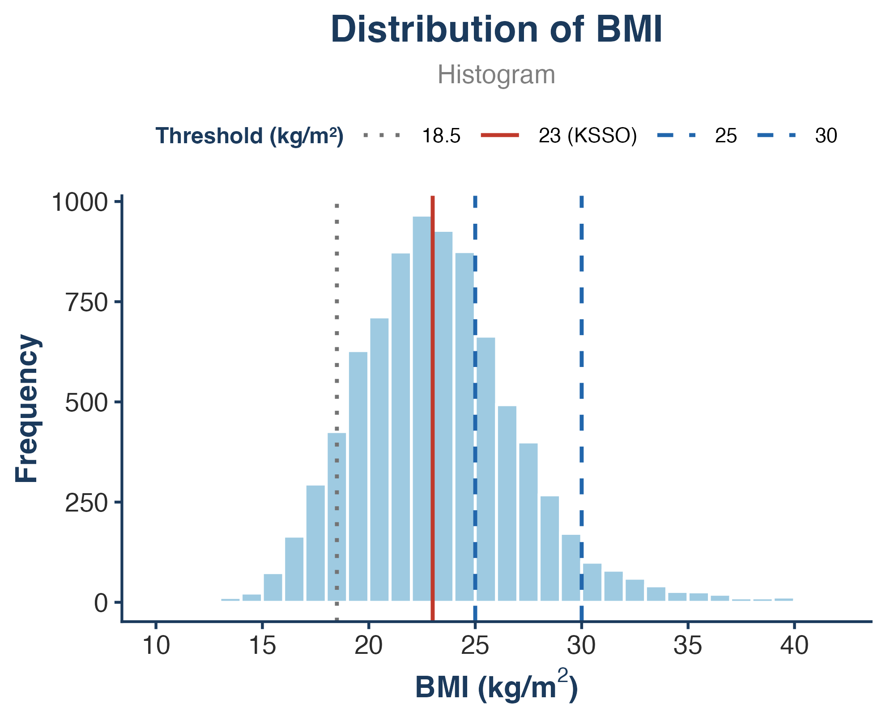
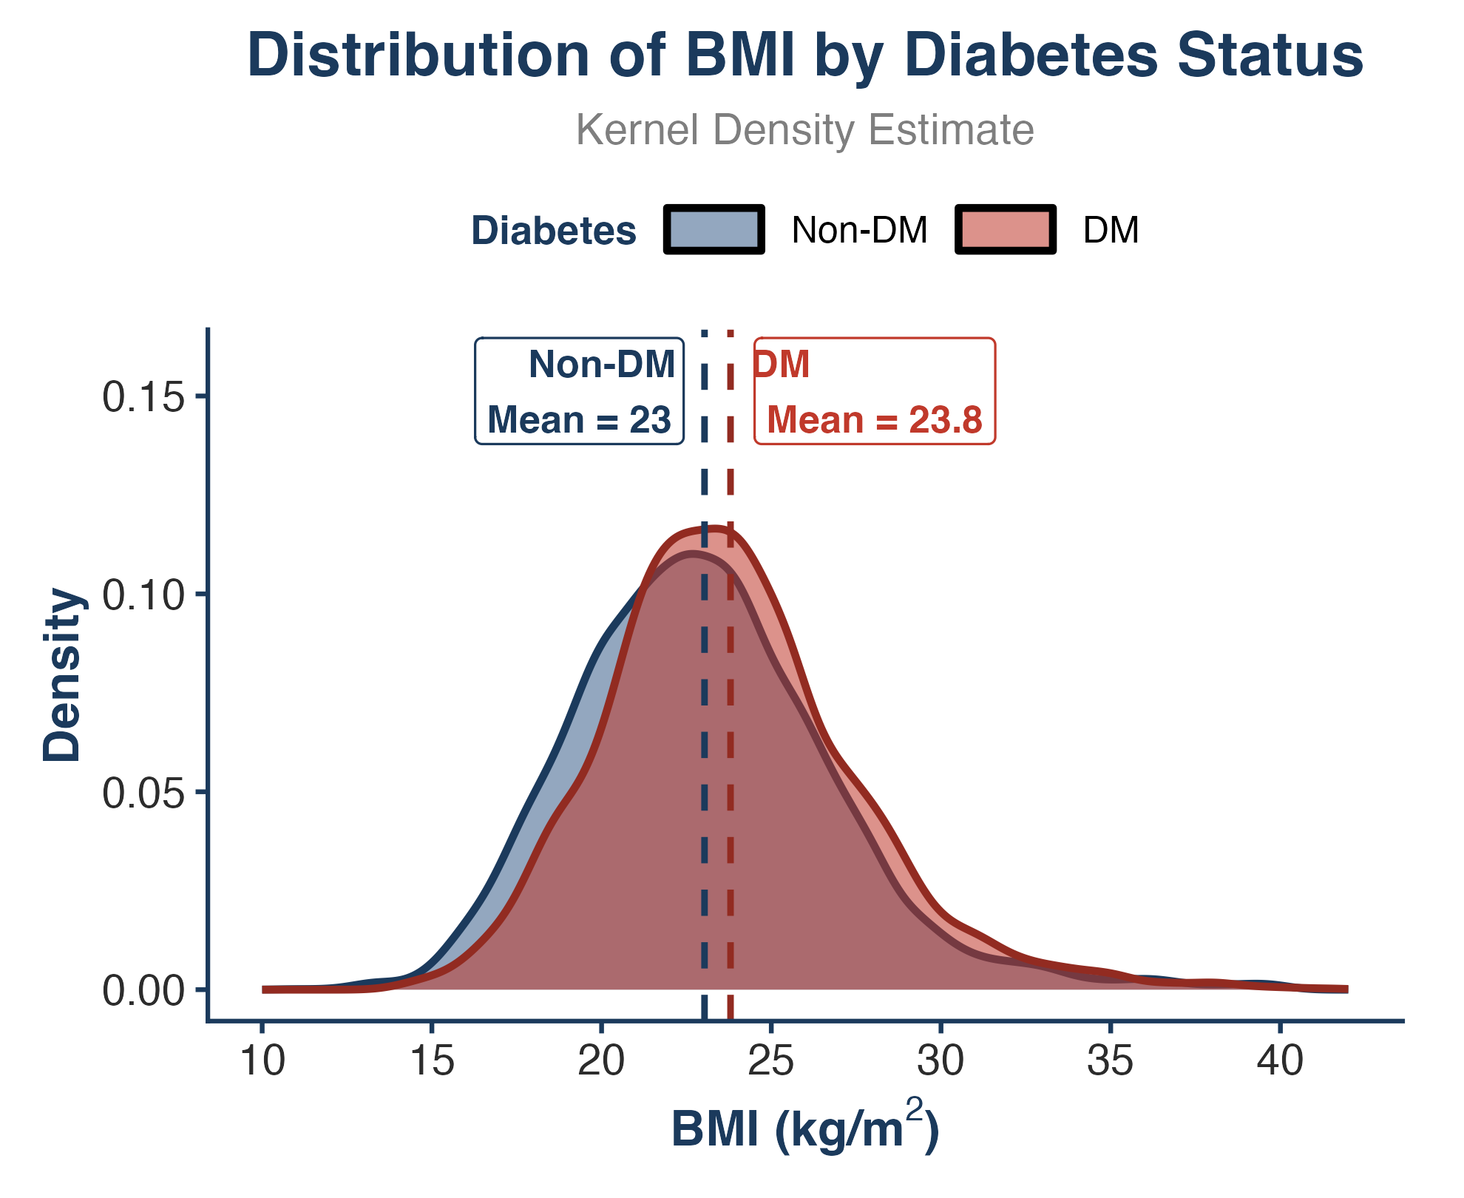
Figure S3. Distribution of body mass index (BMI) in the analysis cohort (N=8,383). (A) Histogram of BMI; vertical reference lines mark the KSSO overweight cutoff (23 kg/m², red solid) and the World Health Organization thresholds for underweight (18.5 kg/m², grey dotted), overweight (25 kg/m², blue dashed), and obesity (30 kg/m², blue dashed). (B) Kernel density estimates of BMI by diabetes status (non-DM vs DM); dashed vertical lines denote group means. Only 4.8% of patients had a BMI ≥30 kg/m².
(A)
(B)

