Slide 1
Supplementary Figure 1 A flow chart for the selection of study participants
8,558 subjects aged 35-69 years
In total 1,150 subjects were excluded.
- Previous history of ischemic heart disease, stroke, cancer or
missing data on these disease (n=859)
- Missing data on smoking habits, drinking habits, physical activity,
or total energy intake >4000 or <1000 kcal/day (n=231)
7,468 subjects

Slide 2
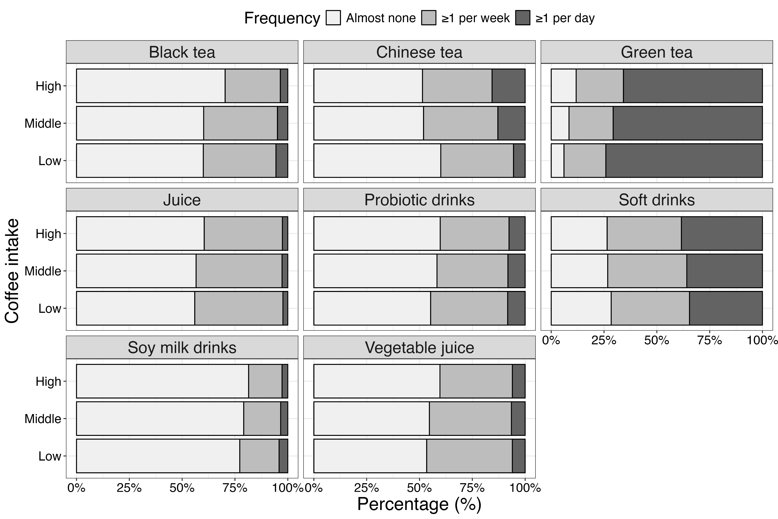
Supplementary Figure 2 Correlation between coffee intake and intakes of other beverages

