Slide 1
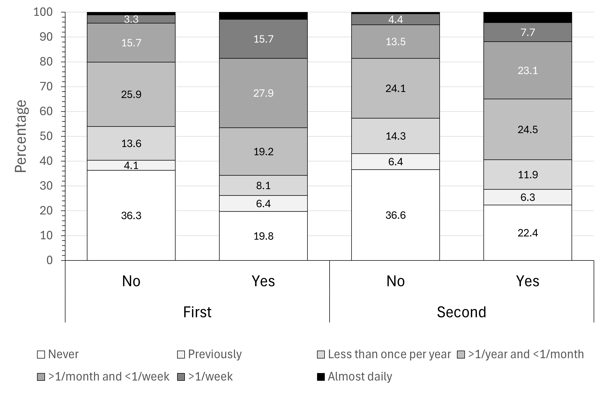
Supplementary figure 3: distribution of periodic leg movements frequency according to magnesium supplement use, second (2014-2017) and third (2018-2021) follow-ups of the CoLaus|PsyCoLaus study, Lausanne, Switzerland

