Slide 1
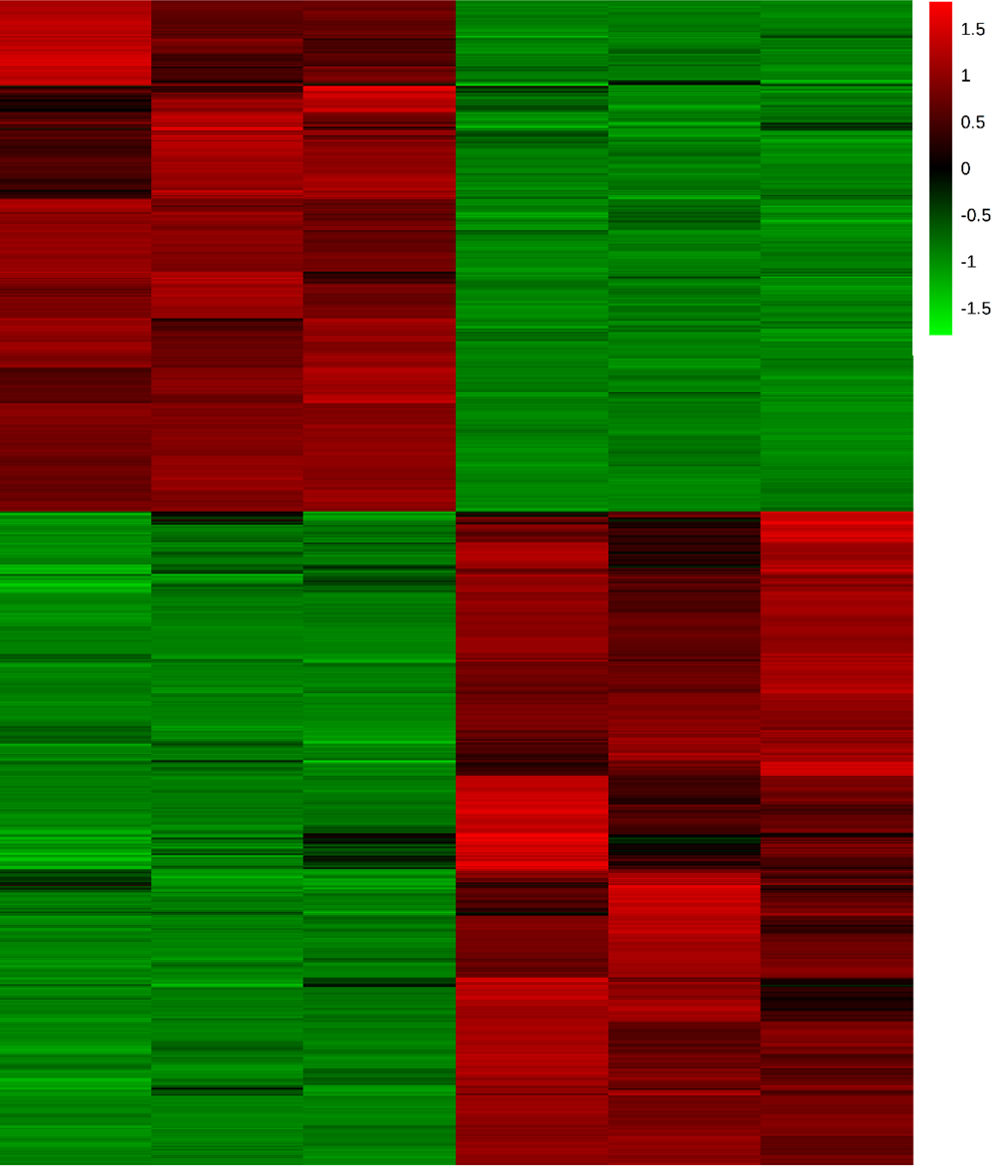
Supplemental Figure 1
2 hr
20 hr
(a)
(b)
Downregulated Biological Process | Combined Score
inflammatory response | 83
Cell proliferation | 71
Response to lipopolysaccharide | 46
Chemokine signaling pathway | 46
IL-1 signaling pathway | 42
Upregulated Biological Process | Combined Score
Interferon alpha synthesis | 33
Cilium assembly | 31
Negative regulation of mast cell degranulation | 31
Vesicle targeting | 29
Neutrophil degranulation | 27

