Slide 1
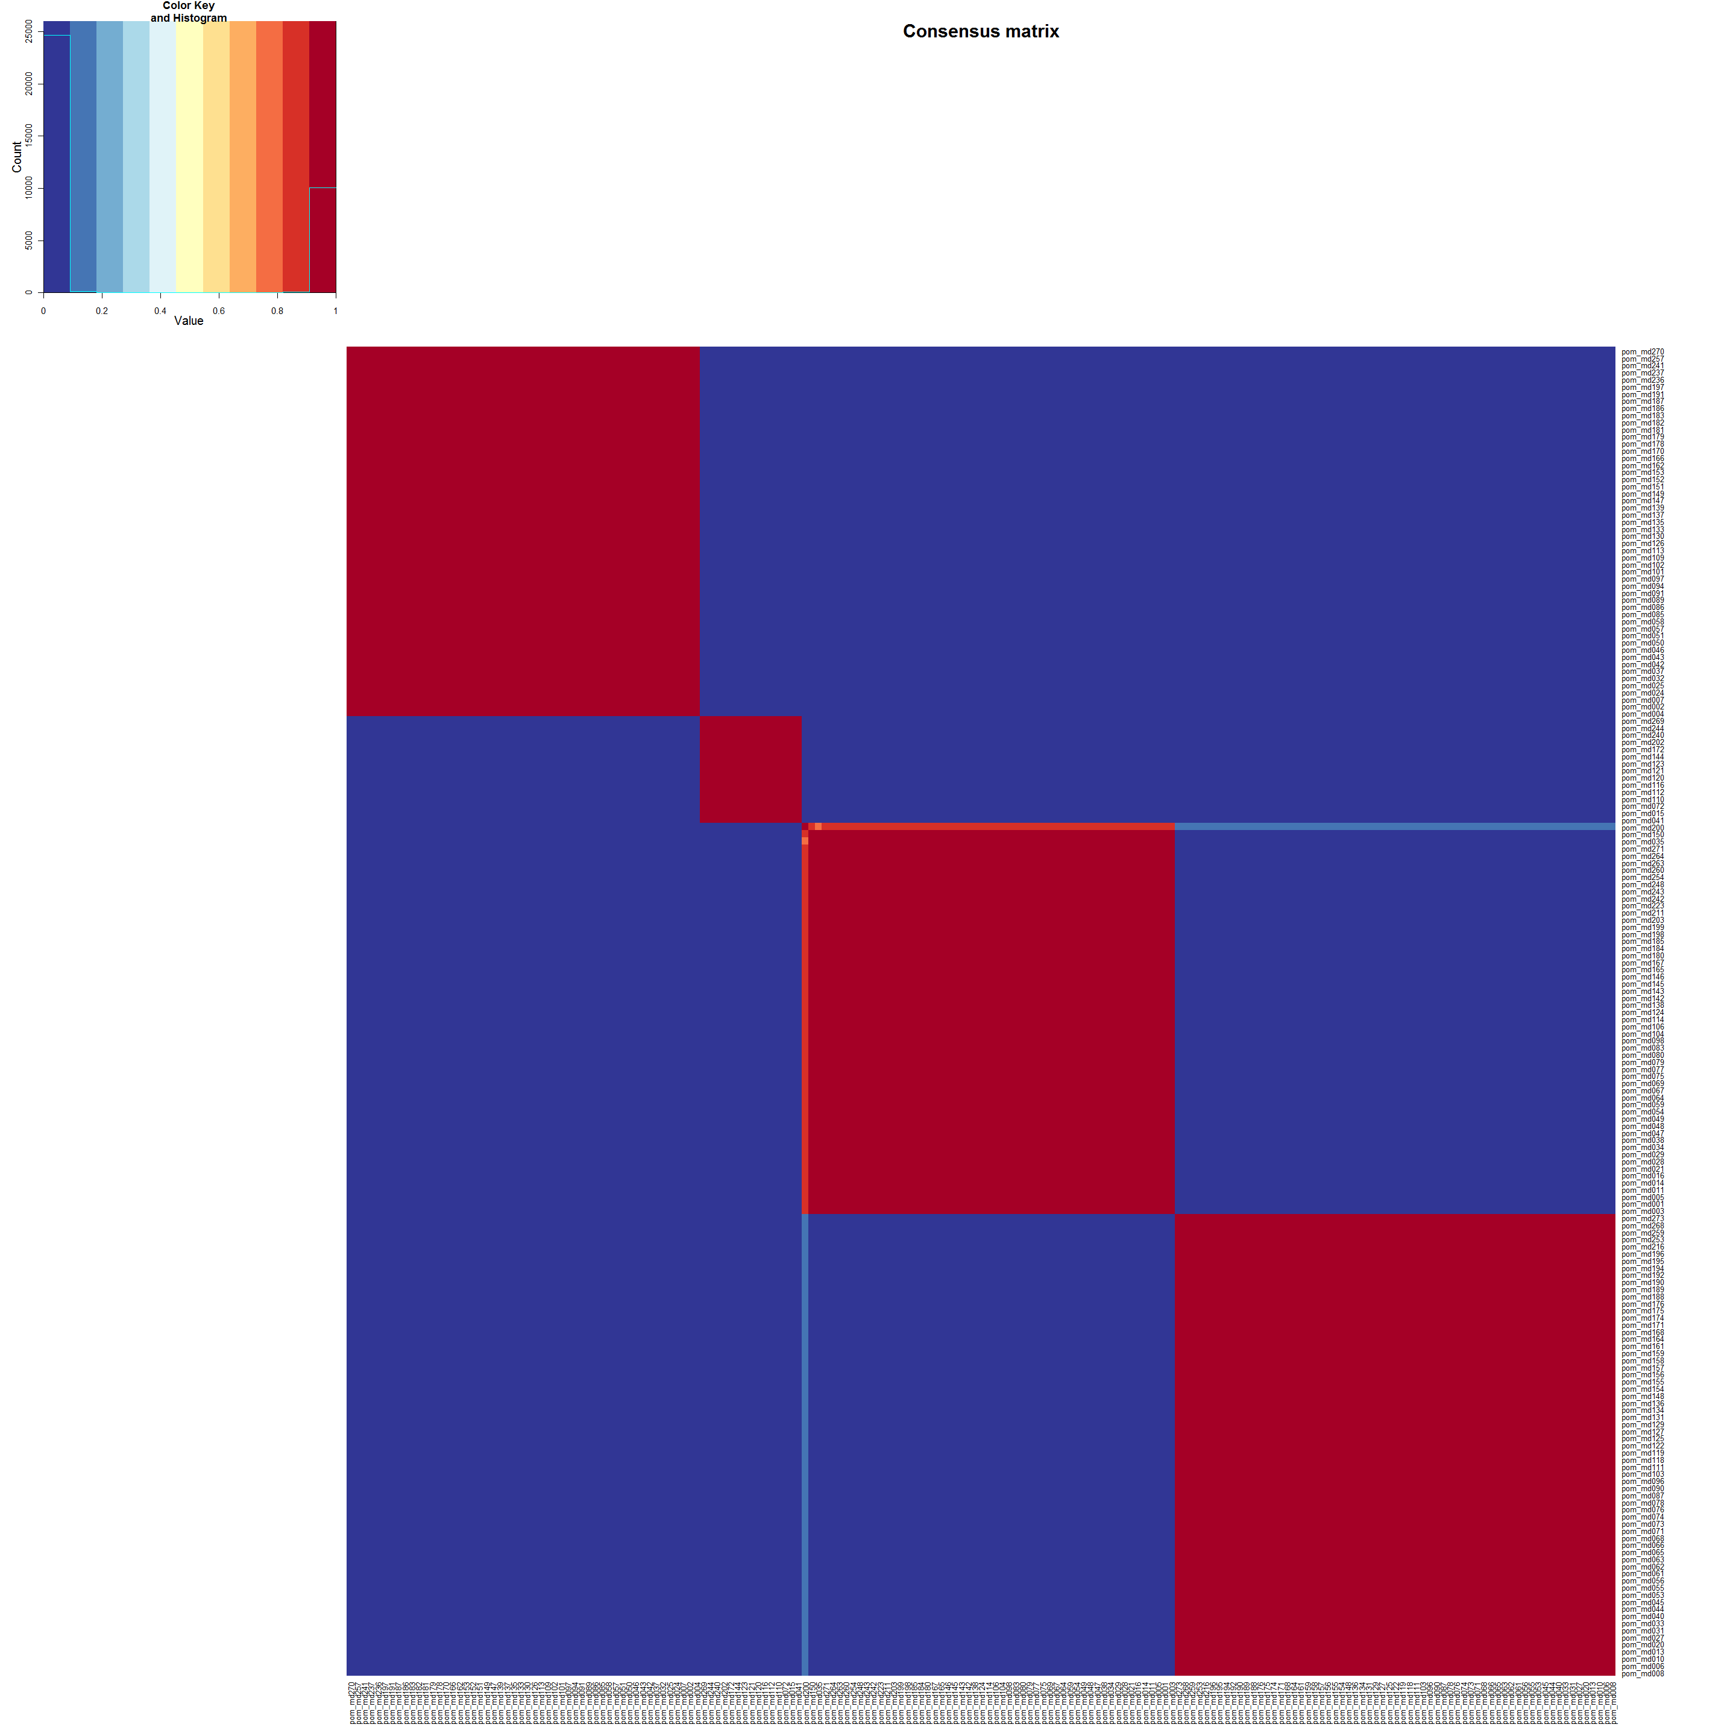
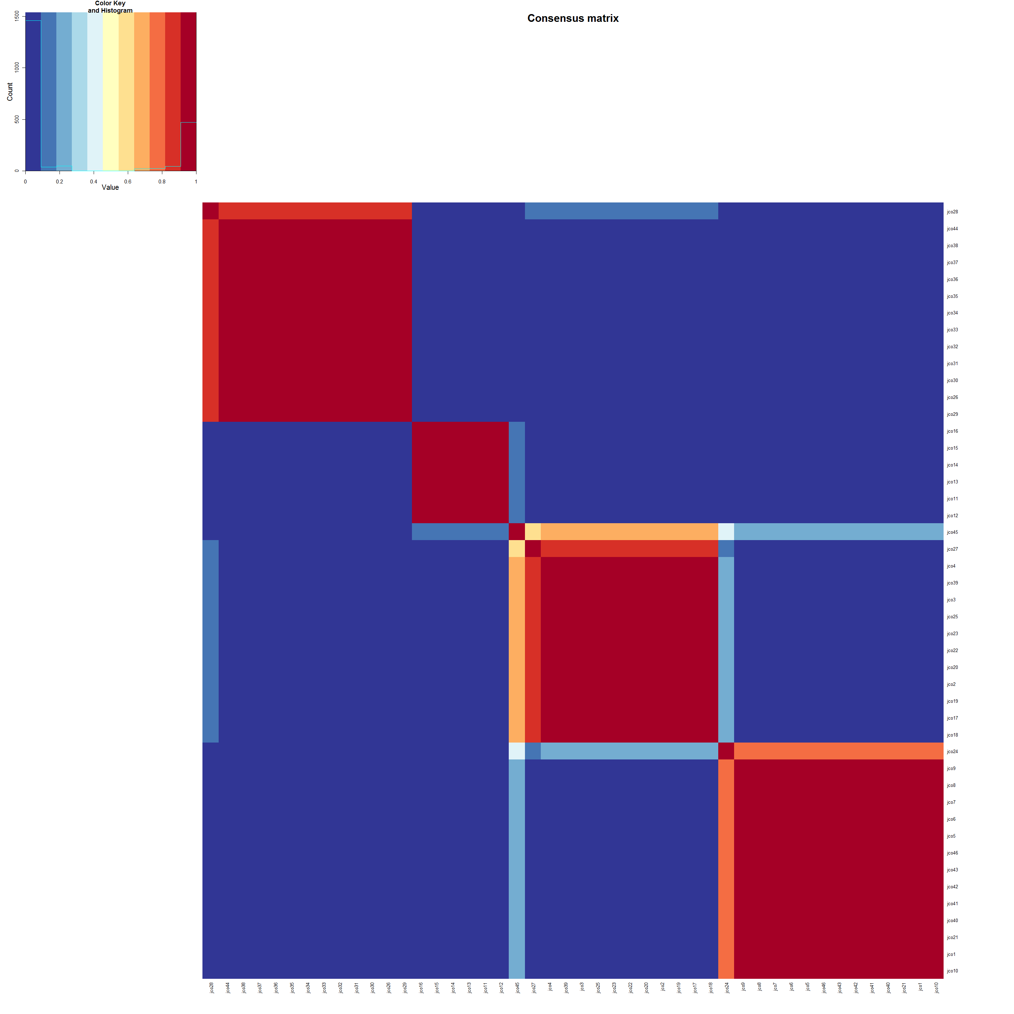
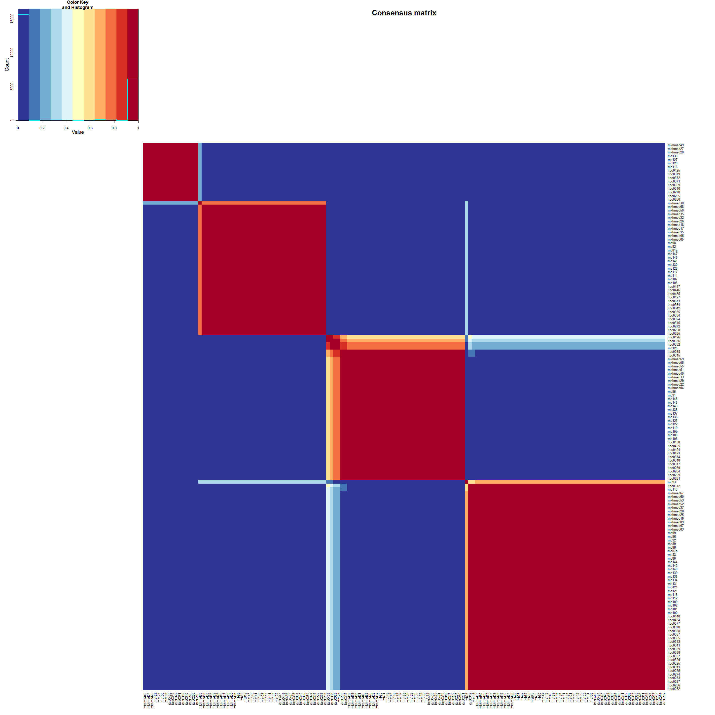
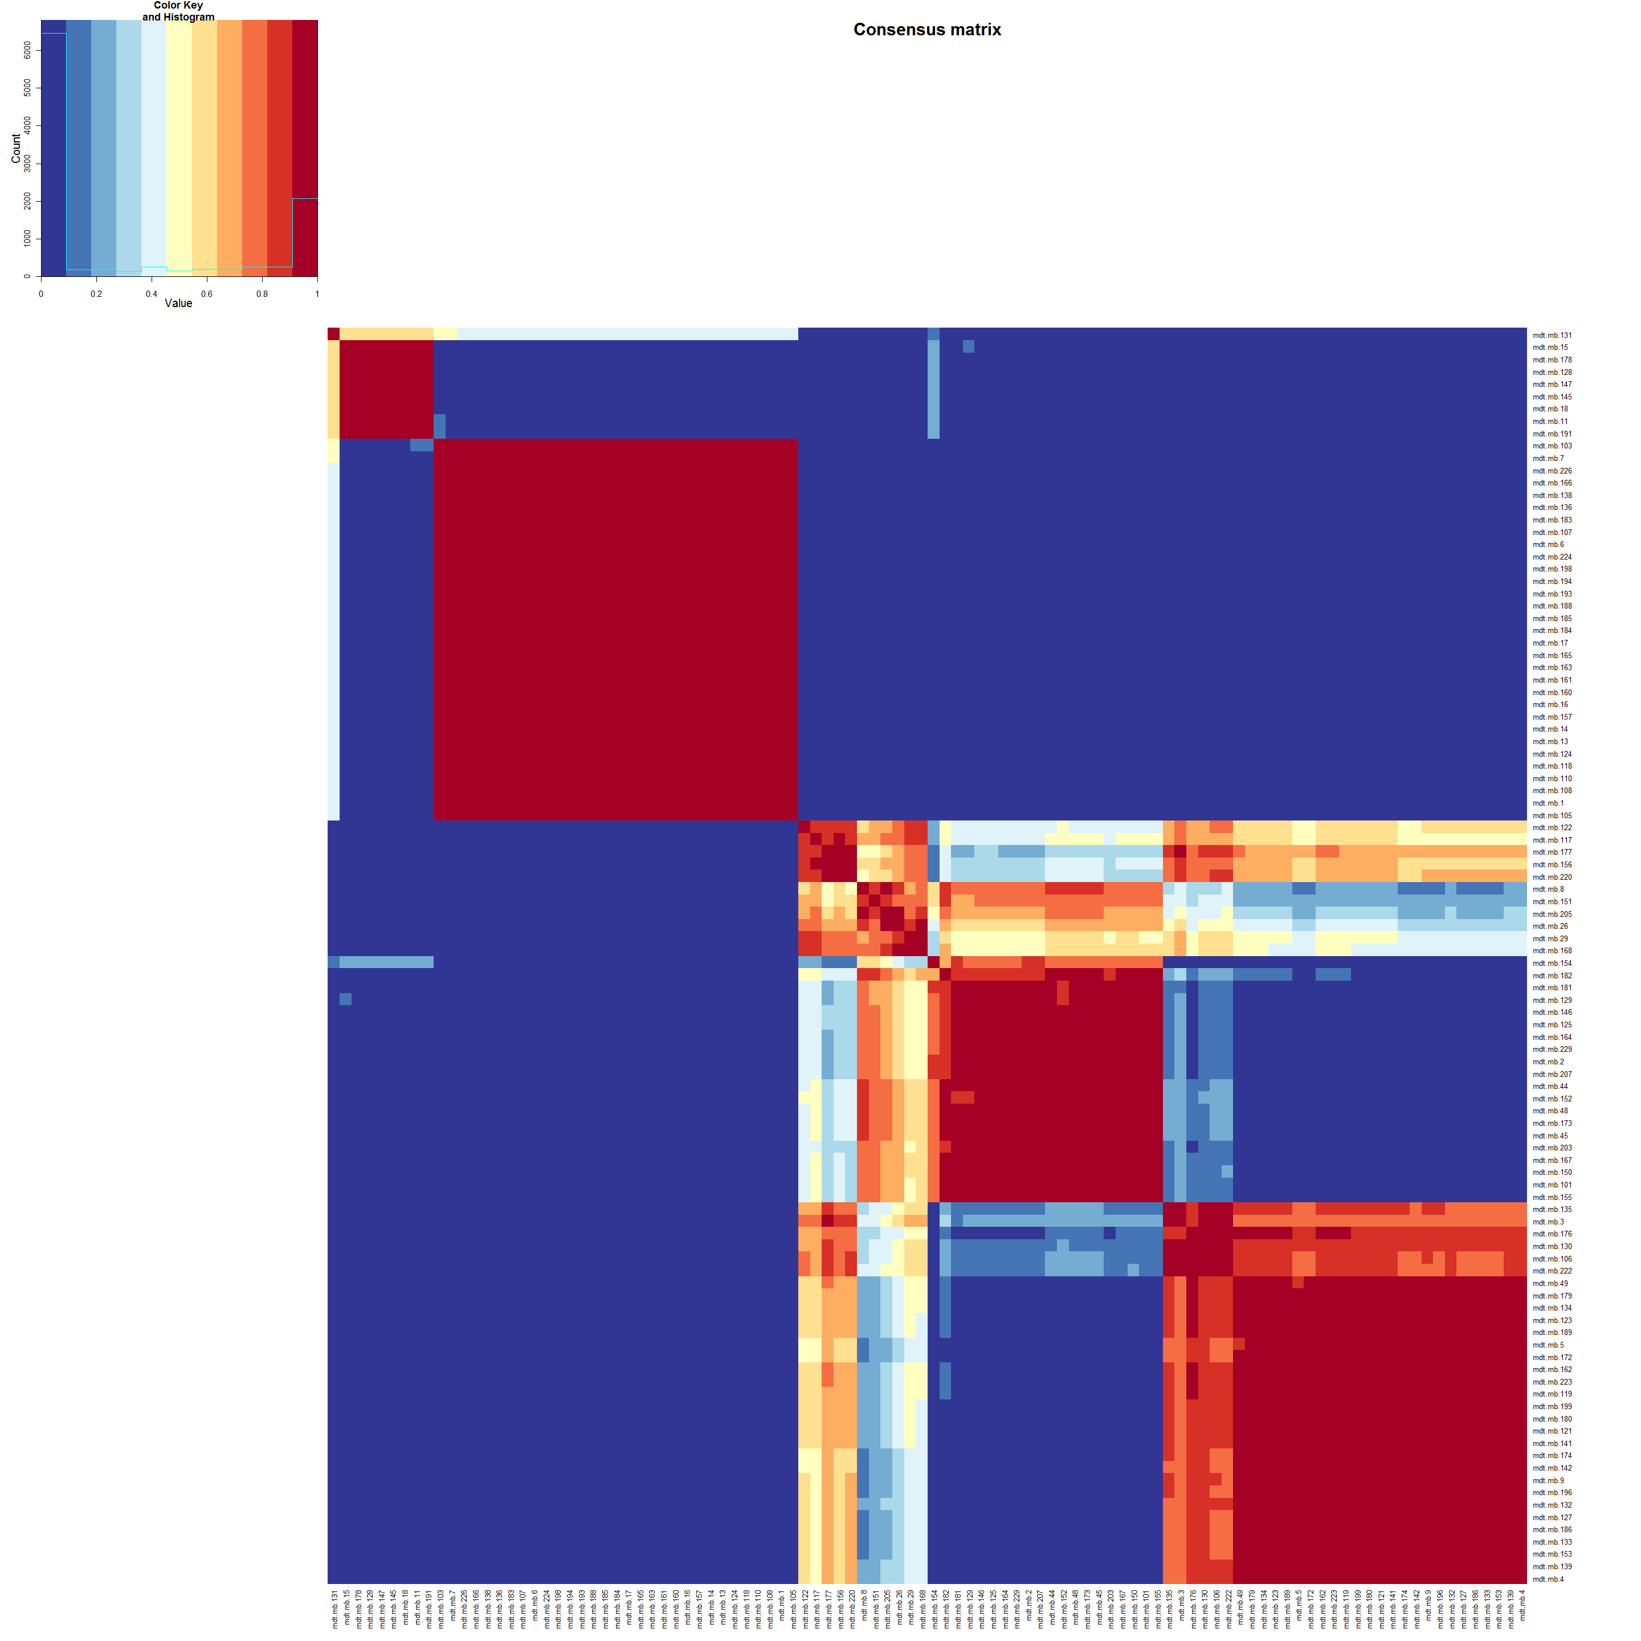
Supplementary Figure S1 - NMF cluster analyses
Cho series
Thompson series
Kool – Fattet – McCabe series
Northcott series
Remke series

Slide 2
Figure S2a: Subgroup distributions GEP and TMA cohorts
All patients GEP
All patients TMA
All patients GEP + TMA
All infants GEP
All infants TMA
All infants GEP + TMA
All children GEP
All children TMA
All children GEP + TMA
All adults GEP
All adults TMA
All adults GEP + TMA
WNT
SHH
GRP3
GRP4

Slide 3
Figure S2b: Subgroup distributions GEP and TMA cohorts
All patients GEP
All patients TMA
All patients GEP + TMA
All infants GEP
All infants TMA
All infants GEP + TMA
All children GEP
All children TMA
All children GEP + TMA
All adults GEP
All adults TMA
All adults GEP + TMA

Slide 4
Figure S2c: Male : female distributions GEP and TMA cohorts
All patients GEP
All patients TMA
All patients GEP + TMA
All infants GEP
All infants TMA
All infants GEP + TMA
All children GEP
All children TMA
All children GEP + TMA
All adults GEP
All adults TMA
All adults GEP + TMA

Slide 5
Figure S2d: Histology distributions GEP and TMA cohorts
All patients GEP
All patients TMA
All patients GEP + TMA
All infants GEP
All infants TMA
All infants GEP + TMA
All children GEP
All children TMA
All children GEP + TMA
All adults GEP
All adults TMA
All adults GEP + TMA

Slide 6
Figure S2e: Metastasis frequencies GEP and TMA cohorts
All patients GEP
All patients TMA
All patients GEP + TMA
All infants GEP
All infants TMA
All infants GEP + TMA
All children GEP
All children TMA
All children GEP + TMA
All adults GEP
All adults TMA
All adults GEP + TMA

Slide 7
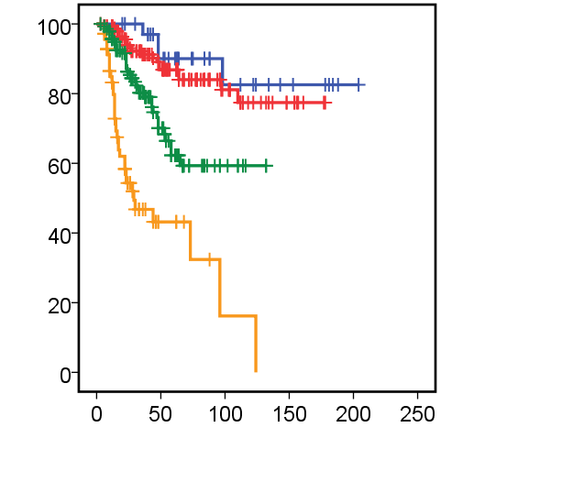
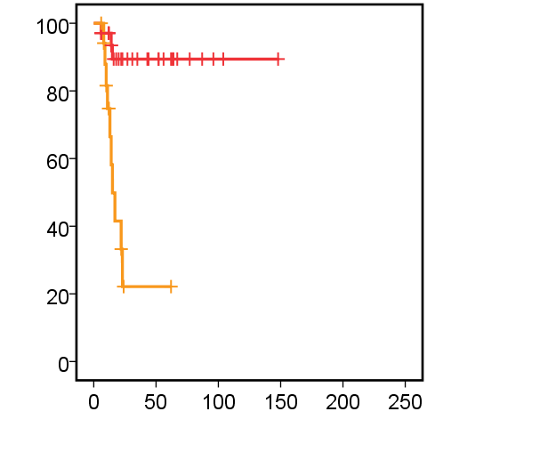
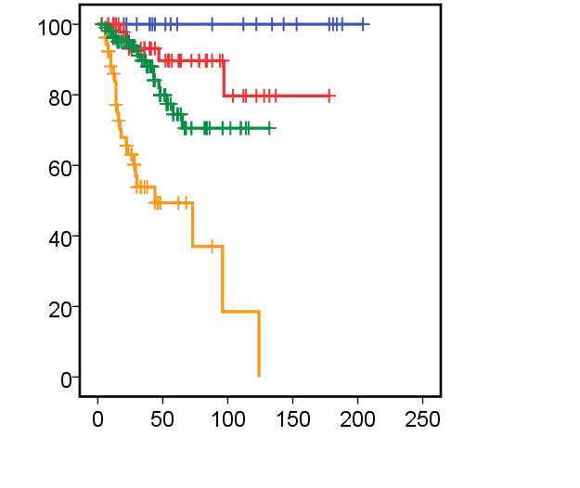
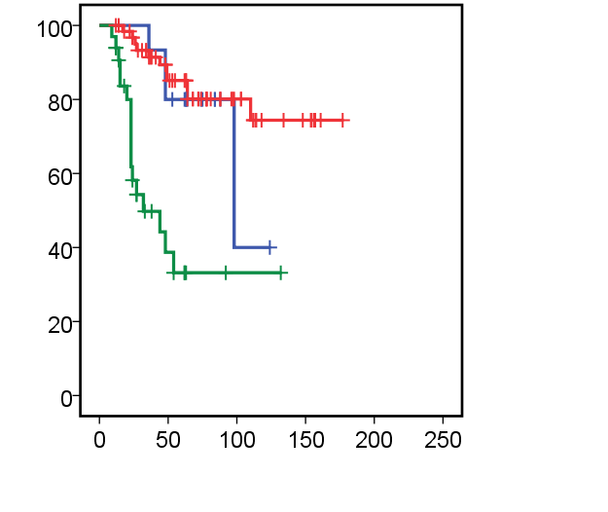
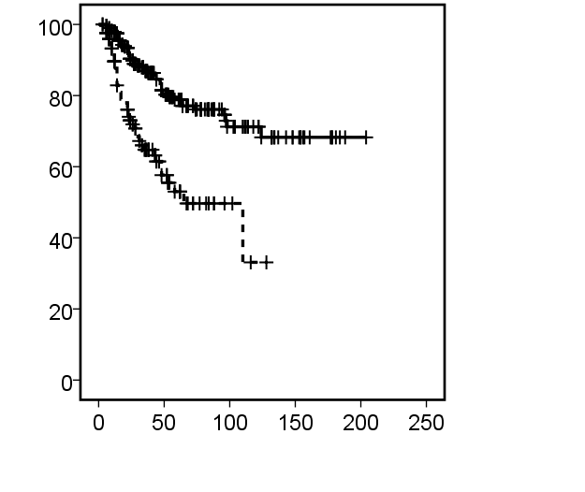
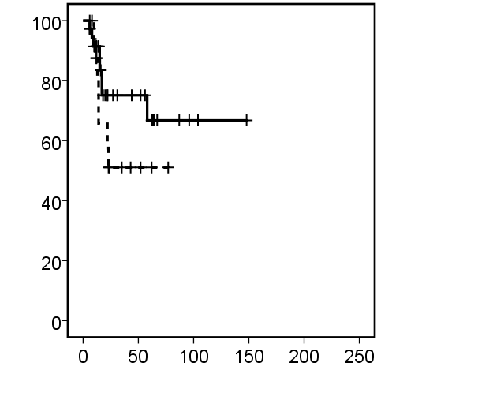
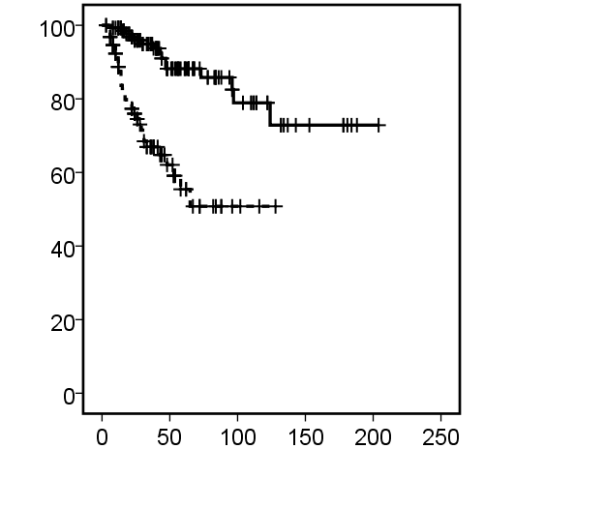
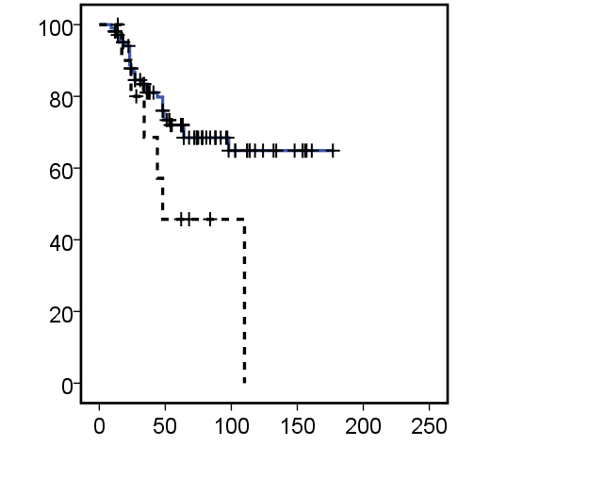
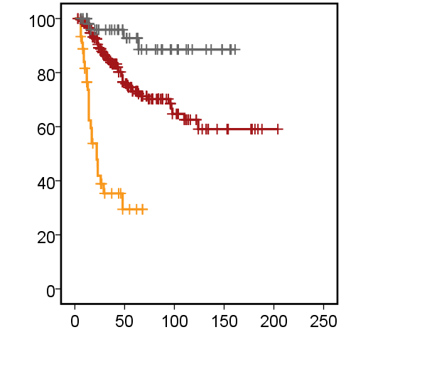
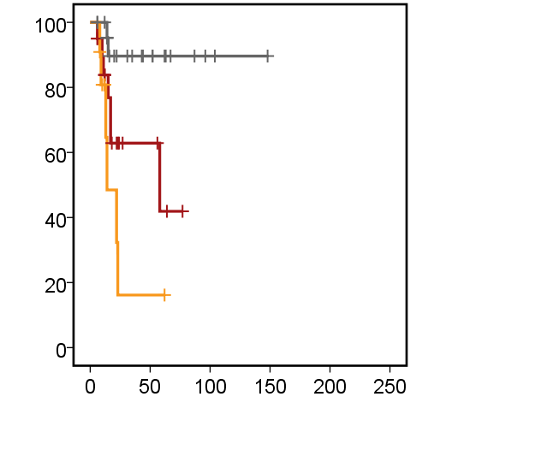
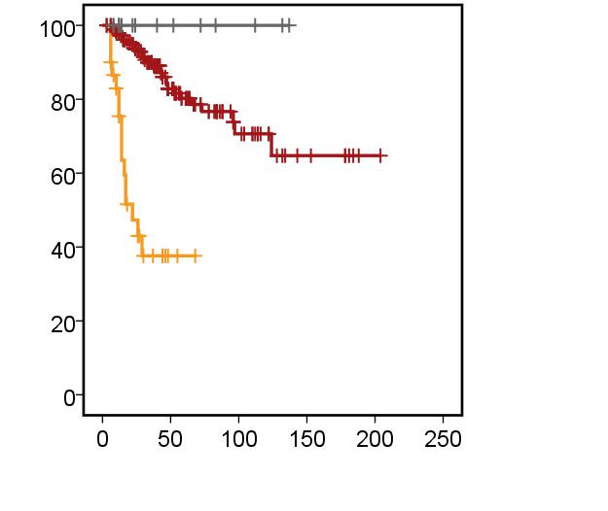
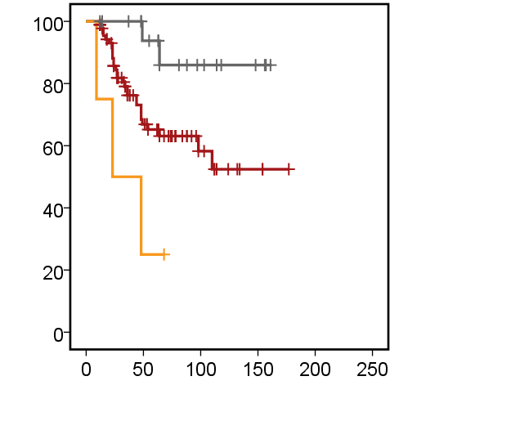
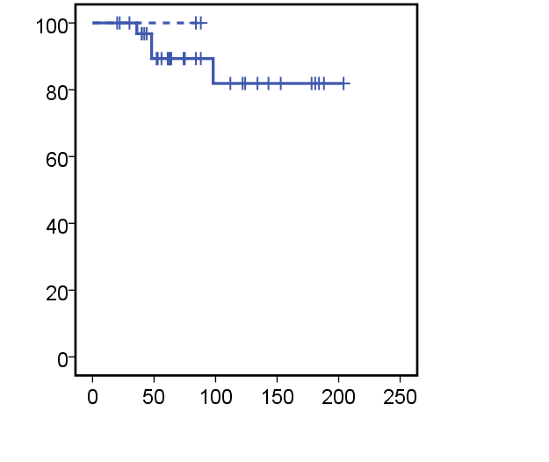
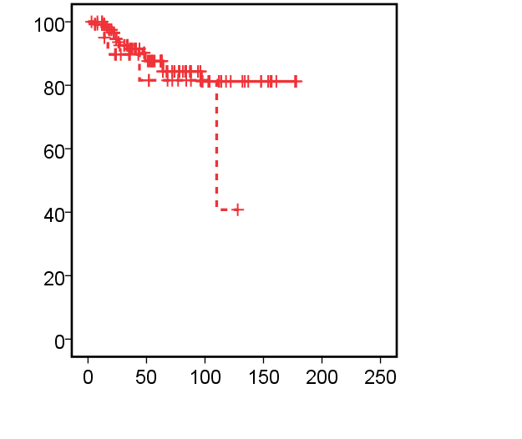
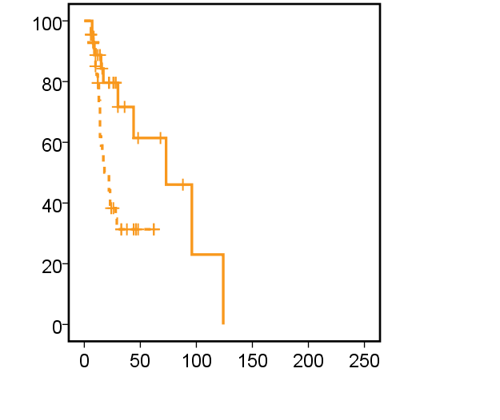
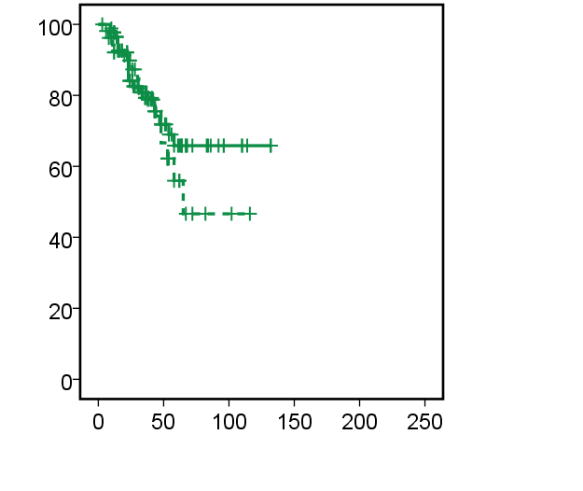
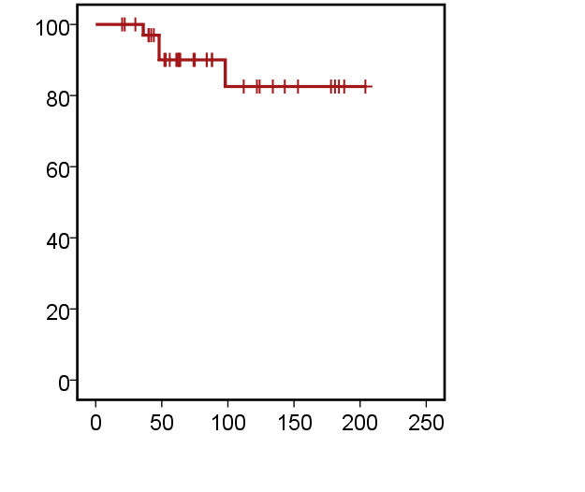
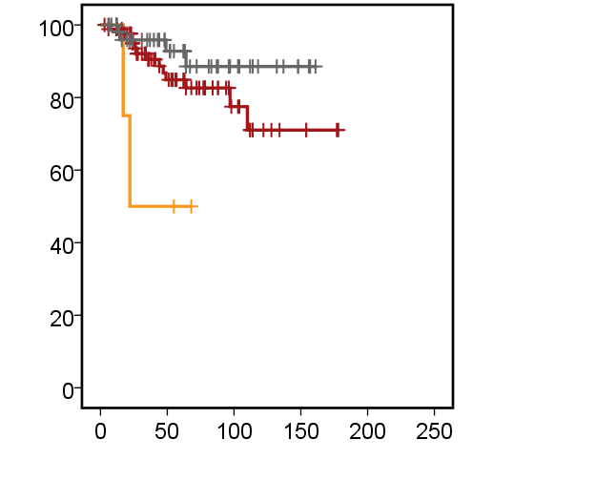
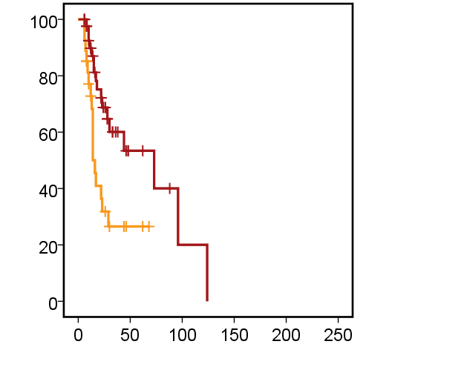
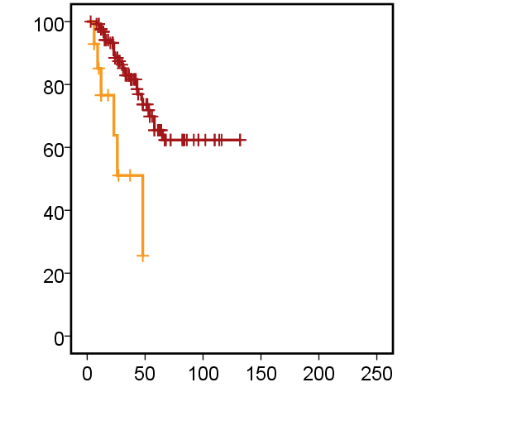
Figure S3: Survival analyses subgroups TMA
All patients
Infants
Children
Adults
WNT
SHH
WNT
SHH
SHH
SHH
GROUP 4
GROUP 4
GROUP 3
GROUP 3
WNT
a
b
GROUP 3
c
d
GROUP 4
P < 0.001
P < 0.001
P < 0.001
P < 0.001
M0
M0
M0
M0
M+
M+
M+
M+
e
P = 0.001
f
NS
g
P < 0.001
h
P = 0.046
DESMOPLASTIC
DESMOPLASTIC
DESMOPLASTIC
DESMOPLASTIC
CLASSIC
CLASSIC
LCA
CLASSIC
CLASSIC
i
LCA
j
LCA
k
l
LCA
P < 0.001
P = 0.001
P < 0.001
P = 0.004
WNT
SHH
GROUP 3
GROUP 4
M+
M0
M0
M0
M+
M0
M+
m
n
o
M+
p
NS
NS
P = 0.009
NS
DESMOPLASTIC
CLASSIC
CLASSIC
CLASSIC
LCA
CLASSIC
LCA
q
r
P = 0.017
s
LCA
P = 0.004
t
P < 0.001

