Slide 1
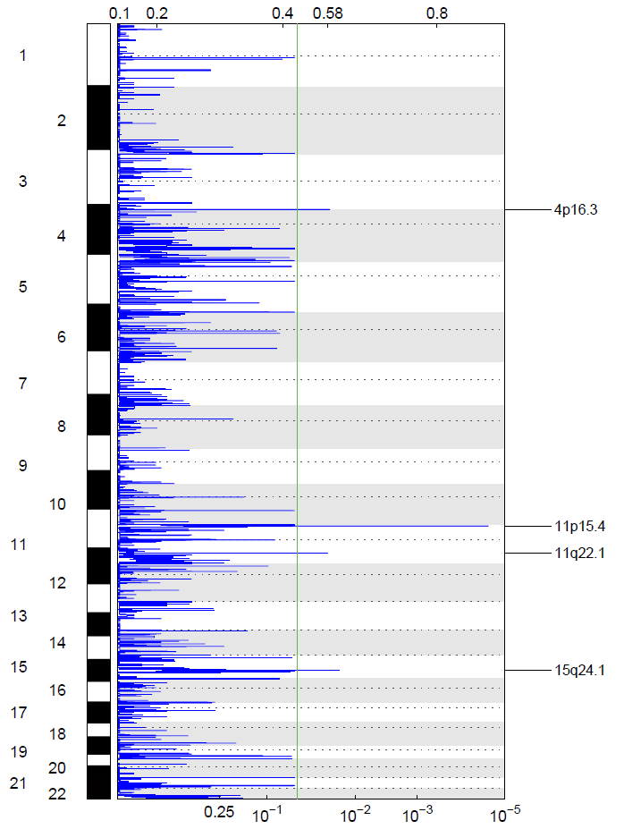
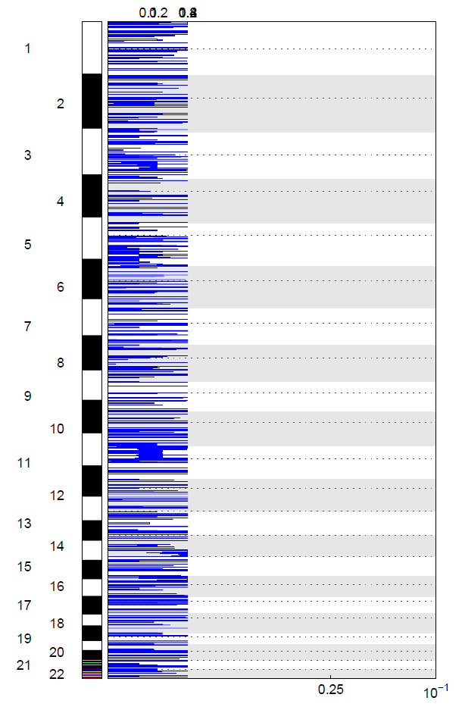
Sup Fig. 1
K27M-H3.3 WT-H3.3
ZNF718
OR52N4
PGR
CLK3

