Slide 1
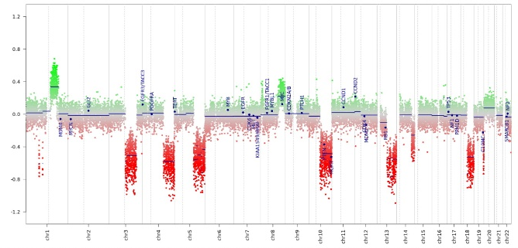
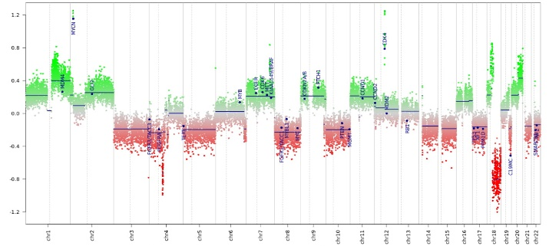
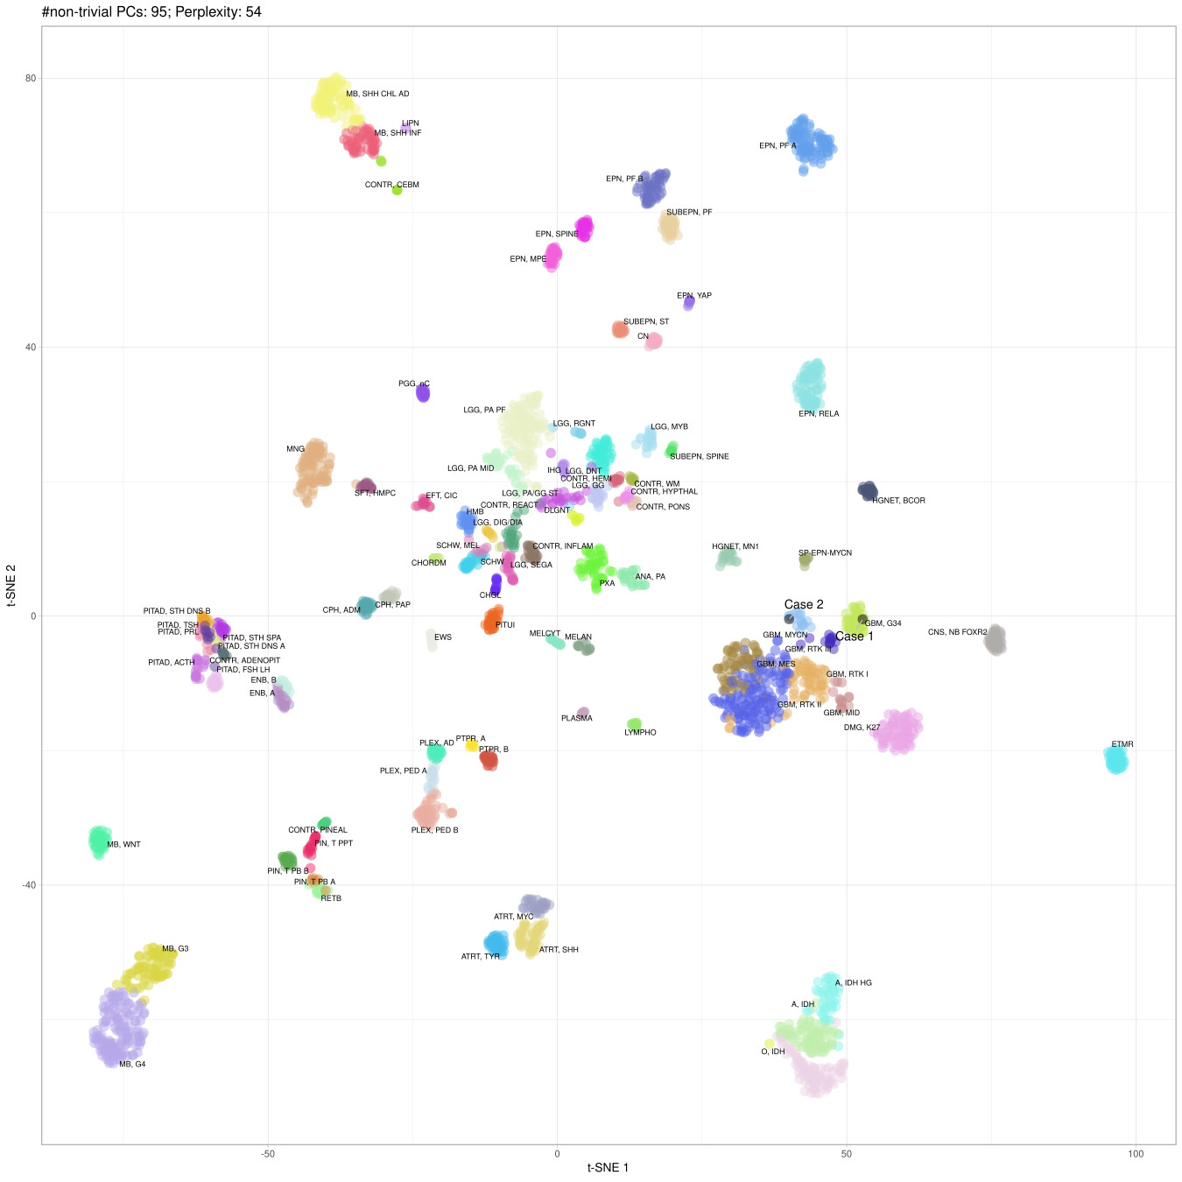
Schoof et al., Supplementary Figure 1
a
Case 1
b
Case 2
c
Supplementary Figure 1: Extended molecular information. (a-b) Copy number profile plots with various chromosomal gains in and losses. Note the focal MYCN and CDK4 amplification in case 2. (c) t-SNE of the entire reference cohort, described in [2] confirms the affiliation of the two cases to the respective DNA methylation classes: glioblastoma, IDH wildtype, H3.3 G34 mutant and glioblastoma, IDH wild type, subclass MYCN.

