Slide 1
Examples of Phase maps including thresholds and figures of each mineral and glass created by overlaying them
We first obtained Phase maps of Mg, Al, Fe, K, and Ca using a JXA-8530F electron microprobe analyzer at Earthquake Research Institute.
Each Phase map shows multiple brightness peaks corresponding to different minerals. Among these, we selected the maps that contained peaks corresponding to the target mineral (Map1) . By setting a threshold to isolate only the peaks of the target mineral and then overlaying and colorizing these extracted regions(Map2), we calculated the colored area to determine the areal distribution of each mineral(Map3).
The detailed methodology is shown in Yasuda and Hokanishi (2022)

Slide 2
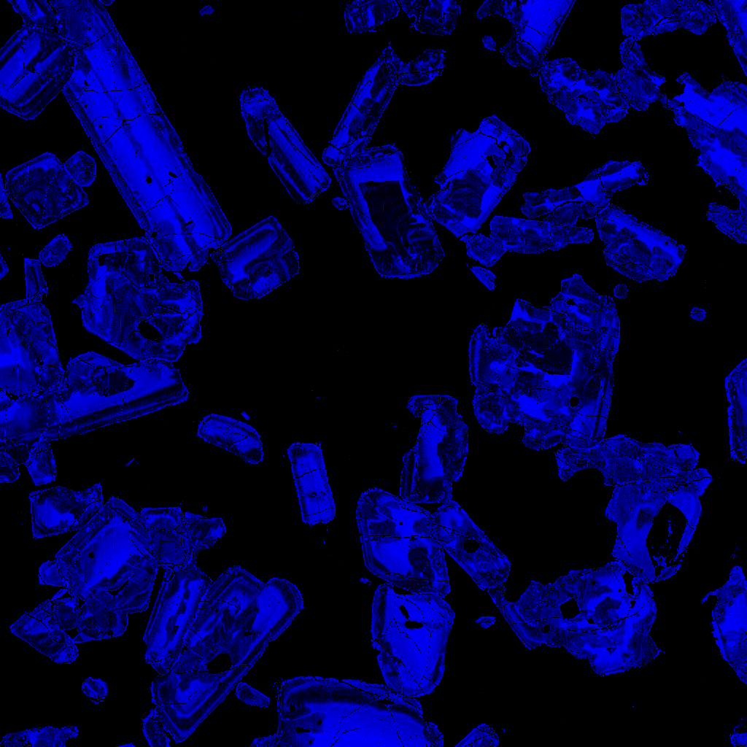
Phase | Threshold
Plagioclase | Al: 400- , Fe:0-20
Plagioclase (Map2)
Al: 400- (Map1)
Fe:0-20 (Map1)
500μm

Slide 3
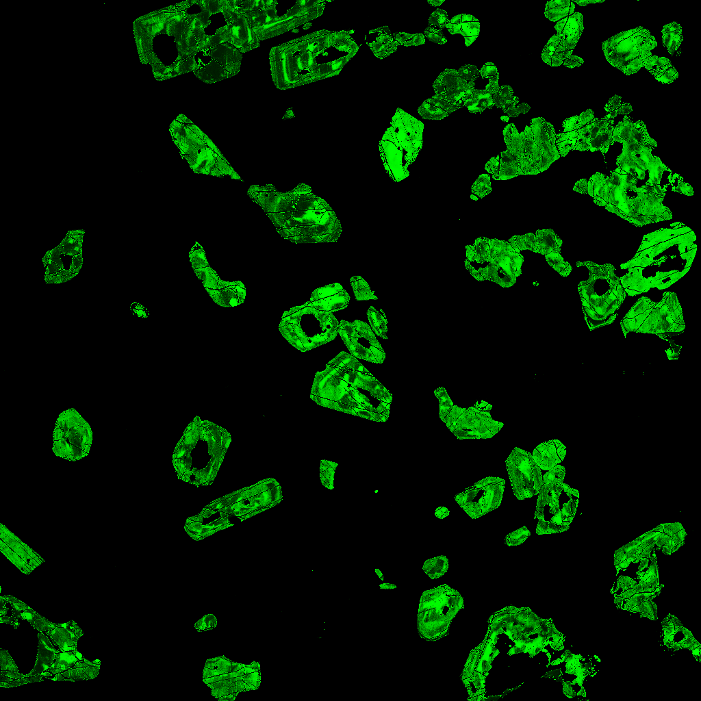
Phase | Threshold
Amphibole | Mg:40-, Ca:50-
Amphibole (Map2)
Mg:40- (Map1)
Ca:50- (Map1)
500μm

Slide 4
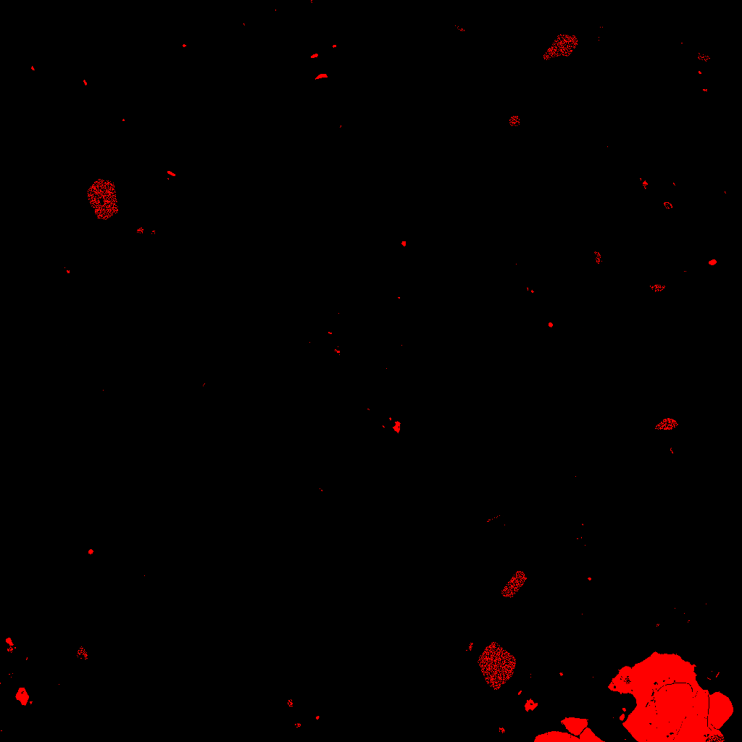
Phase | Threshold
Magnetite | Fe:150-, Mg:0-50
Magnetite (Map2)
Fe:150- (Map1)
Mg:0-50 (Map1)
500μm

Slide 5
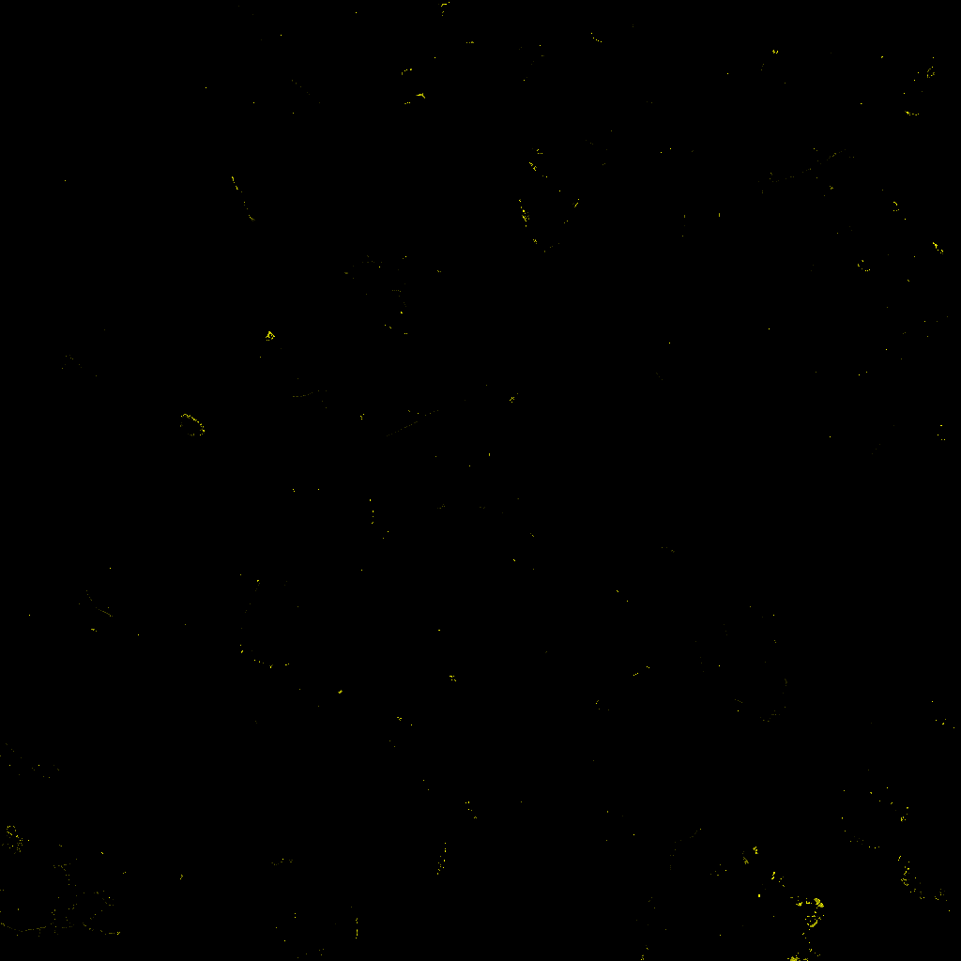
Phase | Threshold
Clinopyroxene | Mg:50-150, Al:0-100, Ca:30-
Clinopyroxene (Map2)
Mg:50-150 (Map1)
Al:0-100 (Map1)
Ca:30- (Map1)
500μm

Slide 6
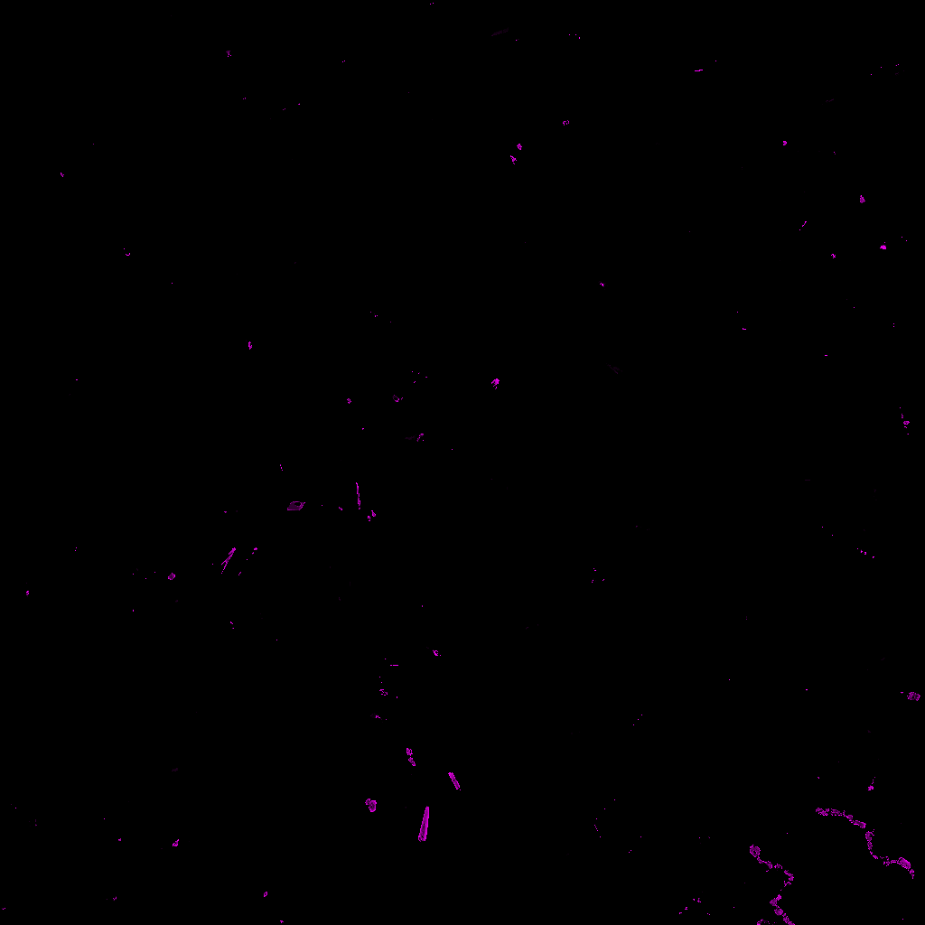
Phase | Threshold
Orthopyroxene | Mg:40-, Al:0-100, Ca:0-30
Orthopyroxene (Map2)
Mg:40- (Map1)
Al:0-100 (Map1)
Ca:0-30 (Map1)
500μm

Slide 7
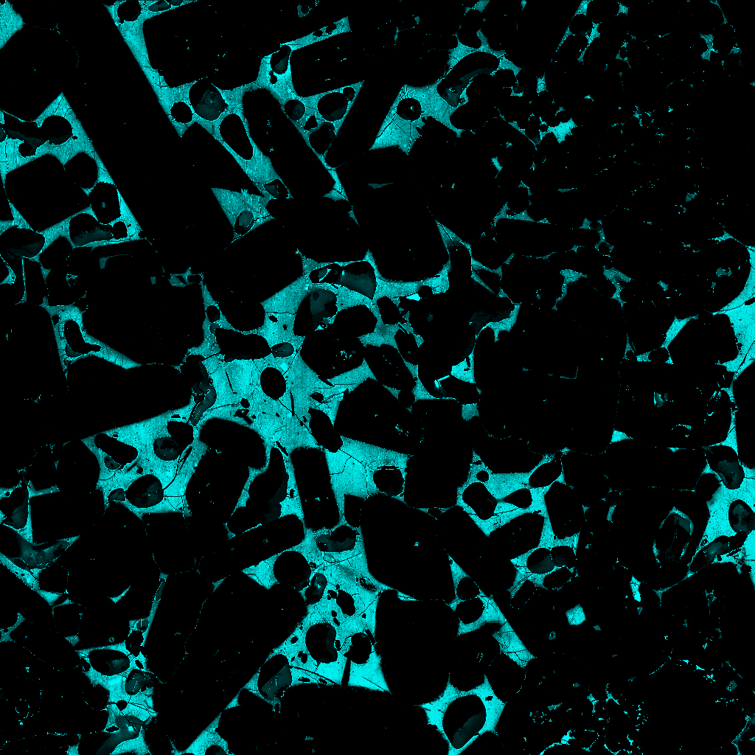
Phase | Threshold
Glass | Al:100-450, K:5-, Mg:0-25
Glass (Map2)
Al:100-450 (Map1)
K:5- (Map1)
Mg:0-25 (Map1)
500μm

Slide 8
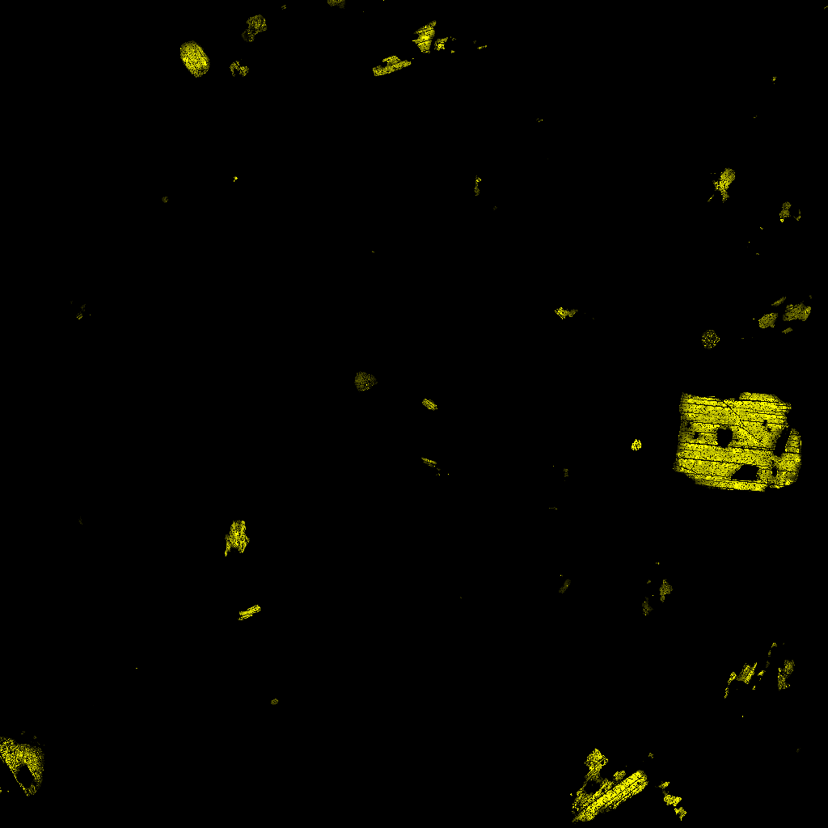
Phase | Threshold
Biotite | K:30-, Mg:40-
Biotite (Map2)
K:30- (Map1)
Mg:40- (Map1)
500μm

Slide 9

Phase | Threshold
Quartz | COMPO:1840-2000, Al:0-20, K:0-4
Quartz (Map2)
COMPO:1840-2000 (Map1)
Al:0-20 (Map1)
K:0-4 (Map1)
500μm

Slide 10
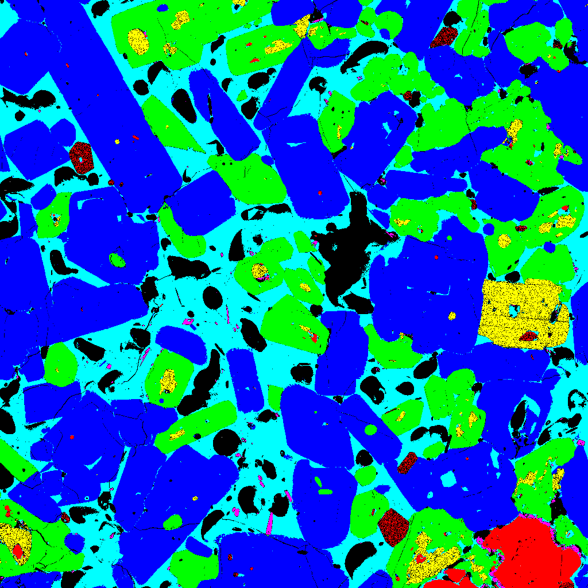
Summary of phase map （Map3）
Blue: Plagioclase (area% = 45.76)
Green: Amphibole (area% = 20.39)
Pink: Pyroxene (area% = 0.31)
Red: Magnetite(area% = 1.95)
Yellow: Biotite (area% = 1.95)
Light blue: interstitial melt (area% = 19.21)
Unclassed : (area% = 1.4)
Total = 92.97 %
Black: Void
500μm
This diagram shows a single map created by overlaying color-coded areas for each mineral. From the diagram, the area of each color-coded region was calculated to determine the modal composition. This was performed for most regions within each crystal clot, calculating the proportion of minerals and glass within each clot.

