Slide 1
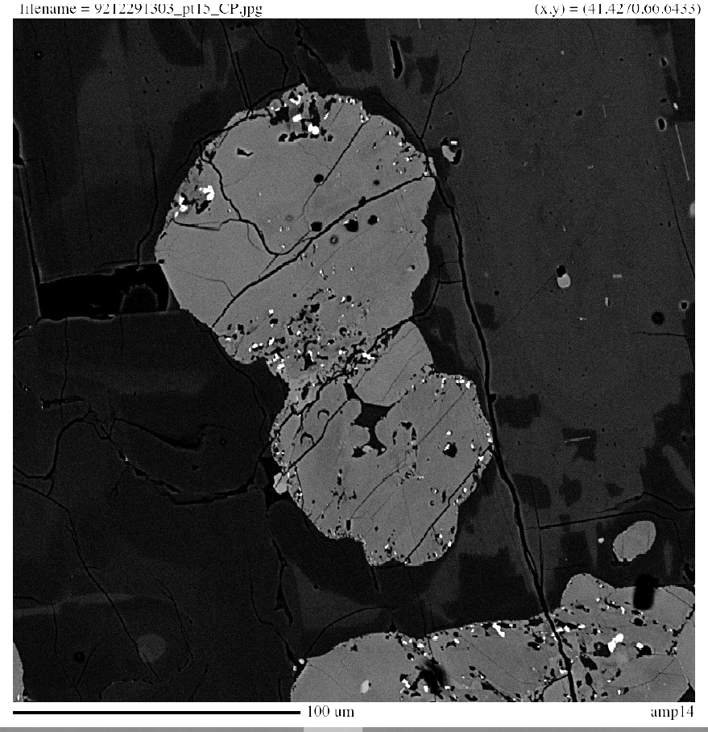
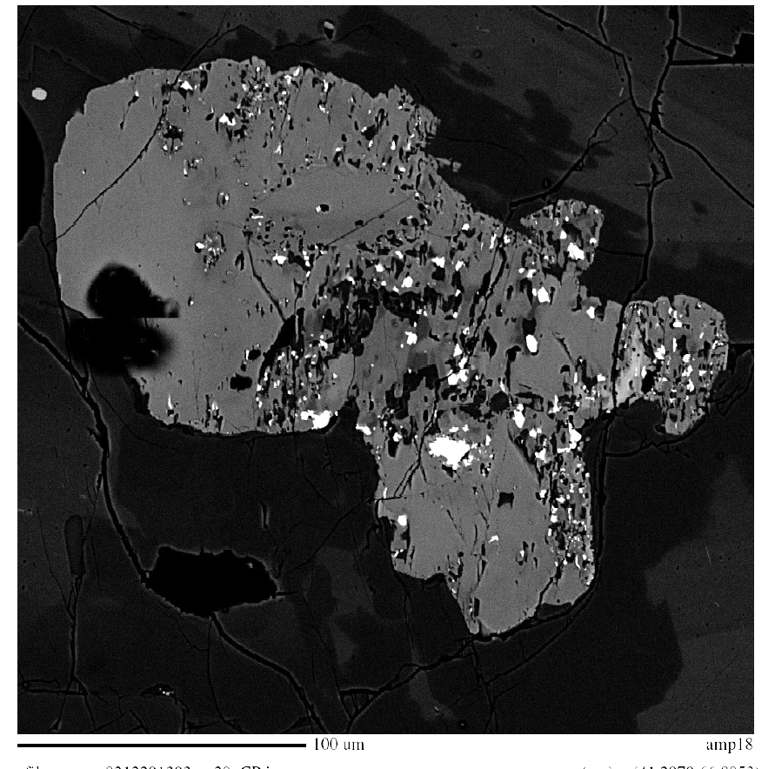
Examples of “rimmed” amphiboles found in #92_1 (December 29, 1992). Reaction rims are developed not only along the outer margins but also internally within the crystals.

