Slide 1
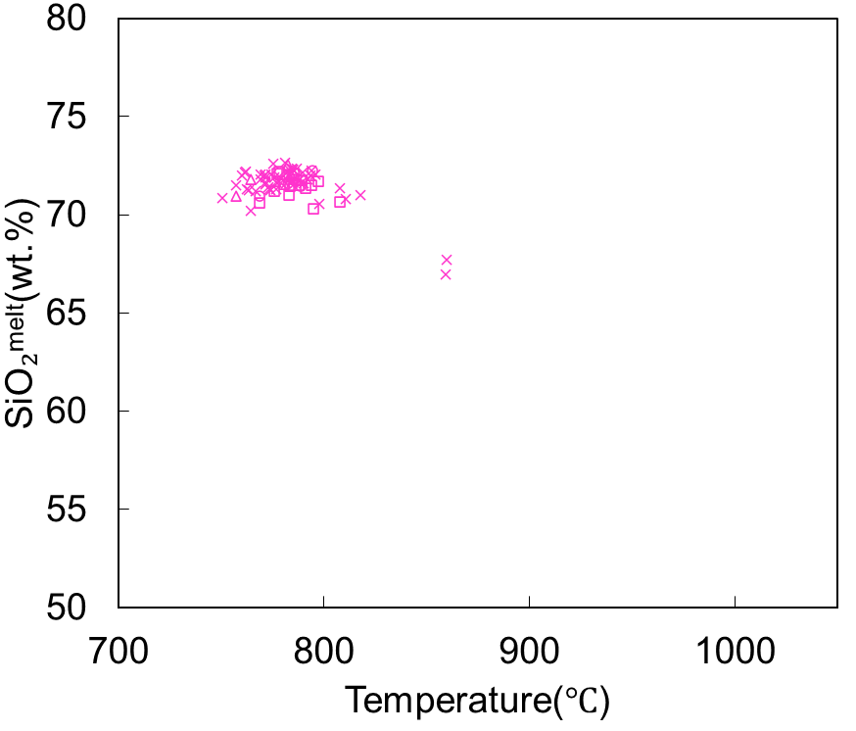
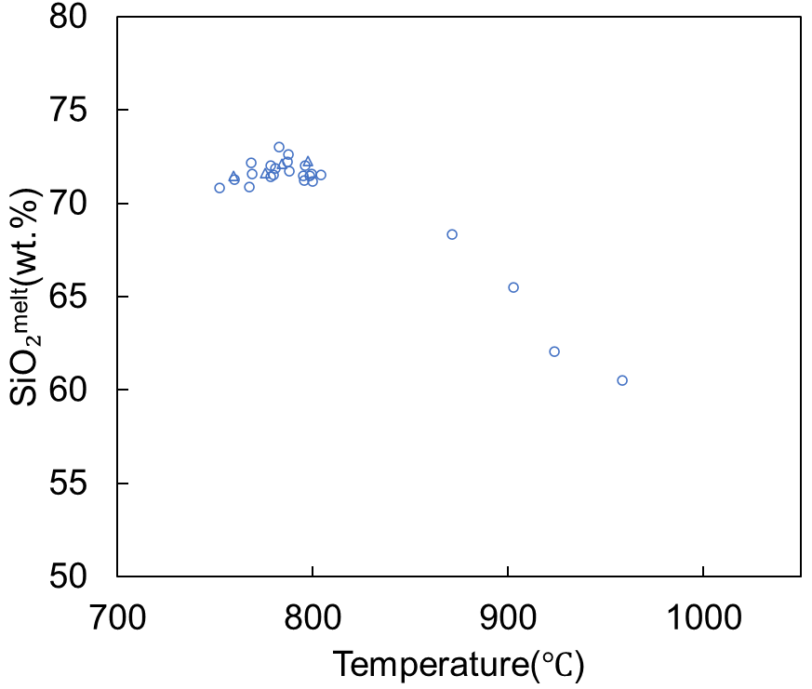
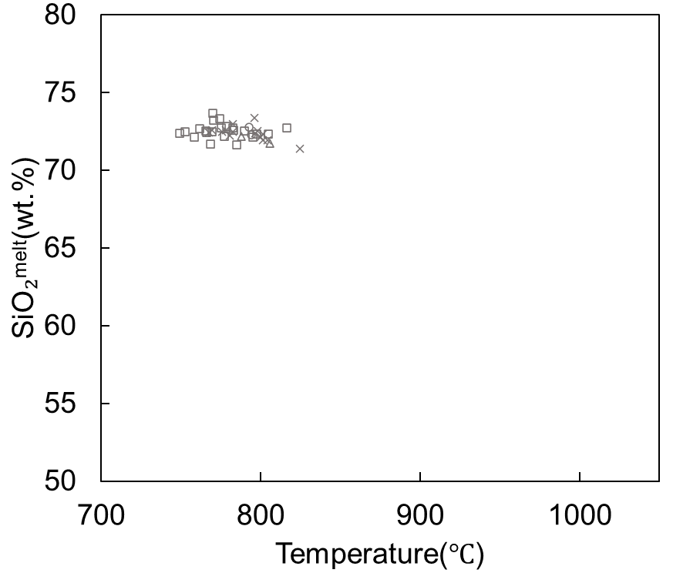
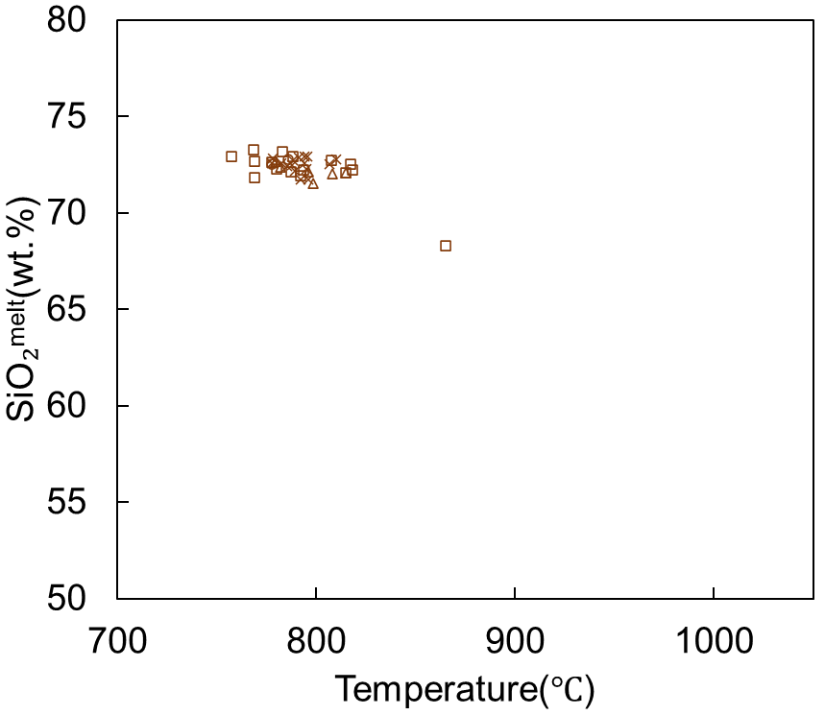
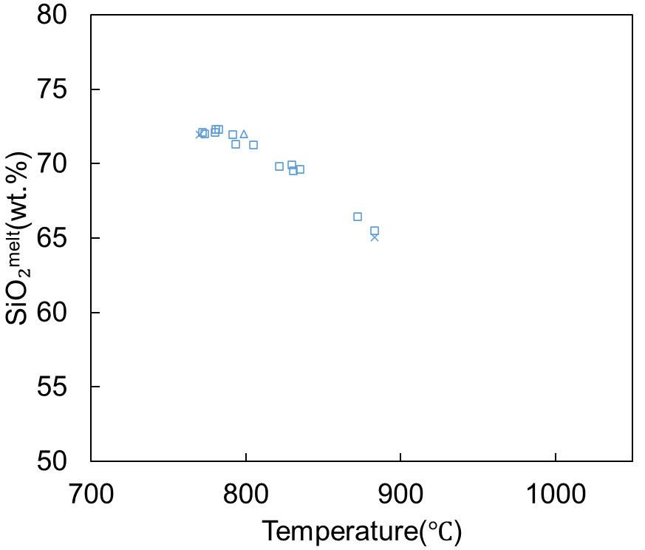
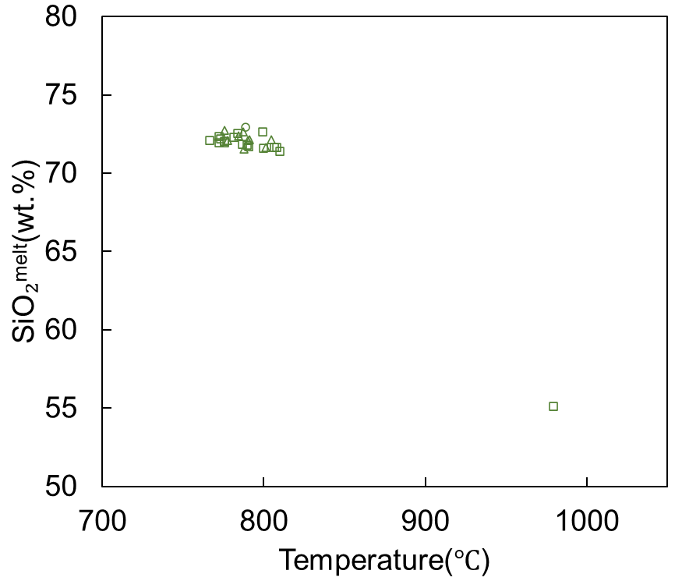
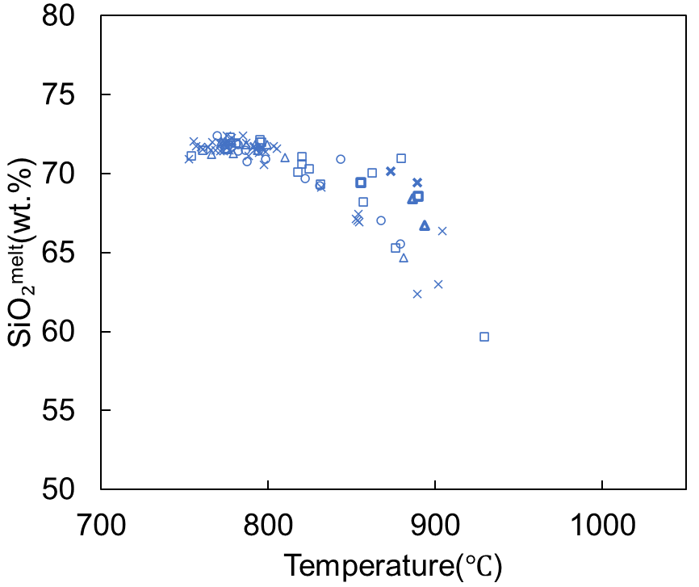
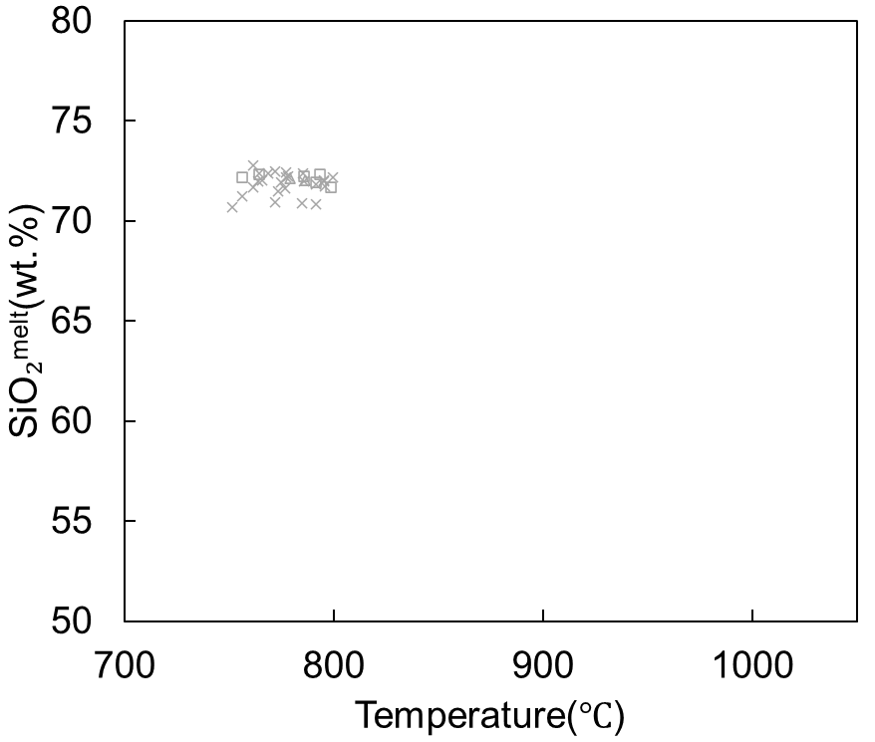
May 1991 (#91_1)
May 1991_2 (#91_2)
December 29 1992_1(#92_1)
December 29 1992_2 (#92_2)
December 29 1992_3 (#92_3)
December 29 1992_4 (#92_4)
May 1 1993 (#93)
February 4 1994 (#94)
Temperature/chemical composition plots derived from cores classified by amphibole type within each crystal clot. No significant differences in temperature-chemical composition distribution were observed between distinct types in any crystal clot. For May 1 1993 (#93), rim compositions are indicated by thicker plots.
Homog
Zoned
Zoned-RR
Homog-RR

